Slide 1

Java Coding Conventions
July, 2007

Slide 2
Resource
http://java.sun.com/docs/codeconv/

Slide 3
Why Coding Conventions?
Makes maintenance easy
Improves readability of software
One can understand code quickly and thoroughly

Slide 4
Ordering within a source file
1. Beginning comments
2. Package statements
3. Import statements
4. Class and interface declarations
If there’s a public class, make it the first class in the file
Beginning Comment
/**
* Classname
*
* Version information
*
* Date
*
* Copyright notice */
Package and Import Statement
package java.awt;
import java.awt.peer.CanvasPeer;
Class and Interface Declaration
public class A{
  ………….

Slide 5
Order in a class or interface
JavaDoc comment describing class or interface
Class or interface statement
Optional class or interface comment
Static variables
  Public static variables
  Protected static variables
  Package level static variables
  Private static variables
Instance variables
  Public instance variables
  Protected instance variables
  Package level instance variables
  Private instance variables
Constructors
Methods
  Functionally grouped, no grouping necessary for scope or accessibility

Slide 6
Blank lines
Use two blank lines:
  Between sections of a source file
  Between class and interface definitions
Use one blank line
  Between methods
  Between local variables in a method and the first statement
  Before a comment (exception: end of line comment)
  Before a block
  Between logical sections inside a method to improve readability

Slide 7
Wrapping
When an expression does not fit on a single line, break it according to these general principles:
Break after a comma.
Break before an operator.
Prefer higher-level breaks to lower-level breaks.
Align the new line with the beginning of the expression at the same level on the previous line.
If the above rules lead to confusing code or to code that's squished up against the right margin, just indent 8 spaces instead.

Slide 8
Wrapping – Examples (1)
Breaking method calls:
  var = someMethod1(longExpression1,
  someMethod2(longExpression2,
  longExpression3));
Breaking an arithmetic expression
  longName1 = longName2 * (longName3 + longName4)
  + 4 * longname6; // PREFER
  longName1 = longName2 * (longName3
  + longName4) + 4 * longname6; //AVOID
  The first is preferred, since the break occurs outside the parenthesized expression, which is at a higher level.

Slide 9
Wrapping – Examples (2)
Examples of wrapping for if statements
  //DON'T USE THIS INDENTATION
  if ((condition1 && condition2)
  || (condition3 && condition4)
  ||!(condition5 && condition6)) { //BAD WRAPS
  doSomethingAboutIt(); //MAKE THIS LINE EASY TO MISS
  }
  //USE THIS INDENTATION INSTEAD
  if ((condition1 && condition2)
  || (condition3 && condition4)
  ||!(condition5 && condition6)) {
  doSomethingAboutIt();
  }

Slide 10
Wrapping – Examples (3)
Ternary expressions
  Here are three acceptable ways to format ternary expressions:
  alpha = (aLongBooleanExpression) ? beta : gamma;
  alpha = (aLongBooleanExpression) ? beta
  : gamma;
  alpha = (aLongBooleanExpression)
  ? beta
  : gamma;

Slide 11
Comments
Don’t explain what’s obvious from the code
A block comment must be preceded by a blank line
Block comment:
  /*
  *comment line(s)
  */
Any method should have header comment follows JavaDoc format.
JavaDoc comments:
  /**
  * comment line(s) for JavaDoc
  */

Slide 12
Sizes
Avoid files longer than 2000 lines
A void lines longer than 80 characters
Example code for use in documentation should be shorter (generally < 70)

Slide 13
Indentation
Do not use Tabs
4 spaces should be used as the unit of indentation
Tabs must be set exactly every 8 spaces

Slide 14
Conditional ? operator
If the part before the ? operator contains an expression with a binary operator, use parenthesis around it
  alpha = (beta > gamma) ? beta : gamma;

Slide 15
Blank spaces
Use blank spaces:
After a keyword followed by a parenthesis
  But not add spaces between a method name and its opening parenthesis!)
  while (true) {
  ...
  }
After commas in argument lists
Before and after binary operators (exception the dot: . )
  int sum = a + b;
  sum += obj.value;
Between expressions in a for statement
  for (expr1; expr2; expr3)
After a cast
  myMethod((byte) aNum, (Object) x);
Notes:
- Do not use blank spaces between unary operators and their operands
i++, i--, !found …
- No blank space after ”(”and before “)”

Slide 16
Naming conventions
Package names
  Start with your domain in reversed order.
  E.g. com.tma.javaspecs
  Use lowercase letters
Class and interface names
  Nouns, mixed case, first letter capitalized
  Use descriptive names and avoid abbreviations
Methods: verbs, mixed case, first letter lowercase
Variables
  Mixed case, first letter lowercase.
  Avoid one letter variable names except for temporary variables
  Use c, d, and e for temporary character variables
  Use i, j, k, m and n for temporary integer variables
Constants: all uppercase, separate words with underscores

Slide 17
Naming conventions
Common abbreviations should not be uppercase when used as name.
  e.g. exportHtmlSource();
Exception classes should be suffixed with Exception.
  class AccessException
All names should be meaningful.
  Abbreviations in names should be avoided.
The name of the object is implicit, and should be avoided in a method name.

Slide 18
The terms get/set/is must be used for getter and setter of an attribute
employee.getName();
matrix.getElement();
employee.isFullTime();
employee.setName(name);
matrix.setElement(value);
employee.setFullTime(true);

Slide 19
Variable Declarations
One declaration per line is recommended
  It is easy to add comments
  int level; // indentation level
  int size; // size of table
Do not put different types on the same line
  int foo, fooarray[]; //WRONG!
Use space(s) or tab between type and identifier
When possible, initialize a local variable with the declaration
Put declarations at the beginning of the block (exception: for loops)
Avoid shadowing variables
Try not to reuse variable names from an outer block

Slide 20
Class and interface definitions
No space between the method name and the parenthesis
Open brace at end of same line as declaration
Closing brace on new line (exception: null statement {})
  Indent it to match the opening statement
Separate methods with a blank line
Use no more than one statement at a line

Slide 21
Programming
Use public only with a good reason to do so
Do not access a static variable or method through an object.
  Use the class name
  AClass object = new AClass();
  object.getIt(); //WRONG
  AClass.getIt(); //RIGHT
Do not combine the declaration of several variables in one statement
Do not use embedded assignments
  d = (a = b + c) + r;// AVOID!
Should use CONSTANT.equals(aString)
  to prevent null pointer exceptions

Slide 22
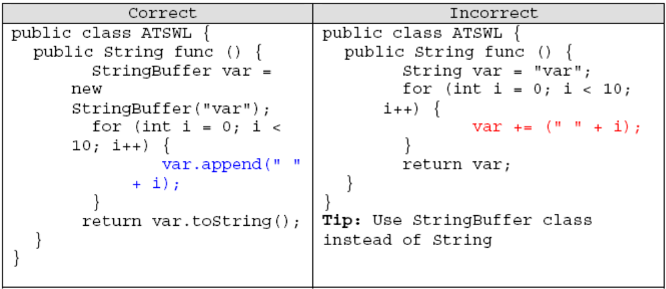
General/programming
Avoid coding numerical constants directly
  (exception:-1, 0, and 1 within a for loop as counter values)
Avoid the assignment operator where it’s easily misinterpreted (by humans) with the equality operator.
Use parenthesis to make complex expressions more clear
Use StringBuilder (or StringBuffer) for concatenating strings.

Slide 23
Return statements
Avoid a structure like
  if ( boolean_expression) {
  return true;
  } else {Return statements
  return false;
  }
Avoid
  if (condition) {
  return x;
  }
  return y;
But use
  return boolean_expression;
But use
  return (condition ? x : y);
➔
➔

Slide 24
Loop statements – for
  for (initialization; condition; update) {
  statements;
  }
An empty for statement
  for (initialization; condition; update);
A for-each statement (since 1.5)
  String[] names = {"Jonh", "Alan", "Peter"};
  for (String name : names) {
  System.out.println(name);
  }

Slide 25
Loop statements – while
While statement
  while (condition) {
  statements;
  }
Empty while statement
  while (condition);
  e.g.
  while(updating());
do-while statement
  do {
  statements;
  } while (condition);

Slide 26
Compound statements
Compound statement is a block of statements within braces {}
Indent the enclosed statements
Use also braces for single statements that are part of some control structure

Slide 27
if-else statements
  if (condition) {
  statements;
  }
  if (condition) {
  statements;
  } else if (condition) {
  statements;
  } else {
  statements;
  }
Note: if statements always uses braces {} .
  //AVOID! THIS OMITS THE BRACES {}!
  if (condition)
  statement;

Slide 28
switch statement
switch (condition) {
case AAA:
statements;
/* falls through */ ← must have if there is no break
case BBB:
statements;
break;
default:
statements;
break; ← prevents a fall-through error if later another case is added.
}
NOTE:
  The comment line /* falls through */ is used if there’s no break statement
  The break in the default case is redundant, but it prevents a fall-through error if later another case is added.

Slide 29
try-catch
try {
statements;
} catch (ExceptionClass1 e1) {
statements;
} catch (ExceptionClass2 e2) {
statements;
} finally {
statements;
}
(the finally part can be omitted)

Slide 30
Q/A
Thank you!

