Slide 1
Adaptive Cruise Control
SIT215 - Artificial computational INTELLIGENCE

Slide 2
Problem statement
Cruise control systems often face the issue of constant oscillation around the input speed.
This is because they cannot account for the many external factors (such as inclines, declines and bumps on the road) when determining whether they should accelerate or brake.
These issues also apply to vehicle separation systems where the car will be constantly moving closer than slowing down to match the speed of the car in front.

Slide 3
The Solution (Overview)
We can solve this problem by combining fuzzy-logic with rule based systems.
Essentially if the car is traveling under the desired speed threshold than it accelerates at a rate relative to the distance between the current and target velocity.
It is at this point that fuzzy-logic comes into play, if the car is close enough to the target speed, it won’t do anything.
While this won’t eliminate the oscillation entirely, it will make a very notable difference.

Slide 4
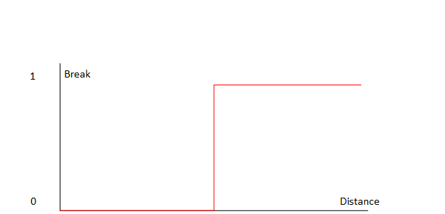
Rule Based Logic
Distance between you and the object in front.
If you are more than two seconds away from car in front run cruise control.
Else warn driver/brake (distances depend on car).

Slide 5
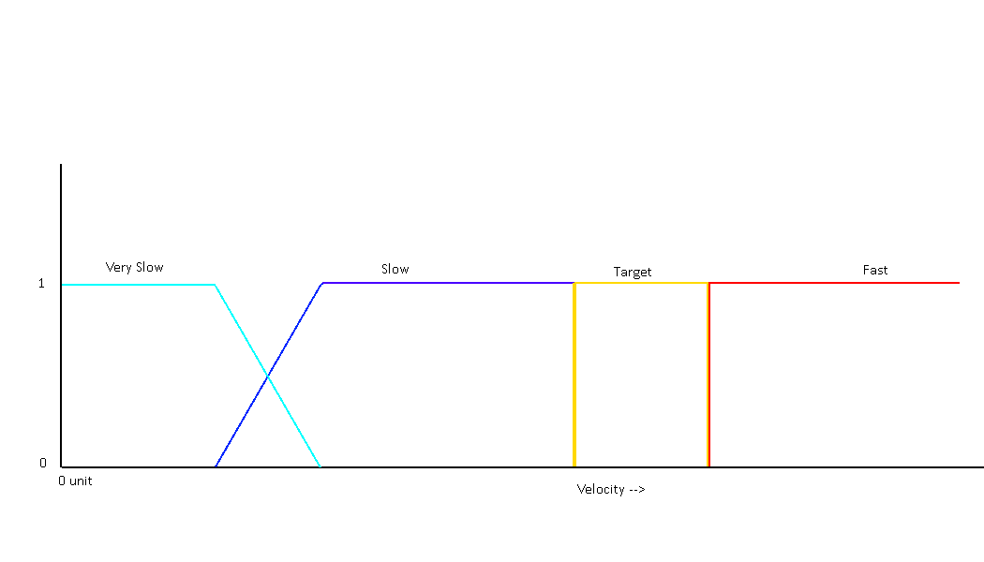
Fuzzy Logic (Cruise Control)
If velocity is very slow, speed up a lot
If velocity is slow, speed up by a bit
If velocity is at target speed, do nothing
If velocity is fast, slow down

