Slide 1
NASGEP

Slide 2
Agenda
Problem Formulation
Methodology
Experiment

Slide 3
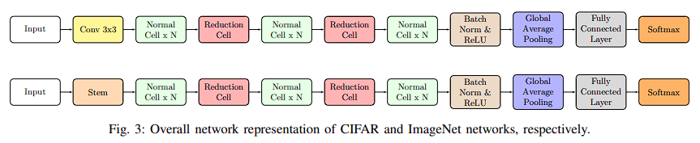
Problem Formulation Search Space
- NAS cell-based: Normal cell & Reduction cell
- Normal cell is repeated 3 times and reduction cell is repeated 2 times

Slide 4
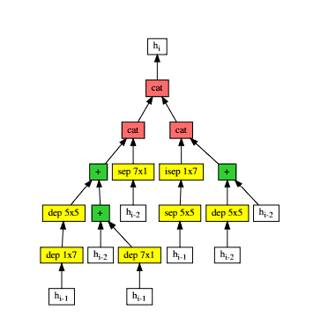
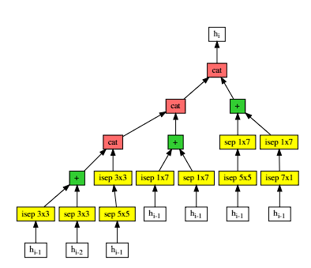
Problem Formulation Search Space
- Normal cell return a feature map of the same dimension
- Reduction cell return a feature map where the feature map height and width is reduced by a factor of two (stride = 2)
Normal cell
Reduction cell

Slide 5
Problem Formulation Search Strategy & Parameter Estimation Strategy
- Evolutionary-based NAS – represented by GEP phenotype – cost only 1 GPU day
- Parameter estimation strategies, it mainly concerns evaluating validation error and training loss. Also, strategies to reduce candidate training time such as fewer epochs, reduced size, weight sharing and cosine annealing learning rate scheduler are employed.
=> Evaluation of candidates can be realized in less computing time

Slide 6

Search Strategy & Parameter Estimation Strategy Genotype Representation (Cell)
- Proposed expression
- Tail length = Head length + 1 (Binary Equivalent Tree)
- Head : Functions + Terminals | Tail: Terminals only
* Functions: addition, concatenation for main | addition, convolutions for ADFs
* Terminals: only ADFs for main | convolutions and previous cell’s outputs for ADFs (only for normal cells, due to appropriate dimension of feature map)
ADF: Automatically defined function

Slide 7
Search Strategy & Parameter Estimation Strategy Convolutions Block
- Convolution block: ReLU activation -> Convolution -> Batch Normalization
* Convolution type:
+) Point-wise convolution (1x1 kernel);
+) Depth-wise convolution with kernels 3x3, 5x5, 3x5, 5x3, 1x7 or 7x1
+) Separable depth-wise convolution (a point-wise convolution followed by a depth-wise) or in the inverse other, with kernel sizes of 3x3, 5x5, 3x5, 5x3, 1x7 and 7x1.
- To reduce training time, whenever a convolution block or gene has validation accuracy greater than before, its current weights are saved to the disk.
Then, whenever a new individual is created, these weights are loaded to the model, rather than being randomly initialized with Kaiming initialization

Slide 8
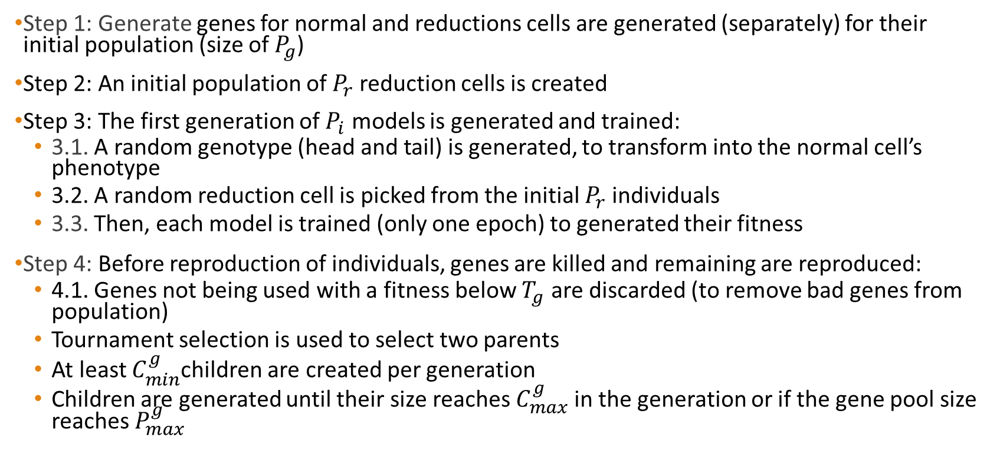
Methodology
Step 1: Generate genes for normal and reductions cells are generated (separately) for their initial population (size of $P_{g}$)
Step 2: An initial population of $P_{r}$ reduction cells is created
Step 3: The first generation of $P_{i}$ models is generated and trained:
3.1. A random genotype (head and tail) is generated, to transform into the normal cell’s phenotype
3.2. A random reduction cell is picked from the initial $P_{r}$ individuals
3.3. Then, each model is trained (only one epoch) to generated their fitness
Step 4: Before reproduction of individuals, genes are killed and remaining are reproduced:
4.1. Genes not being used with a fitness below $T_{g}$ are discarded (to remove bad genes from population)
Tournament selection is used to select two parents
At least $C_{min}^{g}$children are created per generation
Children are generated until their size reaches $C_{max}^{g}$in the generation or if the gene pool size reaches $P_{max}^{g}$

Slide 9
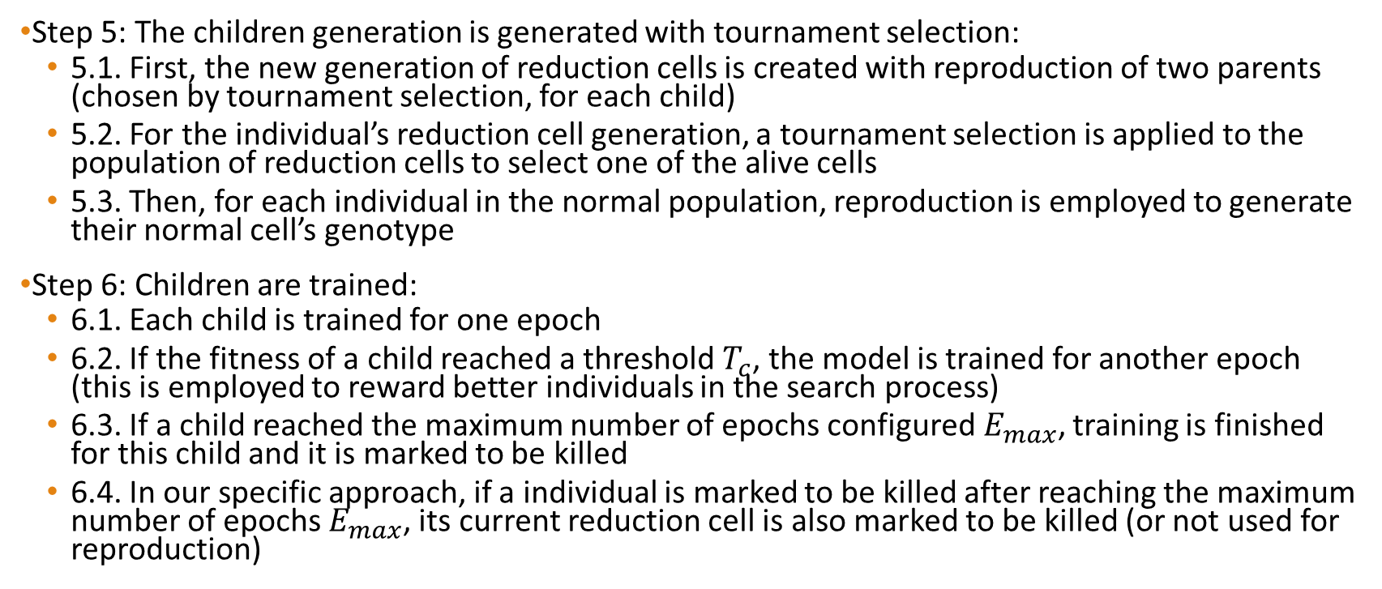
Methodology
Step 5: The children generation is generated with tournament selection:
5.1. First, the new generation of reduction cells is created with reproduction of two parents (chosen by tournament selection, for each child)
5.2. For the individual’s reduction cell generation, a tournament selection is applied to the population of reduction cells to select one of the alive cells
5.3. Then, for each individual in the normal population, reproduction is employed to generate their normal cell’s genotype
Step 6: Children are trained:
6.1. Each child is trained for one epoch
6.2. If the fitness of a child reached a threshold $T_{c}$, the model is trained for another epoch (this is employed to reward better individuals in the search process)
6.3. If a child reached the maximum number of epochs configured$E_{max}$, training is finished for this child and it is marked to be killed
6.4. In our specific approach, if a individual is marked to be killed after reaching the maximum number of epochs $E_{max}$, its current reduction cell is also marked to be killed (or not used for reproduction)

Slide 10
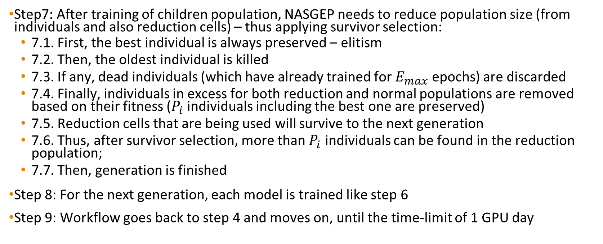
Methodology
Step7: After training of children population, NASGEP needs to reduce population size (from individuals and also reduction cells) – thus applying survivor selection:
7.1. First, the best individual is always preserved – elitism
7.2. Then, the oldest individual is killed
7.3. If any, dead individuals (which have already trained for $E_{max}$ epochs) are discarded
7.4. Finally, individuals in excess for both reduction and normal populations are removed based on their fitness ($P_{i}$ individuals including the best one are preserved)
7.5. Reduction cells that are being used will survive to the next generation
7.6. Thus, after survivor selection, more than $P_{i}$ individuals can be found in the reduction population;
7.7. Then, generation is finished
Step 8: For the next generation, each model is trained like step 6
Step 9: Workflow goes back to step 4 and moves on, until the time-limit of 1 GPU day

Slide 11
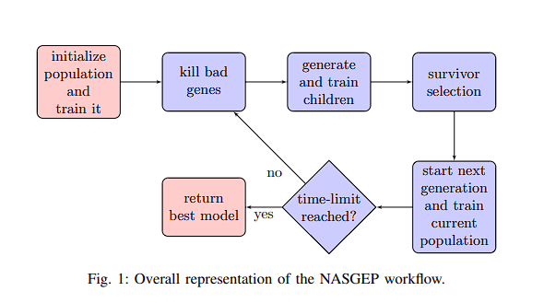
Methodology

Slide 12
Reproduction
The default techniques of GEP are used to generate them, being applied to a pair of parents the following (in order): mutation, transposition, root transposition, one-point and then two-point recombination.

Slide 13
Experiment
- Initial population size Pi for each generation: 10
- Head = 4, tail = 5 for cells
- Head = 1, tail = 2 for genes
- Initial size of the gene pool is set to Pg = 50 and its maximum size P(max)g is set to 100
- For each generation, at least 2 and at most 10 new genes are created
- Number of parameters of network candidates was limited to 300 thousand

