Slide 1







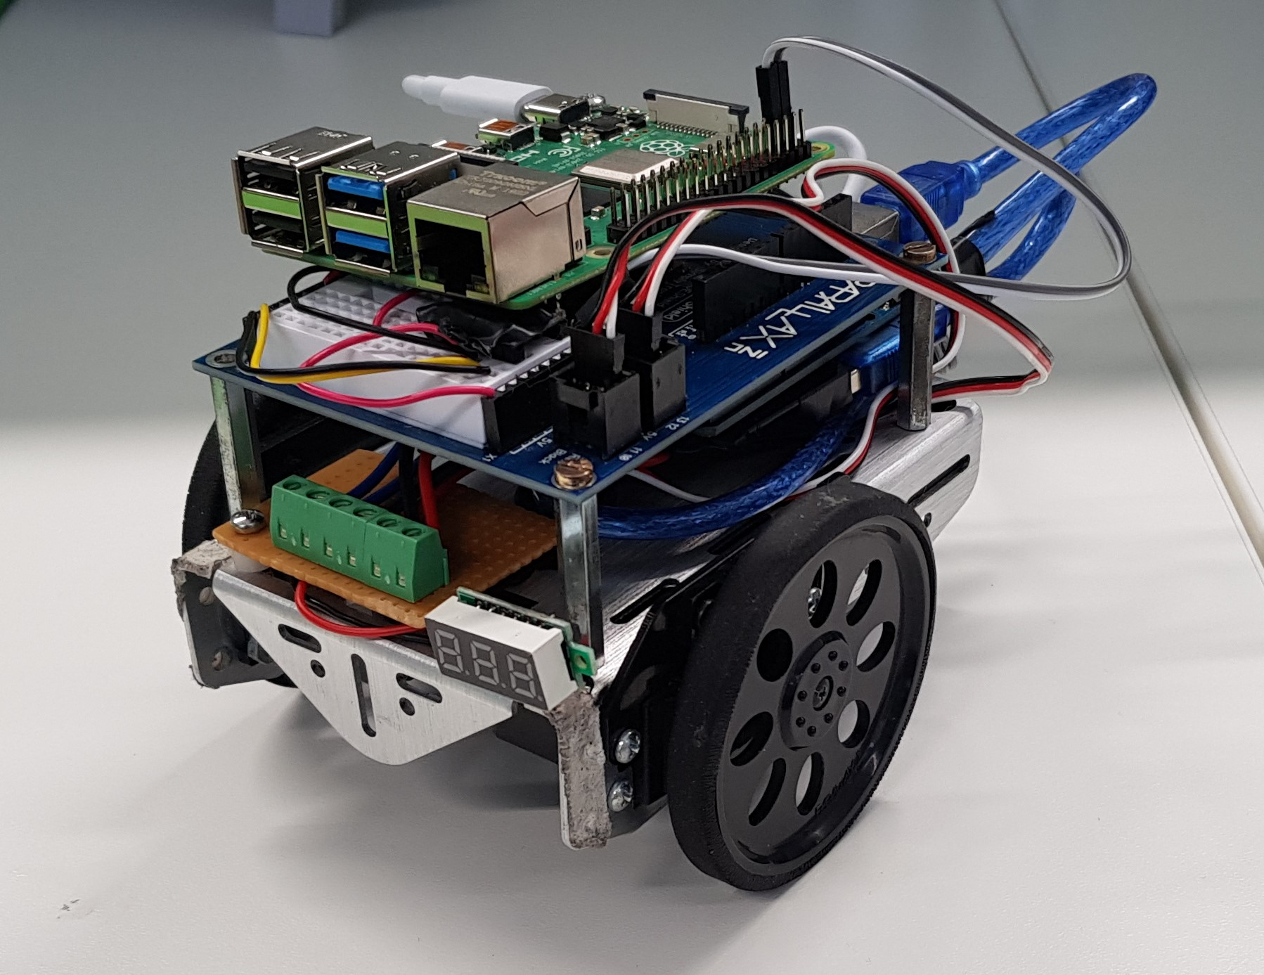

active inference agent
end user model
inferred target
position
=
physics model
=
=
=
=
Share inferred
target w physics
model
expected future
sensed positions
noisy
performance
feedback
sensed position
steering
(control)
target
Location
(undisclosed
to robot)
future
trajectory
observer knows
target location
past
trajectory
environment

