Slide 1
Computer Function

Slide 2
STRATEGY :
The priority is to win
If it can’t not win, try to defend player’s move
Else place in a random position

Slide 3
WHAT WILL NEED
Required
Attack : A function which finds out if it there were two ‘O’ marks in row, places the rest on board to win. Return 1 if it placed and 0 if not
Defense: A similar function as above but this time, find ‘X’ instead. Return 1 if it block the attack, and 0 if not
Optional:
A placing function can access the array to assign value
A random placing function

Slide 4
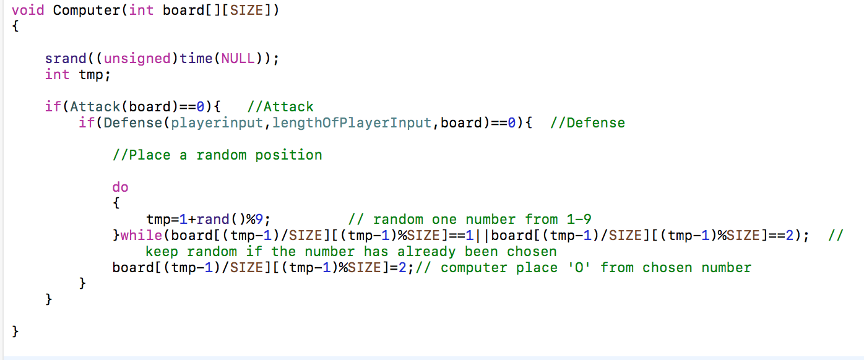

Slide 5
Defense:
Create an array of int to store the player X previous moves
Find all possibility by combined different pairs in array
If find out two are already placed in a row, place the rest to block

Slide 6
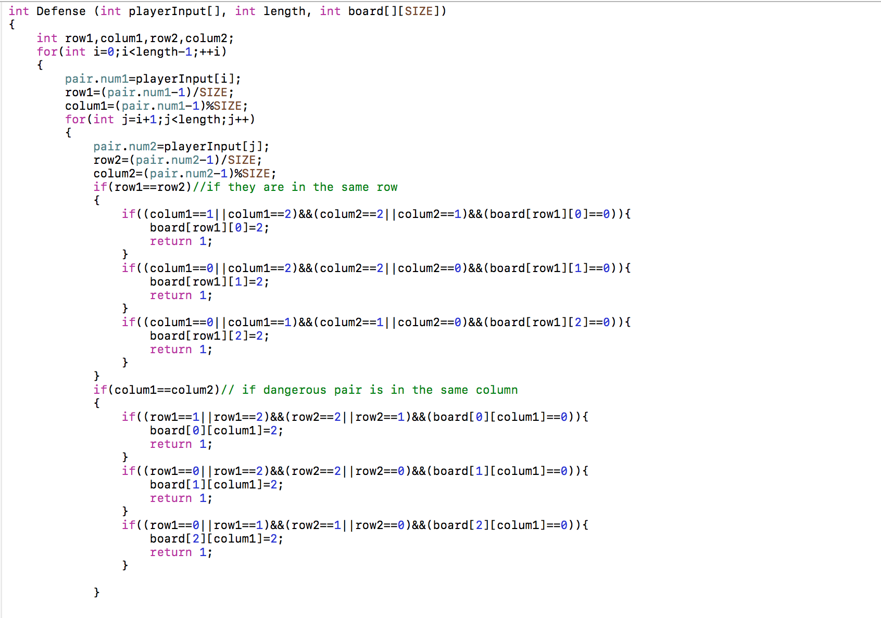

Slide 7
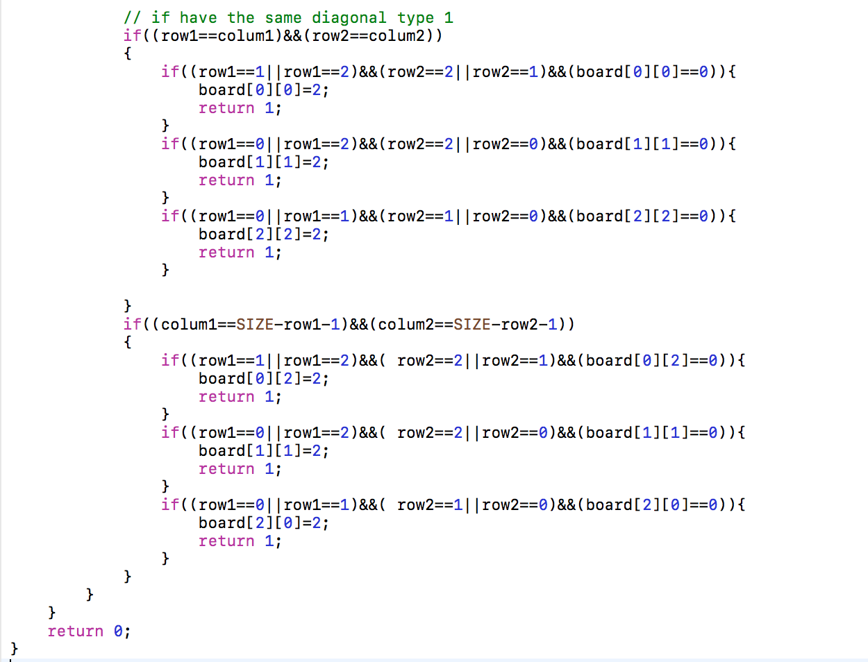

Slide 8
Attack:
Check a ”specific condition” to see if it there was a line in which already two ’O’s and one blank space exist
In that vertical/horizontal/diagonal line, find the place where is not already placed
Place at that position

Slide 9
Problem

Slide 10
X
X
O
O
O
VS

Slide 11
Solution

Slide 12
