Slide 1
ALGORITHM ASYMPTOTIC ANALYSIS
Presentation: Group 1
Members : Nhat, Hung, Minh, Hoang
Class : BH-AF-2005-2.3
Lecturer : Ngo Thi Mai Loan

Slide 2
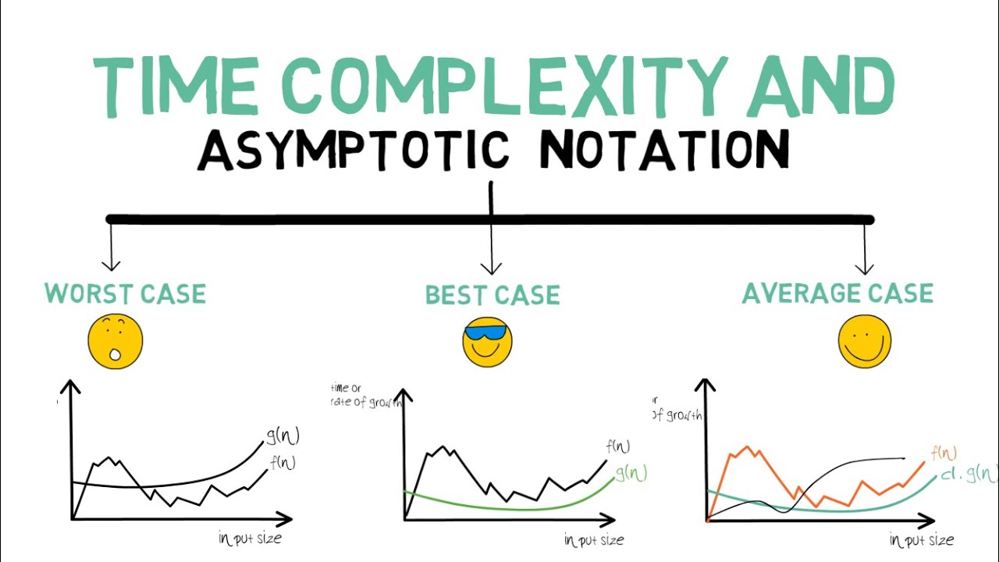
Content
HOANG
Introduction
HUNG
What is Algorithm Analysis ?
Conclusion
NHAT
What is Asymptotic Analysis ?
MINH
Asymptotic Notations
How Does Asymptotic Analysis Work?

Slide 3
I. Introduction
We have learned about theoretical analysis and some concepts of time complexity and memory complexity in algorithm analysis. In this presentation, our group will present about Asymptotic Analysis in Data Structures and Algorithms.
Hoang

Slide 4
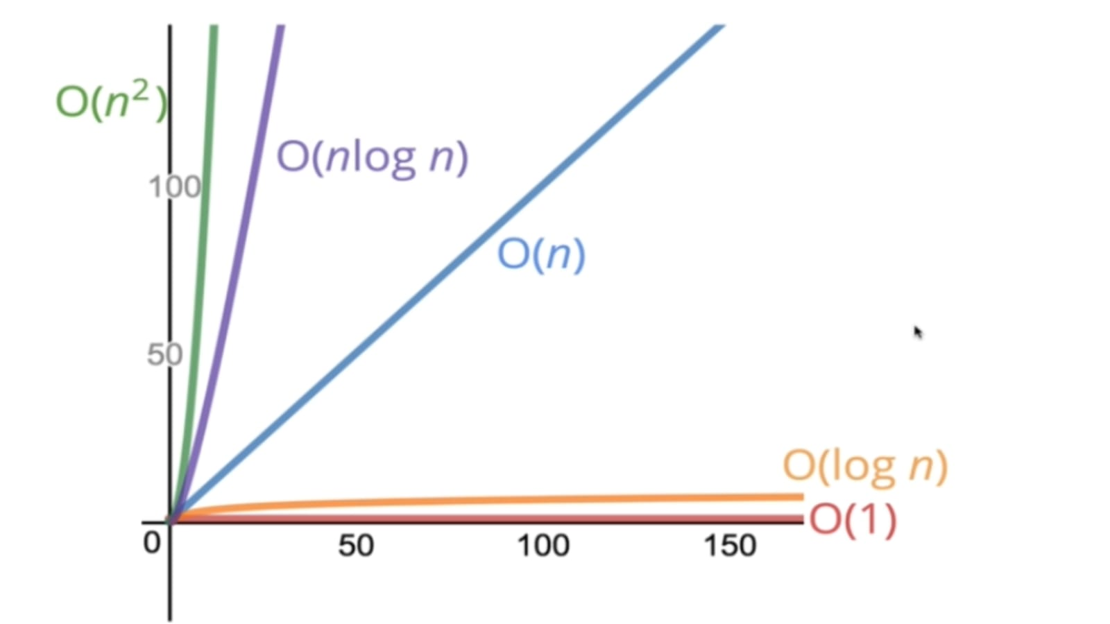
II. What is Algorithm Analysis ?
Algorithm analysis is the determination of the computational complexity of algorithms, which is the amount of time, storage, and/or other resources required to implement them.
Why analyze an algorithm? The simplest reason to analyze an algorithm is to explore its characteristics to assess its suitability for different applications or to compare it with other algorithms for the same application. Furthermore, analyzing an algorithm can help us understand it better and can suggest wise improvements.

Slide 5
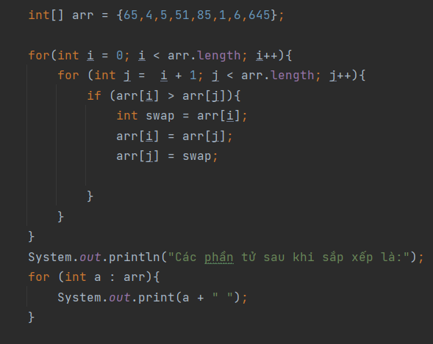
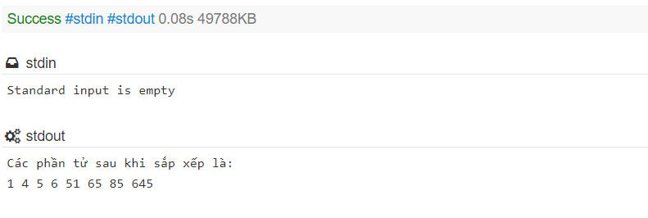
BUBBLE SORT - IDEA
Starting from the first index, compare the first and the second elements.
If the first element is greater than the second element, they are swapped.
Now, compare the second and the third elements. Swap them if they are not in order.
The above process goes on until the last element.
RUN & RESULT
Notes:
Ta có 1 ví dụ đơn giản về thuật toán sắp xếp nổi bọt như sau
Ý tưởng về thuật toán đó đó là:
Bắt đầu Đi từ vị trí đầu tiên cho đến cuối mảng, so sánh phần tử thứ i và j, nếu phần tử thứ j nhỏ hơn phần tử thứ i thì ta hoán vị hai phần tử này.
Cứ như vậy ta so sánh từng cặp cho đến hết mảng. Ý tưởng là như vậy, Như mọi người thấy khi chạy chương trình kết quả sẽ cho ra các phần tử từ bé đến lớn và mất khoảng 0.08s để thực hiện chương trình. Và số thời gian thực hiện chương trình nó có những ảnh hưởng, tác dộng gì thì sau đây chúng ta cùng nhau vào phần Phân tích tiệm cận của CTDL và Thuật toán

Slide 6
III. What is Asymptotic Analysis ?
Asymptotic analysis is the process of calculating the running time of an algorithm in mathematical units to find the program’s limitations, or “run-time performance.” The goal is to determine the best case, worst case and average case time required to execute a given task.
Best case: is the minimum time required to execute the program.
Average case: is the average time it takes to execute the program.
Worst case: is the maximum time required to execute the program
While not a method of deep learning training, Asymptotic analysis is a crucial diagnostic tool for programmers to evaluate an algorithm’s efficiency, rather than just its accuracy.

Slide 7

IV. How Does Asymptotic Analysis Work?
This analysis needs a variable input to the algorithm, otherwise the work is assumed to require a constant amount time. All factors other than the input operation are considered constant.
Example
- For a simple example, the running time of a given data mining query is considered f(n), and its corollary search operation is calculated as g(n2). So the first operation’s running time increases linearly with the rise in n, while the running time of the second operation increases exponentially as n is enlarged.
How does it works?

Slide 8
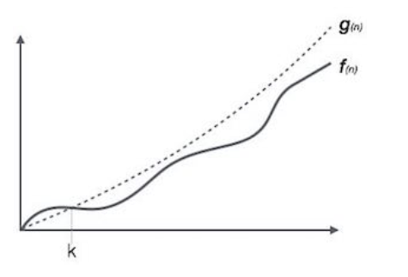
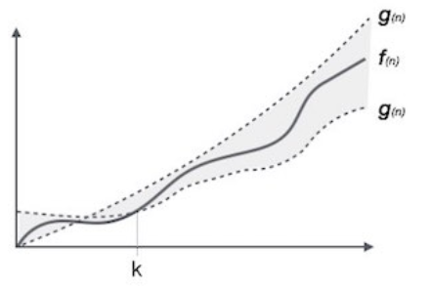
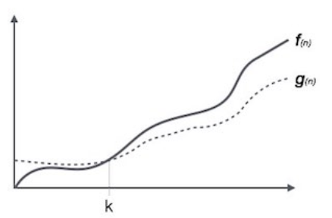
V. Asymptotic Notations
While run-time performance can be calculated with many different functions, the limiting behavior of the algorithm is expressed graphically using simple notation:
Ο(n): Is the upper bound of an algorithm's running time and measures the worst case scenario of how long an algorithm can possibly take to complete a given operation.
Ω(n): Is the lower bound of an algorithm's running time and measures the best case scenario of how long an algorithm can possibly take to complete a given operation.
Θ(n): Is charting both the upper and lower running time boundaries, with the average case scenario express as the average between each border.

Slide 9
Through the presentation And the presentation of 3 friends in the group, I have raised the main ideas, namely: 1: algorithm analysis 2: asymptotic analysis and possible cases And finally how does asymptotic analysis work And this is the end of the group's presentation. If anyone has questions or concerns about any part, they can contact the group's email.
VI. Conclusion

Slide 10




Thank you!
facebook.com/hoang.nguyenhuu.7330763/
036 8716 708
hoangnhbdaf190022@fpt.edu.vn

