Slide 1
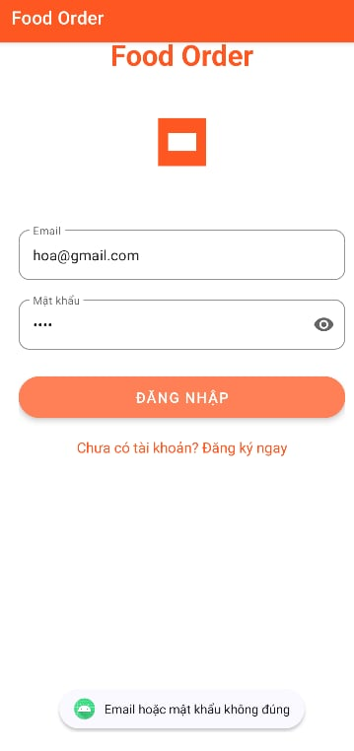
Building an android app
FOOD ORDERING APP
Lập trình di động
Student : Nguyễn Huy Hoàng-20IT430

Slide 2
01
02
Table of Contents
03
Overview
Introducing our app
and objectives behind it
Functionalities
Main functions of this app
Conclusion
A small summarization

Slide 3
01. Overview
This is an android app that helps people ordering food without going directly to the restaurant, vendors

Slide 4
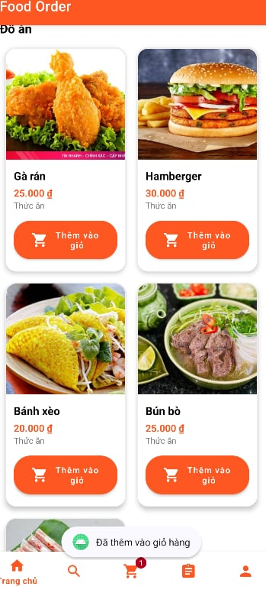
Food Ordering App
Saving your time with just a few clicks

Slide 5
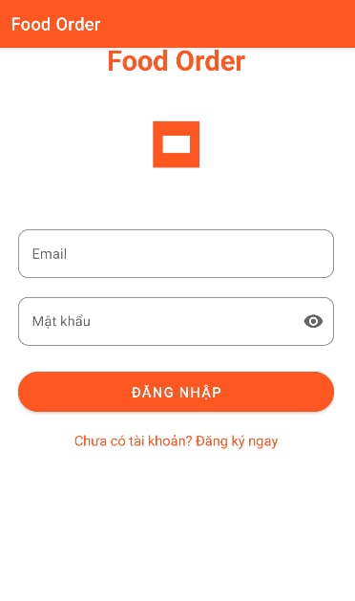
02. Functionalities
1. Login Ui:
Login and Sign up
Reset Password
2. Main Ui:
Show all the food
Show food description,
Finding Food via categories
Add to cart, increase quantity, delete from cart
Buying food
Show order state
Adjust Profile

Slide 6
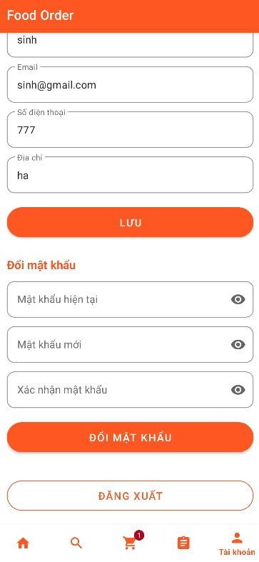
02. Functionalities
1. Login Ui:
Login and Sign up
Reset Password
2. Main Ui:
Show all the food
Show food description,
Finding Food via categories
Add to cart, increase quantity, delete from cart
Buying food
Show order state
Adjust Profile

Slide 7
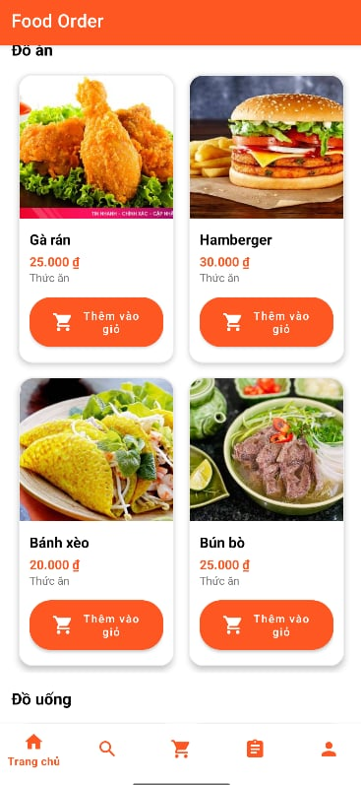
02. Functionalities
1. Login Ui:
Login and Sign up
Reset Password
2. Main Ui:
Show all the food
Show food description,
Finding Food via categories
Add to cart, increase quantity, delete from cart
Buying food
Show order state
Adjust Profile

Slide 8
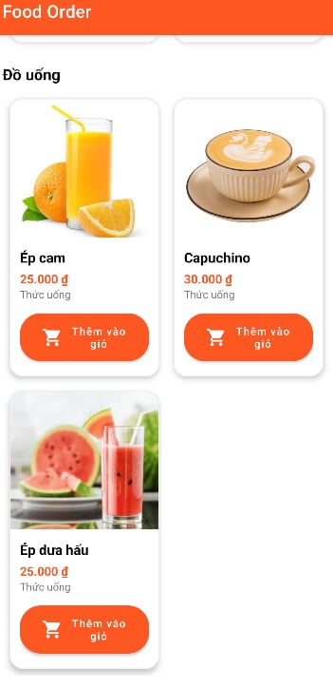
02. Functionalities
1. Login Ui:
Login and Sign up
Reset Password
2. Main Ui:
Show all the food
Show food description,
Finding Food via categories
Add to cart, increase quantity, delete from cart
Purchase Confirmation
Buying food
Show order state
Adjust Profile

Slide 9
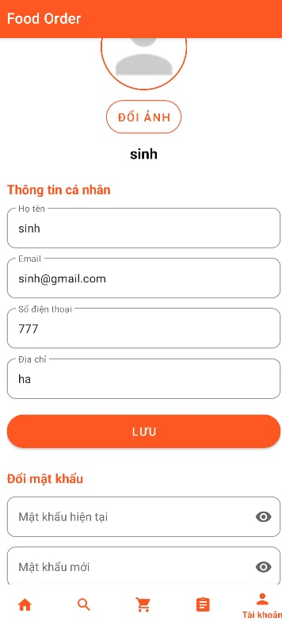
02. Functionalities
1. Login Ui:
Login and Sign up
Reset Password
2. Main Ui:
Show all the food
Show food description,
Finding Food via categories
Add to cart, increase quantity, delete from cart
Buying food
Show order state
Adjust Profile

Slide 10
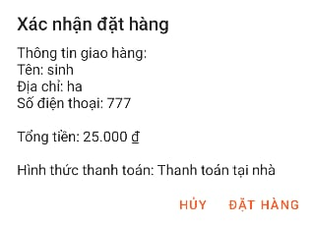
02. Functionalities
1. Login Ui:
Login and Sign up
Reset Password
2. Main Ui:
Show all the food
Show food description,
Finding Food via categories
Add to cart, increase quantity, delete from cart
Buying food
Show order state
Adjust Profile

Slide 11
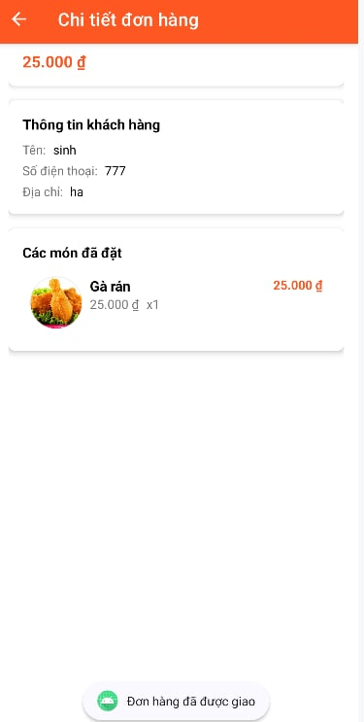
02. Functionalities
1. Login Ui:
Login and Sign up
Reset Password
2. Main Ui:
Show all the food
Show food description,
Finding Food via categories
Add to cart, increase quantity, delete from cart
Purchase Confirmation
Buying food
Show order state
Adjust Profile

Slide 12
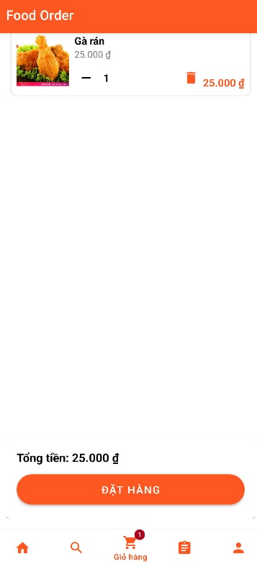
02. Functionalities
1. Login Ui:
Login and Sign up
Reset Password
2. Main Ui:
Show all the food
Show food description,
Finding Food via categories
Add to cart, increase quantity, delete from cart
Purchase Confirmation
Buying food
Show order state
Adjust Profile

Slide 13
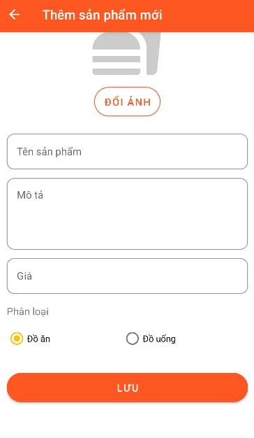
02. Functionalities
1. Login Ui:
Login and Sign up
Reset Password
2. Main Ui:
Show all the food
Show food description,
Finding Food via categories
Add to cart, increase quantity, delete from cart
Purchase Confirmation
Buying food
Show order state
Adjust Profile

Slide 14
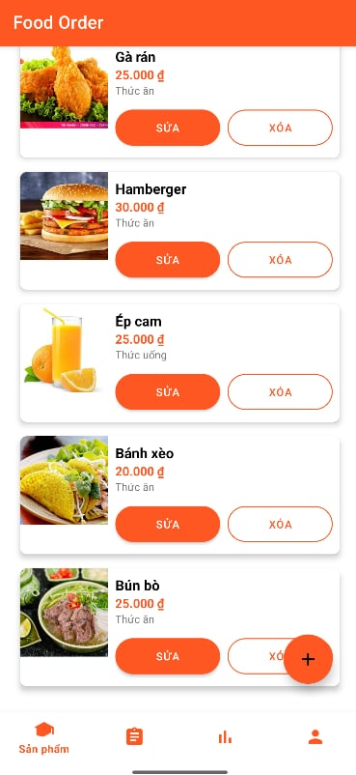
02. Fuctionalities
3. Adding new product to the store

Slide 15
03. Conclusion
Acheivements:
Friendly UI that’s easy to interact
Using SQLite for real-time database
A fully functional app
Can be implemented in the future
Future Features:
More products
Better UI that loads faster
More real-life funtions

