Slide 1

Machine learning for B-cell epitope prediction
Application of AI in genomics
Instructor: Prof. Nguyen Quoc Khanh Le
Final project report
Group 3 _ Project No. 3
Group members:
Tran Thi Oanh (Sarah) D151110003
Luong Thi My Trang M142111003
Hoang Son U0FS000280
June 2023

Slide 2
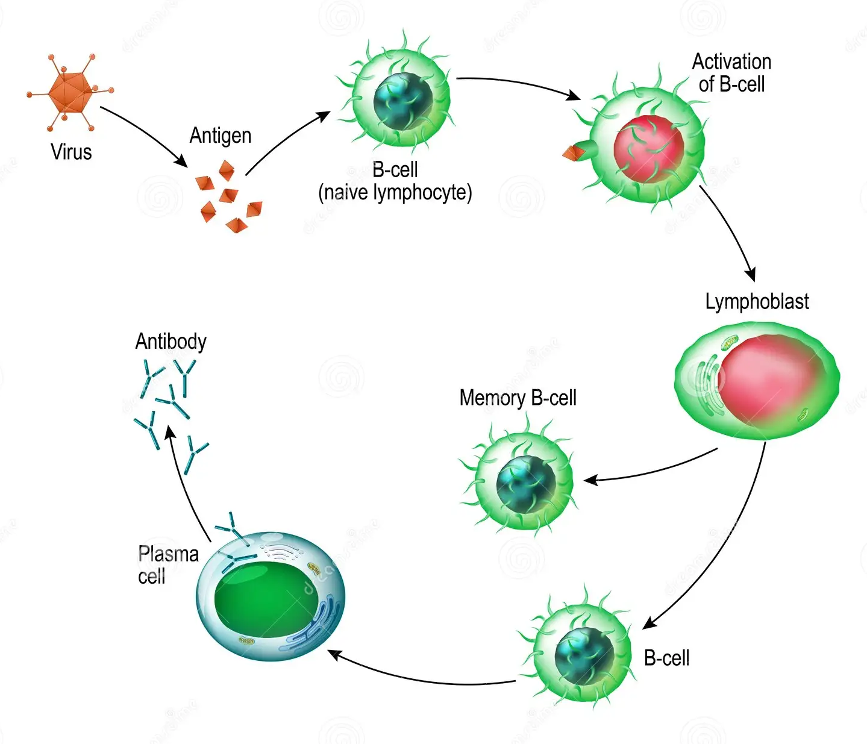
B cells are antibody producing cells
Introduction
B cells (B lymphocytes) are a type of white blood cell that plays a important role in the adaptive immune response by producing antibodies, presenting antigens, and coordinating immune responses.
Activated B cell
B cell activation
Murphy et al., 2012; Alberts B et al., 2002.
Notes:
https://www.youtube.com/watch?v=rrv0GMvF-oc

Slide 3
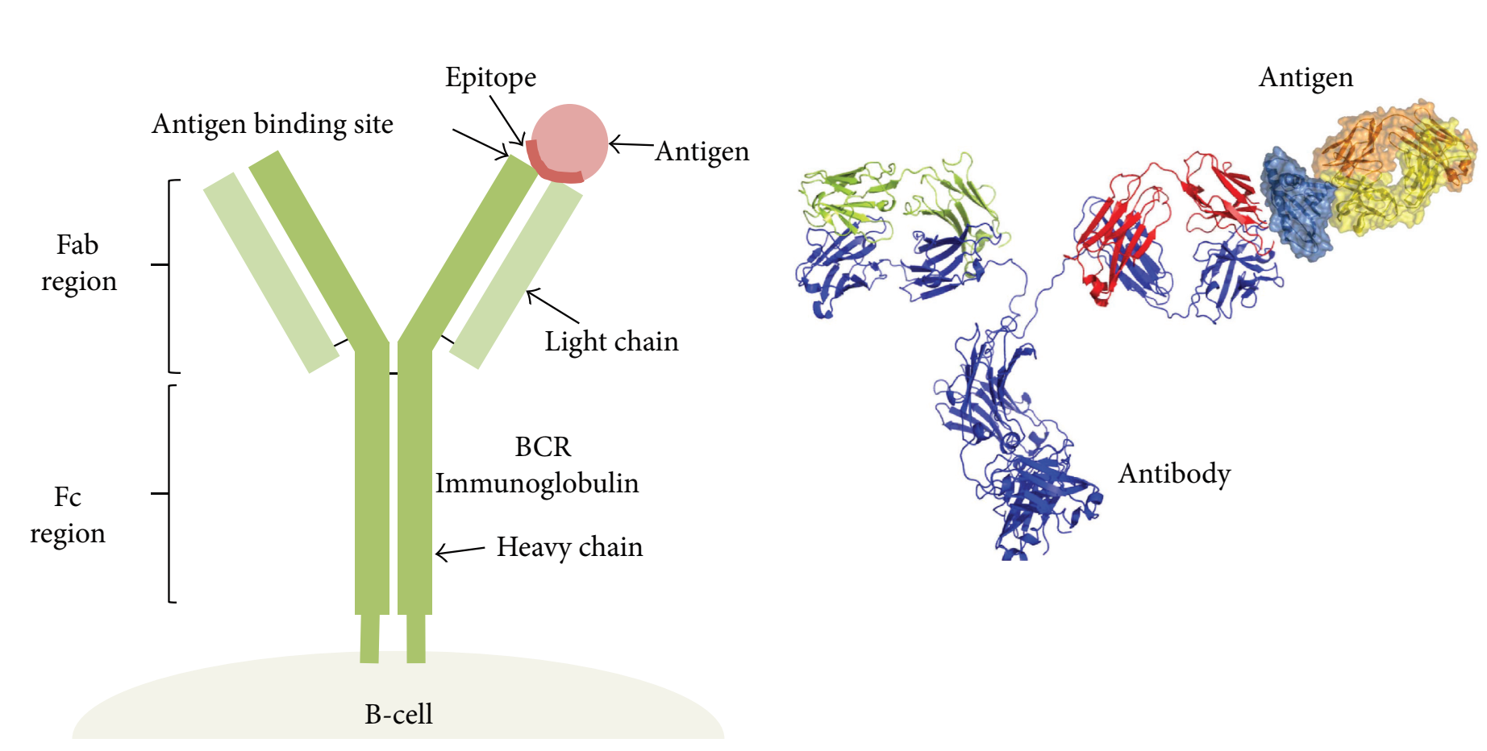
Antigen - antibody interaction
Introduction
Jose et al., 2017
Antibodies recognize proteins (antigen) based on their structure, content, and can be very specific, binding to only a small part of an antigen (known as epitope).
High specificity and affinity protein interaction
Betsy Foxman et al., 2012; Janeway et al.,2001.

Slide 4
The development of antibody-based therapies
Introduction
Based on the high specificity and affinity interaction of antibody-antigen, diagnostic tools (ABO blood group, ELISA-HIV diagnose), therapeutics and peptide-based vaccines were developed.
Khan, 2014.
To facilitate the use of antibodies, it is important to identify the distinct region on the antigen that will be recognized by an antibody; known as the epitope.
Potocnakova et al., 2016.
Identification of an antigen’s epitope regions and a better understanding of the mechanism of antibody–antigen-recognition will lead to improved antibody engineering and thus widen their applications in the future.
Sela-Culang et al., 2013.

Slide 5
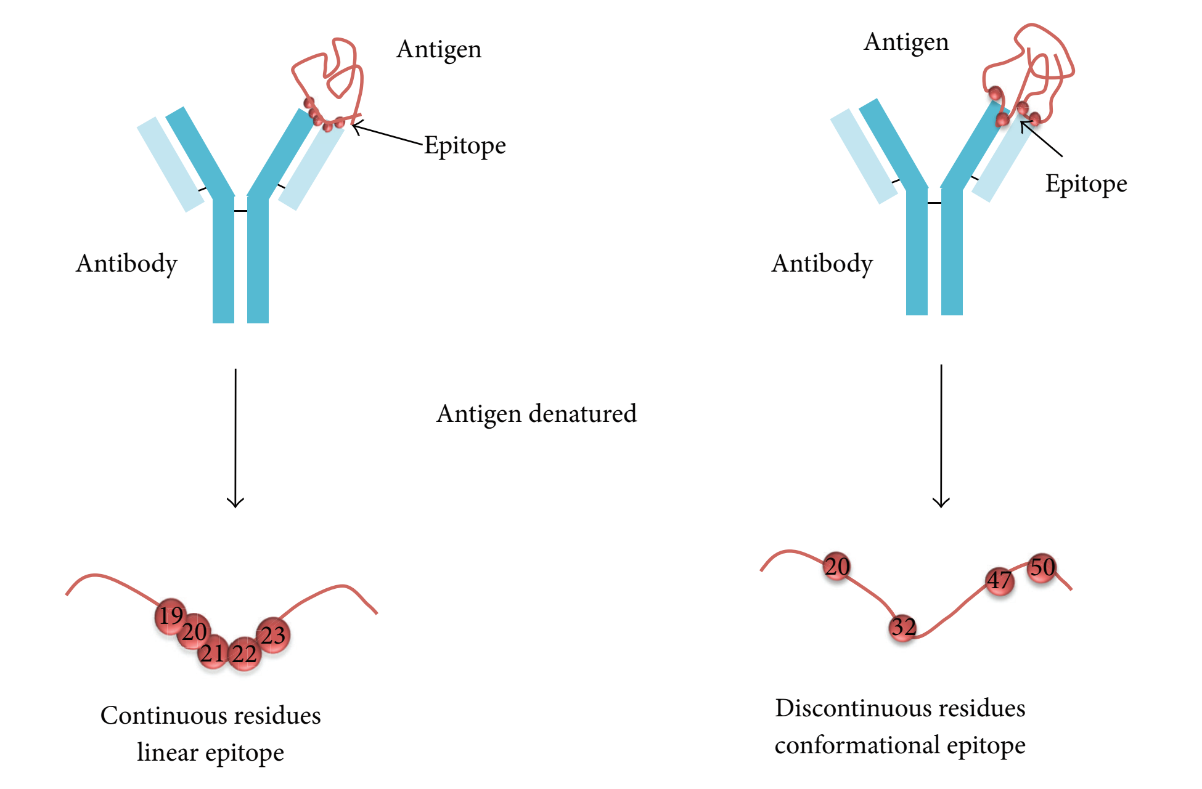
Linear and conformational B cell epitopes
Introduction
Generally, there is a distinction between continuous (linear) epitopes and discontinuous (conformational) epitopes.
Barlow et al., 1986.
It is estimated that conformational epitopes make up around 90% of all B-cell epitopes.
Huang and Honda, 2006.
Jose et al., 2017

Slide 6

Previous studies for B-cell epitope prediction
Introduction
BepiPred-2.0: improving sequence-based B-cell epitope prediction using conformational epitopes.
Jespersen et al., 2017
NetSurfP-3.0: accurate and fast prediction of protein structural features by protein language models and deep learning.
Magnus et al., 2022
Advice from instructor: sliding window technique

Slide 7
Our task
Machine learning model for B cell epitope prediction by using structural features and sliding window technique.

Slide 8





Our framework
Data processing
Feature extraction
Build a base model
Feature selection
Imbalance treatment
Optimize the model

Slide 9
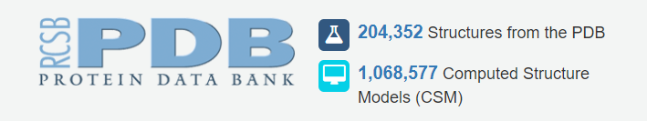

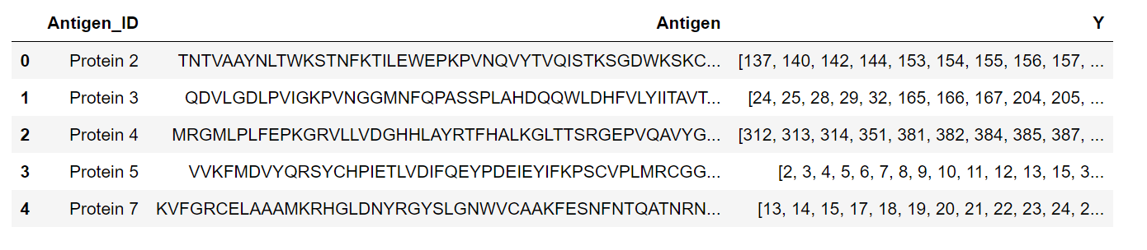
Provided data
Data | Train sets | Test sets
EDB | 358 | 89
IEDB | 2528 | 632
Protein sequences🡪 extract features
Add active sites
Notes:
MAFFT

Slide 10
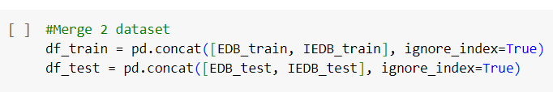
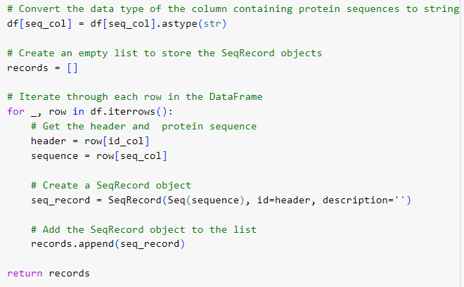
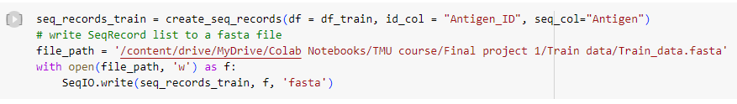
Data processing
Combining data from two sources: EDB and IEDB
Converting to FASTA format

Slide 11
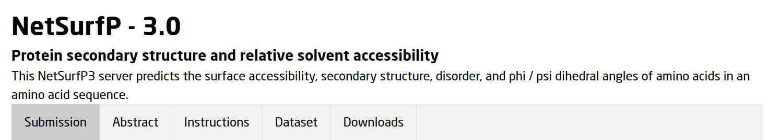
Feature extraction by using NetSurfP
https://services.healthtech.dtu.dk/services/NetSurfP-3.0/
18 structural features

Slide 12
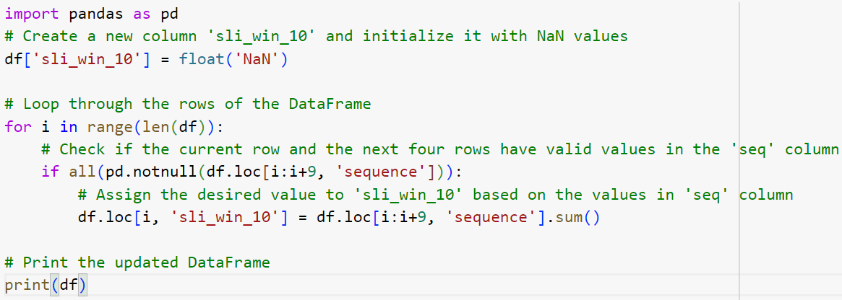
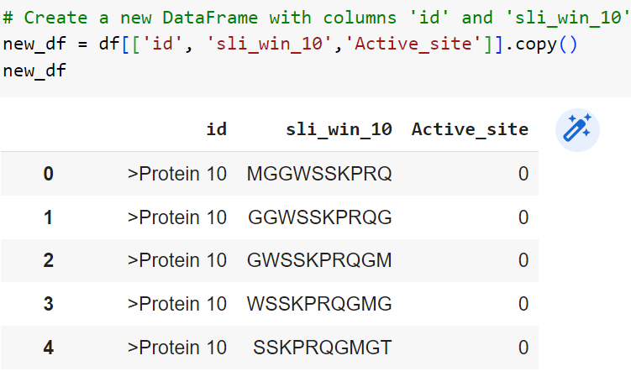
Feature extraction by using sliding window technique
1 | A
0 | C
0 | G
0 | H
1 | T
0 | R
0 | D
1 | S
1 | J
0 | B
1 | Y
0 | T
0 | C
0 | A
1 | A
Window size = 10
ACGHTRDSJB | 1
CGHTRDSJBY | 0
GHTRDSJBYT | 0
HTRDSJBYTC | 0
TRDSJBYTCA | 1
RDSJBYTCAA | 0

Slide 13

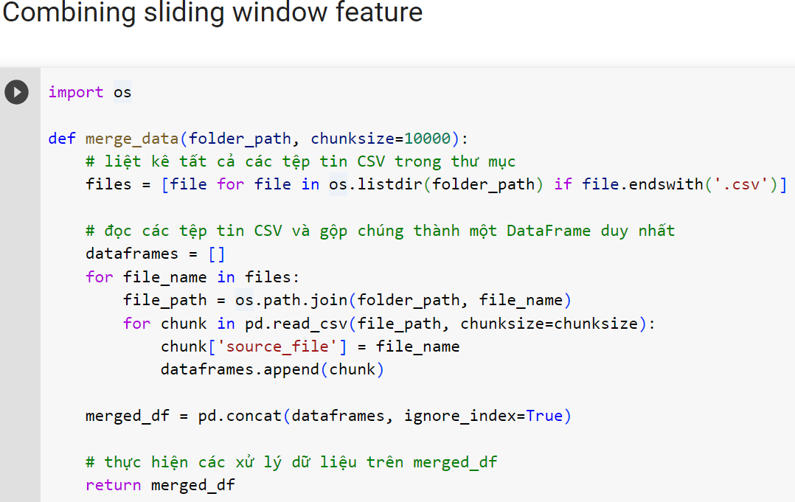
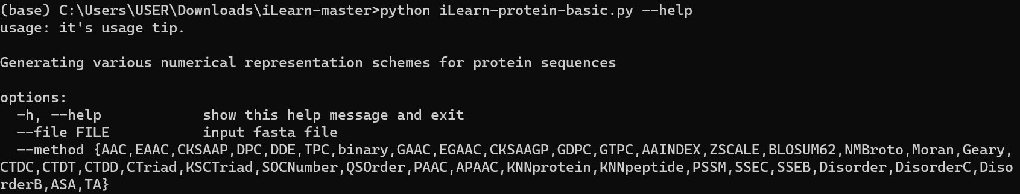
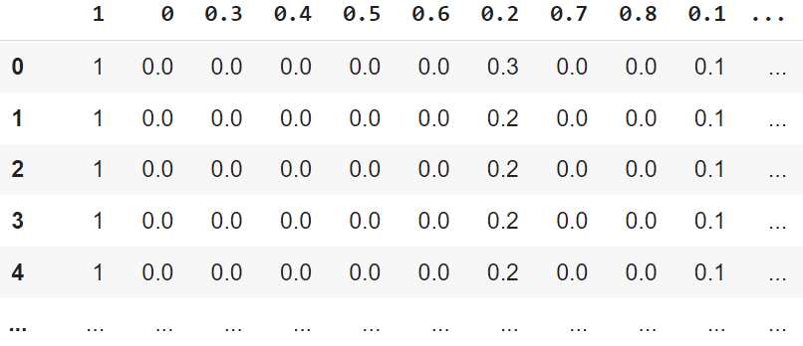
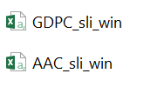
Feature extraction by using sliding window technique
45+18= 63 features
New 45 features

Slide 14
Combining features and adding active sites
'Unnamed: 0', 'id', ' seq', ' n', ' rsa', ' asa', ' q3', ' p[q3_H]',
' p[q3_E]', ' p[q3_C]', ' q8', ' p[q8_G]', ' p[q8_H]', ' p[q8_I]',
' p[q8_B]', ' p[q8_E]', ' p[q8_S]', ' p[q8_T]', ' p[q8_C]', ' phi',
' psi', ' disorder', 'sliding 1', 'sliding 2', 'sliding 3', 'sliding 4',
'sliding 5', 'sliding 6', 'sliding 7', 'sliding 8', 'sliding 9',
'sliding 10', 'sliding 11', 'sliding 12', 'sliding 13', 'sliding 14',
'sliding 15', 'sliding 16', 'sliding 17', 'sliding 18', 'sliding 19',
'sliding 20', 'sliding 21', 'sliding 22', 'sliding 23', 'sliding 24',
'sliding 25', 'sliding 26', 'sliding 27', 'sliding 28', 'sliding 29',
'sliding 30', 'sliding 31', 'sliding 32', 'sliding 33', 'sliding 34',
'sliding 35', 'sliding 36', 'sliding 37', 'sliding 38', 'sliding 39',
'sliding 40', 'sliding 41', 'sliding 42', 'sliding 43', 'sliding 44',
'sliding 45', 'sliding 46', 'Active_site'],
dtype='object'
Data | Sides | Active [1] | None active [0]
Created Train set | 1639857 | 43364 | 1596493 (x37)
‹#›

Slide 15
Base machine learning models
No | Classifiers | Accuracy (0.25) | Precision Active sites_1 | Recall Active sites_1 | F1-score Active sites_1
1 | RandomForest | 0.97 | 0.04 | 0.00 | 0.00
4 | DecisionTree | 0.94 | 0.04 | 0.05 | 0.04
7 | LogisticRegression | 0.97 | 0.00 | 0.00 | 0.00
Problem: Imbalanced data when the number of [1] active sites is too small in comparison to the [0] non-active sites.

Slide 16
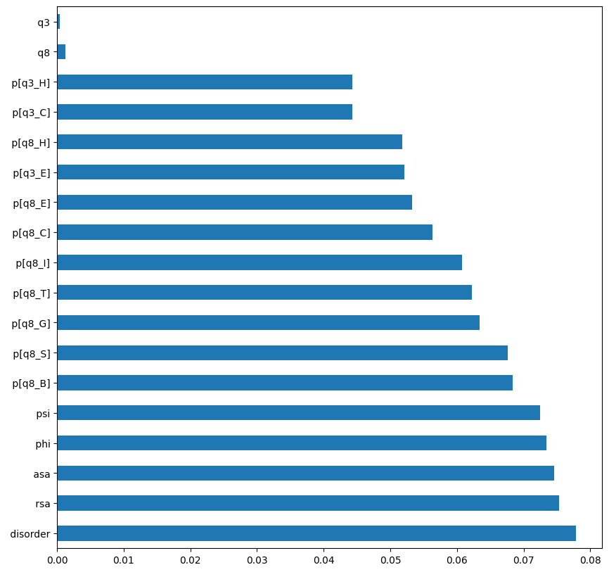
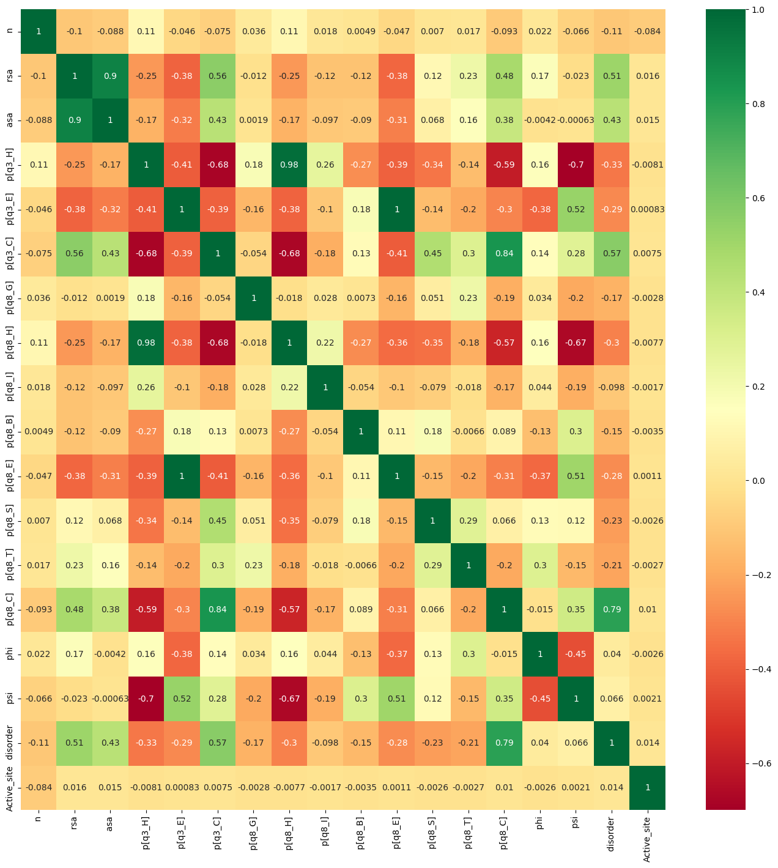
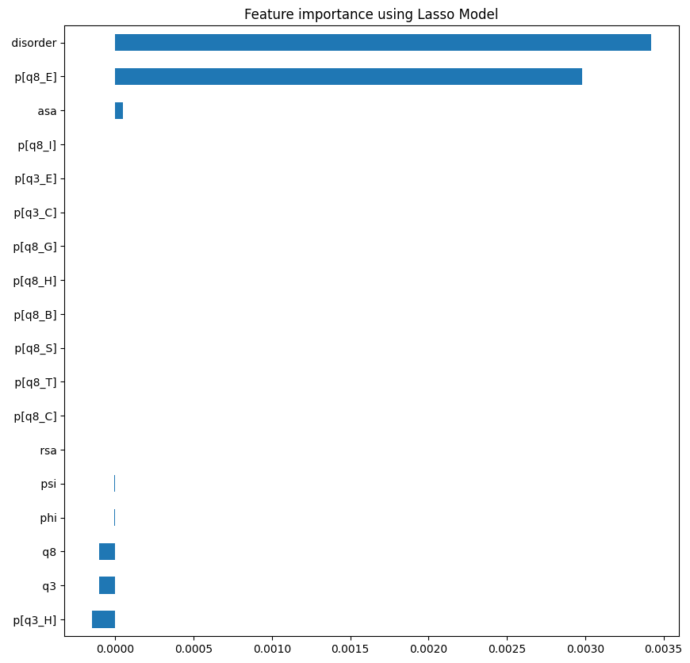
Feature selection
DecisionTreeClassifier
Heatmap
Techniques
Correlation Matrix with Heatmap
DecisionTreeClassifier
LassoCV
RFE (Recursive Feature Elimination)
Importance features
LassoCV

Slide 17
DecisionTree based model and imbalance treatment performances
Methods | Accuracy (CV = 5) | Precision Active sides_1 | Recall Active sides_1 | F1-score Active sides_1
Under-sampling (1:1) | 0.60 | 0.04 | 0.59 | 0.07
Over-sampling | 0.95 | 0.07 | 0.07 | 0.07
ADASYN (Adaptive Synthetic) | 0.84 | 0.04 | 0.22 | 0.07

Slide 18
In comparison with previous studies
Studies | ACC
BepiPred-2.0 | 0.62
NetsurfP3.0 | 0.60
Our best performance | 0.60

Slide 19
Conclusion
The combination of structural features and sliding window technique could benefit machine learning model for B cell epitope prediction.

Slide 20

Thank for your attention!

