Slide 1

SOP PCN System
Department: MBD TE-AUTO-IOT

Slide 2
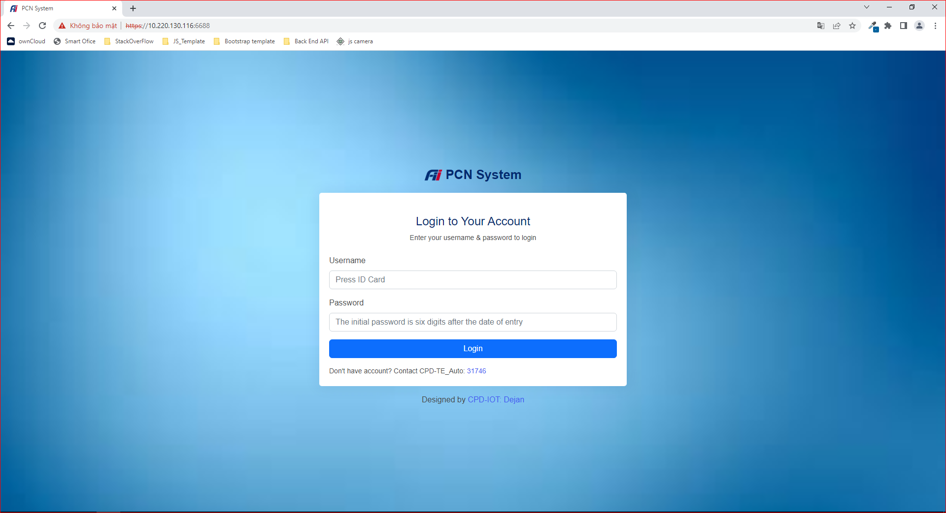
I. Login Screen
1. Press your ID card (Ex: V103xxxx)
2. Press your Password The initial password is six digits after the date of entry Example: Hire Date: 2022-07-16
password: 220716
Hire Date: 2016-05-05
=> password: 160505
3. Click button Login to login

Slide 3
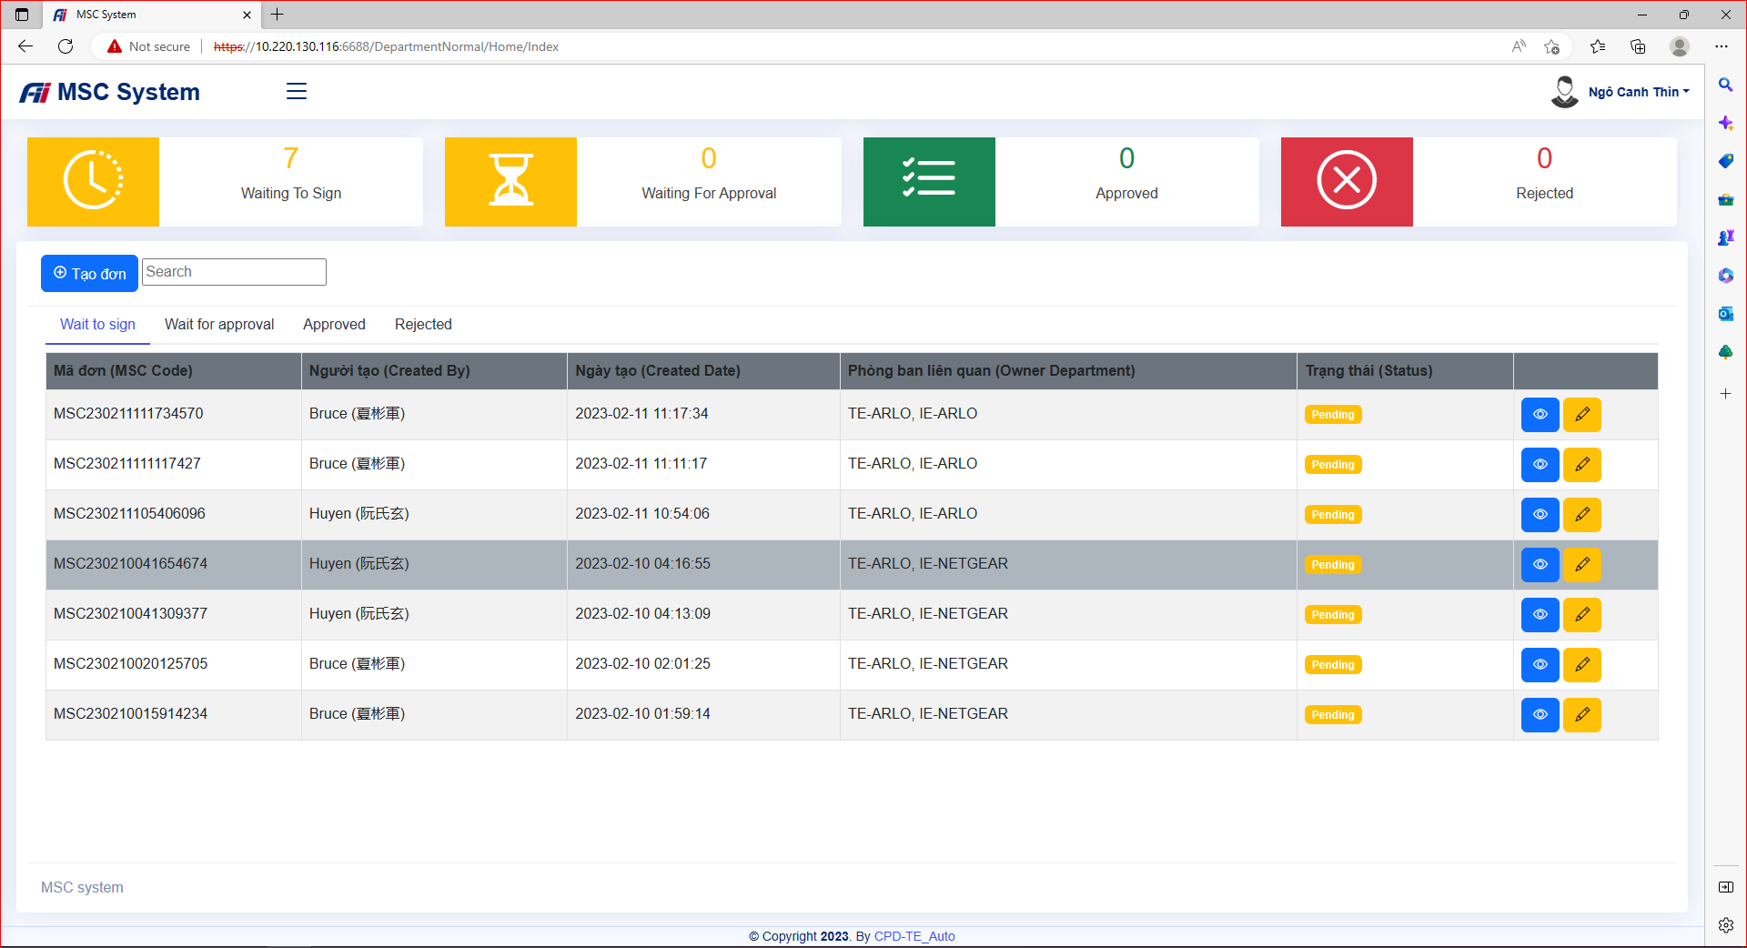
II. Home Screen
1. Overview
- Click on the waiting application area to see the list of waiting applications
- Click on the waiting for approval area to see the list of waiting for approval applications
- Click on the approved area to see the list of approved applications
- Click on the rejected area to see the list of rejected applications

Slide 4
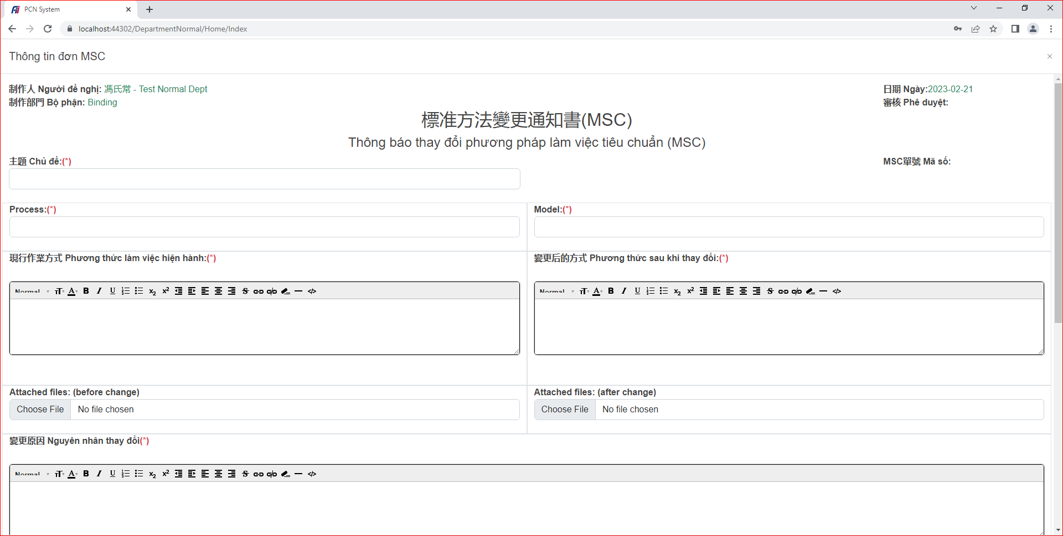
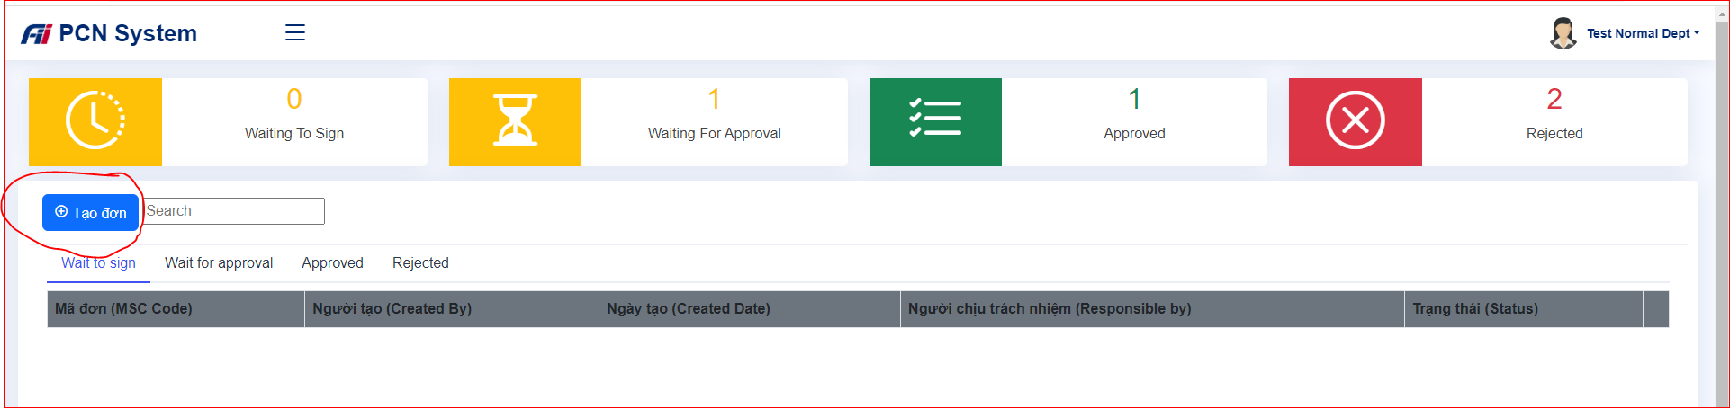
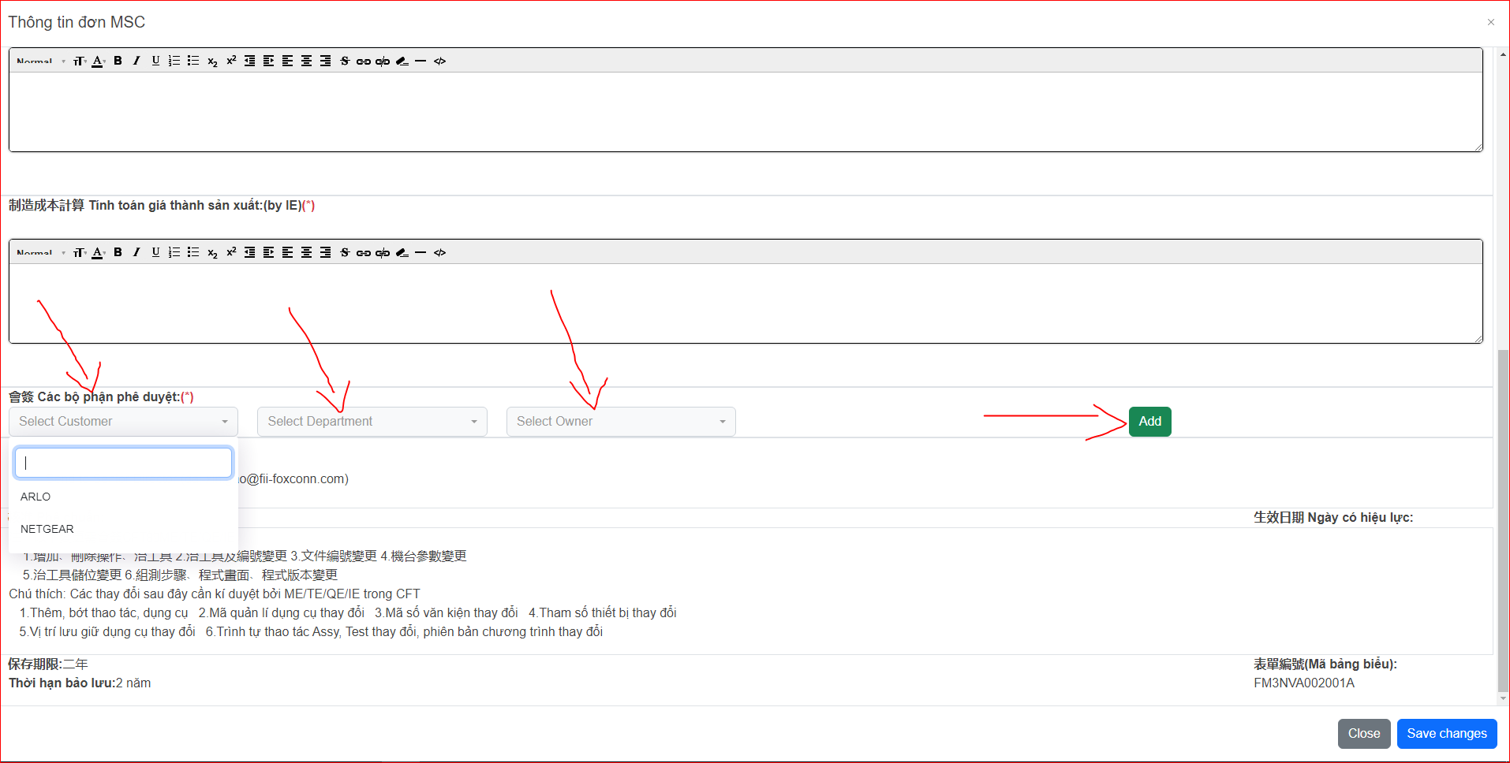
II. Home Screen
2. Create an MSC application
Click Create new button then fill out all the information of MSC application and select Customer, Department and Owner Combobox

Slide 5
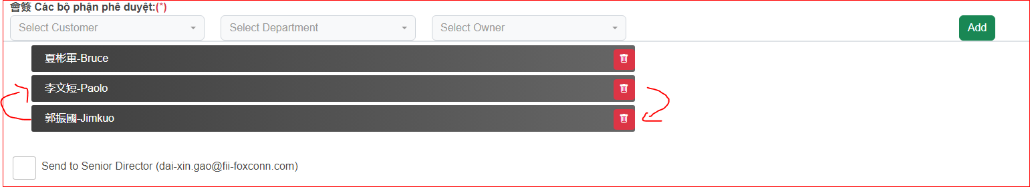
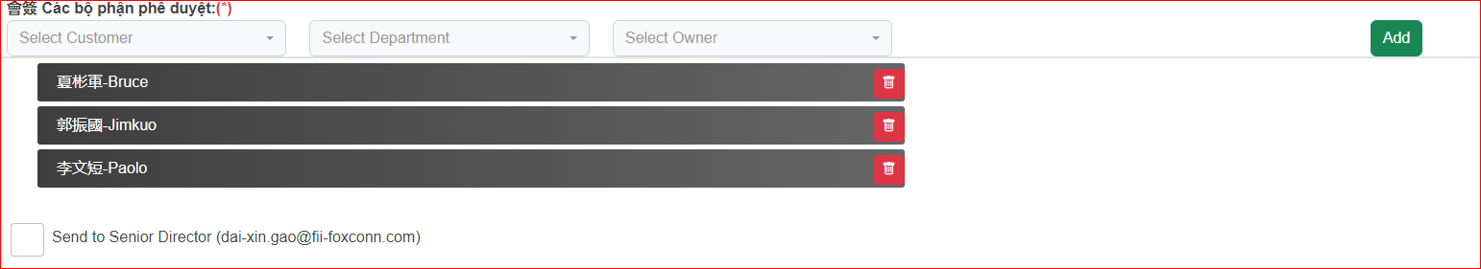
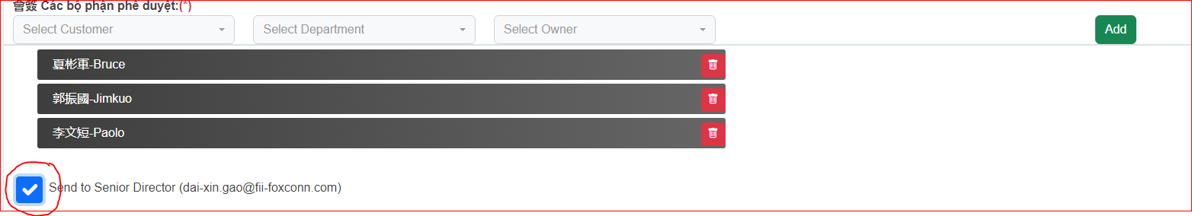
II. Home Screen
2. Create an MSC application
The order of sending mail will be from top to bottom, you can change it by dragging and dropping the name of the signers
If you want the senior director to confirm, check the box Send to Senior Director (dai-xin.gao@fii-foxconn.com)

Slide 6
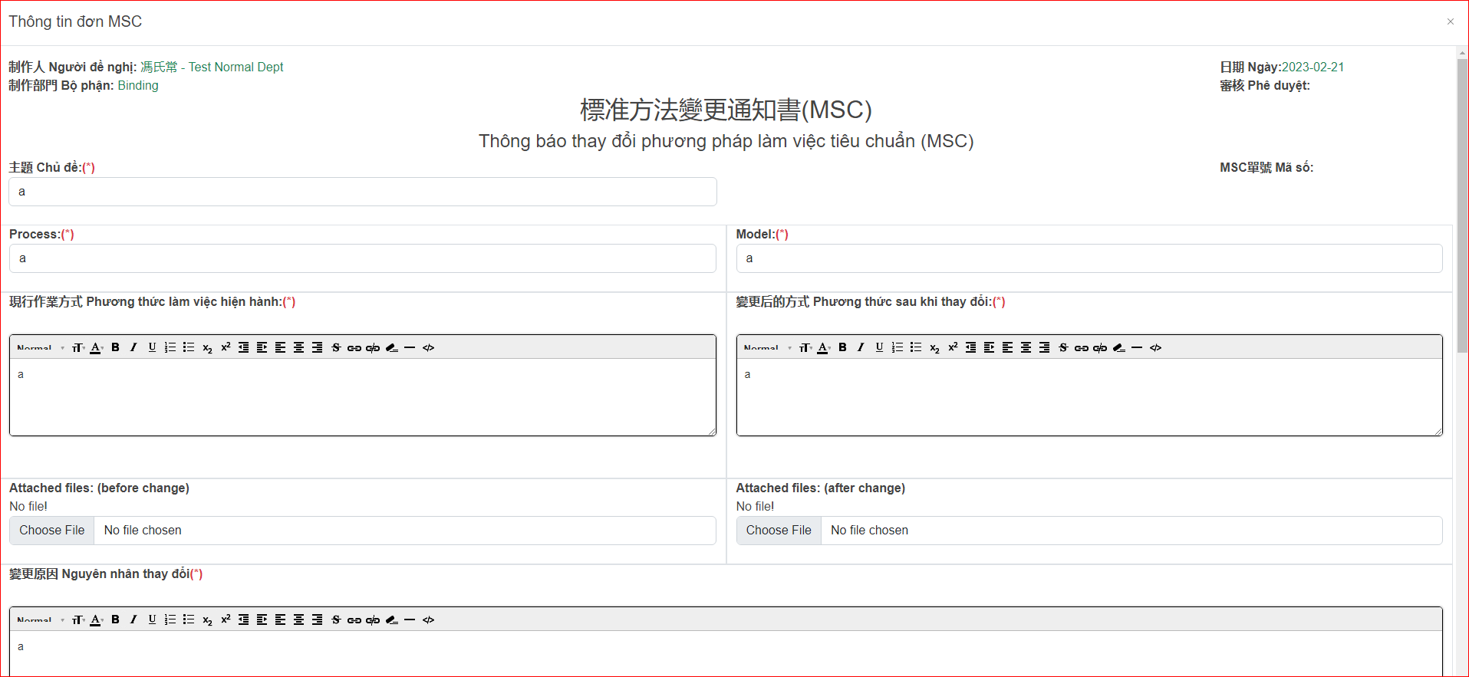
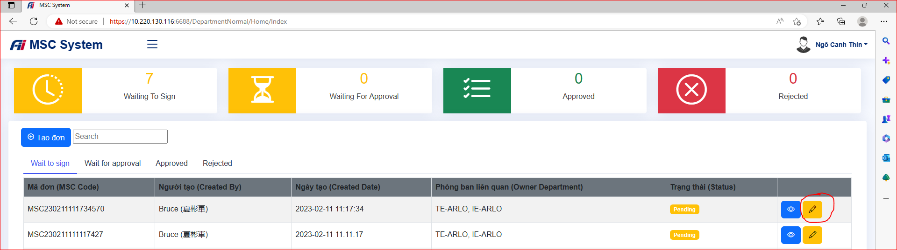
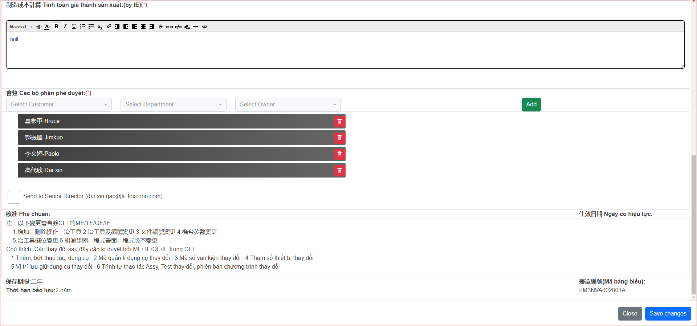
II. Home Screen
3. Edit an MSC application
Click the edit button then fill out all the information of MSC application (the same operation as when adding new) and click Save Change

Slide 7
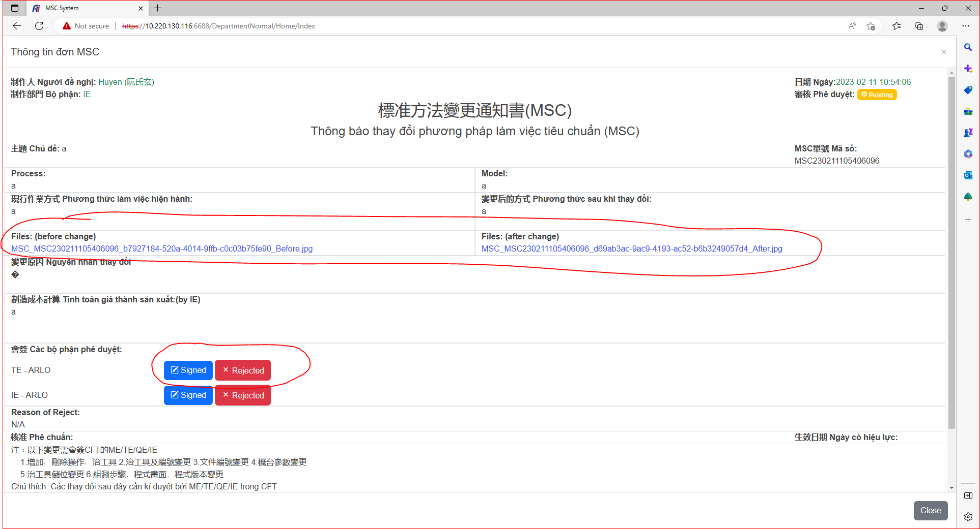
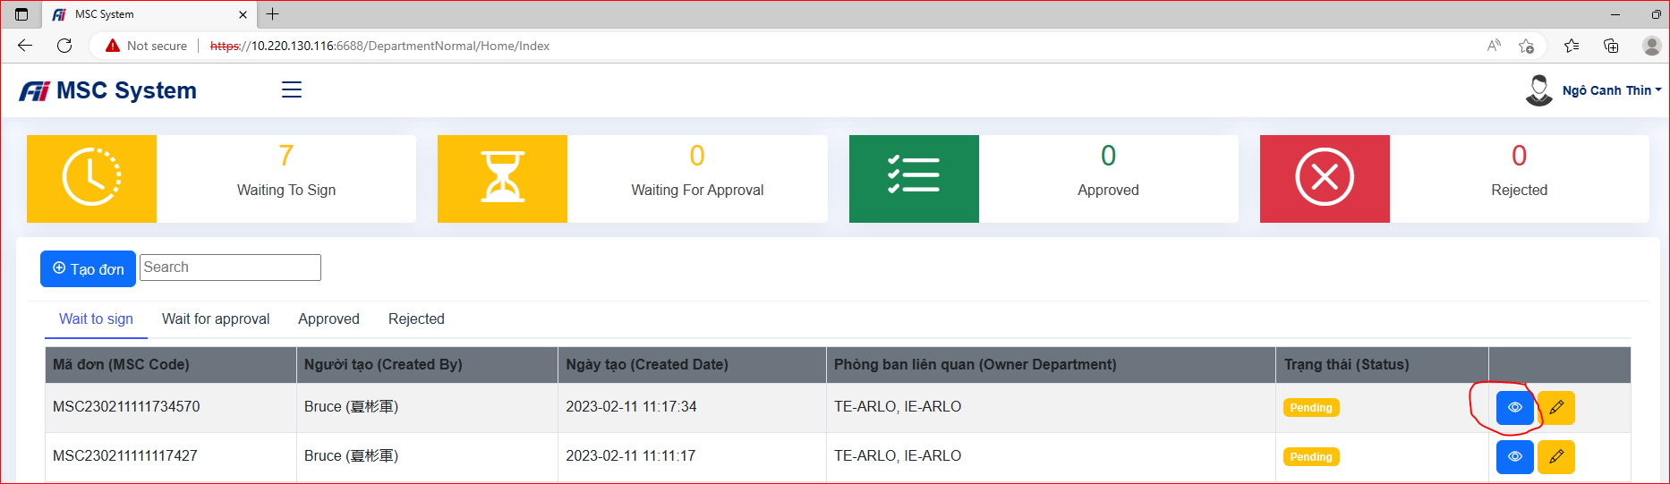
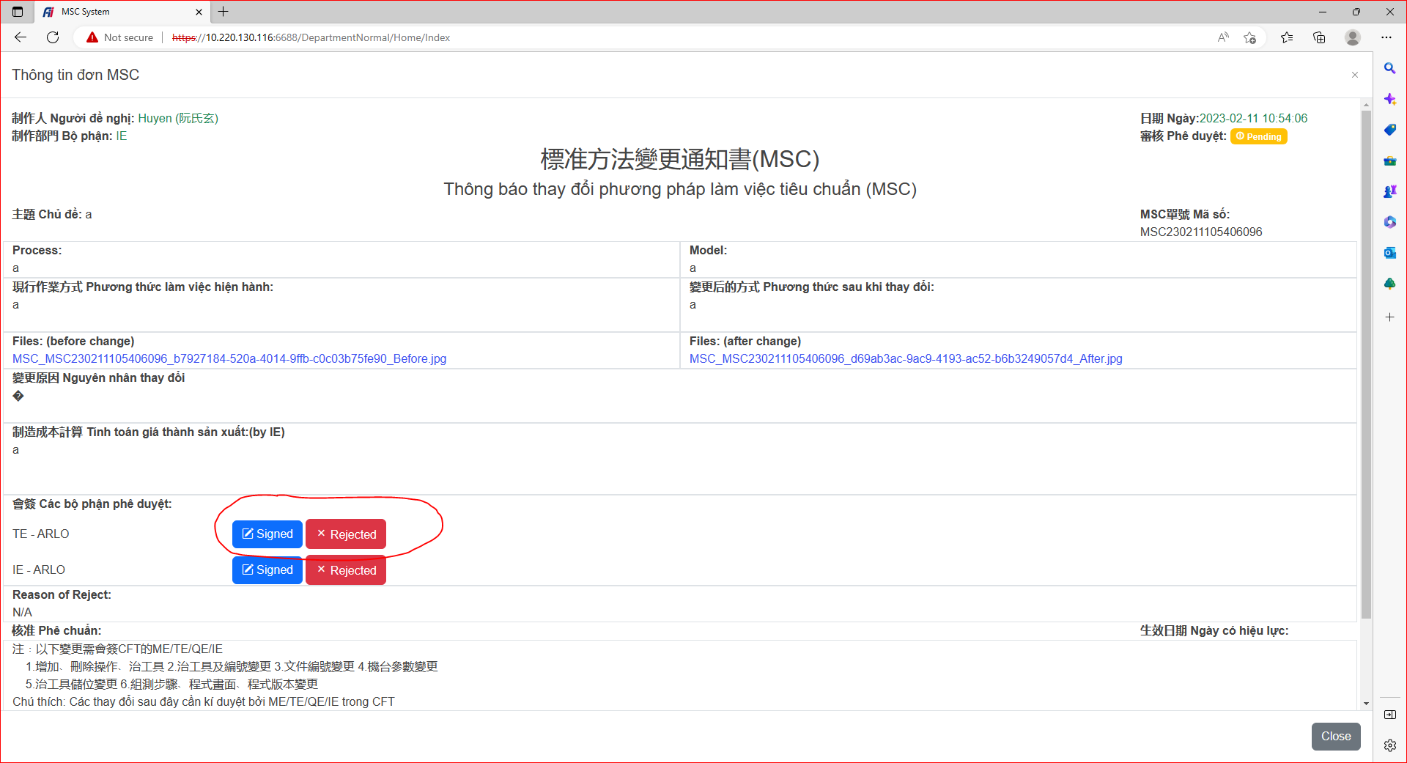
II. Home Screen
4. Click detail an MSC application
If you want to see the file before and after the changes, click on the file to view it
Click the details button to view the MSC application information.
If you agree, click the Signed button. If you refuse, click the reject button

Slide 8
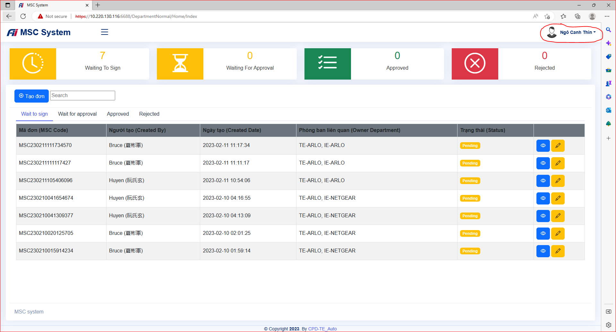

III. Profile Screen
1. Open Profile screen
Click on the name in the upper right corner of the screen then click My profile to go to your profile screen

Slide 9
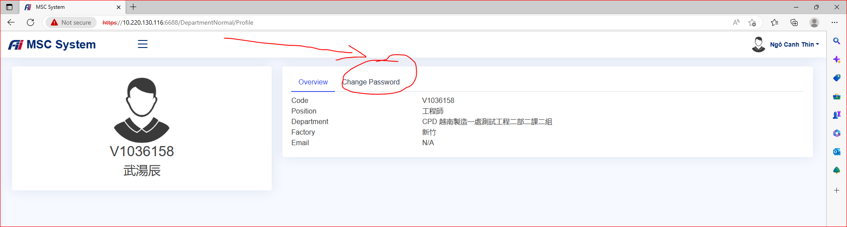
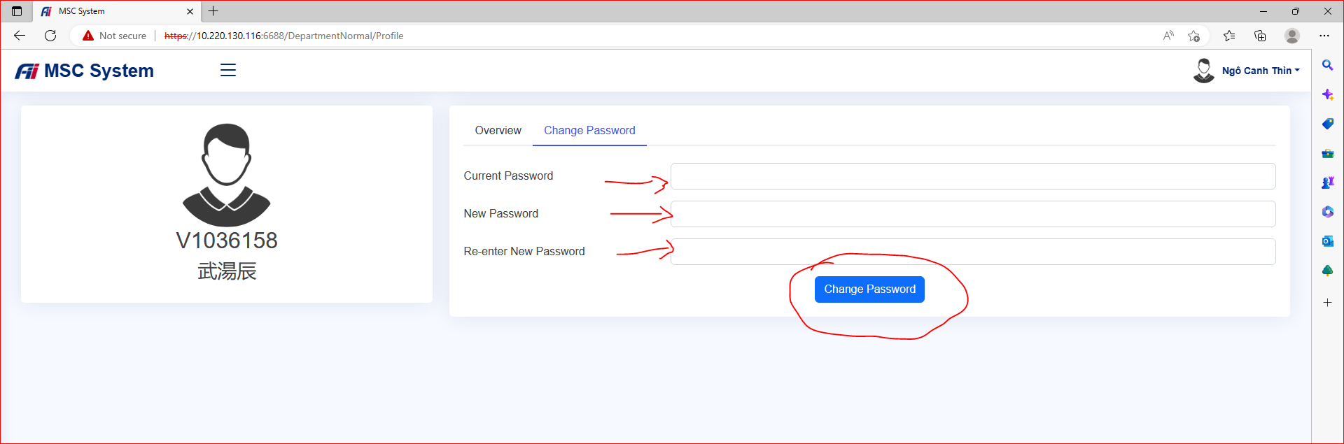
III. Profile Screen
2. Change password
If you want to change your password, Click Change password and fill in the form completely, then click Change Password button to submit the form.

Slide 10
Thank you!
Any comments, please send to:
Email: you-nan.ruan@mail.foxconn.com
Phone number: 31746

