Slide 1
Software Architecture
Project Management Game

Slide 2
List Of Memebers
MSSV | Họ và Tên
2191708 | Lê Bùi Hoàng Văn
2191413 | Đoàn Trương Minh Khương

Slide 3
Table of contents
01
Project Introduction
02
Architecture For Use Project
03
Database Project
04
Features Of Use Project

Slide 4
01
Project Introduction
Introduction Project Management Game

Slide 5
Introduction
The creation of a program that controls gaming browsers is the aim of this project in order to facilitate teamwork among project managers and team members.

Slide 6
02
Architecture For Use Project
Architecture For Use Project Management Game

Slide 7


Architecture For Use Project Management Game
MicroServices
Windows Services

Slide 8
03
Database Project
Database For Use Project Management Game

Slide 9
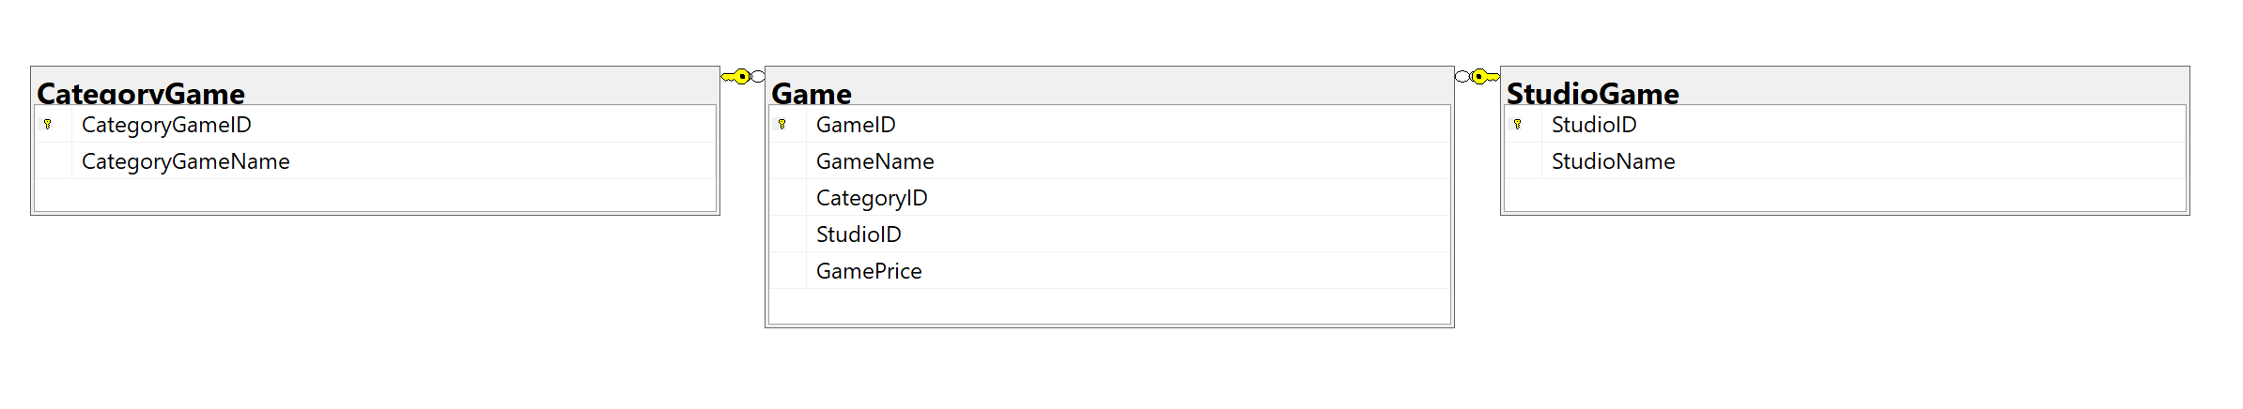
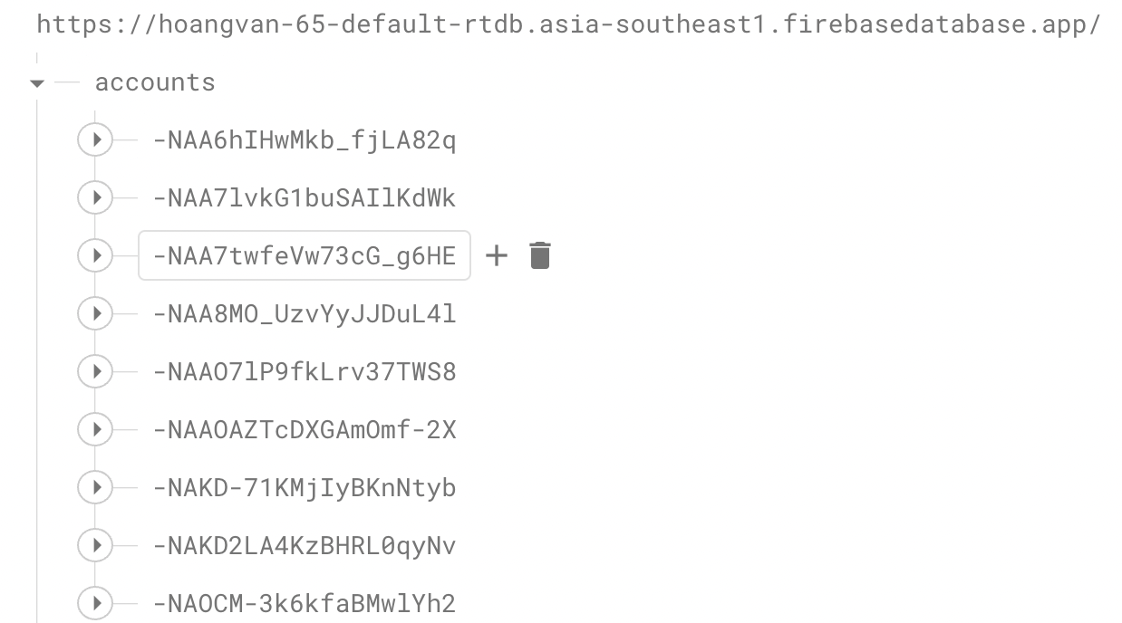
Database Project Management Game

Slide 10
04
Features Of Use Project
Features Of Use Project Management Game

Slide 11
Features Of Use Project Management Game
Add News
Update
Delete
View Data
Login
Register

Slide 12
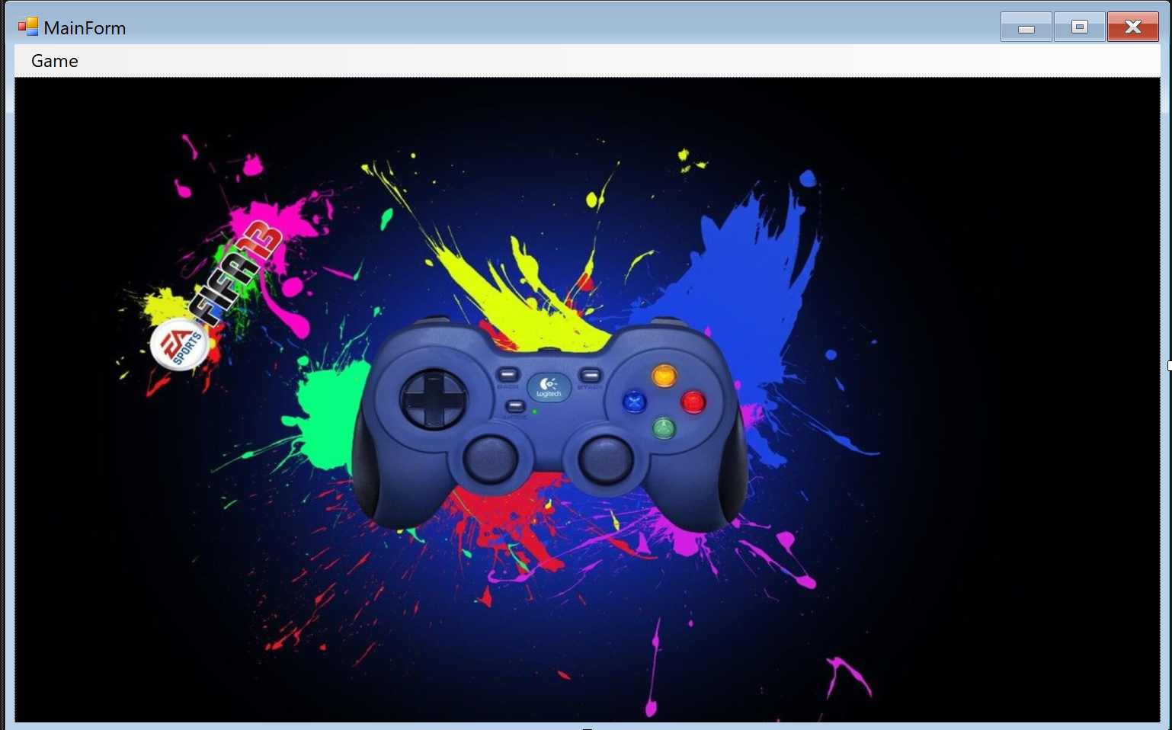
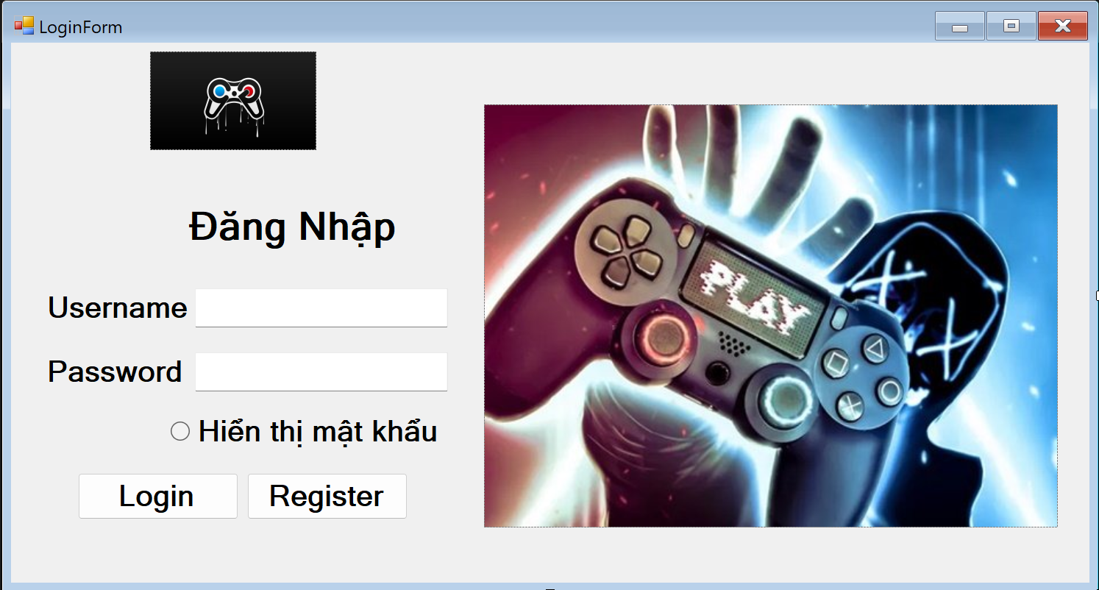
Image Project Management Game

Slide 13
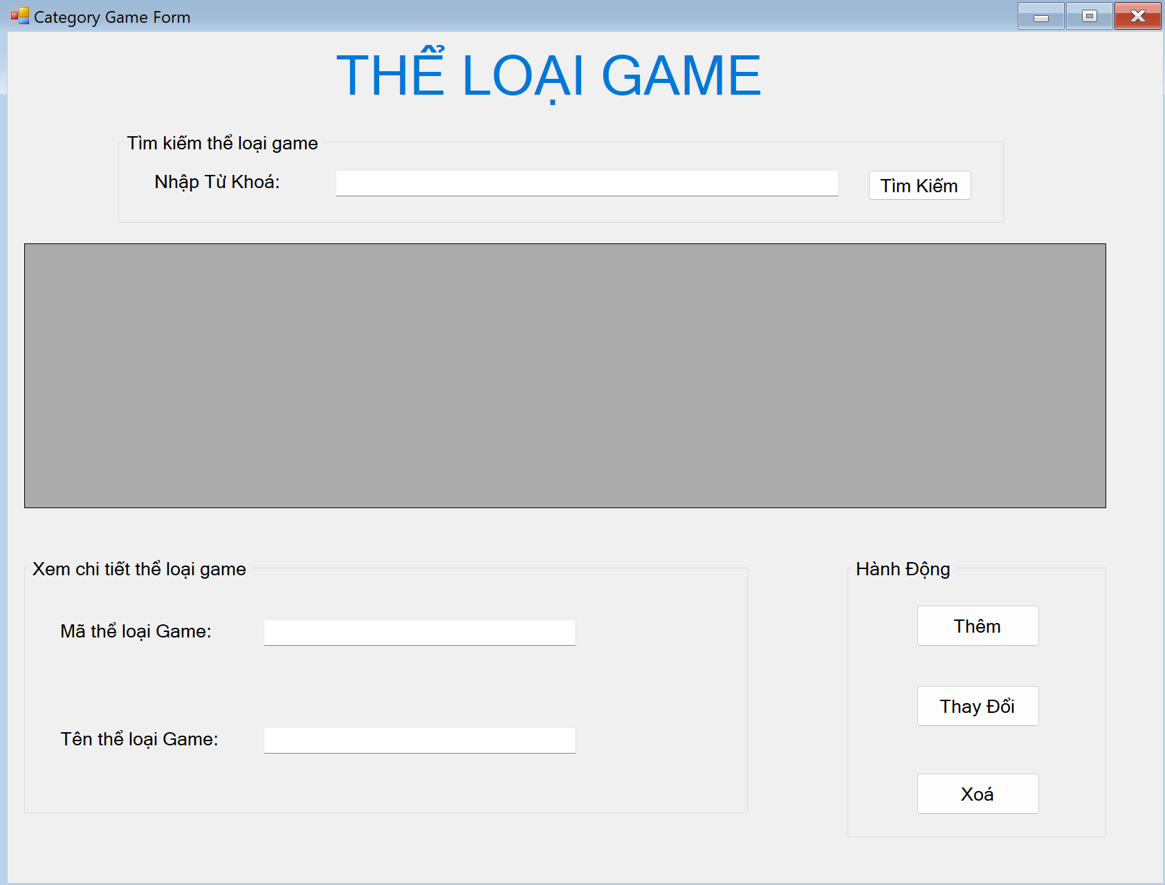
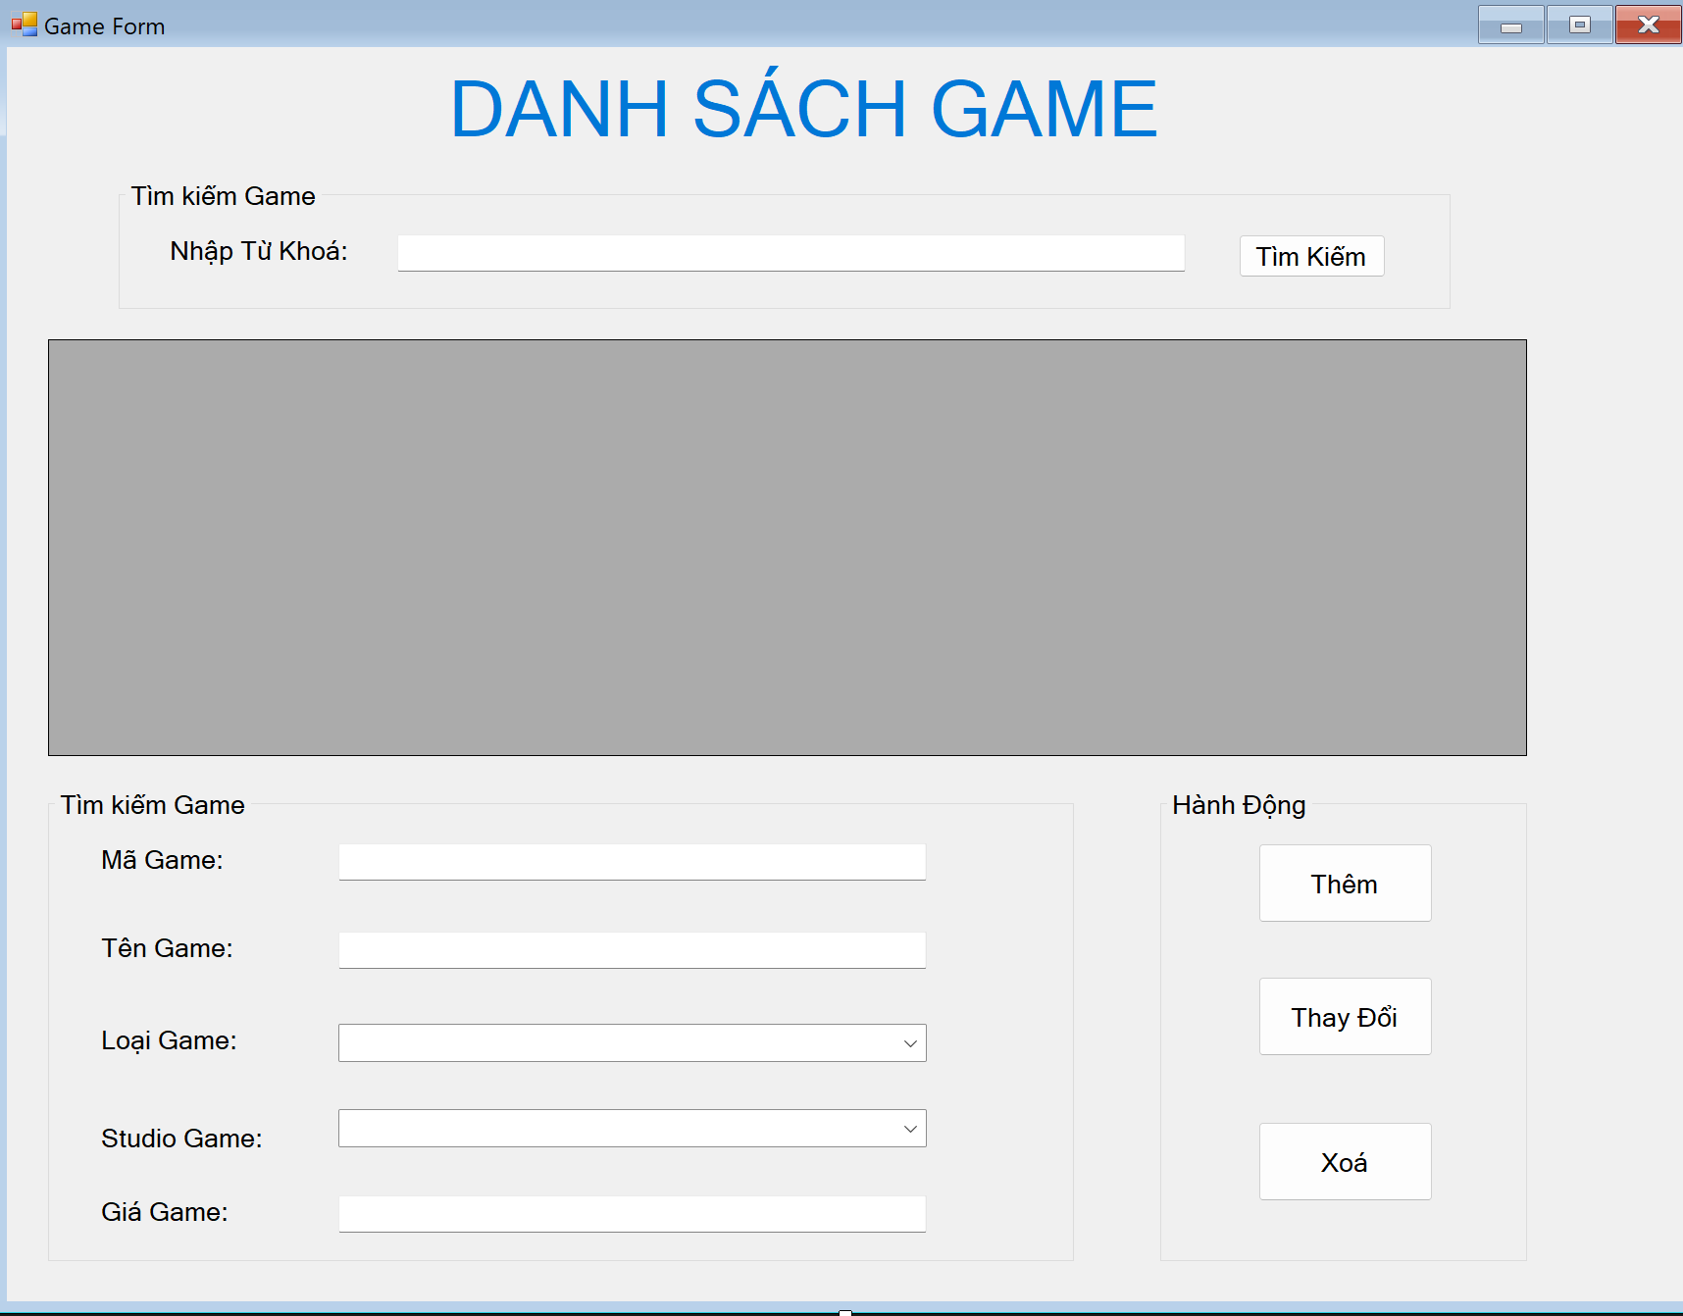
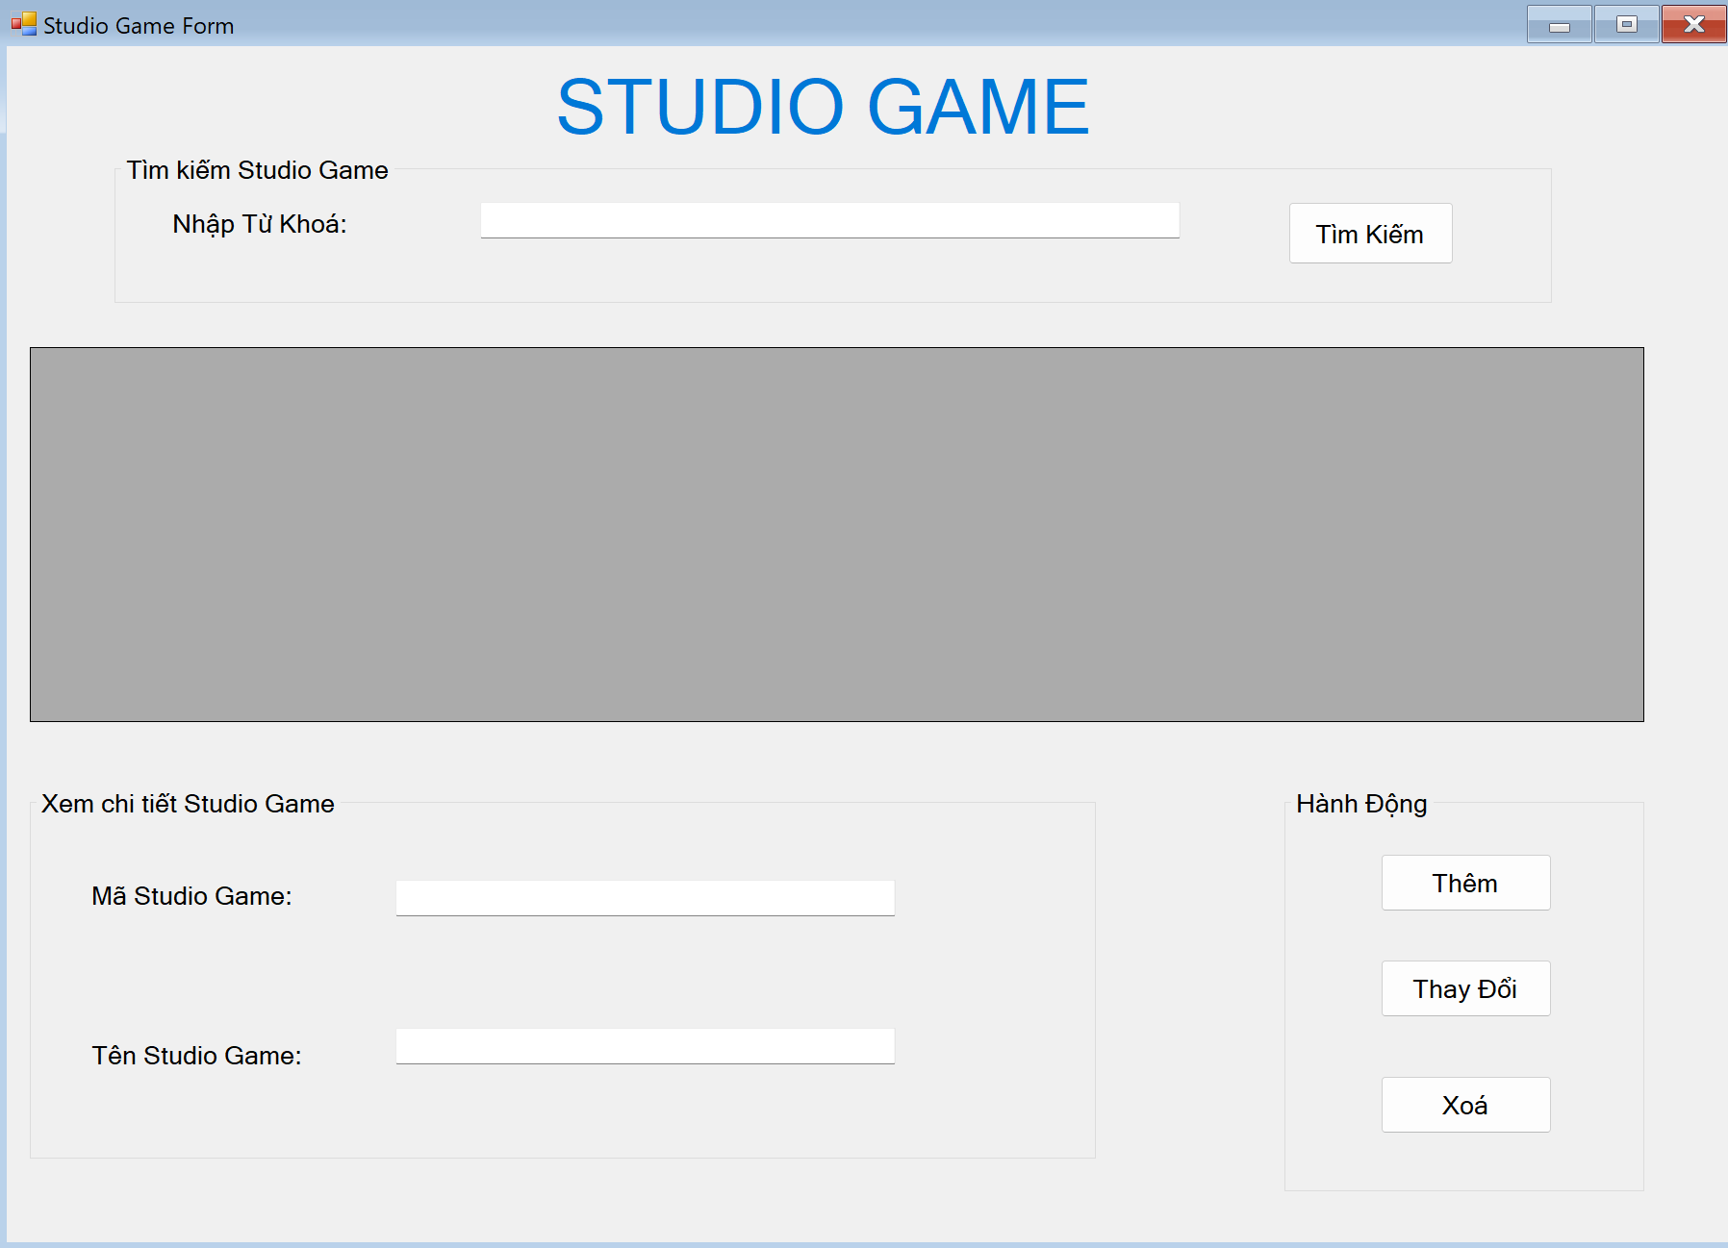
Image Project Management Game

Slide 14

Demo Project

Slide 15
Thanks!
+
Cmd
A
Does anyone have any questions?
Ctrl
Z
C

