Slide 1
NATURAL LANGUAGE PROCESSING : PROBLEM FORMULATION
DATASET : EMPATHETIC DIALOGUES

Slide 2
Task
The Motivation behind this project is to help AI systems to recognize and acknowledge human’s feelings and emotion in a conversation. After recognizing the human’s emotion, we aim to enable them to generate appropriate and empathetic responses that align with the specific emotions.

Slide 3
Objectives
Motivation:
Enhance AI systems' ability to recognize and respond appropriately to human emotions in a conversation.
Goals:
Improve AI models' empathetic capabilities.
Investigate model adaptations for empathetic responding without extensive re-training.

Slide 4
Dataset & EDA
Dataset: Empathetic Dialogues
Comprises of 25k conversations grounded in various emotions such as sadness, happiness, anger, etc.
Conversations are labeled with the expressed emotions, speaker ID, utterance, self-evaluation, and tags.

Slide 5
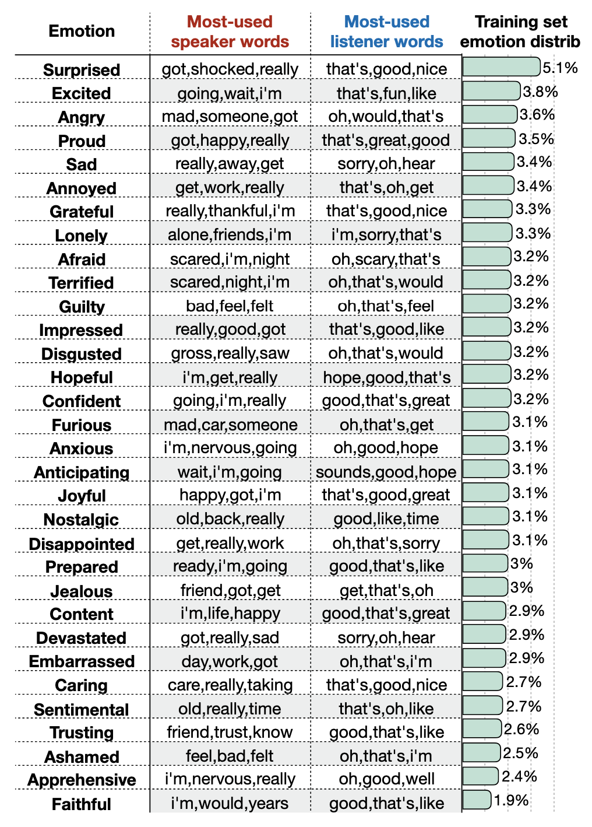

Slide 6
Approach
Models/Methods/Algorithms:
Empathetic Dialogues Model
Techniques: Prepending classifier labels

Slide 7
Roles & Responsibilities
Jia Ze Wan:
Dataset Acquisition and Preprocessing
Kim Long Hoang:
Model Training and Evaluation
Florian Grohmann:
Documentation and Reporting

Slide 8
Project Timeline
Weeks 1: Dataset Acquisition and Preprocessing
Weeks 2-3: Exploratory Data Analysis
Weeks 4-5: Model Training and Evaluation
Week 6: Model Adaptations
Week 7: Documentation and Reporting

Slide 9
Anticipated Challenges
Limited availability of high-quality empathetic dialogue data.
Ensuring ethical considerations: bias, privacy, cultural sensitivities.
Potential performance limitations of the models.

