Slide 1
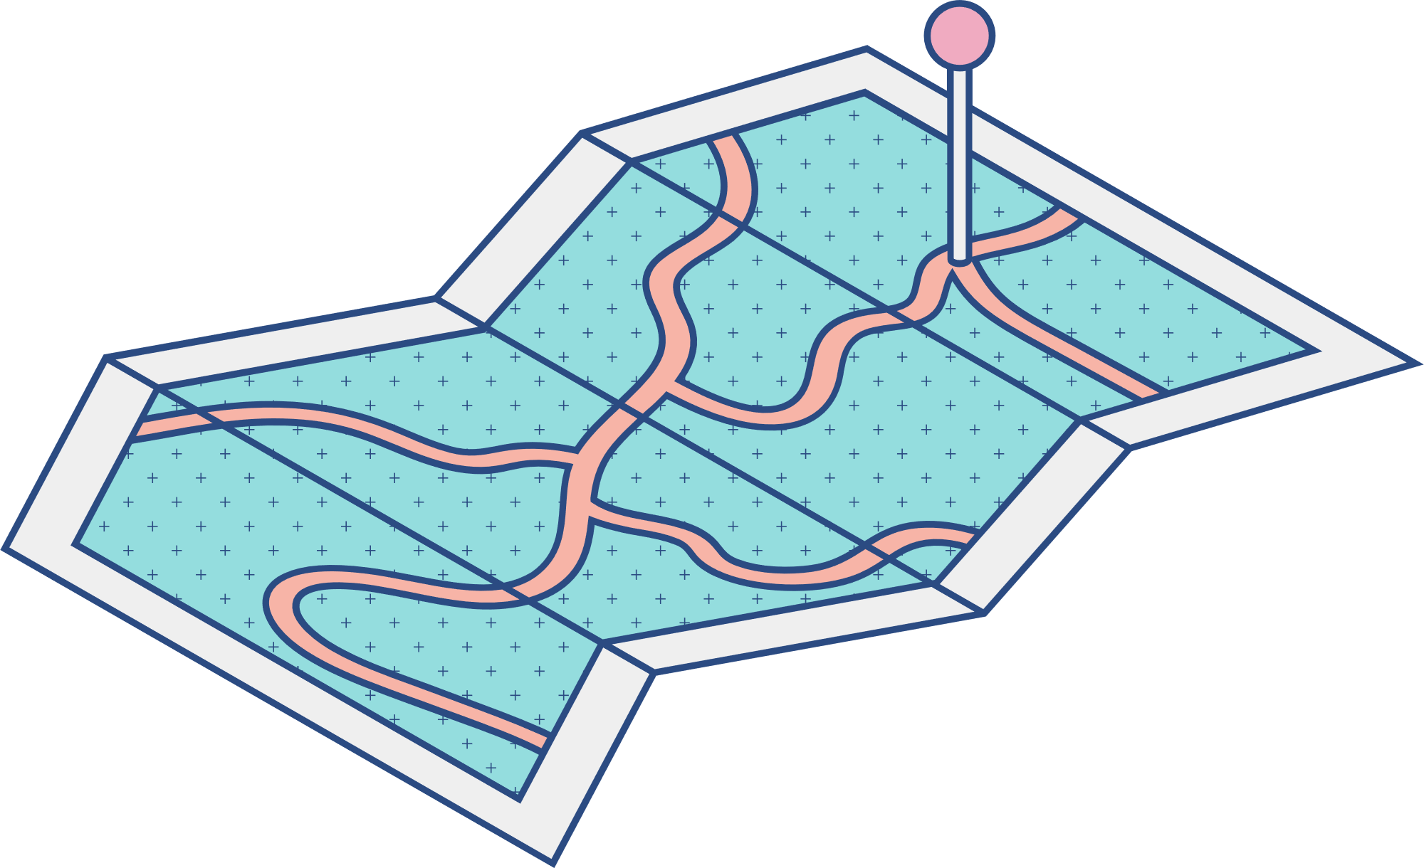
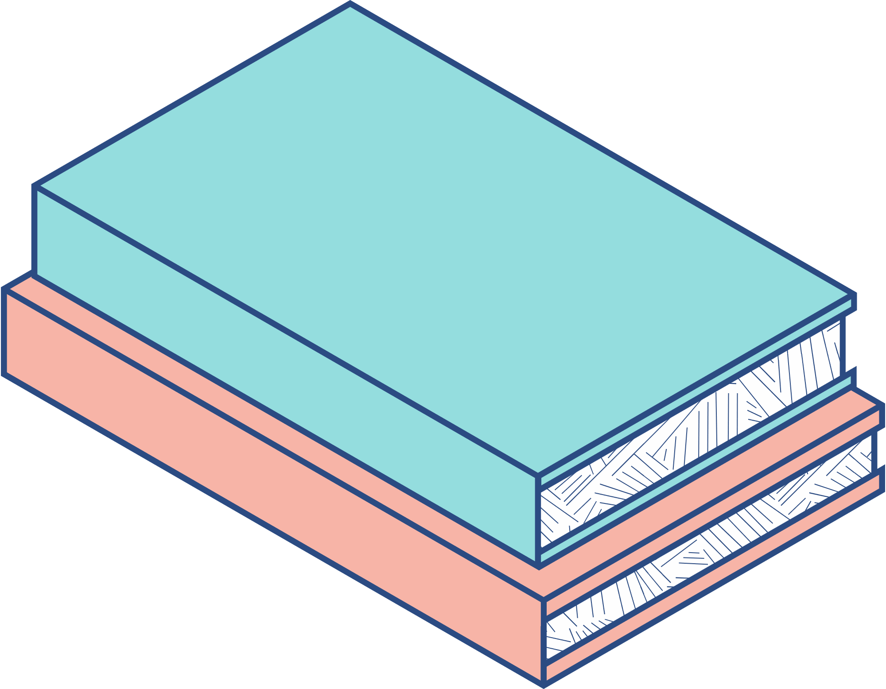




Introduction to Parallel Programming
Project: Parallelize the LeNet-5 Architecture
Group 3 - Team Allin
20120030 – Nguyễn Thiên An
20120090 – Nguyễn Thế Hoàng
20120146 – Nguyễn Thị Châu Ngọc​

Slide 2
CONTENTS
PROBLEM
DEFINITION
PARALLEL VERSION 1.0
PARALLEL VERSION 2.0
SEQUENTIAL VERSION
MISC.
01
02
03
04
05

Slide 3
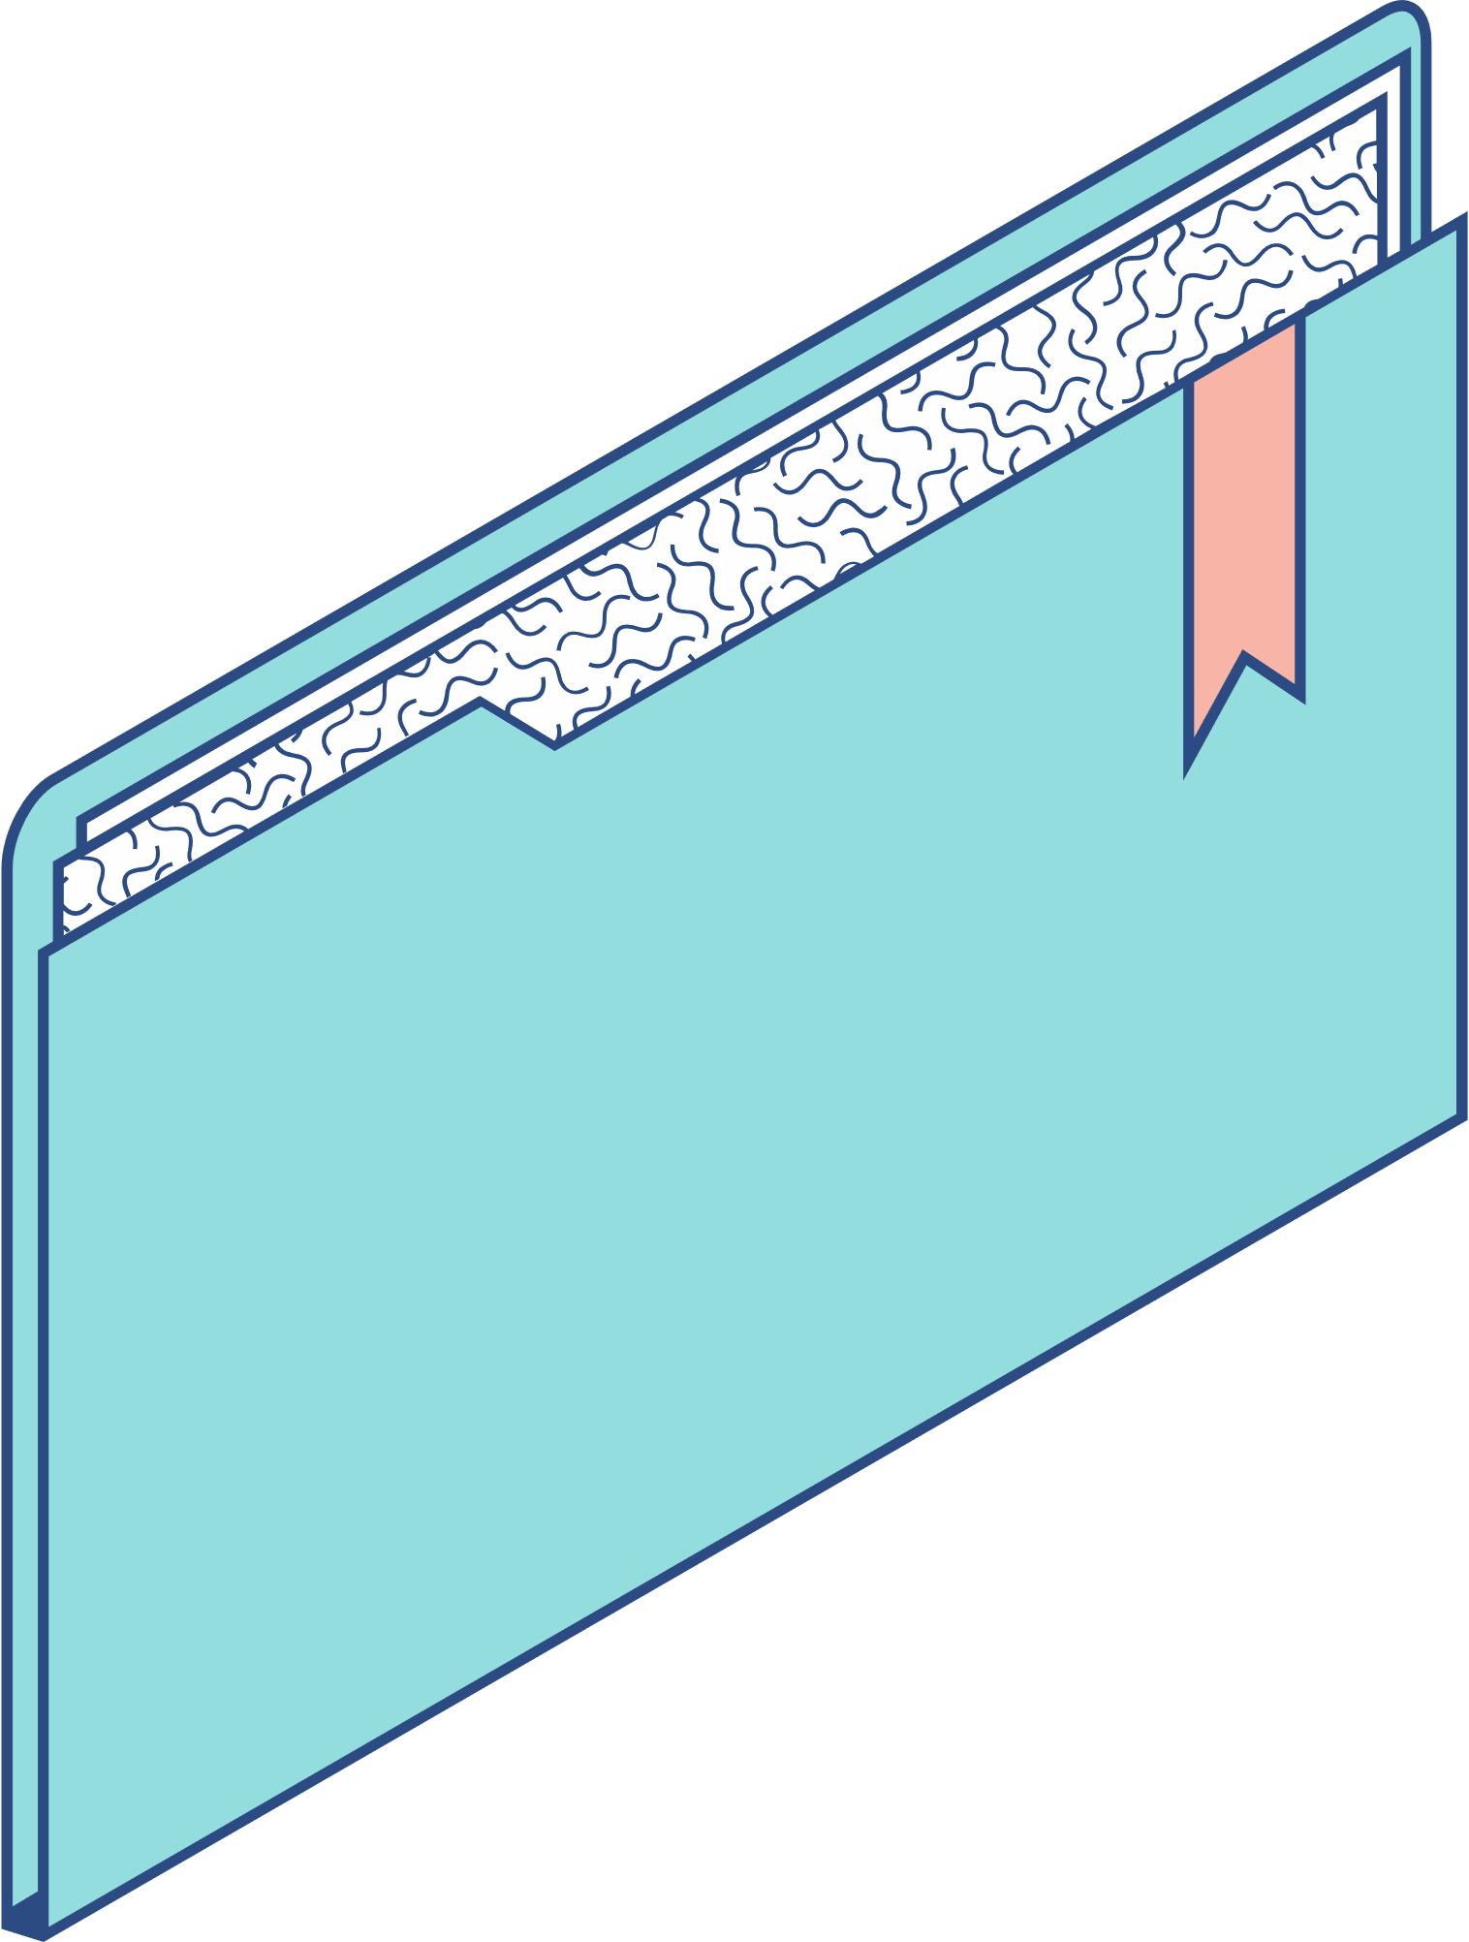
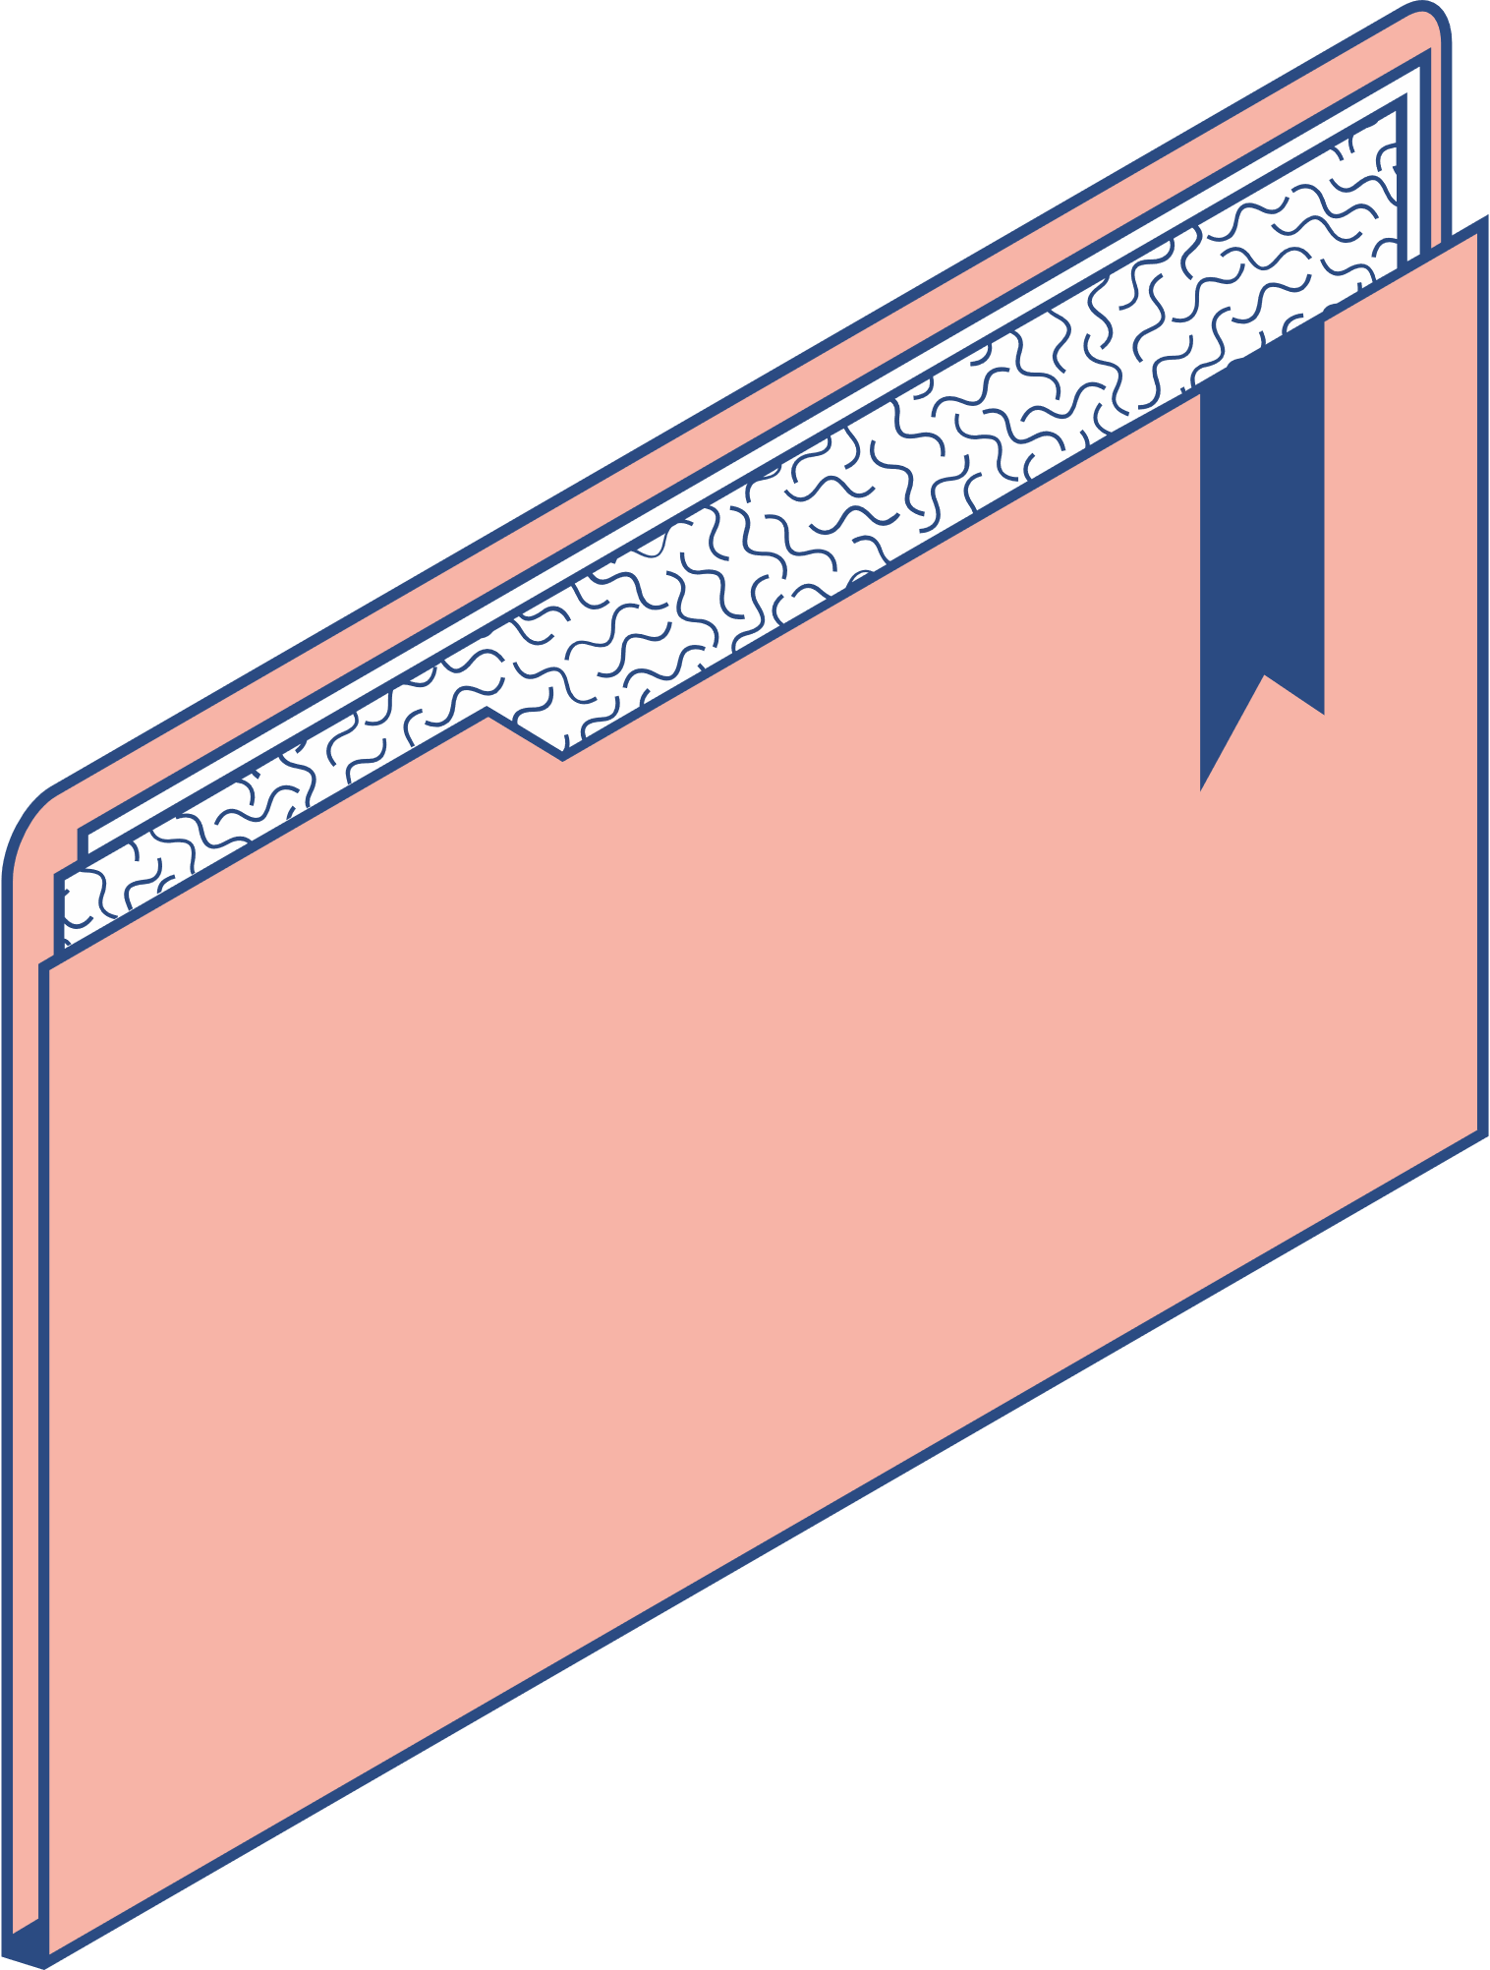
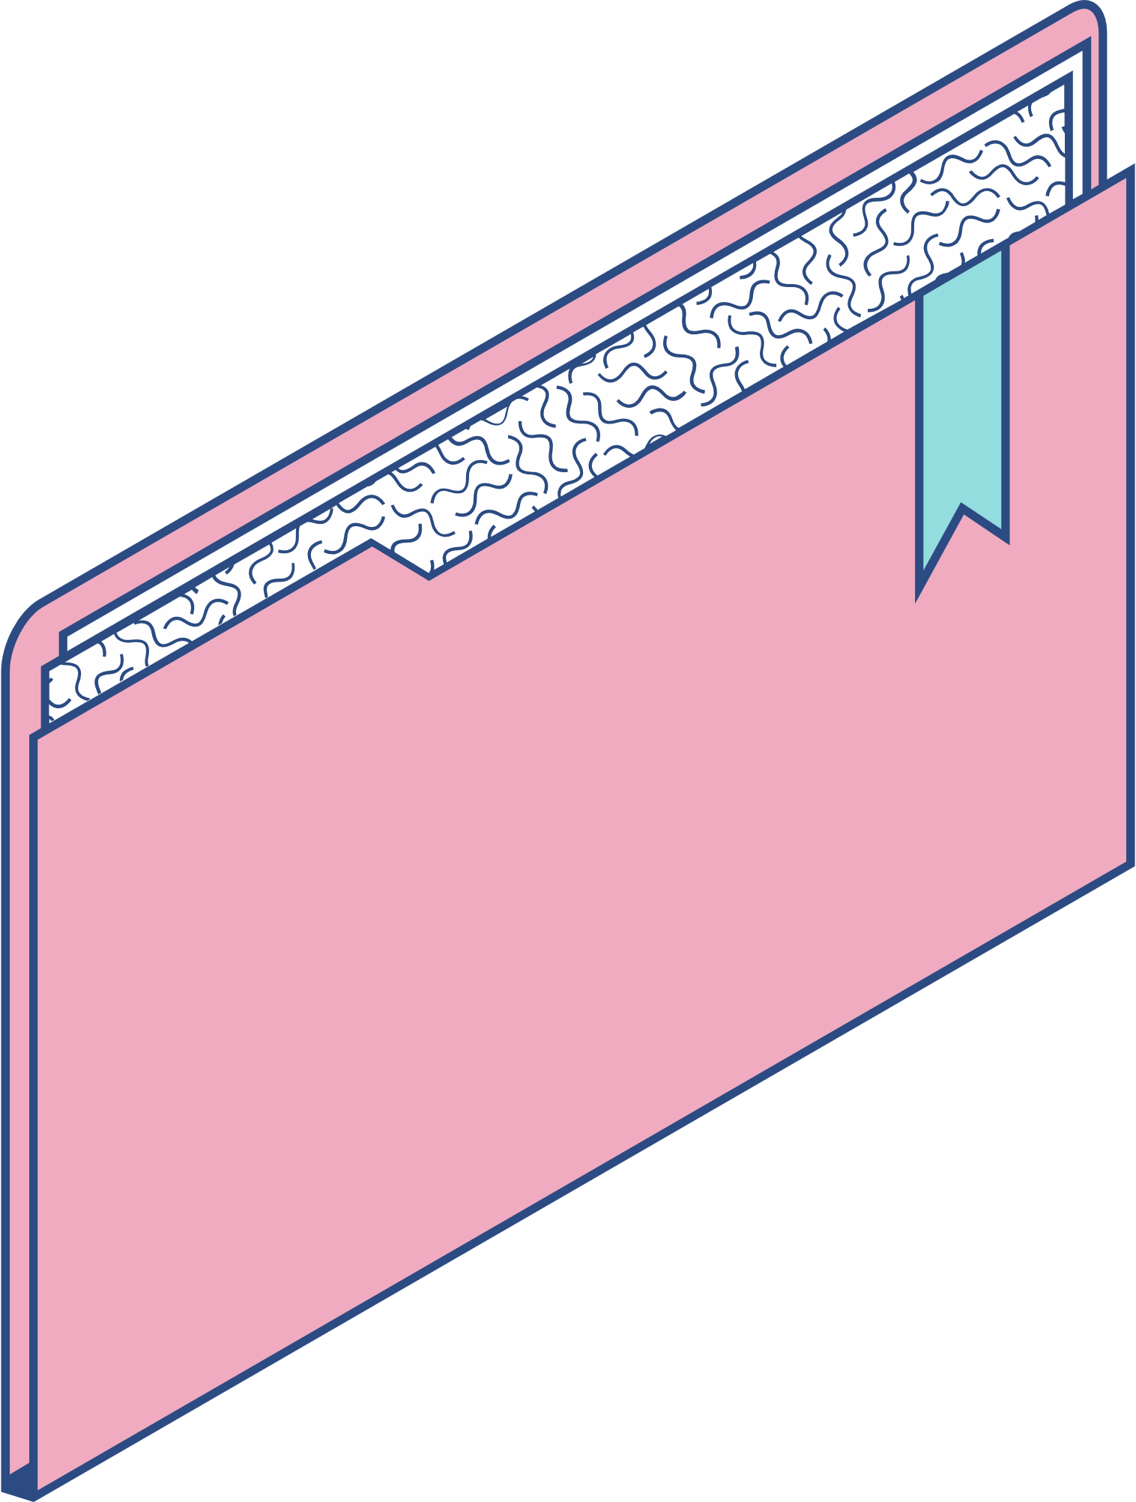
PROBLEM
DEFINITION

Slide 4
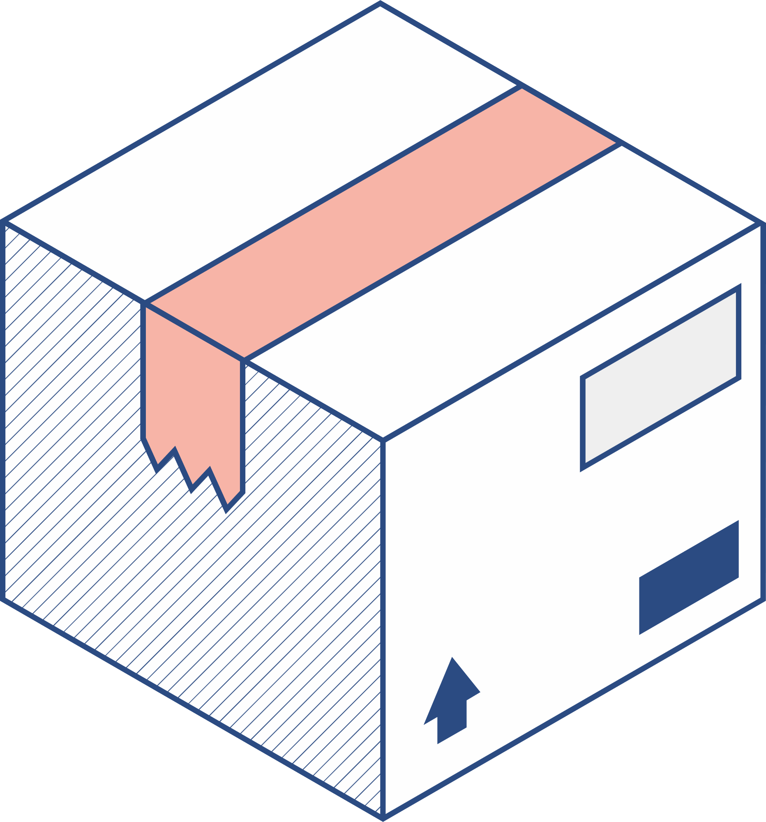
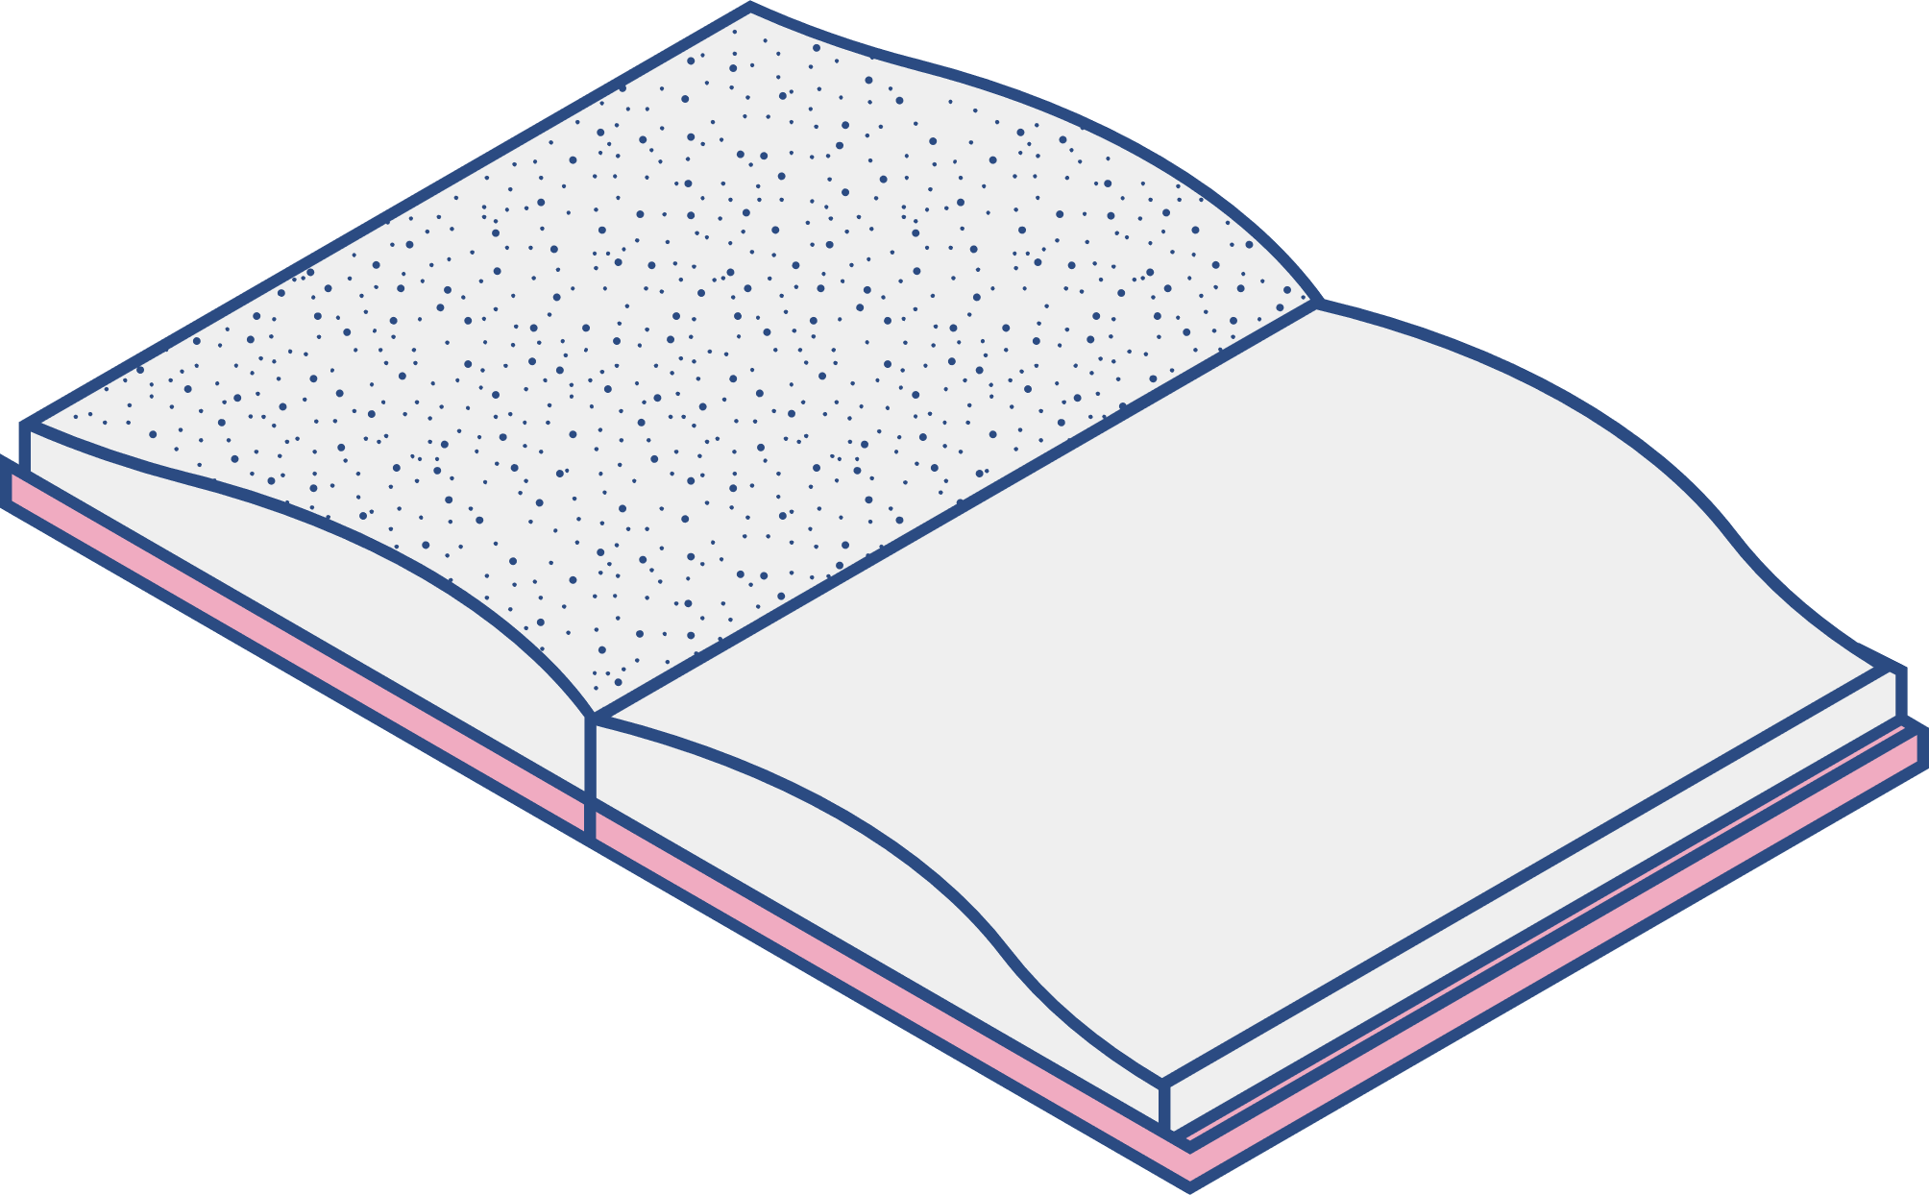
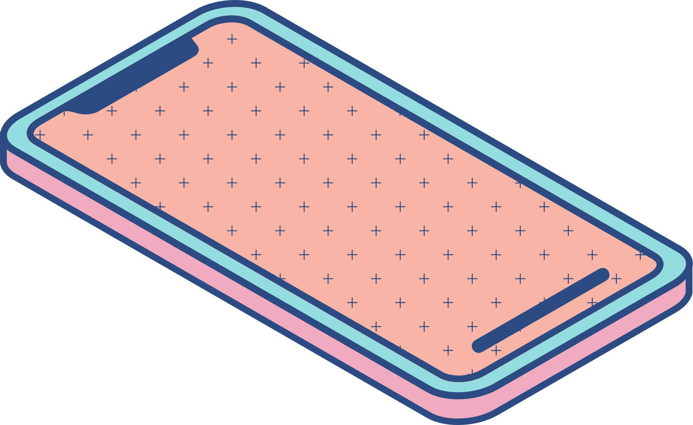
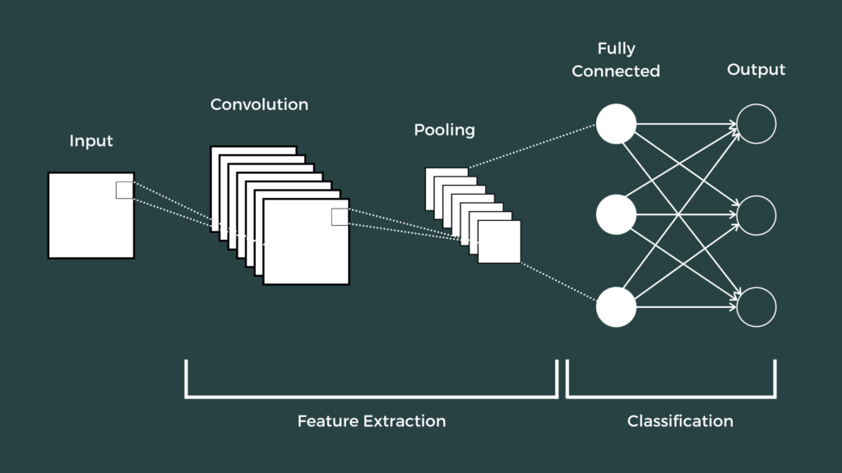
CNN
Applied most in Computer Vision
Reduce size of images and learn multiple level of information for raw images
Pure CNN with naïve convolution may too slow

Slide 5
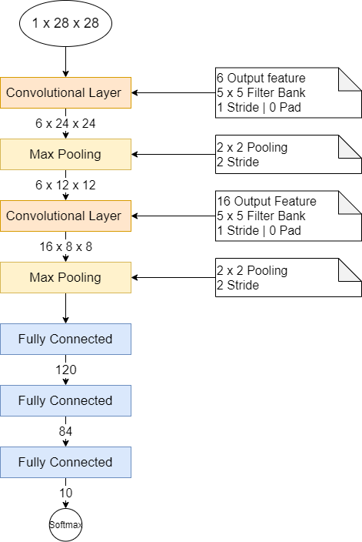
Implemented CNN Models
The most simple CNN models: based on LeNet-5
Assumption: Only deal with Stride = 1 and No padding

Slide 6
Implemented CNN Models
Developing from mini-dnn-cpp project
List of done works:
Install simplified sequential version of forward of Convolution layer (Conv. layer)
Parallelize the forward of Conv. layer with two versions, using basic CUDA API and techniques.

Slide 7
SEQUENTIAL IMPLEMENTATION

Slide 8
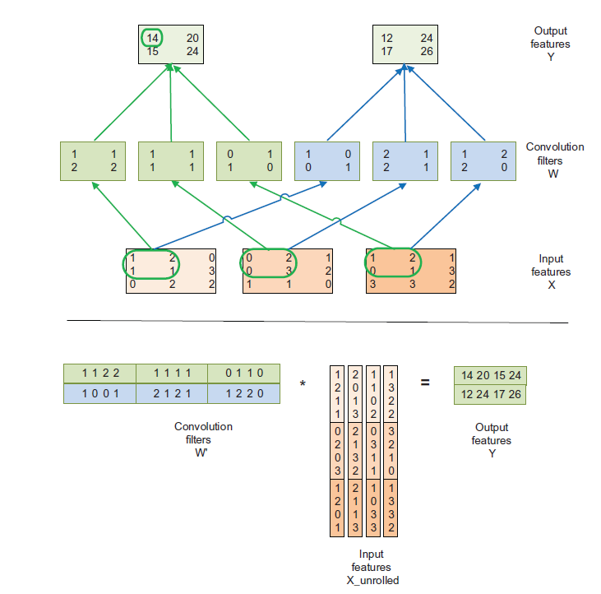
Conv. Layer Parallel with Input Unrolling and Matrix Multiplication

Slide 9
Unroll the Input Matrix
For each input-feature c
For each element e in filter-area
For each filter-area f possible in c
unroll[h_unroll][w_unroll] <- input[c][e][f]

Slide 10
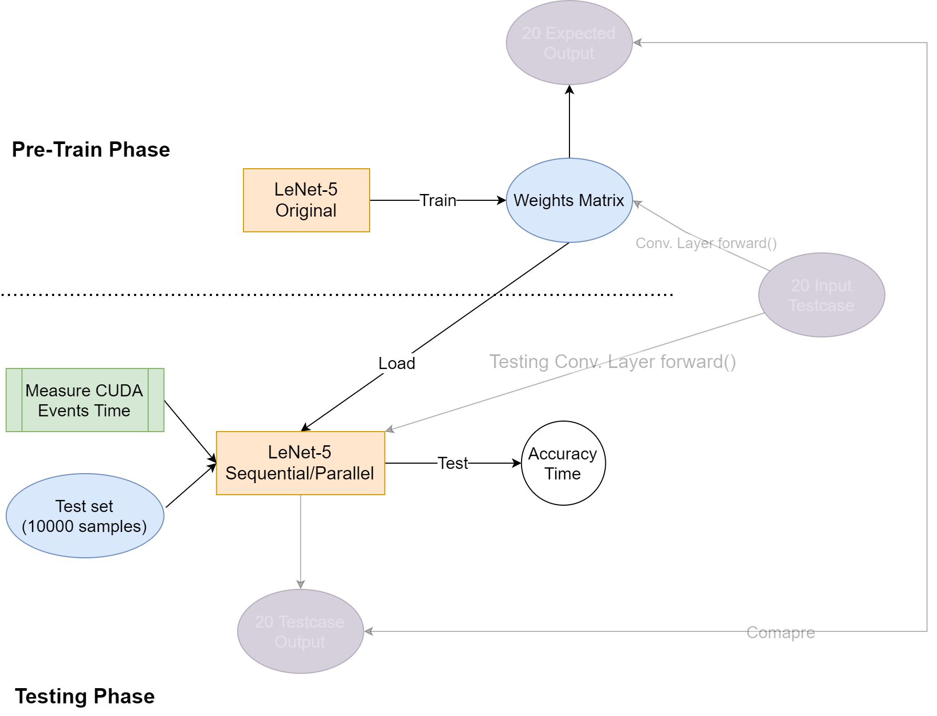
Flow Experiments

Slide 11
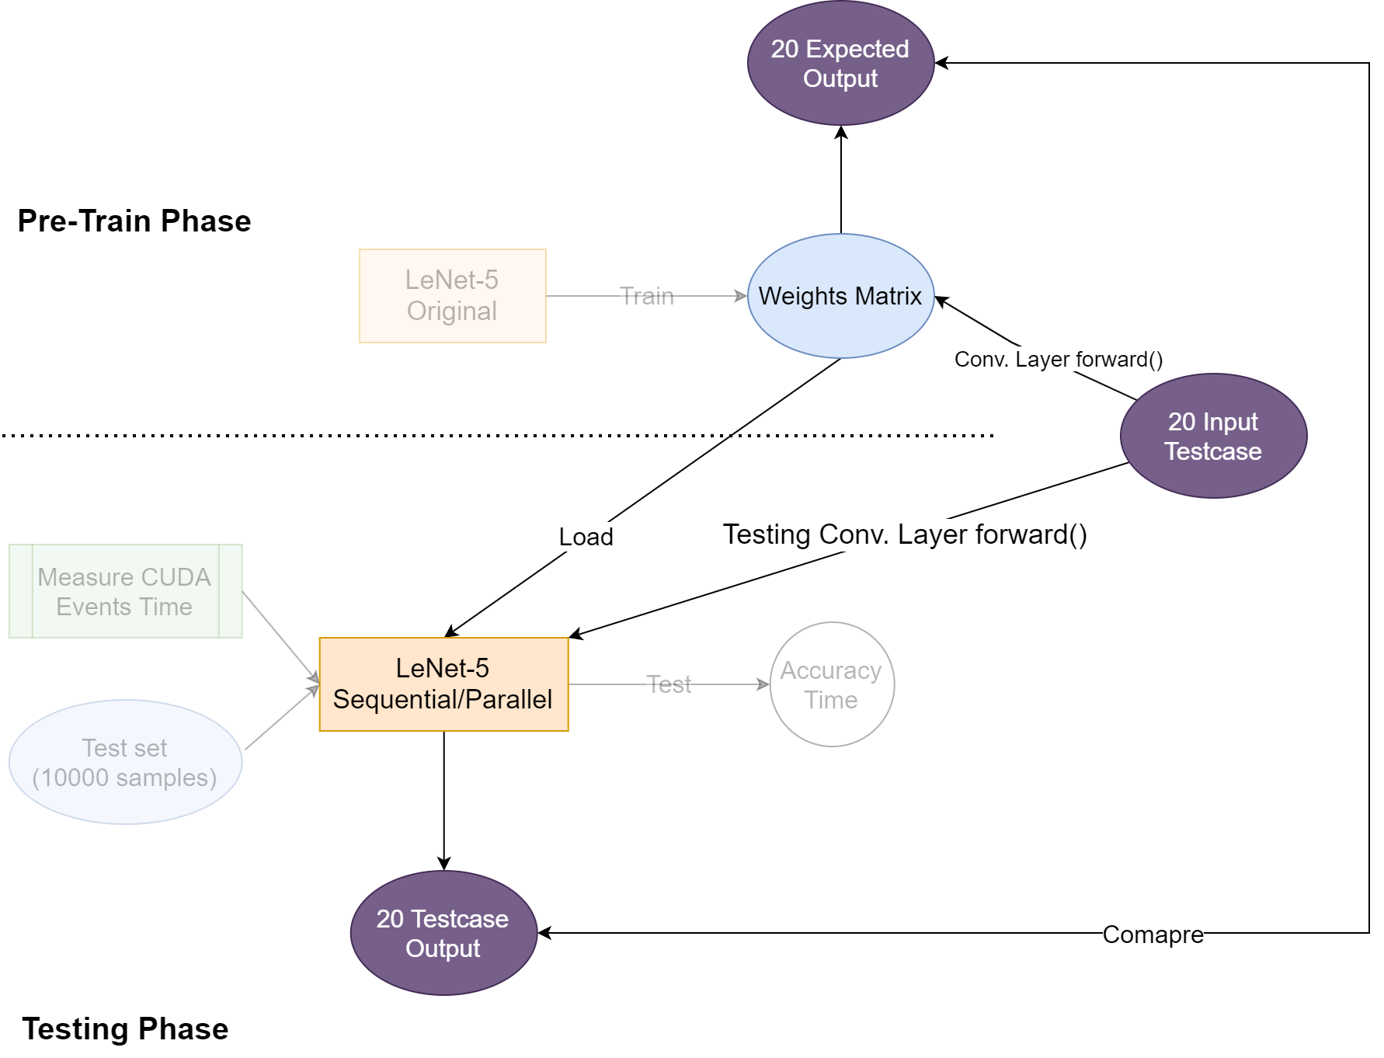
Flow Experiments

Slide 12
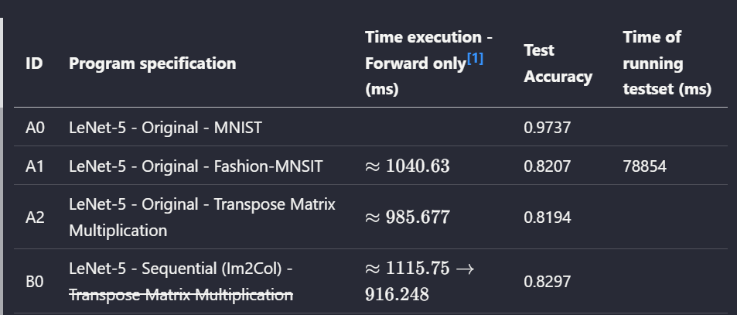
Sequential Results

Slide 13
PARALLEL VERSION 1.0

Slide 14
Idea
- Each thread fills a filter area of a channel input feature.

Slide 15
Technical
- Using 1D grid.
- Number of threads: C * Width_out * Height_out
- Block size: 1024

Slide 16
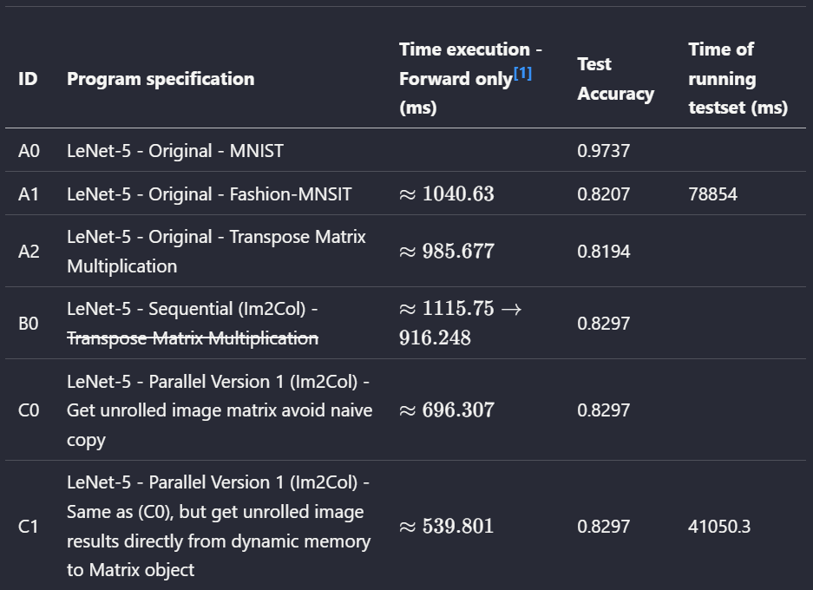
Version 1.0 Results

Slide 17
PARALLEL VERSION 2.0

Slide 18
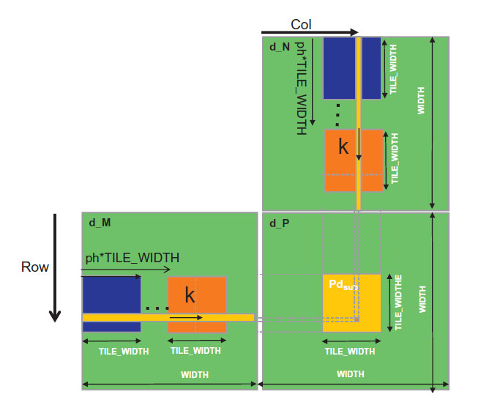
Idea
- Parallel Matrix Multiplication
- Using titling and shared memory

Slide 19
Technical
- Using 2D grid. Only the position on grid that computes valid result elements can be computed.
- Block size and TILE_WIDTH: 32

Slide 20
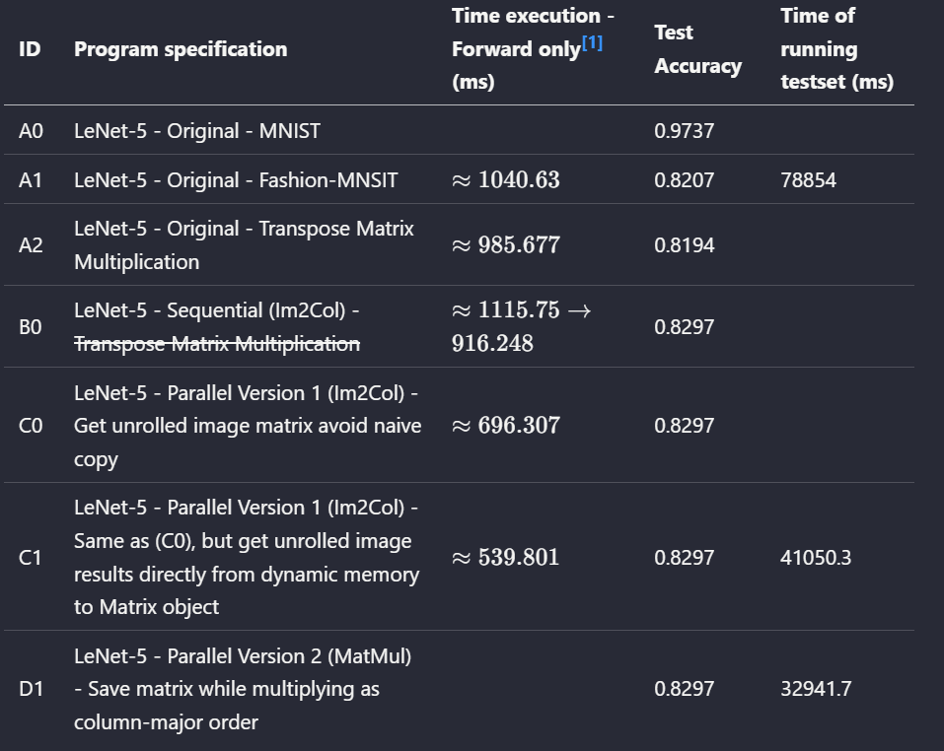
Version 2.0 Results

Slide 21
MICS.

Slide 22
Challenges
- Eigen used column-major order: need to deal carefully to avoid copying data between Matrix

Slide 23
Further Developments
- Careful check the memory access in CUDA operation in forward of Conv. layer.
- Apply Streams parallel.
- Apply cuDNN for Matrix Multiplication or parallelize other layers.

