Slide 1

CUTTING STOCK 2D
REINFORCEMENT LEARNING
Group 3
AI17C
FPT University
Mar 24 2025

Slide 2





MEMBERS
Ha Khai Hoan
Nguyen Quoc Vuong
Nguyen Van Thu
Dang Phuc Bao Chau
Nguyen Van Sy Thinh

Slide 3

CONTENT
I
PROJECT OVERVIEW
II
IMPLEMENTATION
III
CONCLUSION

Slide 4
I. PROJECT OVERVIEW

Slide 5
PROJECT OVERVIEW
1
PROBLEM – CASE STUDY
2
CONSTRAINTS - INPUT & OUTPUT DATA
3
Input & Output Data

Slide 6
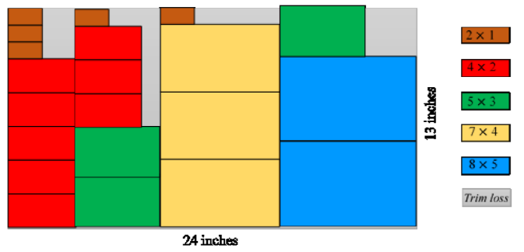




1 PROBLEM – CASE STUDY
Cutting Stock Problem (2D) is an important optimization problem in many industries such as metal processing, wood manufacturing, glass cutting, textiles...
"Case Study: Optimizing Glass Cutting in Manufacturing"
Cutting large glass panels into smaller custom sizes presents material waste challenges.
Factories struggle with inefficient cutting layouts, increasing costs and waste.
📌Objective: Cut large raw material sheets into small pieces as required while minimizing material waste.
♻️ Practical application: Reduce production costs, optimize resources, protect the environment.

Slide 7
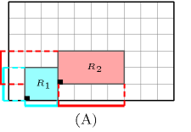
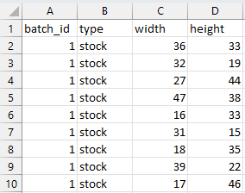
2 CONSTRAINTS - INPUT & OUTPUT DATA
#Constraints
Demand constraint: The number of cut products must meet the order demand.
Material usage constraint: The total area of ​​cut products must not exceed the size of the raw material.
No overlap constraint: The cut pieces must not overlap.
No large gap constraint: Minimize the gap between cut pieces.
Start from edge constraint: Cuts must start from the edge of the raw material sheet.
Start
(A): Two pieces R₁​ (blue) and R₂​ (red) are placed so that they do not overlap, with the dashed outline showing the space limit that each piece occupies.
#Input & output data
We created a test data set of 10 batches. Each batch contains 10 stocks with different product sizes, but ensures that the number of stocks is enough to cut all the required products.
Stock size set
Algorithm
Area Used
Average Surplus
Stock Used
Execution Time
1 batch
Product size set

Slide 8
3 TASK
SY THINH
HEURISTIC
KHAI HOAN
Q - LEARNING
VAN THU
PPO
BAO CHAU
ALGORITHM
Master
QUOC VUONG
DATA - REPORT

Slide 9
II. IMPLEMENTATION

Slide 10
IMPLEMENTATION
1
HEURISTIC ALGORITHMS
2
PPO APPROACH TO TRAINING A RL AGENT
3
Q - LEARNING

Slide 11
1 HEURISTIC ALGORITHMS
1.1
FIRST-FIT ALGORITHM
1.2
BEST-FIT ALGORITHM
1.3
COMBINATION ALGORITHM
1.4
RESULTS

Slide 12
1.1 FIRST-FIT ALGORITHM
The First-Fit 2D-CSP algorithm works as follows:
Initialize a list of raw material stocks with one stock of each type.
Iterate through the stocks, sorting by decreasing area.
Iterate through the products, sorting by decreasing area:
If the current stock fits → Insert.
If it doesn't fit → Create a new stock that is smallest enough to hold the product.
If there are enough products needed, remove from the list.
p1
p2
p3
p3
p3
…
p3
…
STOCKS:
s1
s2
s3
s4
PRODUCT:
p1
p2
p3
p4
p5

Slide 13



1.2 BEST-FIT ALGORITHM
p1
s2
p1
The Best-Fit 2D-CSP algorithm works as follows:
Sort the products in descending order of area.
Iterate through each product:
Find the raw material plate with the least excess area after placing the product.
If found → Place the product there.
If not → Create a new plate and place the product there.
Update the plate list and remove the product after it is placed.
Return the list of used plates.
p1
p1
s1
p1
p1
STOCKS:
PRODUCT:
p1
p2
p3
p4
p5

Slide 14
1.3 COMBINATION ALGORITHM
step1
step2
The Combination 2D-CSP algorithm works as follows:
Cut the product from the raw material plate:
Iterate through the raw material plates (in decreasing order of area).
Iterate through the products (in decreasing order of area).
Find the position (x, y) where the product can be cut with the smallest area coverage.
Cut the product at that optimal position.
Assemble the excess part to another plate:
Iterate through the cut plates (from small to large).
If the excess part is smaller than the uncut plate, assemble it to the larger plate.
p1
p2
p3
p1
p2
p3
p4
p5
p4
p5
p5
area 2
area 1
area 1 > area 2
s2
s1
s3
s4
s5
STOCKS:
s2
s3
s4
PRODUCT:
p2
p3
p1
p4
p5

Slide 15
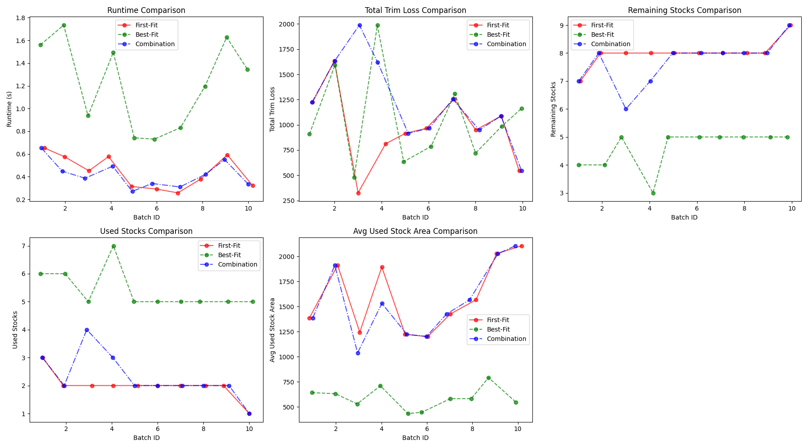
1.4 RESULTS
Best-Fit is the most efficient in minimizing trim loss but comes at the cost of significantly higher runtime and more stock usage.
First-Fit and Combination are computationally efficient but may lead to slightly higher trim loss.
Combination performs similarly to First-Fit, with some variations in total trim loss and used stock area.

Slide 16
2 PPO APPROACH TO TRAINING A RL AGENT
2.1
...
2.2
…
3.3
…

Slide 17
3 Q - LEARNING
3.1
…
3.2
…
3.3
…

Slide 18

3 DEMONSTRATION

Slide 19
III. CONCLUSION

Slide 20

CONCLUSION

Slide 21
THANK YOU
FOR WATCHING

