Slide 1
Databinding
TypeScript code
(Logic)
Fetched from a server
Calculation results
Template(HTML)
Button click
Output Data
Text interpolation: {{data}}
Property binding: [property]=“data”
React to (User) Events
Event binding: (event)=“expression”
Ex: button click
Combination of both➔Two-way-binding: [(ngModel)]=“data”

Slide 2
Databinding
範例:建立伺服器
Text interpolation : 顯示目前伺服器內容
Property binding: 更改按鍵狀態，目前是否可以新增伺服器(disable)
Event binging: 使用者在頁面按下按鍵後，建立伺服器
Two-way binding: 使用者輸入的伺服器名稱，按下建立後，顯示名稱
*https://angular.io/guide/interpolation

Slide 3
Databinding
1. Text interpolation文字插值
( Server with ID ?? Is ??)
Any expression which can be resolved to a string in the end, that the only condition for a string interpolation syntax here.
With interpolation, Angular performs the following tasks:
Evaluates all expressions in double curly braces.
Converts the expression results to strings.
Links the results to any adjacent literal strings. 將這些結果結合相鄰的字串文字中。
Assigns the composite to an element or directive property.
<p>The sum of 1 + 1 is not {{1 + 1 + getVal()}}.</p>
<!-- "The sum of 1 + 1 is not 4" -->
Angular 官網範例 getVal() ➔ return 2
*https://angular.io/guide/interpolation

Slide 4
Databinding
1. Text interpolation
In .ts file
serverID: number = 10;
serverStatus: string = 'offline’
getServerStatus(){
return 'offline';
}
In .html file
<p>
{{'Server'}} with ID {{serverID}} is {{getServerStatus()}}
</p>
<p>
{{'Server'}} with ID {{serverID}} is {{serverStatus}}
</p>
*https://angular.io/guide/interpolation

Slide 5
Databinding
1. Text interpolation
You can't use JavaScript expressions that have or promote side effects, including:
Assignments (=, +=, -=, ...)
Operators such as new, typeof, or instanceof
Chaining expressions with ; or ,
The increment and decrement operators ++ and --
Some of the ES2015+ operators
Other notable differences from JavaScript syntax include:
No support for the bitwise operators such as | and &
New template expression operators, such as |, ?. and !
*https://angular.io/guide/interpolation

Slide 6
Databinding
2. Property binding
更改按鍵狀態，目前是否可以新增伺服器(disable)
User square brackets around HTML attributes
In Angular, the only role of HTML attributes is to initialize element and directive state.
When you write a data binding, you're dealing exclusively with the DOM properties and events of the target object.
In .html file
<button class="btn btn-primary" [disabled]="allowNewServer">Add server</button>
In .ts file
setTimeout(() => {
this.allowNewServer = true;
}, 2000)

Slide 7
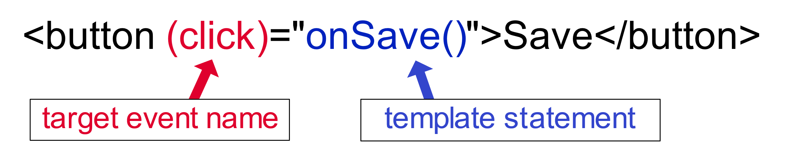
Databinding
3. Event binding
Event provided? ➔a good idea is to console.log() the element you're interested in to see which properties and events it offers.
onclick➔click
使用小括號
In .html file
<button class="btn btn-primary" [disabled]="!allowNewServer" (click)="onCreateServer()">Add
server</button>
In .ts file
onCreateServer() {
this.serverCreationStatus = 'Server was created'
}
*https://developer.mozilla.org/en-US/docs/Web/HTML/Element/button
*https://developer.mozilla.org/en-US/docs/Web/Events

Slide 8
Databinding
4. Two-Way-Binding
Input，使用者輸入，立即顯示輸入內容
Important: For Two-Way-Binding (covered in the next lecture) to work, you need to enable the ngModel directive.
You need to add the import from @angular/forms in the app.module.ts file:import { FormsModule } from '@angular/forms’;
This is done by adding the FormsModule to the imports[] array in the AppModule.

Slide 9
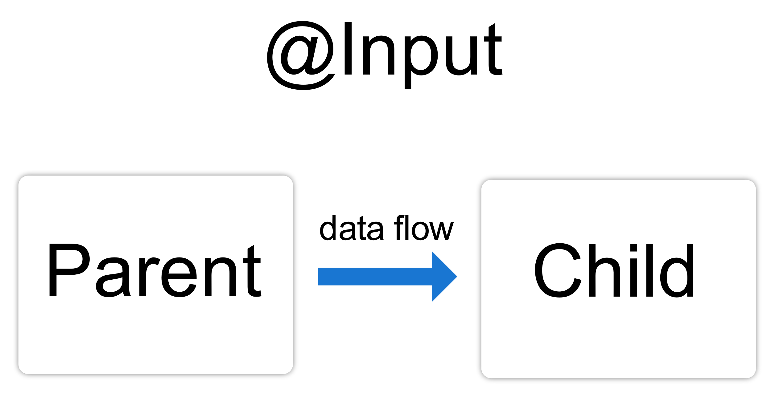
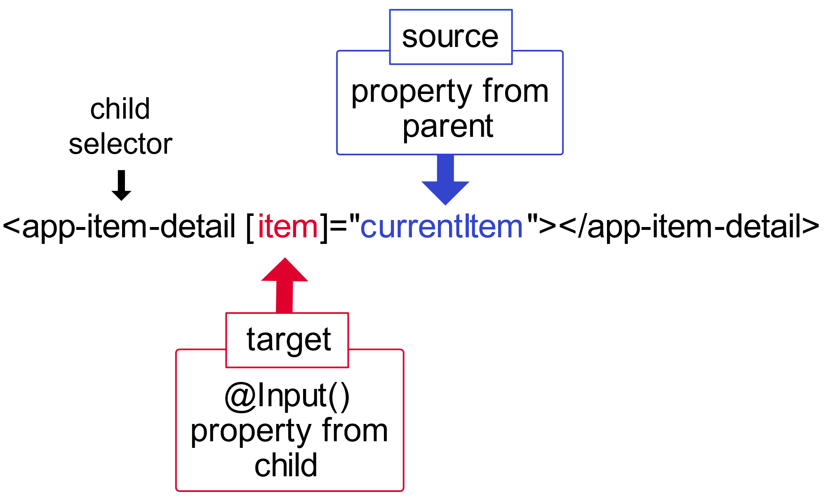
Databinding
4. Two-Way-Binding－show interpretations base on input and output decorator
The @Input() decorator in a child component or directive signifies that the property can receive its value from its parent component.
import {Input } from '@angular/core'; // First, import Input
@Input() item = ‘’; // decorate the property with @Input() ➔ in child component.ts file
Use the variable {{item}} in template
User child component selector app-child ➔<app-child [item]="currentItem"></app-child>
Set variable currentItem in parent.component.ts

Slide 10
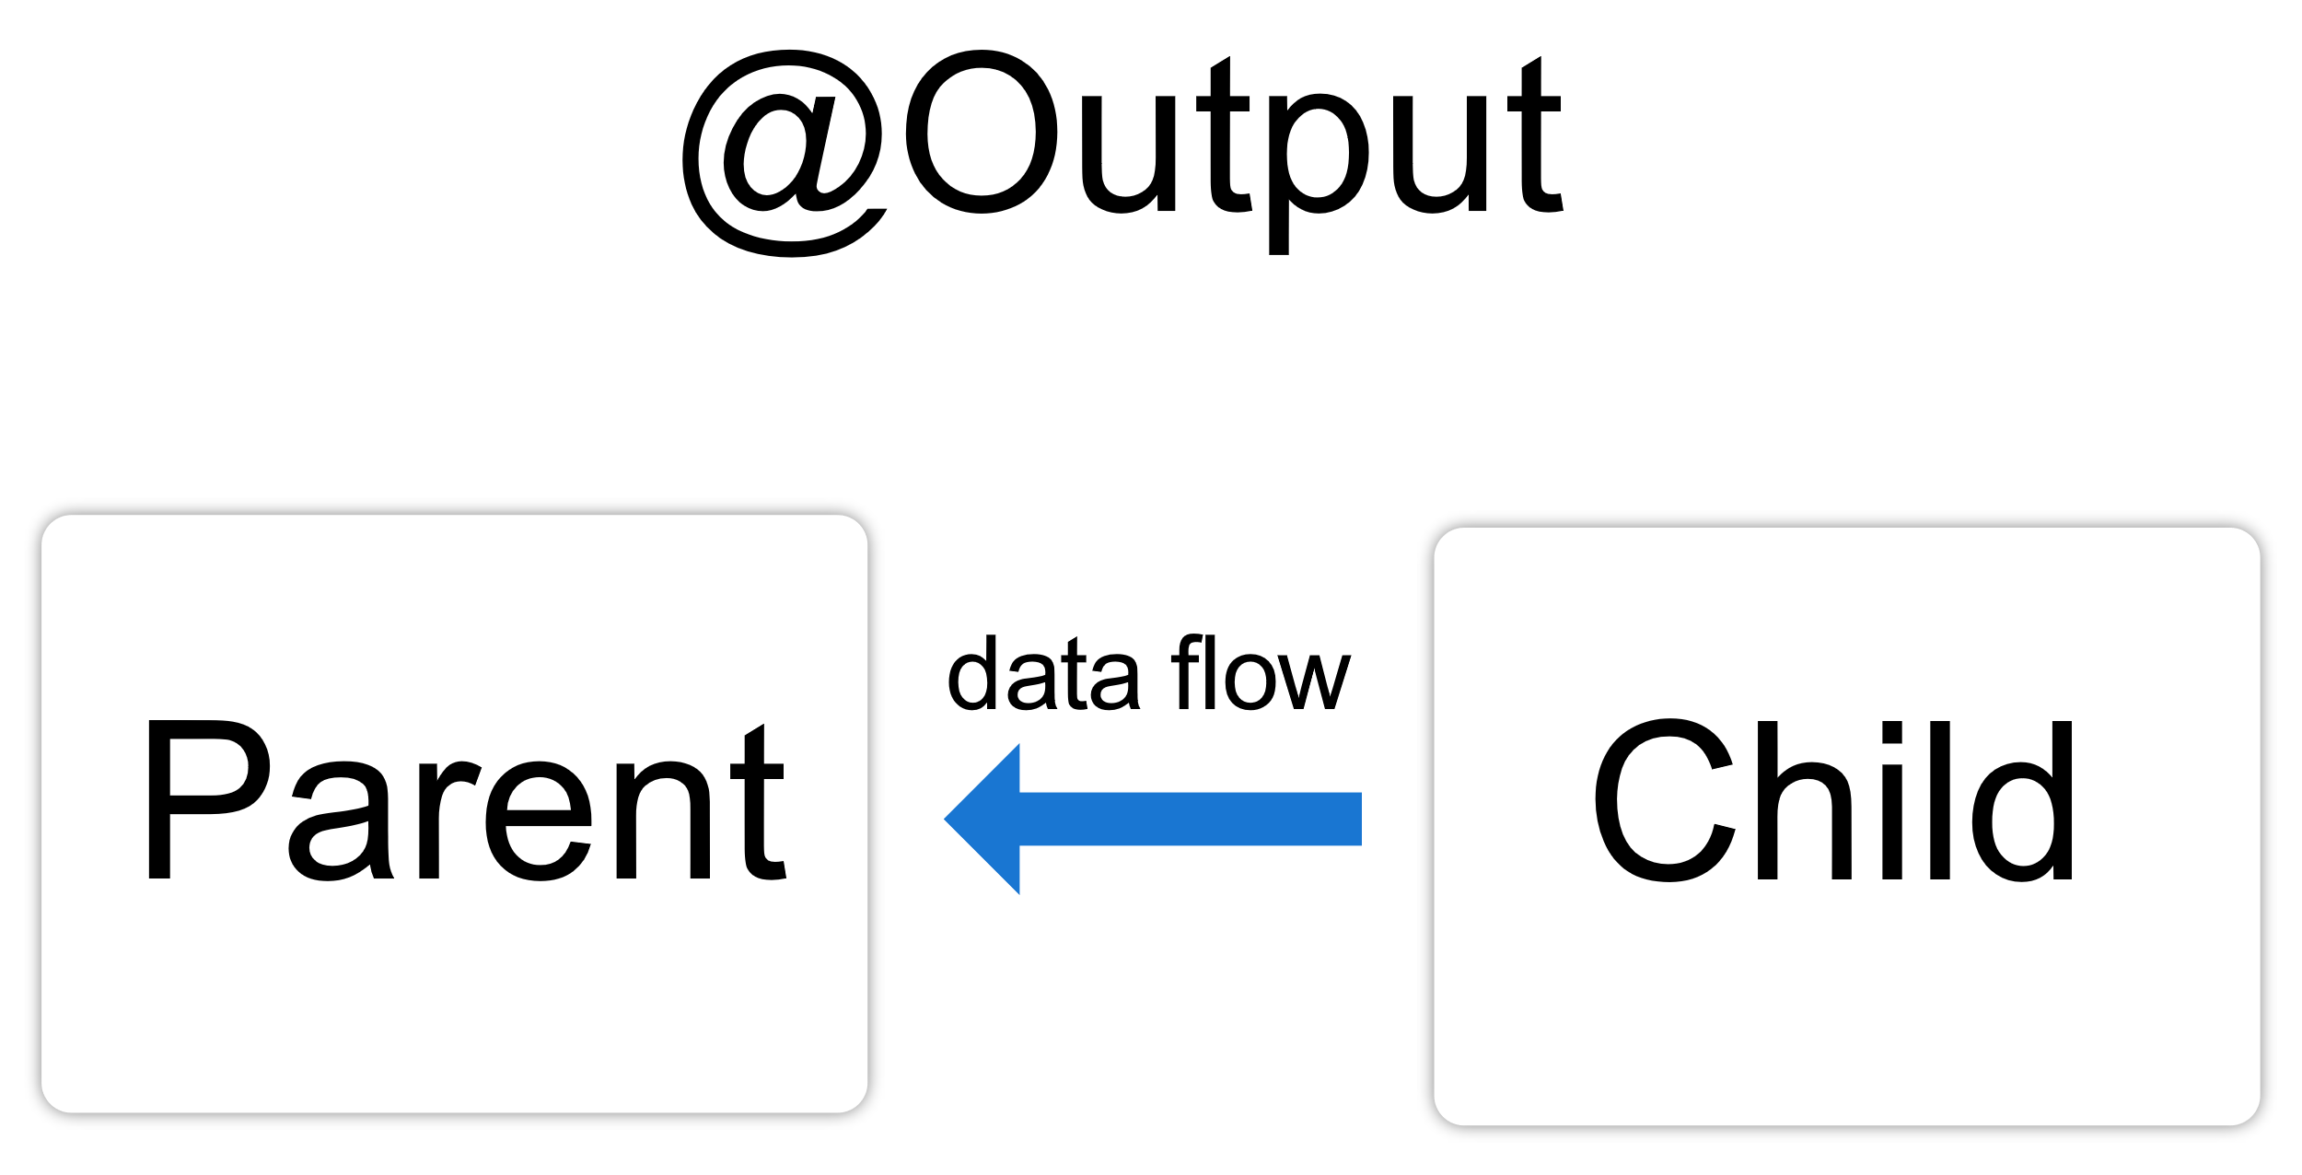
Databinding
4. Two-Way-Binding－show interpretations base on input and output decorator
The @Output() decorator in a child component or directive lets data flow from the child to the parent.
In child component.ts
import { Output, EventEmitter } from '@angular/core’;
@Output() newItemEvent = new EventEmitter<string>();
addNewItem(value: string) { this.newItemEvent.emit(value); }
In child component.html
<label for="item-input">Add an item:</label>
<input type="text" id="item-input" #newItem>
<button type="button" (click)="addNewItem(newItem.value)">Add to parent's list</button>
In parent component.ts
items = ['item1', 'item2', 'item3', 'item4']; addItem(newItem: string) { this.items.push(newItem); }
In parent component.ts
<app-item-output (newItemEvent)="addItem($event)"></app-item-output>
<ul> <li *ngFor="let item of items">{{item}}</li> </ul>

Slide 11
Databinding
4. Two-Way-Binding－show interpretations base on input and output decorator
Use @Input() and @Output() on the same child component as follows:
@Input ngModel;
@Output ngModelChange = new EventEmitter<string>();

Slide 12
補充
設定開啟參數在幾個地方被參考
typescript.referencesCodeLens.enabled
typescript.implementationsCodeLens.enabled

