Slide 1
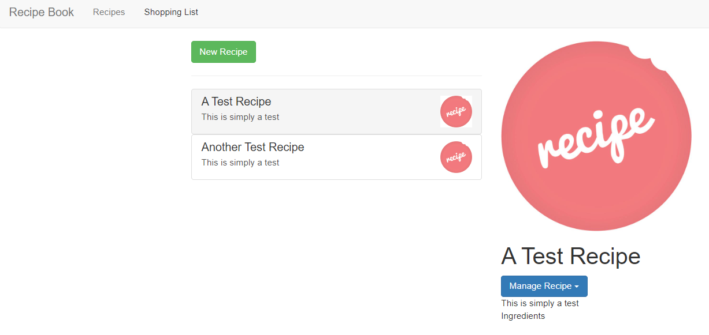
Recipe-list.component
Recipes.component
Recipe-item.component
Recipe-detail.component

Slide 2
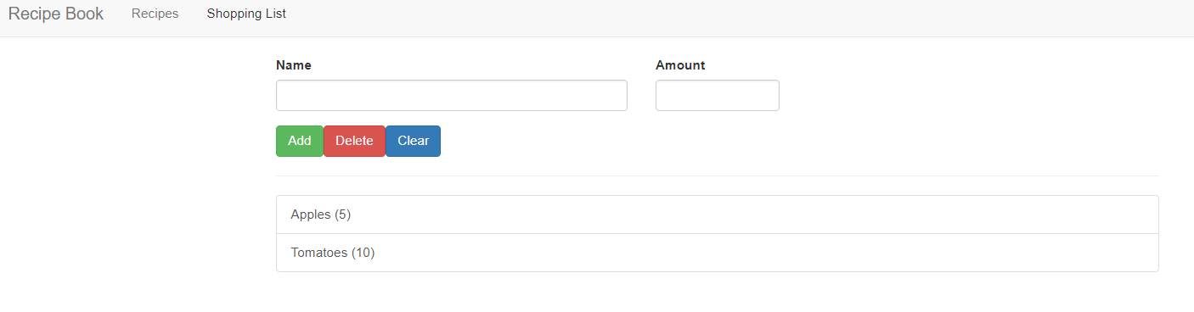
shopping-list-edit.component
shopping-list.component

Slide 3
App
ingredient.module
Header
Recipe
Shopping-list
Recipe-detail
Recipe-list
Shopping-list-edit
Recipe-item

Slide 4
項目
在recipe-list中，顯示recipes資料。
將在recipe-item的click後的選項，顯示在recipe-detail上。
將shopping-list的資料，顯示到shopping-list上。
將shopping-list-edit的新增資料，顯示到shopping-list上。
將recipe-detail中的資料，傳遞到shopping-list上。
App
Recipes data
Recipe
Shopping-list
Shopping lists data
Recipe-detail
Recipe-list
Shopping-list-edit
Recipe-item

Slide 5
Services
透過service，在recipe-list中，顯示recipes data。
1. 在recipe資料夾，用手動建立recipe.service.ts檔案。
2. 在shopping-list資料夾，用手動建立shpping-list.service.ts。
export class RecipeService{
}
順便建立shopping-list service
export class ShoppingListService{
}

Slide 6
Services
透過service，在recipe-list中，顯示recipes資料。
3. 先進行recipe.service.ts
Manage our recipes。將在recipe-list.component.ts的recipes:Recipe[]=[];複製到recipe-service中，並引入Recipe
import { Recipe } from "./recipe.model";
export class RecipeService{
private recipes: Recipe[] = [
new Recipe('', ''),
new Recipe('', '', '')
]; getRecipes(){
return this.recipes.slice(); //不回傳原始資料
} }

Slide 7
Services
透過service，在recipe-list中，顯示recipes資料。
4. 在recipes.component.ts中使用providers:[RecipeService]，並引入。
recipes.component.ts和它的child component分享同一個實例
In recipes.component.ts
providers:[RecipeService]
5. 在recipe-list.component.ts中，取得service資料
In recipes-list.component.ts
recipes: Recipe[];
constructor(private recipeService:RecipeService) { }
ngOnInit() {
this.recipes=this.recipeService.getRecipes();
}

Slide 8
Services
透過service，在recipes和子元件傳遞資料
之前作法是，使用decorator input和output傳遞資料
➔(@Output)在recipe-item元件中，透過(variable recipeSelected)EventEmitter傳遞event到recipe-list元件，再用同樣的方式(variable recipeWasSelected)EventEmitter傳遞到recipes元件。
<app-recipe-item
*ngFor="let recipeEl of recipes"
[recipe]="recipeEl"
(recipeSelected)="onRecipeSelected(recipeEl)"></app-recipe-item>
<app-recipe-list (recipeWasSelected)="selectedRecipe = $event"></app-recipe-list>
再使用(@Input)，從recipes.component.ts傳遞資料到recipe-detail.component.ts中
<app-recipe-detail
*ngIf="selectedRecipe; else infoText" [recipe]="selectedRecipe">
</app-recipe-detail>

Slide 9
Services
透過service，在recipes和子元件傳遞資料
目標: 當在recipe-item中，選擇item之後，直接透過recipe-detail顯示，不透過中間的components
在recipe-item.component.ts中，將之前的一些 Output decorator刪掉
➔刪除recipe-item的@Output
➔將onSelected(){ } 中的方法改成由recipe.service.ts更改資訊
➔在constructor中，宣告recipeService。(等2做完)
export class RecipeItemComponent implements OnInit {
@Input() recipe: Recipe;
constructor(private recipeService:RecipeService) { }
ngOnInit() {
}
onSelected() {
this.recipeService.recipeSelected.emit(this.recipe)
}
}

Slide 10
Services
透過service，在recipes和子元件傳遞資料
目標: 當在recipe-item中，選擇item之後，直接透過recipe-detail顯示，不透過中間的components
在recipe.service.ts中
➔宣告一個新的事件，來接收recipe-item中，onSelected()傳遞的方法
import { EventEmitter } from "@angular/core";
import { Recipe } from "./recipe.model"; export class RecipeService{ recipeSelected=new EventEmitter<Recipe>(); private recipes: Recipe[] = [
new Recipe('', '', ''),
new Recipe('', '', '')
]; getRecipes(){
return this.recipes.slice(); //不回傳原始資料
} }

Slide 11
Services
透過service，在recipes和子元件傳遞資料
目標: 當在recipe-item中，選擇item之後，直接透過recipe-detail顯示，不透過中間的components
3. 在recipe-list.component中
➔刪除.html的(recipeSelected)="onRecipeSelected(recipeEl)"
➔刪除.ts的
onRecipeSelected(recipe: Recipe) {
this.recipeWasSelected.emit(recipe);
}
@Output() recipeWasSelected = new EventEmitter<Recipe>();
import {EventEmitter, Output } from '@angular/core';

Slide 12
Services
透過service，在recipes和子元件傳遞資料
目標: 當在recipe-item中，選擇item之後，直接透過recipe-detail顯示，不透過中間的components
3. 在recipe.component中
➔刪除.html的方法
<app-recipe-list (recipeWasSelected)="selectedRecipe = $event"></app-recipe-list>
➔在.ts中，使用recipeService獲取在recipe-item中觸發的事件
constructor(private recipeService:RecipeService) { }
ngOnInit() {
this.recipeService.recipeSelected.subscribe(
(recipe:Recipe)=>{
this.selectedRecipe=recipe;
}
)
}

Slide 13
Services
透過service，將shopping-list-edit的資料，顯示到shopping-list上
將shopping-list中的ingredients資料，複製到shopping.service.ts中
import { Ingredient } from "../shared/ingredient.model";
export class ShoppingListService{
private ingredients: Ingredient[] = [
new Ingredient('Apples', 5),
new Ingredient('Tomatoes', 10),
];
getIngredients(){
return this.ingredients.slice();
}
}

Slide 14
Services
透過service，將shopping-list-edit的資料，顯示到shopping-list上
2. 在app.module.ts，在providers中宣告shoppingService
providers: [ShoppingListService],
這樣在整個component中，都可以使用這個shoppingListService(同一個實例)，因為之後的應用會在其他service注入此service，所以在app.module.ts中宣告。
3. 在shopping-list.component.ts中使用service
ingredients: Ingredient[];
constructor(private slService:ShoppingListService) { }
ngOnInit() {
this.ingredients=this.slService.getIngredients()
}

Slide 15
Services
透過service，將shopping-list-edit的新增資料，顯示到shopping-list上
目標: 原本在edit中，新增的資料會透過EventEmitter傳遞到list中，現在要透過service處理
之前作法是，使用decorator output傳遞資料
➔(@Output)在edit元件中，透過(variable ingredientAdded)EventEmitter傳遞event到list元件。
@Output() ingredientAdded = new EventEmitter<Ingredient>();
onAddItem() {
.
.
.
this.ingredientAdded.emit(newIngredient);
}
<app-shopping-edit (ingredientAdded)="onIngredientAdded($event)">
</app-shopping-edit>

Slide 16
Services
透過service，將shopping-list-edit的新增資料，顯示到shopping-list上
在service中，增加新增的方法
addIngredient(ingredient:Ingredient){
this.ingredients.push(ingredient)
}
2. 在shopping-list-edit.component.ts中，
➔刪除 this.ingredientAdded.emit(newIngredient);
➔刪除 @Output() ingredientAdded = new EventEmitter<Ingredient>();
➔刪除 import { EventEmitter, Output} from '@angular/core’;

Slide 17
Services
透過service，將shopping-list-edit的新增資料，顯示到shopping-list上
2. 在shopping-list.component.html中，
➔刪除 <app-shopping-edit (ingredientAdded)="onIngredientAdded($event)"></app-shopping-edit>
3.在shopping-list.component.ts中，
➔刪除
onIngredientAdded(ingredient: Ingredient) {
this.ingredients.push(ingredient);
}
~要在service操作

Slide 18
Services
透過service，將shopping-list-edit的新增資料，顯示到shopping-list上
4. 在shopping-list-edit.component.ts中，
宣告service，並在onAddItem(){}中，使用在service中的addIngredient()
constructor(private slService:ShoppingListService) { }
ngOnInit() {
}
onAddItem() {
const ingName = this.nameInputRef.nativeElement.value;
const ingAmount = this.amountInputRef.nativeElement.value;
const newIngredient = new Ingredient(ingName, ingAmount);
this.slService.addIngredient(newIngredient)
}

Slide 19
Services
透過service，將shopping-list-edit的新增資料，顯示到shopping-list上
4. In shopping-list.service，因為在service中，return的資料是透過slice()，並沒有及時回傳更新後的資料，因此使用EventEmitter來更新，新增後的資料。
ingredientChanged=new EventEmitter<Ingredient[]>();
private ingredients: Ingredient[] = [
new Ingredient('Apples', 5),
new Ingredient('Tomatoes', 10),
];
getIngredients(){
return this.ingredients.slice();
}
addIngredient(ingredient:Ingredient){
this.ingredients.push(ingredient);
this.ingredientChanged.emit(this.ingredients.slice())
}

Slide 20
Services
透過service，將shopping-list-edit的新增資料，顯示到shopping-list上
5. 在shopping-list.component.ts中，因為新增資料後，目前取得的資料方式沒有同步更新，因此使用訂閱的方式取得資料。
ngOnInit() {
this.ingredients = this.slService.getIngredients();
this.slService.ingredientChanged.subscribe(
(ingredients: Ingredient[]) => {
this.ingredients = ingredients;
}
)
}

Slide 21
Services
透過service，將recipe中的資料，傳遞到shopping-list。
1. 修改recipe.model.ts檔案，增加ingredient model
import { Ingredient } from './../shared/ingredient.model';
export class Recipe {
public name: string;
public description: string;
public imagePath: string;
public ingredients: Ingredient[]
constructor(name: string, desc: string, imagePath: string, ingredients: Ingredient[]) {
this.name = name;
this.description = desc;
this.imagePath = imagePath;
this.ingredients=ingredients;
}
}

Slide 22
Services
透過service，將recipe中的資料，傳遞到shopping-list
2. 修改recipe.service.ts中的資料格式，新增ingredient資料
private recipes: Recipe[] = [
new Recipe(
'A Test Recipe',
'This is simply a test',
'https://upload.wikimedia.org/wikipedia/commons/1/15/Recipe_logo.jpeg',
[
new Ingredient('meat',1),
new Ingredient('French fires',20)
]),
new Recipe('Another Test Recipe',
'This is simply a test',
'https://upload.wikimedia.org/wikipedia/commons/1/15/Recipe_logo.jpeg',
[
new Ingredient('Buns',22),
new Ingredient('Meat',20)
])
];

Slide 23
Services
透過service，將recipe中的資料，傳遞到shopping-list
3. 修改recipe-detail.component.html中的顯示資料，新增ingredient
<ul class="list-group">
<li class="list-group-item" *ngFor="let ingredient of recipe.ingredients">
{{ingredient.name}} - {{ingredient.amount}}
</li>
</ul>

Slide 24
Services
透過service，將recipe中的資料，傳遞到shopping-list
4.增加recipe-detail.component.html中的To Shopping List的menu button功能
<ul class="dropdown-menu">
<li><a (click)="onAddToShoppingList()" style="cursor: pointer;">To Shopping List</a></li>
<li><a href="#">Edit Recipe</a></li>
<li><a href="#">Delete Recipe</a></li>
</ul>
5.在recipe-detail.component.ts中宣告recipeService，並且傳遞目前的ingredients資料
onAddToShoppingList(){
this.recipeService.addIngredientsToShoppingList(this.recipe.ingredients)
}

Slide 25
Services
透過service，將recipe中的資料，傳遞到shopping-list
5.在recipe.service.ts中，Inject shopping-list.service
➔新增 @Injectable()
➔新增 constructor(private slService:ShoppingListService){}
➔新增 addIngredientsToShoppingList(ingredients:Ingredient[]){
this.slService.addIngredients(ingredients);
}

Slide 26
Services
透過service，將recipe中的資料，傳遞到shopping-list
6.在shopping-list.service.ts中，新增接收來自recipe.service.ts的方法
addIngredients(ingredients:Ingredient[]){
this.ingredients.push(...ingredients);
this.ingredientChanged.emit(this.ingredients.slice())
}

