Slide 1
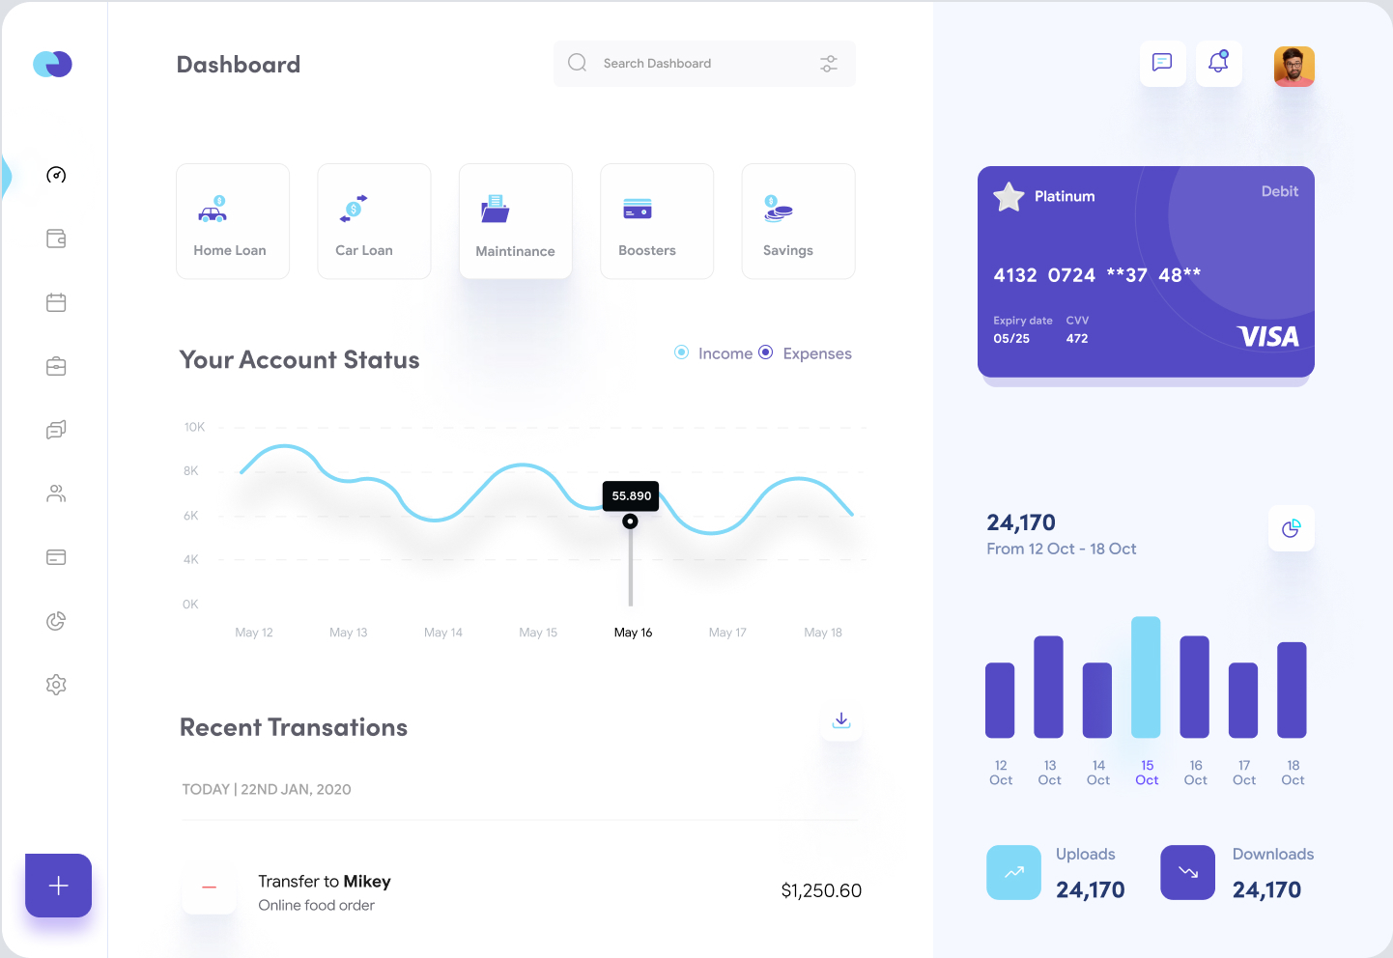
0.87 / 5.5%
1.1/ 5%
7.28/ 32%
2.71 / 17%
3.42 / 15%
#544ac4
#655cc9
5.68 / 36%
7.03 / 45%
0.75 / 3%
#ddf4fc
1.76/ 8%
13.55 / 59%
7.57 / 33%

Slide 2
dashboard
setting
navigation
news
dashboard_information

