Slide 1
CHAPTER 3 Requirements engineering good practices

Slide 2
Objectives
Student should enhance every stage in the requirement development process framework and how to implement these stages.
Student should obtain a wide range of good practice in software requirements to prepare for the next chapters
Need to help student understand these practices aren’t suitable for every situation, so use good judgment, common sense, and experience. Even the best practices need to be selected, applied, and adapted thoughtfully to appropriate situations by skilled business analysts.
Student must enhance that different practices might be most appropriate for understanding the requirements for different portions of a given project.
Use cases and user interface prototypes might help for the client side, whereas interface analysis is more valuable on the server side…etc.

Slide 3
Contents
Requirements engineering good practices
A requirements development process framework
Elicitation
Analysis
Specification
Validation
A representative requirements development process
Requirements management

Slide 4
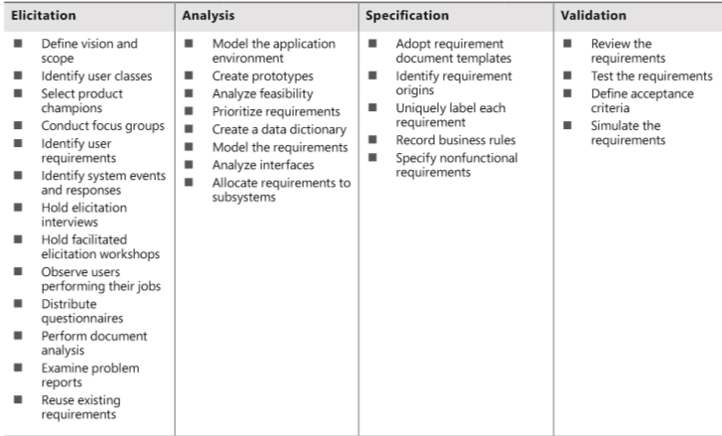
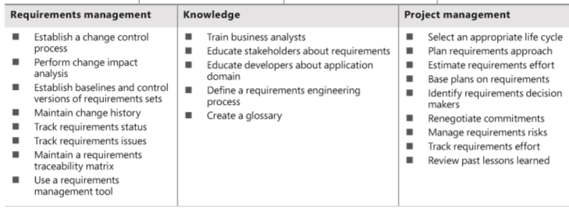
Requirements engineering good practices
Để ghi lại các yêu cầu trong tổ chức
Xđ nguồn gốc: đảm bảo các bên liên quan biết lý do tại sao

Slide 5
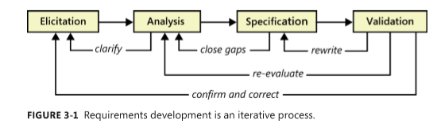
A requirements development process framework

Slide 6
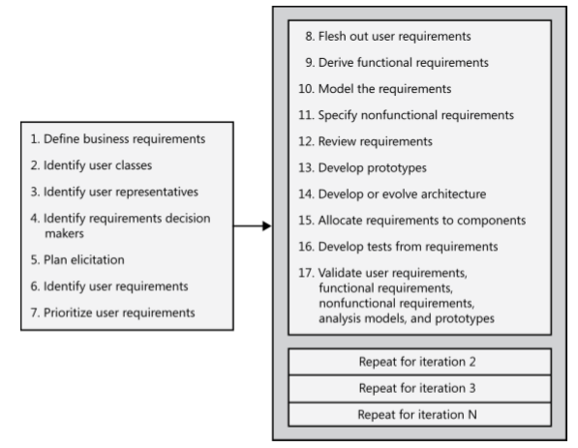
A representative requirements development process

Slide 7
Requirements elicitation
Define product vision and project scope
Identify user classes and their characteristics
Select a product champion for each user class
Conduct focus groups with typical users
Work with user representatives to identify user requirements
Identify system events and responses
Hold elicitation interviews
Hold facilitated elicitation workshops
Observe users performing their jobs
Distribute questionnaires
Perform document analysis
Examine problem reports of current systems for requirement ideas
Reuse existing requirements

Slide 8
Requirements analysis
Model the application environment
Create user interface and technical prototypes
Analyze requirement feasibility
Prioritize the requirements
Create a data dictionary
Model the requirements
Analyze interfaces between your system and the outside world
Allocate requirements to subsystems

Slide 9
Requirements specification
Adopt requirement document templates
Identify requirement origins
Uniquely label each requirement
Record business rules
Specify nonfunctional requirements

Slide 10
Requirements validation
Review the requirements
Test the requirements
Define acceptance criteria
Simulate the requirements

Slide 11
Requirements management
Establish a requirements change control process
Perform impact analysis on requirements changes
Establish baselines and control versions of requirements sets
Maintain a history of requirements changes
Track the status of each requirement
Track requirements issues
Maintain a requirements traceability matrix
Use a requirements management tool

Slide 12
Project management
Select an appropriate software development life cycle
Plan requirements approach
Estimate requirements effort
Base project plans on requirements
Identify requirements decision makers
Renegotiate project commitments when requirements change
Analyze, document, and manage requirements-related risks
Track the effort spent on requirements
Review lessons learned regarding requirements on other projects

Slide 13
Knowledge
Train business analysts
Educate stakeholders about requirements
Educate developers about the application domain
Define a requirements engineering process
Create a glossary

