Slide 1



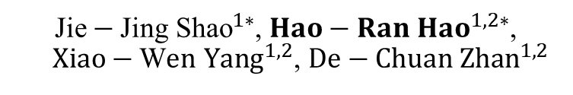
Abductive Learning for Neuro-Symbolic Grounded Imitation
${\text{Jie}−\text{Jing} \text{Shao}}^{1∗}$, ${Hao−Ran Hao}^{1,2∗}$, ${Xiao−\text{W}en Yang}^{1,2}$, ${\text{De}−\text{Chuan} \text{Zhan}}^{1,2}$
National Key Laboratory for Novel Software Technology, Nanjing University, China
School of Artificial Intelligence, Nanjing University, China

Slide 2
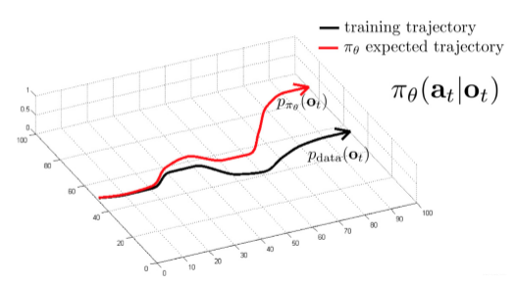
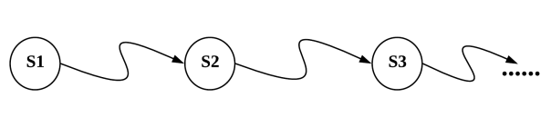
What is this work about
Long-Horizon Decision-Making is critical for embodied intelligence.
Imitation Learning
Shows promising performance on robotics and auto-driving.
Is limited in open environments, especially in the long-horizon tasks.
Traditional symbolic planning
Excels at long-horizon tasks via logical reasoning.
Typically abstracts away perception with ground-truth symbols,
struggles to map visual observations to human-defined symbolic spaces.
Imitation Learning
Symbolic planning
Such limitations restrict their application in Open environments.

Slide 3
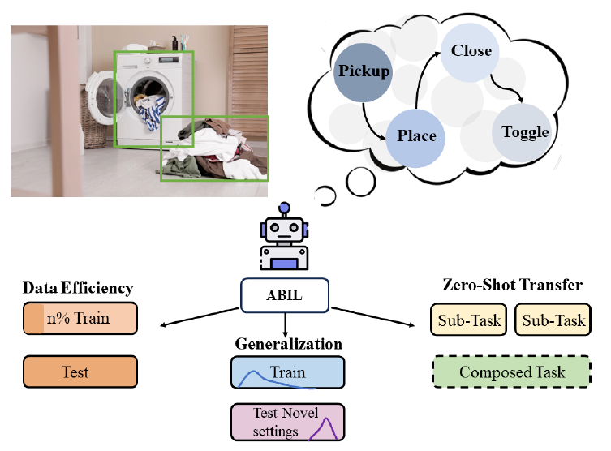
What is this work about
In this work, we propose a novel framework Abductive Imitation Learning (ABIL) to combine the benefits of data-driven learning and symbolic-based reasoning.
Our ABIL shows significantly improved performance on settings of data-efficiency and generalization in the open environments.

Slide 4
Outline
1. Background
2. ABIL Framework
3. Empirical Results
4. Conclusion

Slide 5

Long-Horizon Planning
Background
Previous Studies:
Imitation learning: is weak at long-horizon tasks
Symbolic Planning: requires symbolic-level grounding
Recent efforts on neuro-symbolic solutions[1,2,3]:
These methods typically assume there are sufficient symbolic information, or only applicable to low-dimensional robotics states.
Our Goal
Help the agent understand demonstrations in symbolic space from high-dimensional visual observations without symbolic-level label.
Enable long-term logical planning for imitation learning.
[1] Regression Planning Networks. NeurIPS’19
[2] Learning Symbolic Operators for Task and Motion Planning. IROS’21
[3] Programmatically grounded, compositionally generalizable robotic manipulation. ICLR’23

Slide 6
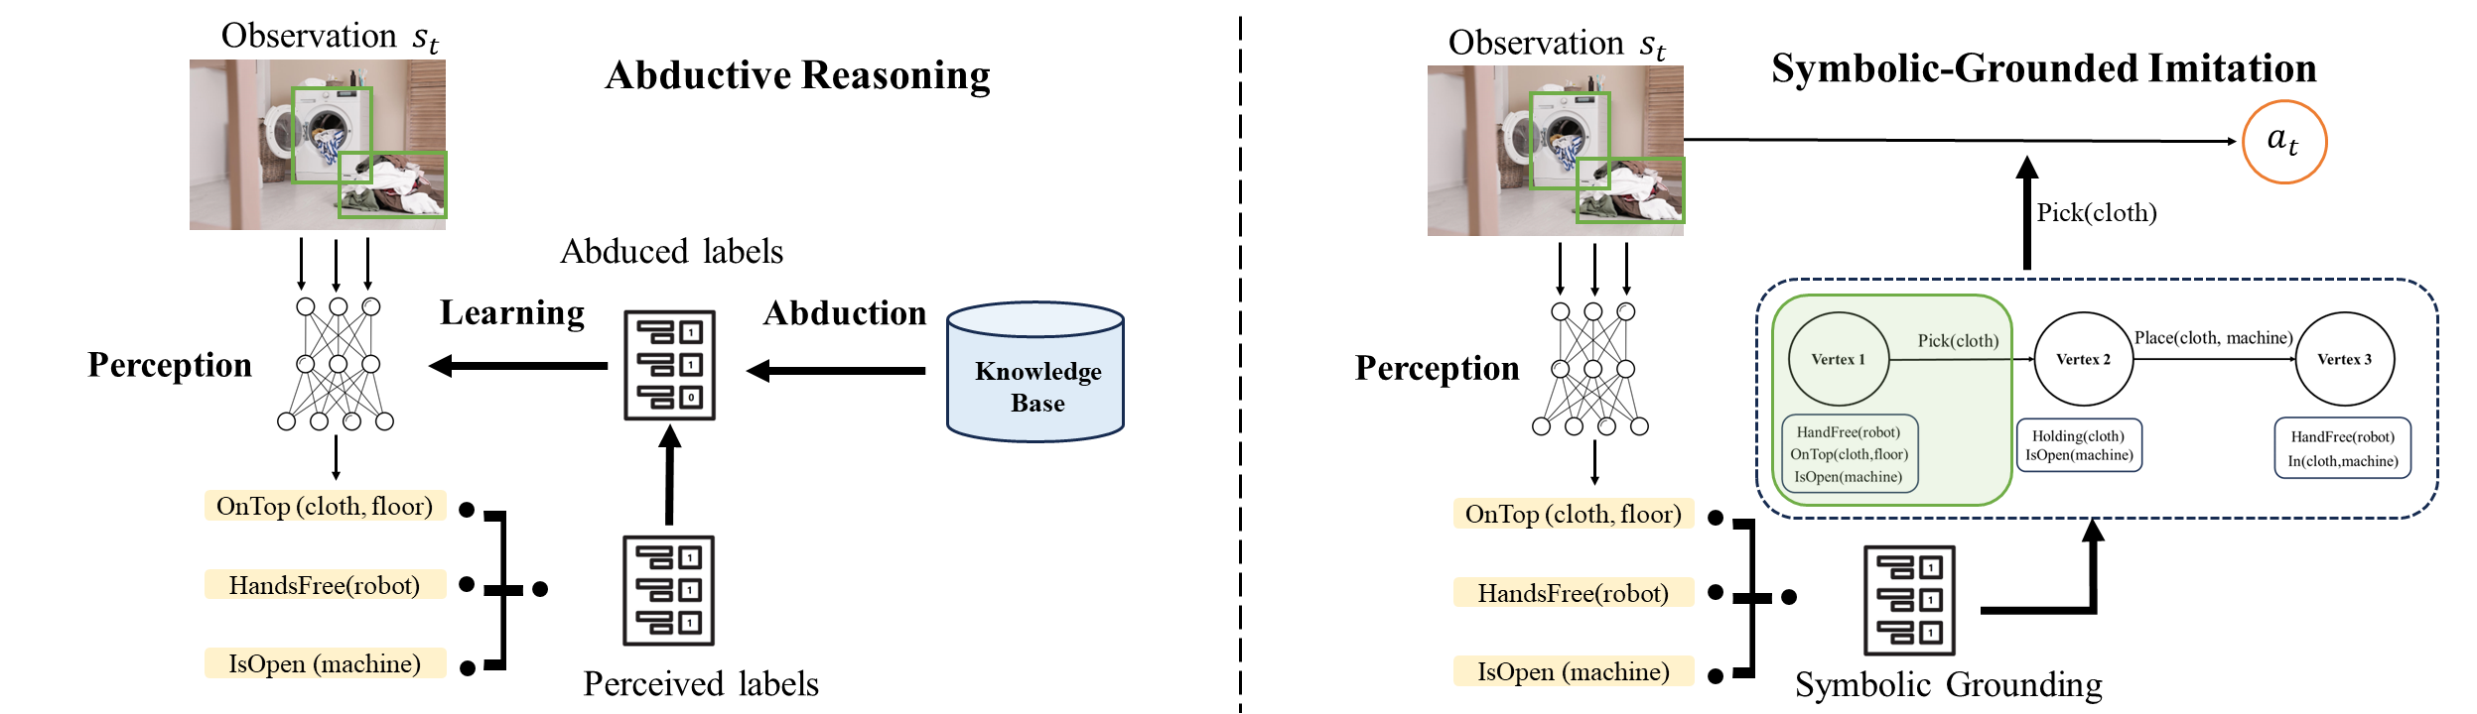
Main Idea of ABIL
The Overall Framework
Goal:
Help the agent understand demonstrations in symbolic space from high-dimensional visual observations without symbolic-level label.
Enable long-term logical planning for imitation learning.

Slide 7
Outline
1. Background & Problem
2. ABIL Framework
3. Empirical Results
4. Conclusion

Slide 8
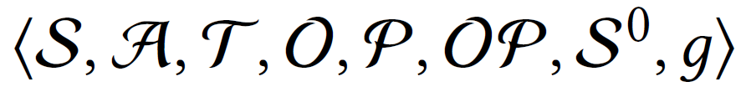
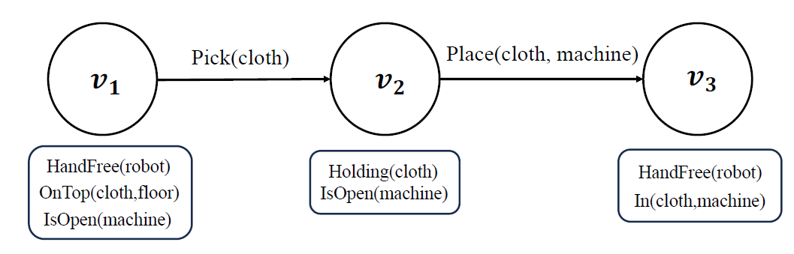
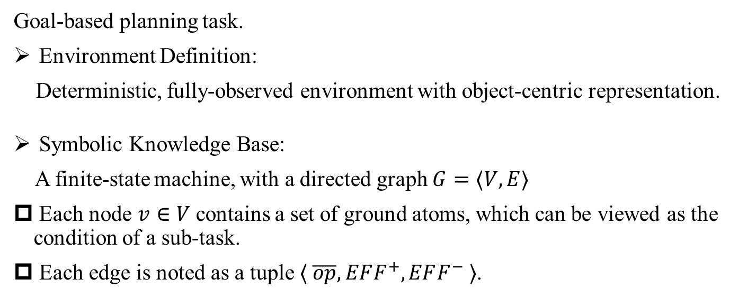
Problem Formulation
Goal-based planning task.
Environment Definition:
Deterministic, fully-observed environment with object-centric representation.
Symbolic Knowledge Base:
A finite-state machine, with a directed graph $G=⟨V, E⟩$
Each node $v∈V$ contains a set of ground atoms, which can be viewed as the condition of a sub-task.
Each edge is noted as a tuple $⟨ \overline{op}, EFF^{+}, EFF^{−} ⟩$.
An example of the knowledge base

Slide 9
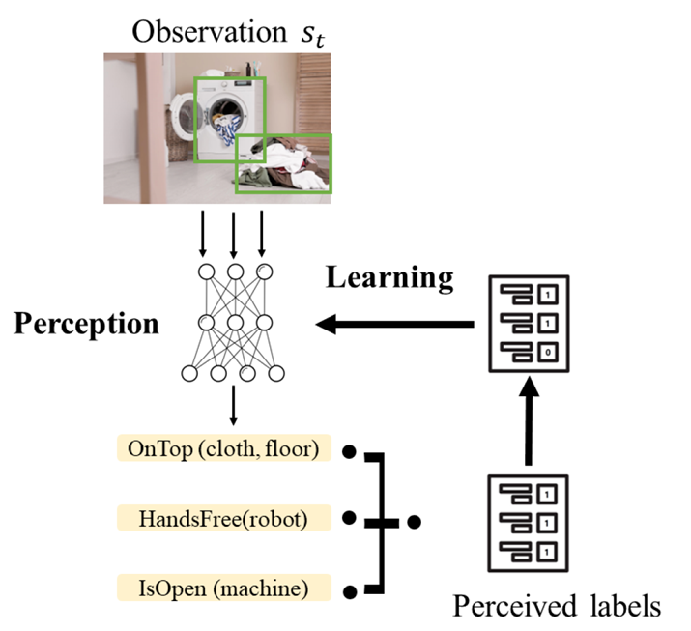
Symbolic-grounded Understanding
Ground-truth Symbolic Labels
A straightforward method: optimize the network with the symbolic labels.
However: Symbolic supervision is typically costly or not available

Slide 10
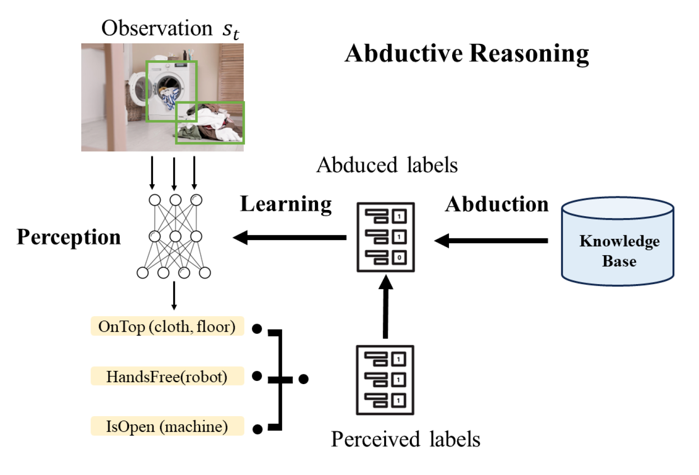
Symbolic-grounded Understanding
Ground-truth Symbolic Labels
A straightforward method: optimize the network with the symbolic labels.
However: Symbolic supervision is typically costly or not available
We introduce the abductive reasoning to optimize the network.

Slide 11
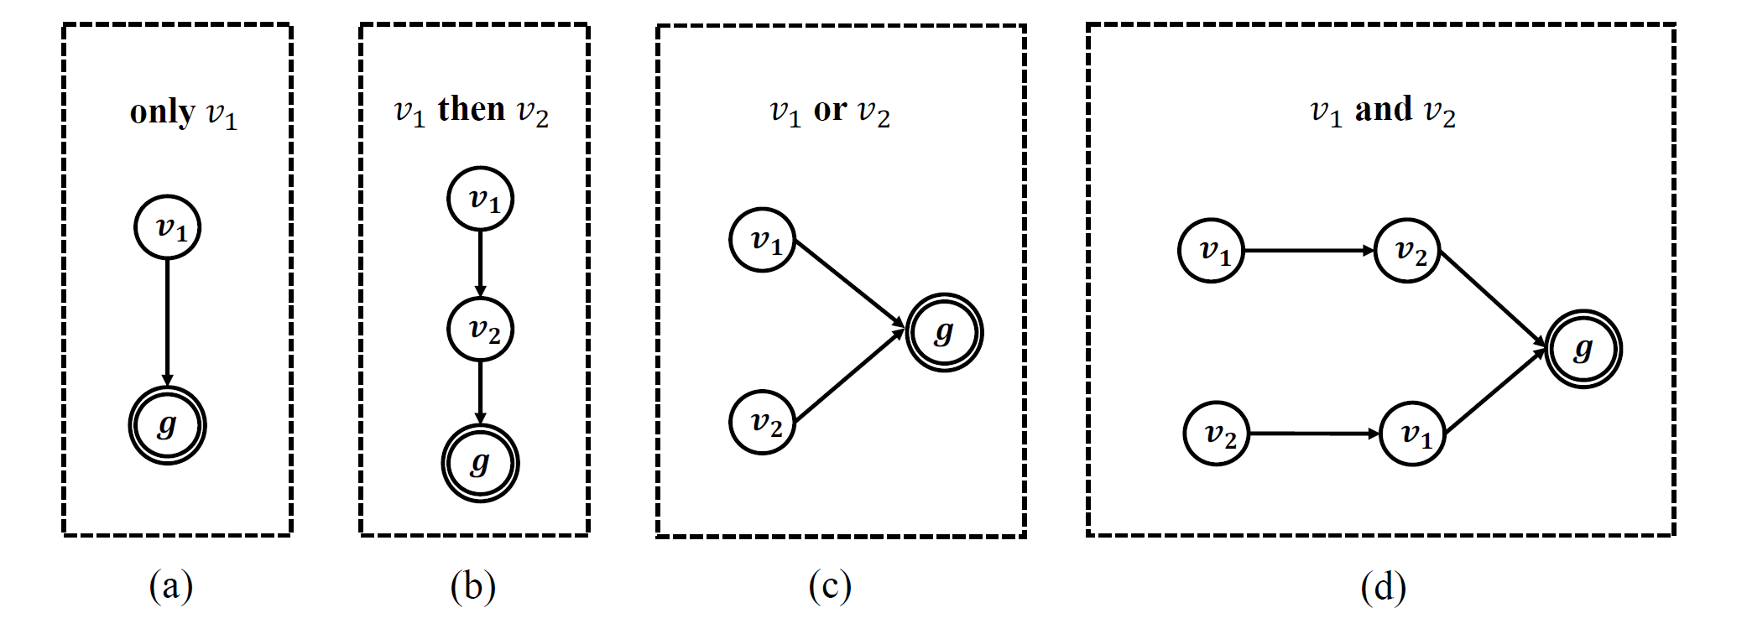
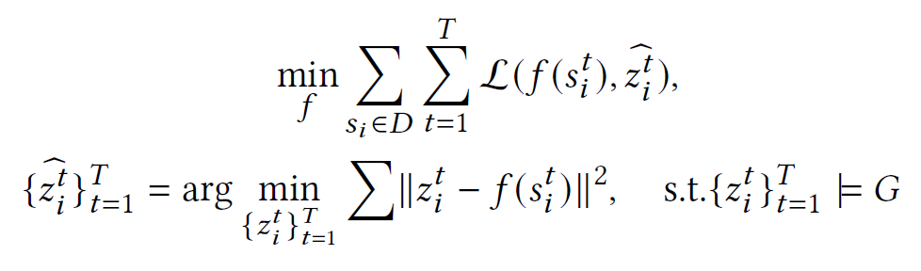
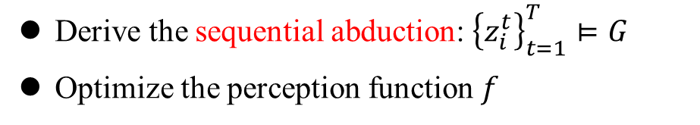
Abductive Reasoning
Acquire the pseudo label from the knowledge of state machine via abductive reasoning.
Typical structures of the state machine
Derive the sequential abduction: ${\left\{z_{i}^{t}\right\}}_{t=1}^{T}⊨G$
Optimize the perception function $f$

Slide 12
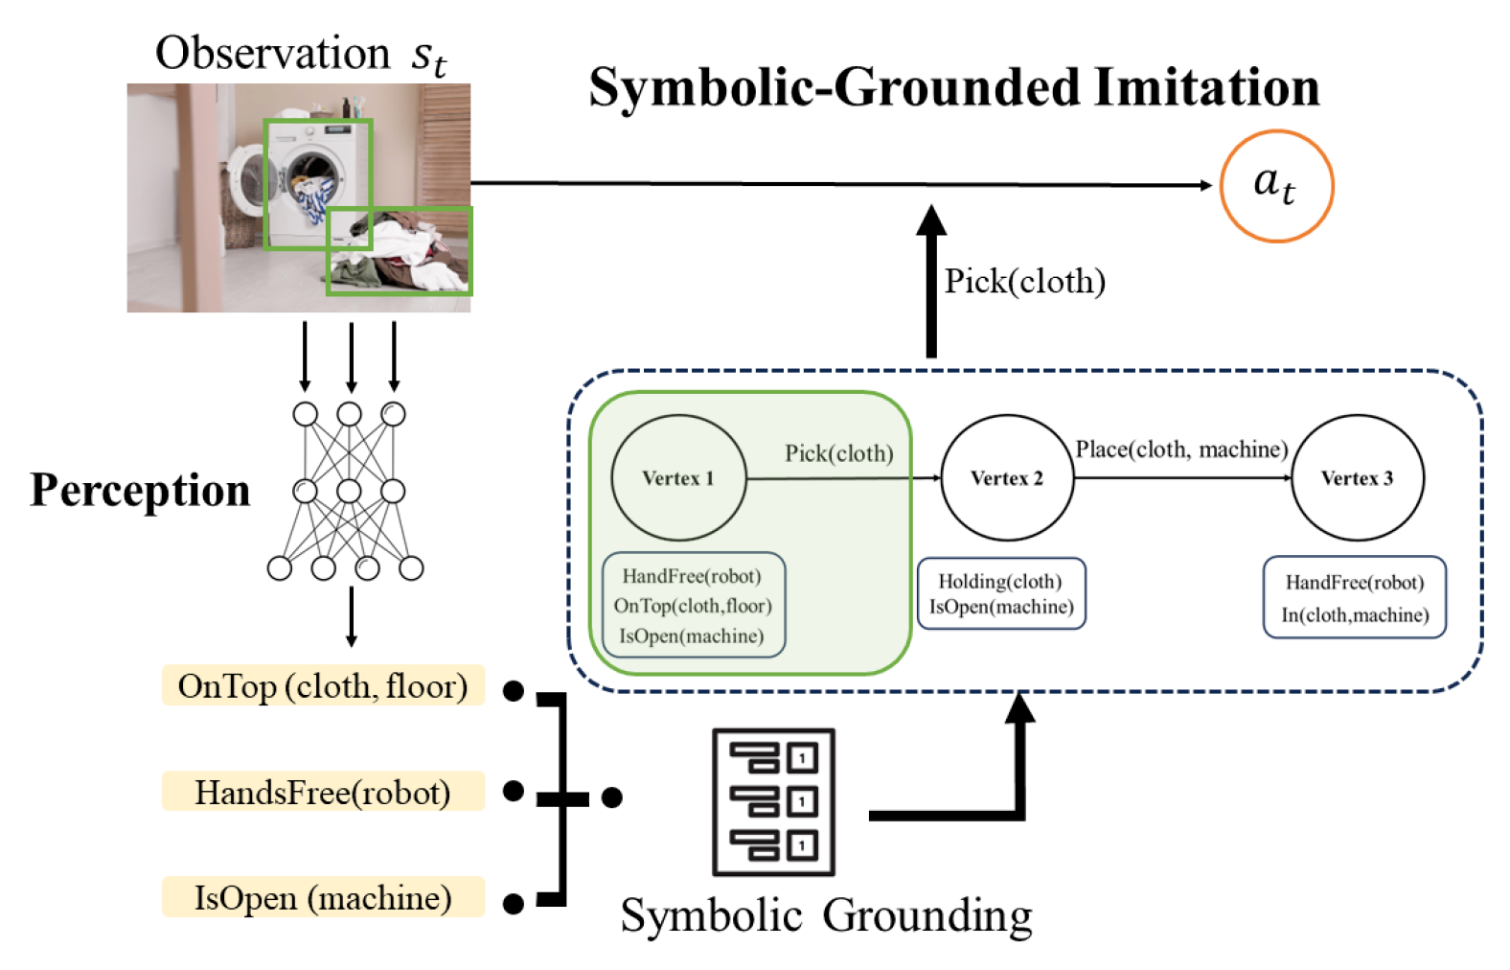
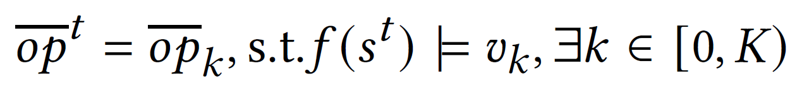
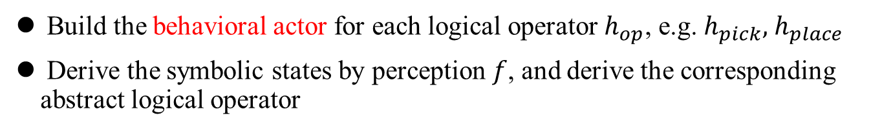
Symbolic-grounded Imitation
Build the behavioral actor for each logical operator $h_{op}$, e.g. $h_{pick},$ $h_{place}$
Derive the symbolic states by perception $f$, and derive the corresponding abstract logical operator

Slide 13
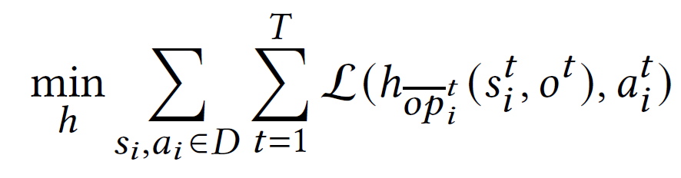
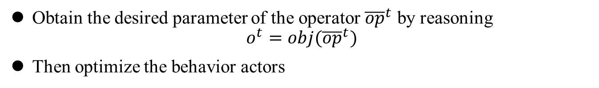
Symbolic-grounded Imitation
Obtain the desired parameter of the operator ${\overline{op}}^{t}$ by reasoning
$$o^{t}=obj({\overline{op}}^{t})$$
Then optimize the behavior actors

Slide 14
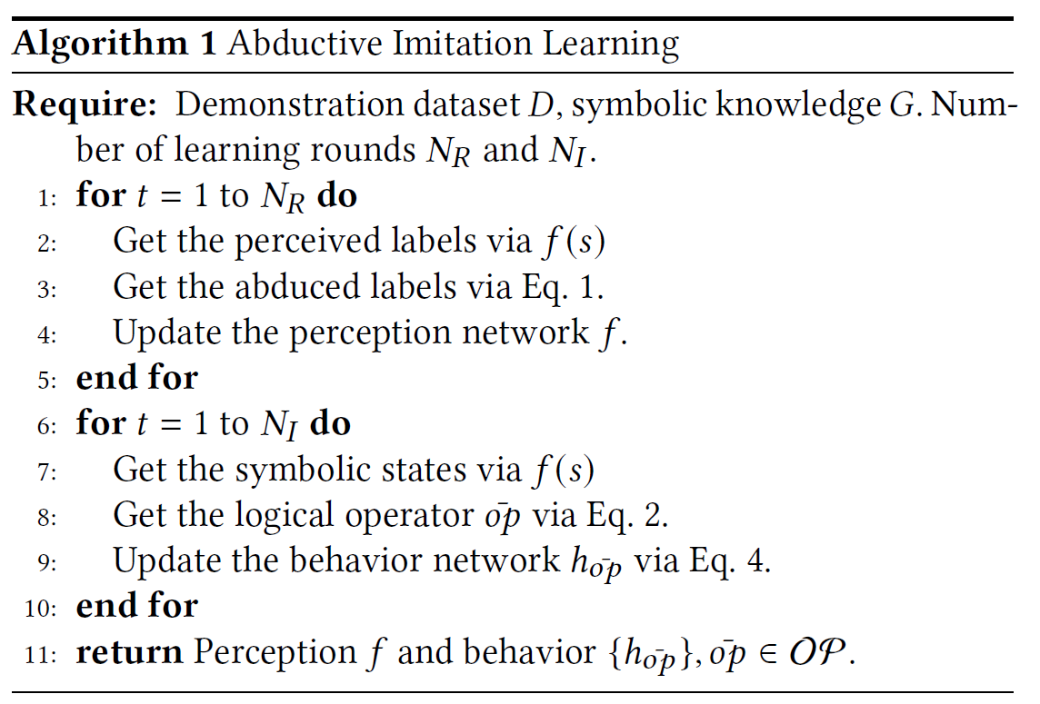
ABIL Algorithm
A two-stage learning algorithm.
Embed high-level logical reasoning into the imitation learning process.

Slide 15
Outline
1. Background & Problem
2. ABIL Framework
3. Empirical Results
4. Conclusion

Slide 16
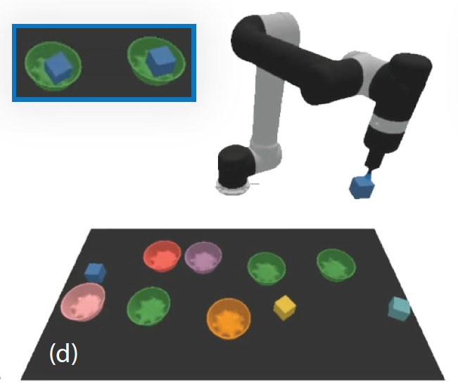
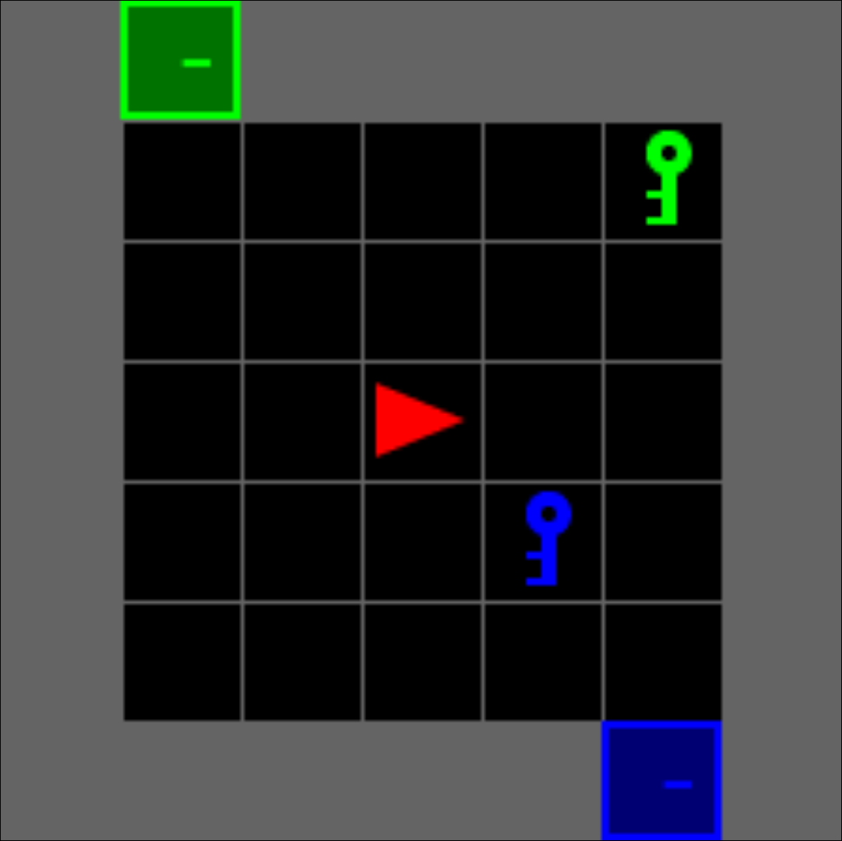
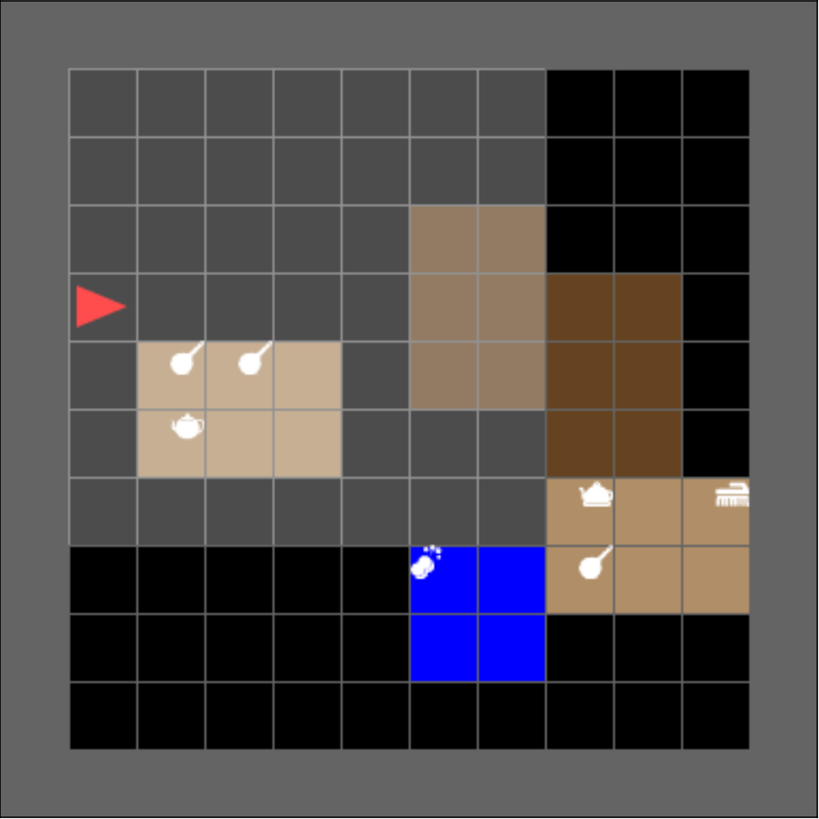
Setup
Three diverse environments
BabyAI
Learning with logical instruction
Mini-BEHAVIOR
Household Agent
CLIPort
Robotic manipulation
Baseline Methods
Behavior Cloning (BC)
Decision Transformer (DT)
PDSketch
BabyAI
Mini-BEHAVIOR
CLIPort

Slide 17
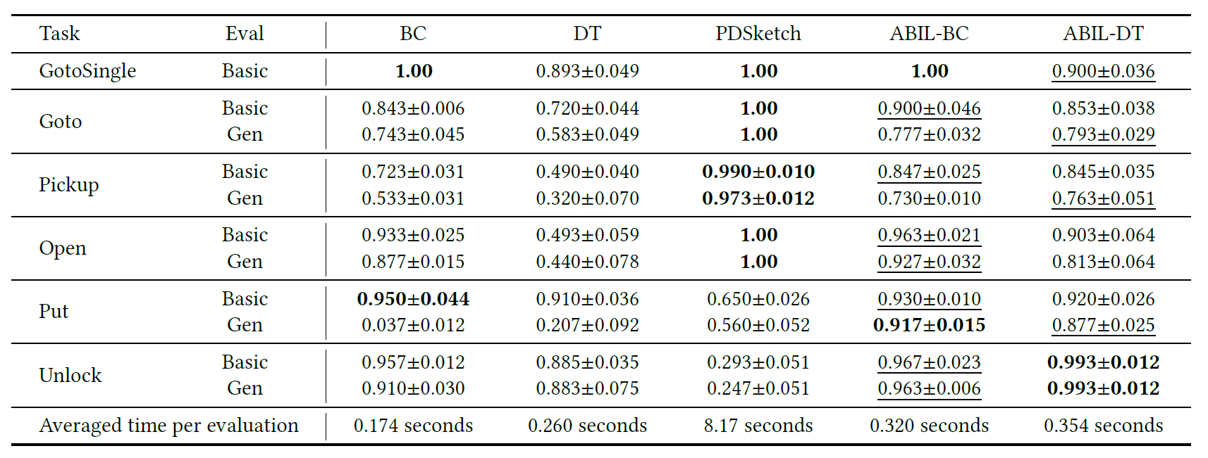
Evaluation on BabyAI
ABIL effectively improves the performance of imitation learning methods.

Slide 18
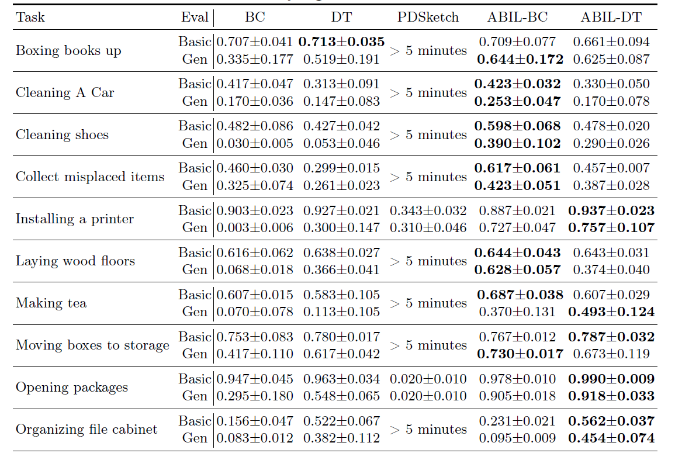
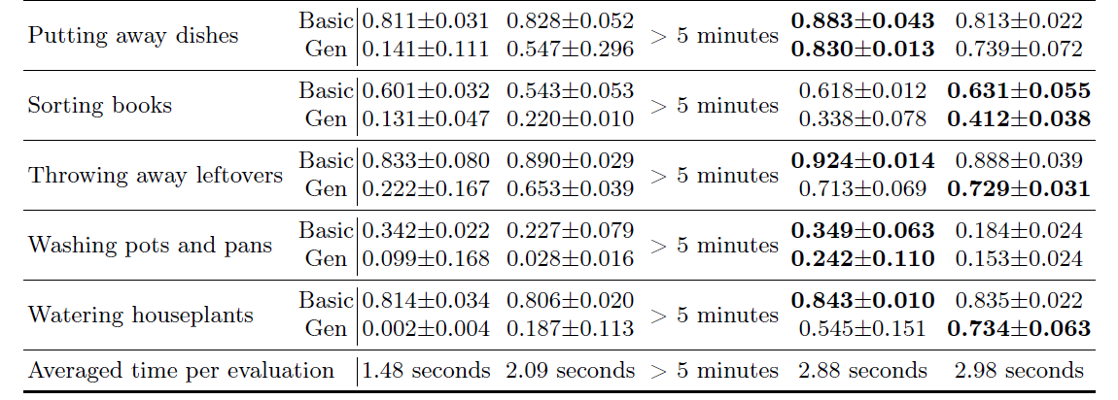
Results on Mini-BEHAVIOR
ABIL demonstrates great performance under the open enviornments.

Slide 19
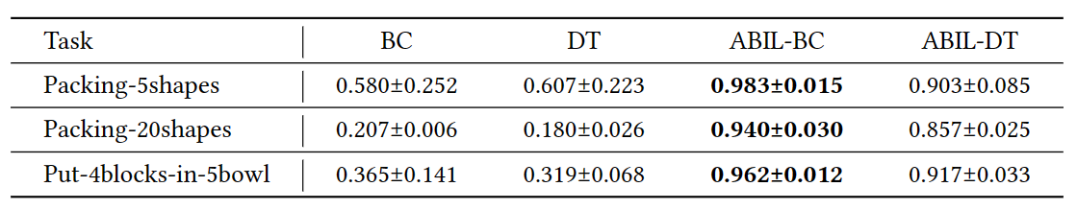
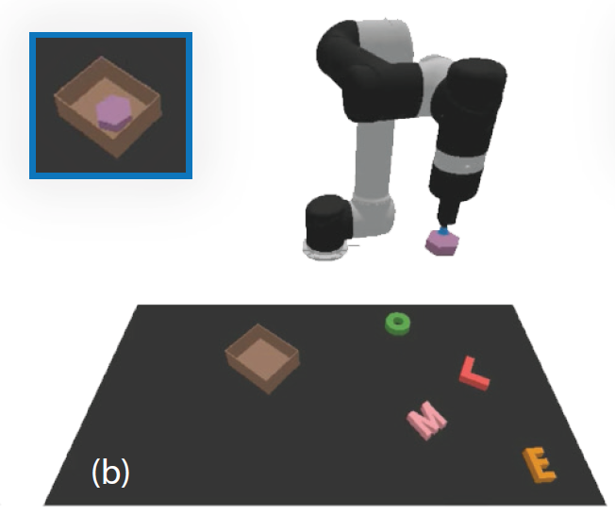
Results on CLIPort
Packing-shapes
Put-blocks-in-bowls
ABIL gives outstanding results in CLIPort Environment.

Slide 20
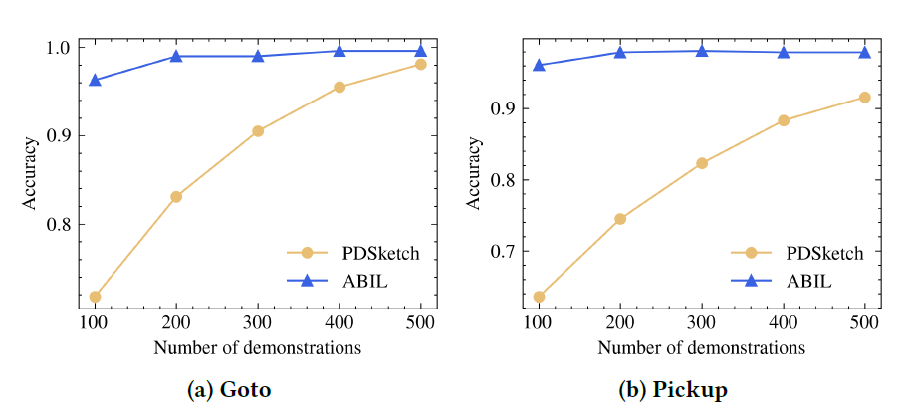
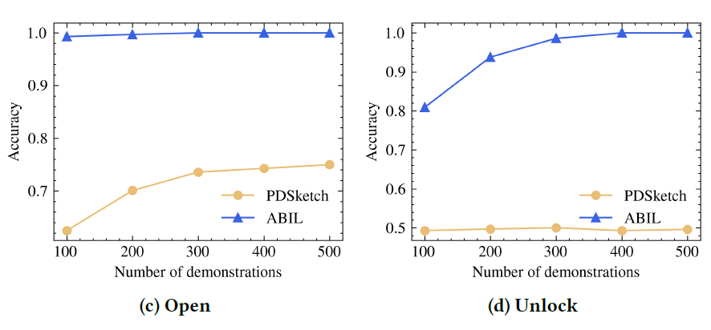
Comparison of Neural-Symbolic Grounding
ABIL outperforms in understanding the environment accurately.

Slide 21
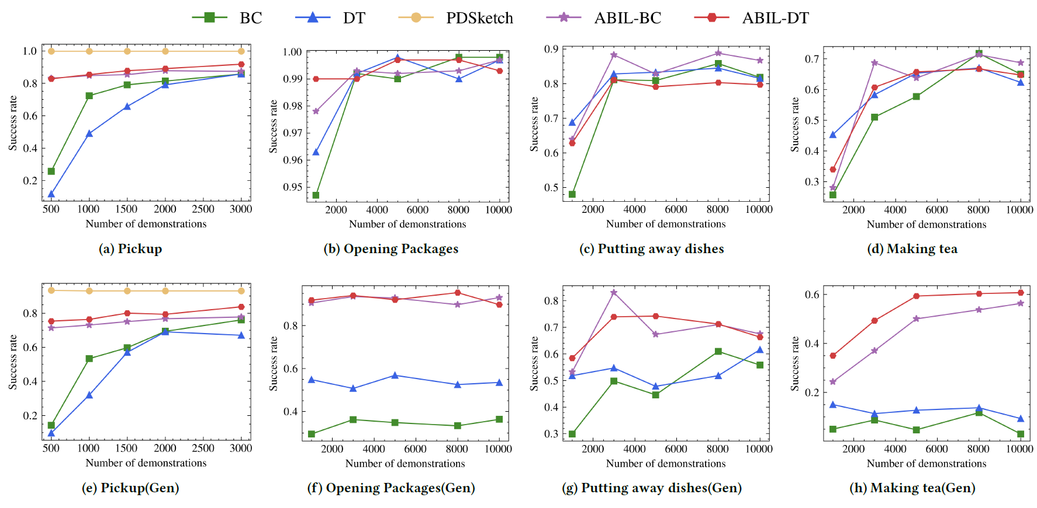
Data Efficiency and Generalization
ABIL improves the data efficiency of the BC and DT baselines, achieves significant generalization improvement in the out-of-distribution evaluation

Slide 22
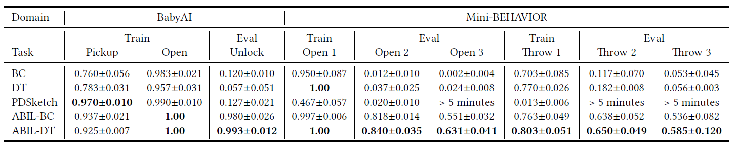
Compositional Generalization
ABIL has the ability to zero-shot generalize to novel composed tasks.

Slide 23
Outline
1. Background & Problem
2. ABIL Framework
3. Empirical Results
4. Conclusion

Slide 24
Conclusion
In this paper, we propose a novel framework: ABIL
A novel framework which combines the benefits of data-driven learning and symbolic-based reasoning.
Extensive experiments demonstrate the effectiveness and generality of ABIL.
Future work
Learning with accurate and incomplete knowledge base
Thank you!
If you are interested in, feel free to contact us:
Hao-Ran Hao (hhr277133291@gmail.com)
Jie-Jing Shao (shaojj@lamda.nju.edu.cn)

