Slide 1
CONTRACT INTELLIGENCE · AI / RAG · AZURE-NATIVE
Contract360
A retrieval-augmented assistant that answers natural-language questions over
energy & infrastructure contracts — with grounded, citation-backed answers.
Presented to Senior Leadership
Notes:
Contract360 is an AI assistant for our energy & infrastructure contracts (EPC, O&M, PPA). It is built end-to-end on Azure. Today: the problem we set out to solve, the solution and how it works, the architecture, and a live demo. Headline: every answer is grounded in the actual contract text and cites its source — built for auditability.

Slide 2
SLIDE 1 — CONTEXT
Problem, Solution & Where It Creates Value
The problem
The solution — Contract360
• Long & high-stakes. EPC, O&M and PPA contracts run to hundreds of pages of dense legal text.
• Slow, manual review. Finding obligations, deadlines, payment terms, termination & indemnity clauses is hours of work.
• Generic AI can't be trusted. Off-the-shelf chatbots hallucinate and give no citations — not auditable for legal decisions.
• Ask in plain English. Upload a contract; query it conversationally — single contract or a portfolio.
• Grounded & cited. Every answer is drawn from actual clause text and cites title, page range & source.
• Contract-aware. Clause-aware chunking, a hierarchical contract tree and a legal knowledge graph for relationship questions.
Business value
Technology stack
• Faster review & due diligence. Cut manual contract-reading time across legal, commercial & deal teams.
• Audit-ready answers. Citation trail supports compliance and risk decisions.
• Portfolio insight. Surface obligations, rights & deadlines across many contracts at once.
APP
FastAPI
React
Vite
Tailwind
AI
Azure OpenAI (GPT-4)
text-embedding-3
DATA
AI Search
Cosmos NoSQL
Cosmos Gremlin
Blob
RUN
Azure Container Apps
ACR
Contract360 | Confidential — for internal management review
2
Notes:
Problem: our key contracts are long, dense and high-stakes, and reviewing them is slow and manual. Generic AI tools hallucinate and don't cite sources, so they can't be trusted for legal decisions. Solution: Contract360 lets you upload a contract and ask questions in plain English; every answer is grounded in the real clause text and cites title, page and source. Value: faster review and due diligence, audit-ready answers, and portfolio-wide visibility of obligations and deadlines. It's built entirely on our Azure stack — no new vendor footprint.

Slide 3
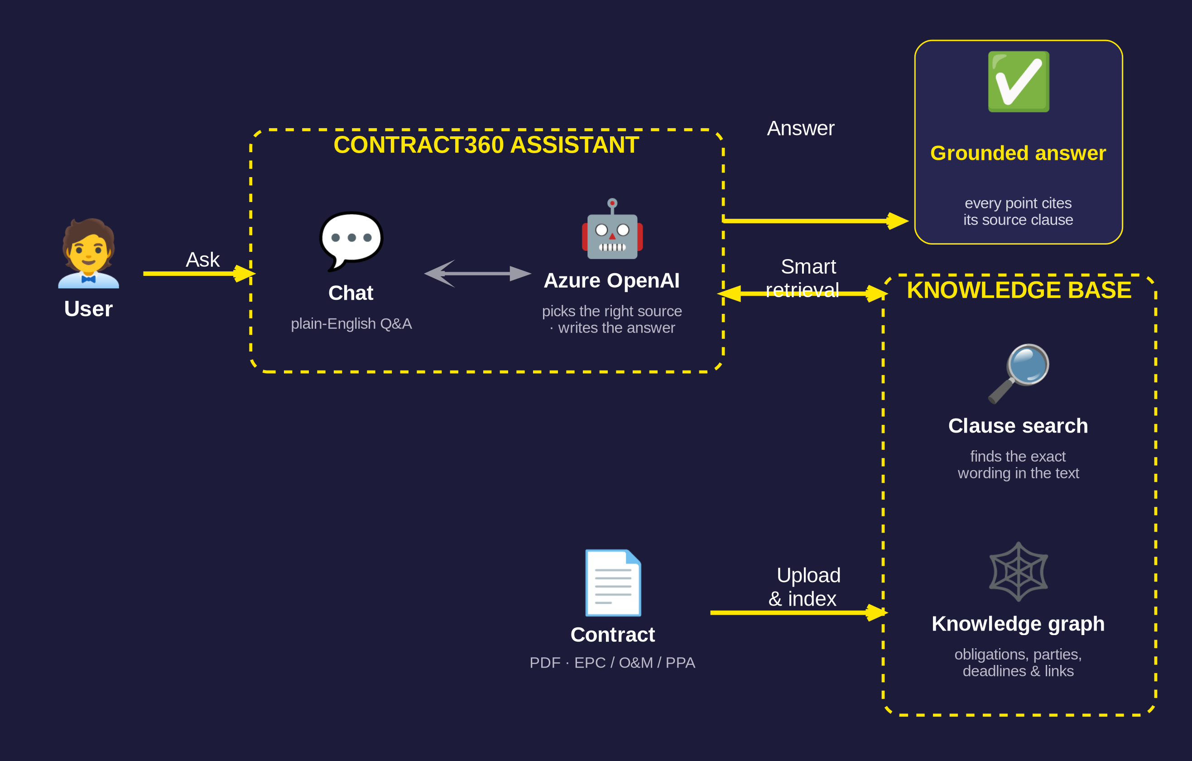
How the Platform Works
HOW IT WORKS · CONTRACT360
PLAIN-LANGUAGE ACCESS
Anyone can interrogate a contract — no legal training needed.
GROUNDED & AUDITABLE
Every answer cites the exact source clause it came from.
AZURE-NATIVE
Runs in our own cloud tenant — your data stays with you.
Contract360 | Confidential — for internal management review
3
Notes:
Here's the whole platform in one picture. Two simple phases. ONBOARD, once per contract: you upload a PDF, and the system reads it, splits it into clauses, and makes it searchable. ASK, anytime: you ask a question in plain English, the AI finds the right clauses, and returns a clear answer with every point linked back to its source clause. The whole thing runs on Azure services we already operate — so the data never leaves our tenant. The detailed engineering view is on the next slide.

Slide 4
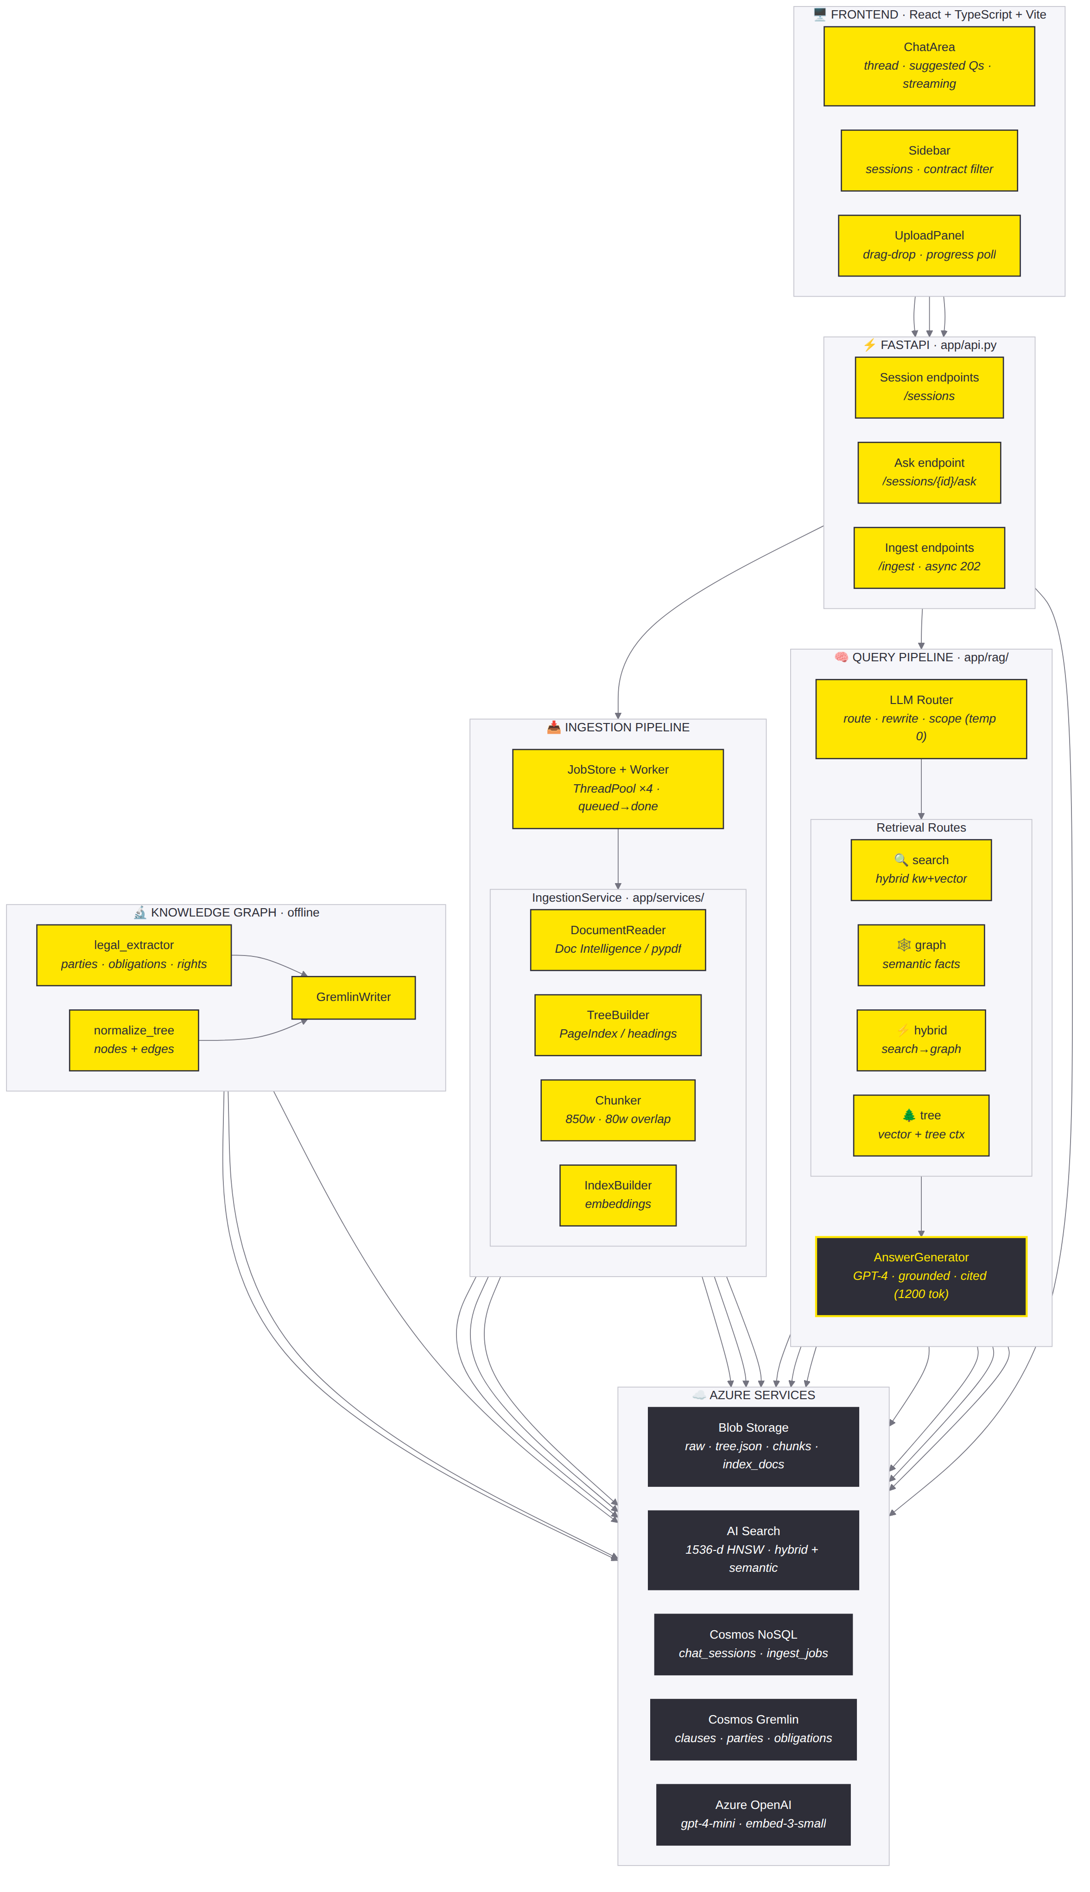
SLIDE 2 — ENGINEERING VIEW
Detailed Architecture
FIVE LAYERS
DESIGN HIGHLIGHTS
Frontend
React + TypeScript SPA — chat, sidebar, upload.
Async ingestion
Upload returns immediately (202); a thread pool processes files with live progress.
FastAPI
Sessions, ask (sync/stream), async ingest.
Pluggable parsing
Azure Document Intelligence with a pypdf fallback.
Query pipeline
LLM router → search / graph / hybrid / tree → AnswerGenerator.
Cited answers
Sources carried end-to-end into every response.
Ingestion pipeline
Worker pool: read → tree → chunk → embed → index.
Scales out
Container Apps; Service Bus path for multi-instance.
Knowledge graph
Offline: parties, obligations, rights → Gremlin.
Config-driven
Graph & Doc-Intelligence toggle on/off via env.
Azure services
Blob · AI Search · Cosmos NoSQL · Gremlin · OpenAI.
Contract360 | Confidential — for internal management review
4
Notes:
The engineering view. Frontend talks to a FastAPI backend. Reads go through the query pipeline: the LLM router rewrites the question, resolves scope, and chooses a retrieval route; results feed the AnswerGenerator. Writes go through the ingestion pipeline: an async worker pool parses, builds the tree, chunks, embeds and indexes each file with live status. An offline knowledge-graph pipeline adds parties, obligations and rights to Cosmos Gremlin for relationship questions. All of it runs on Azure-managed services, and the optional pieces are env-toggle. Full interactive diagram lives in ARCHITECTURE.md in the repo.

Slide 5
SLIDE 3 — DEMO
See It In Action
Live demo flow
⚑ Backup plan
• 1. Upload a contract. Drag-drop a PDF; watch parse → embed → index progress live.
• 2. Ask a question. “What are the contractor's payment obligations?”
• 3. Read a grounded answer. Response streams in with inline clause citations.
• 4. Show the routing. A relationship question (graph) vs. a lookup (tree).
• 5. Multi-contract scope. Filter to one contract or query across several.
A pre-recorded demo video is ready in case of live connectivity or
environment issues. [ insert link / embed before the meeting ]
What to watch for
• Speed. Answer in seconds; ingestion runs in the background.
• Trust. Each claim links to a clause — open it to verify.
• Range. Same assistant handles lookup, summary & relationship questions.
Sample questions to demo
Roadmap (post-MVP)
• “Summarise the termination clauses and any notice periods.”
• “What deadlines does the contractor have in the first 90 days?”
• “Which party bears liability for delay, and is there a cap?”
• “List the indemnities granted to the owner.”
• Content-aware scoping by party / contract.
• Reasoning-based navigation of the contract tree.
• Knowledge-graph portfolio analytics across contracts.
• Azure Entra ID authentication for production.
Contract360 | Confidential — for internal management review
5
Notes:
Demo plan: upload a contract live and show the ingestion progress, then ask a payment-obligations question and show the streamed, cited answer — click a citation to prove it's grounded. Then contrast a relationship question (graph route) with a simple lookup (tree route), and show multi-contract scope. Always click into at least one citation — that's the trust moment. Backup: a recorded video is ready if the live environment misbehaves (remember to insert the link before the meeting). Close on roadmap: content-aware scoping, reasoning-based retrieval, portfolio analytics, and Entra ID auth.

