Slide 1
Guidance
If Only Creations
Notes:
Newly formed indie studio
Working on discovering gaps in the market

Slide 2
High Concept of the Game
Guidance is a 2D co-operative multiplayer fantasy RPG game. The main character is controlled by one player who is unable to see past their feet, while the additional players are able to see the rooms clearly and provide directions to the character controller. The additional players can either be using another PC with the game installed, or using a free smartphone app that connects to the game via the internet.

Slide 3
Target Audience
People looking for a more communicative and social type of game. (625,000 people purchased ‘Keep talking and nobody explodes’ a game based around communicating via voice to disarm a bomb)
People wanting to play videos games with someone unable to access a computer to play on. Households with only one PC, people traveling away from home.

Slide 4
Core Game Mechanics
Character controller very limited vision
Additional player able to see to guide the character controller
Additional players can’t ‘hear’ (see NPC text) this must be communicated by the controller
Slow paced melee and ranged combat (swords and bows)
Puzzles and riddles some requiring note taking or memory
Procedurally generated rooms and audio, no playthrough is the same

Slide 5
Unique Selling Points
Main controller must be guided by another player
Integration of smartphone app
Comfortable for those with no video game experience to try out (specifically as guides)

Slide 6
Platform
Steam - £76.50 fee to distribute onto steam Generally an additional 30% taken from each sale
Itch.io – Free to distribute via (much smaller market) Choice of giving a percentage of each purchase to itch We can discuss this percentage

Slide 7

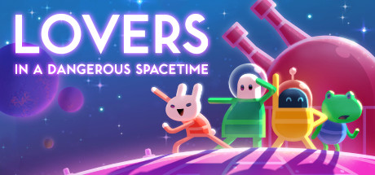

Competition
Although these games have very different setting and mechanics they all have a focus on good communication between the players.
Price: £10.99
Sales via steam: 625,000
Monthly sales: 26,000
Price: £10.99
Sales via steam: 205,000
Monthly sales: 8200
Price: £12.99
Sales via steam: 380,000
Monthly sales: 27,000

Slide 8
Development Costs
These costs are based on a 10 month period
Rent & bills - £7600
Insurance - £1900
Salaries - £150,000 (based on 6 people)
Convention participation - £6000
Legal/accountant fees - £4500

Slide 9
Business Offer
Looking for a 170,000 investment
We request 25% royalties from net profit
Development will take 10 months

Slide 10
Preliminary Income Projection
Predicted minimum 100,000 sales in the first year
Steam takes a 30% commission
Projected income on Steam after commission - £769,300
Any sales via itch.io will have a bigger return
If we hit sales like similar top selling games (312,000 1st year)
Projected income on Steam after commission - £3,428,880

Slide 11
An estimate of the break-even point
At minimum projected sales you recoup your money in 2.5 months of release
At expected sales its within a month

Slide 12
Estimate of the Return-on-Investment
Over 2 years ROI is 5.8 assuming we do not surpass our minimum sales prediction.
Total gain over 2 years after release is £1,540,000 (after steam commission)
Total profit over 2 years after release is £1,155,000 (after royalties)

Slide 13
Thank You
Thank you for listening.
We will be happy to answer any questions you may have.

