Slide 1



Parallelized Discrete Event Simulator
Efficient Logic Verification for VHDL Circuits
IIT Delhi | Cornerstone Systems Project 2025MCS2105 & 2025MCS2094

Slide 2


Project Motivation
Scalability Crisis: Modern circuits contain millions of gates. O(N) naive simulation is no longer feasible.
Redundancy: Most gates don't change state in a given cycle; re-evaluating them wastes CPU cycles.
The Goal
Hardware Evolution: Multicore processors are standard, yet many academic simulators remain single-threaded.
Build a correct, deterministic simulator that leverages OpenMP for batch process execution while maintaining strict causality via delta cycles.
Our Solution: A parallelized, event-driven engine written in C++17 with Flex/Bison parsing.

Slide 3




System Architecture
Frontend
Intermediate
Core Engine
VHDL Lexer (Flex) and Parser (Bison) translate source code into an Abstract Syntax Tree (AST).
The Code Generator flattens AST expressions into a standardized Netlist (.net) and Stimulus (.stim) format.
Event-driven simulator with priority queue management, double-buffering, and VCD wave generation.

Slide 4


Discrete Event Simulation
Key Principles
Event-Driven: Evaluations only occur when a signal's input changes.
Time Management: Simulation time advances to the next scheduled event, skipping inactive intervals.
Efficiency: Reduces complexity from O(Gates per step) to O(Active events per step).

Slide 5


Delta Cycles & Causality
To handle zero-delay logic and maintain causality, we introduce sub-steps called Delta Cycles.
If Gate A drives Gate B, B must see A's output after A executes. Delta cycles ensure that all concurrent changes at time T are ordered correctly before advancing real time.

Slide 6


Double-Buffered Signal Design
The Race Condition
The Snapshot Solution
In parallel execution, if Process B reads Signal X while Process A is writing to it, the result is non-deterministic.
Signals use a two-phase commit strategy. All processes read from a "Current" value and schedule updates to a "Next" value.

Slide 7
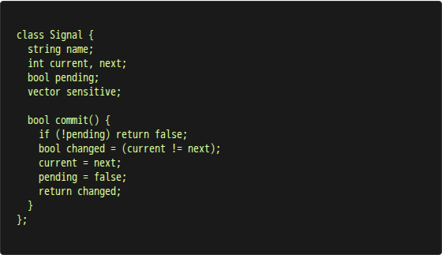
The Signal Class
Data Members
int current_value: The committed state.
int next_value: Pending update value.
vector deps: Processes to trigger on change.
Key Methods
getValue(): Thread-safe read of current.
scheduleUpdate(v): Queue a pending change.
commit(): Atomically swap values.

Slide 8
Comprehensive Gate Library
Category | Implementation | Functionality
Logic Gates | AND, OR, XOR, NAND, NOR, XNOR | Standard 2-input boolean logic
Unary Ops | NOT, BUF | Signal inversion and buffering
Control | MUX | Selector-based signal routing
Sequential | DFF, SR Latch | Edge-triggered and level-sensitive memory
Timing | Clock | Self-rescheduling periodic signal generator

Slide 9

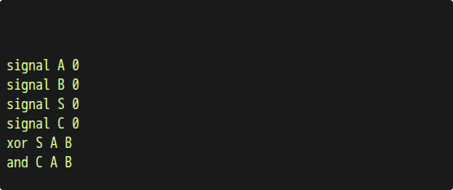
Netlist Parsing & Wiring
example.net
Dynamic Wiring
The parser instantiates Signal objects and links them to Process sensitivity lists. This creates a directed graph where edges represent signal propagation paths.

Slide 10

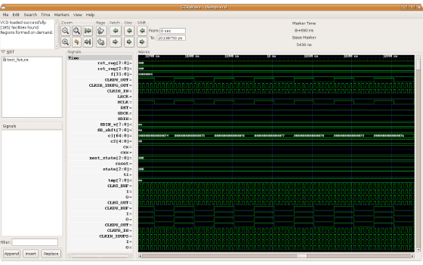
Waveform Visualization
VCD Writer Integration
Standard Compliance: Outputs IEEE 1364 Value Change Dump files.
Atomic Logging: Changes are recorded only when commit() returns true.
Analysis: Waveforms can be inspected in GTKWave to verify timing and logic.

Slide 11
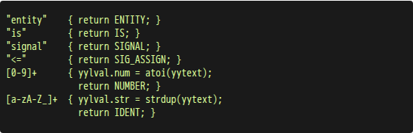
VHDL Lexer (Flex)
Case Insensitivity: VHDL ignores case; Lexer maps all keywords to uniform tokens.
Line Tracking: yylineno ensures precise error reporting.
Tokenization: Handles complex entities like rising_edge, signal assignments (<=), and time literals (ns).

Slide 12

VHDL Parser (Bison)
Grammar Hierarchy
Pattern Matching
Implements a recursive descent parser for VHDL subsets: Entity declarations, Architectures, and Signal Assignments.
Recognizes high-level constructs like if rising_edge(CLK) and maps them to specialized DFF processes.

Slide 13

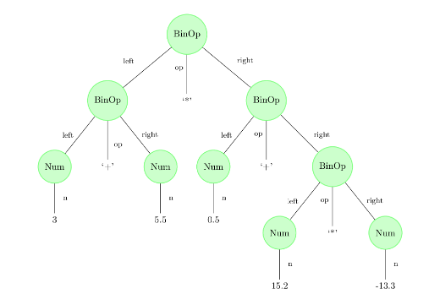
Abstract Syntax Tree
AST Node Types
VExpr: Expression trees (AND/OR/NOT).
VGateProcess: Logic blocks.
VHDLDesign: Top-level container.
Ensures semantic correctness before code generation.

Slide 14

Code Generator
Expression Flattening: Converts OUT <= A and (B or C) into a series of primitive gates using temporary signals.
Stimulus Extraction: Processes wait for statements into time-stamped events for the .stim file.
Result: Decouples the VHDL language from the simulator execution engine.
Example Transformation:

Slide 15


Test Case: Full Adder
Simulation Metrics
Gates: 5 (2 XOR, 2 AND, 1 OR)
Max Delta Depth: 3 Cycles
Tests concurrent gate firing and multi-level signal propagation.

Slide 16

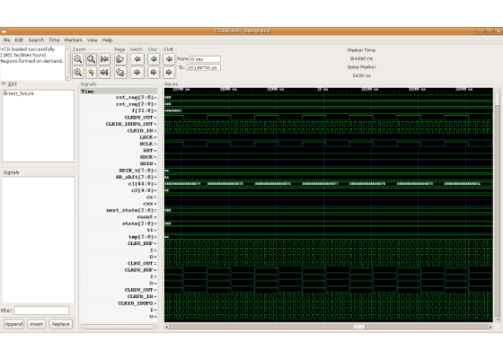
Sequential Logic: D Flip-Flop
Verification Points
State change strictly on rising_edge(CLK).
Signal hold behavior when CLK is stable.
Complementary output (Q and Q_NOT) stability.

Slide 17

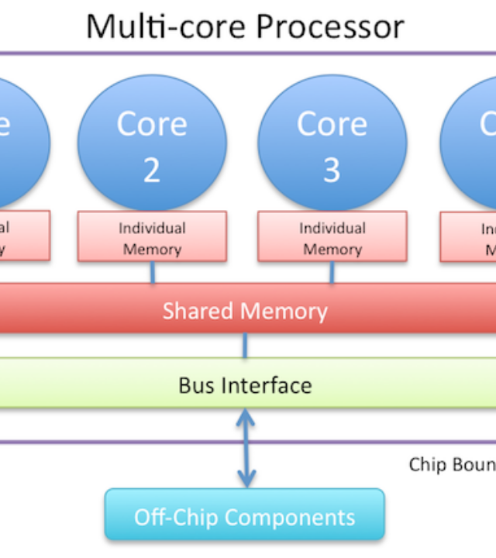

Parallelization Strategy
We utilize OpenMP to parallelize the execution of independent processes within a single delta batch.
Dynamic Scheduling: Handles variations in process complexity.
Thread-Safe Updates: Double-buffering removes the need for fine-grained locks during evaluation.

Slide 18
Lessons & Decisions
C++17 Choice: Leveraged std::optional and std::variant for cleaner AST management.
Flex/Bison: Proven tools for rapid HDL parser development vs. manual recursive descent.
Double Buffering: Proved essential for thread-safety without killing performance with mutexes.
Modularity: Decoupling the simulator from the parser allowed independent testing of the logic engine.

