Slide 1
IP Security
Notes:
Using IPSec in Windows 2000 and XP, Part 1
Chris Weber 2001-12-05
http://www.securityfocus.com/infocus/1519

Slide 2
IP Security
Have a range of application specific security mechanisms
  eg. S/MIME, PGP, Kerberos, SSL/HTTPS
However there are security concerns that cut across protocol layers
Would like security implemented by the network for all applications
Notes:
The Internet community has developed application-specific security mechanisms in a number of application areas, including electronic mail (S/MIME, PGP), client/server (Kerberos), Web access (Secure Sockets Layer), and others. However users have some security concerns that cut across protocol layers. By implementing security at the IP level, an organization can ensure secure networking not only for applications that have security mechanisms but also for the many security-ignorant applications.

Slide 3
IPSec
General IP Security mechanisms
Provides
  authentication
  confidentiality
  key management
Applicable to use over LANs, across public & private WANs, & for the Internet
Notes:
IP-level security encompasses three functional areas: authentication, confidentiality, and key management. The authentication mechanism assures that a received packet was transmitted by the party identified as the source in the packet header, and that the packet has not been altered in transit. The confidentiality facility enables communicating nodes to encrypt messages to prevent eavesdropping by third parties. The key management facility is concerned with the secure exchange of keys. IPSec provides the capability to secure communications across a LAN, across private and public WANs, and across the Internet.

Slide 4
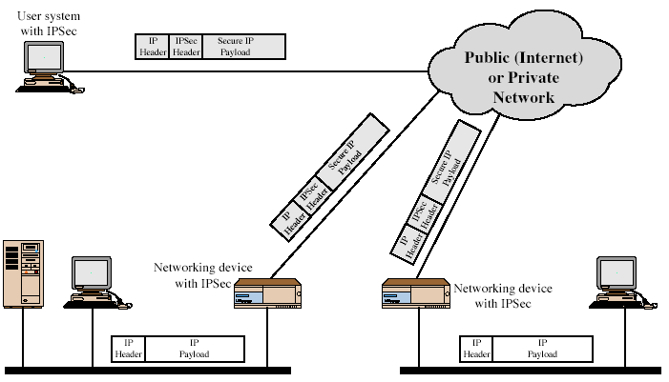
IPSec Uses
Transparency
Notes:
Stallings Figure 16.1 illustrates a typical IP Security scenario. An organization maintains LANs at dispersed locations. Nonsecure IP traffic is conducted on each LAN. For traffic offsite, through some sort of private or public WAN, IPSec protocols are used. These protocols operate in networking devices, such as a router or firewall, that connect each LAN to the outside world. The IPSec networking device will typically encrypt and compress all traffic going into the WAN, and decrypt and decompress traffic coming from the WAN; these operations are transparent to workstations and servers on the LAN. Secure transmission is also possible with individual users who dial into the WAN. Such user workstations must implement the IPSec protocols to provide security.
Security Associations
A one-way relationship between sender & receiver that affords security for traffic flow
Can be between
A pair of hosts
A host and a security gateway
A pair of security gateways

Slide 5
VPN
Application-level VPN
  E.g., tunnel through ssh
  Analogous to app-level gateways
IPSec-based VPN
  Analogous to packet-filtering firewalls

Slide 6
Benefits of IPSec
In a firewall/router, provides strong security to all traffic crossing the perimeter
Is below transport layer, hence transparent to applications
Can be transparent to end users
Can provide security for individual even mobile users
Secures routing architecture
Notes:
[MARK97] lists the benefits shown for IPSec. It also plays a vital role in the routing architecture required for internetworking.

Slide 7
IP Security Architecture
Specification is quite complex
Defined in numerous RFC’s
  incl. RFC 2401/2402/2406/2408
  many others, grouped by category
Mandatory in IPv6, optional in IPv4
Have two security header extensions:
  Authentication Header (AH)
  Encapsulating Security Payload (ESP)
Notes:
The IPSec specification has become quite complex. The IPSec specification consists of numerous documents. The most important of these,issued in November of 1998, are
• RFC 2401: An overview of a security architecture
• RFC 2402: Description of a packet authentication extension to IPv4 and IPv6
• RFC 2406: Description of a packet encryption extension to IPv4 and IPv6
• RFC 2408: Specification of key management capabilities
In addition to these four RFCs, a number of additional drafts have been published by the IP Security Protocol Working Group set up by the IETF. The documents are divided into seven groups.
Support for these features is mandatory for IPv6 and optional for IPv4.
In both cases, the security features are implemented as extension headers that follow the main IP header. The extension header for authentication is known as the Authentication Header (AH); that for encryption is known as the Encapsulating Security Payload (ESP) header.

Slide 8
Architecture & Concepts
Tunnel vs. Transport mode
Security association (SA)
  Security parameter index (SPI)
  Security policy database (SPD)
  SA database (SAD)
Authentication header (AH)
Encapsulating security payload (ESP)
Practical issues w/ NAT

Slide 9

Transport Mode vs. Tunnel Mode
Transport mode: host -> host
Tunnel mode: host->gateway or gateway->gateway
Encrypted Tunnel
Gateway 1
Gateway 2
Encrypted
Unencrypted
A
Unencrypted
B
New IP Header
AH or ESP Header
Orig IP Header
TCP
Data
Notes:
Stallings Figure 16.5 shows the difference between end-to-end (transport) mode and end-to-intermediate (tunnel) mode.
Transport mode provides protection primarily for upper-layer protocol payloads, by inserting the AH after the original IP header and before the IP payload. Typically, transport mode is used for end-to-end communication between two hosts.
Tunnel mode provides protection to the entire IP, after the AH or ESP fields are added to the IP packet, the entire packet plus security fields is treated as the payload of new “outer”IP packet with a new outer IP header. Tunnel mode is used when one or both ends of an SA are a security gateway, such as a firewall or router that implements IPSec.

Slide 10
Transport Mode
IP
header
IP
options
IPSec
header
Higher
layer protocol
ESP
Real IP
destination
AH
ESP protects higher layer payload only
AH can protect IP headers as well as higher layer payload

Slide 11
Tunnel Mode
Outer IP
header
IPSec
header
Inner IP
header
Higher
layer protocol
Destination
IPSec
entity
ESP
Real IP destination
AH
ESP applies only to the tunneled packet
AH can be applied to portions of the outer header

Slide 12
IPSec In Depth

Slide 13
Encapsulated Security Payload (ESP)
Must encrypt and/or authenticate in each packet
Encryption occurs before authentication
Authentication is applied to data in the IPSec header as well as the data contained as payload

Slide 14
IPSec Encapsulating Security Payload (ESP) in Transport Mode
Orig IP Hdr
TCP Hdr
Data
Insert
Append
Orig IP Hdr
ESP Hdr
TCP Hdr
Data
ESP Trailer
ESP Auth
Usually encrypted
integrity hash coverage
SecParamIndex
Seq#
InitVector
Keyed Hash
22-36 bytes total
Padding
PadLength
NextHdr
ESP is IP protocol 50
© 2000 Microsoft Corporation

Slide 15
IPSec ESP Tunnel Mode
Orig IP Hdr
TCP Hdr
Data
IPHdr
ESP Hdr
IP Hdr
TCP Hdr
Data
ESP Trailer
ESP Auth
Usually encrypted
integrity hash coverage
New IP header with source & destination IP address
© 2000 Microsoft Corporation

Slide 16
Authentication Header (AH)
Authentication is applied to the entire packet, with the mutable fields in the IP header zeroed out
If both ESP and AH are applied to a packet, AH follows ESP

Slide 17
IPSec Authentication Header (AH) in Transport Mode
Orig IP Hdr
TCP Hdr
Data
Insert
Orig IP Hdr
AH Hdr
TCP Hdr
Data
Integrity hash coverage (except for mutable fields in IP hdr)
Next Hdr
Payload Len
Rsrv
SecParamIndex
Seq#
Keyed Hash
AH is IP protocol 51
24 bytes total
© 2000 Microsoft Corporation

Slide 18
IPSec AH Tunnel Mode
Orig IP Hdr
TCP Hdr
Data
IP Hdr
AH Hdr
Orig IP Hdr
TCP Hdr
Data
Integrity hash coverage (except for mutable new IP hdr fields)
New IP header with source & destination IP address
© 2000 Microsoft Corporation

Slide 19
Internet Key Exchange (IKE)
Phase I
  Establish a secure channel(ISAKMP SA)
  Authenticate computer identity
Phase II
  Establishes a secure channel between computers intended for the transmission of data (IPSec SA)

Slide 20
Main Mode
Main mode negotiates an ISAKMP SA which will be used to create IPSec Sas
Three steps
  SA negotiation
  Diffie-Hellman and nonce exchange
  Authentication

Slide 21
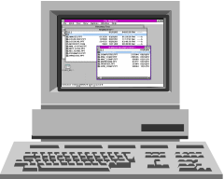
Main Mode (Kerberos)
Initiator
Responder
Header, SA Proposals
Header, Selected SA Proposal
Header, D-H Key Exchange, Nonce_{i}, Kerberos Token_{i}
Header, D-H Key Exchange, Nonce_{r}, Kerberos Token_{r}
Encrypted
Header, Id_{i}, Hash_{i}
Header, Id_{r}, Hash_{r}

Slide 22
Main Mode (Certificate)
Initiator
Responder
Header, SA Proposals
Header, Selected SA Proposal
Header, D-H Key Exchange, Nonce_{i}
Header, D-H Key Exchange, Nonce_{r},Certificate Request
Encrypted
Header, Id_{i}, Certificate_{i}, Signature_{i}, Certificate Request
Header, Id_{r}, Certificate_{r}, Signature_{r}

Slide 23
Main Mode (Pre-shared Key)
Initiator
Responder
Header, SA Proposals
Header, Selected SA Proposal
Header, D-H Key Exchange, Nonce_{i}
Header, D-H Key Exchange, Nonce_{r}
Encrypted
Header, Id_{i}, Hash_{i}
Header, Id_{r}, Hash_{r}

Slide 24
Quick Mode
All traffic is encrypted using the ISAKMP Security Association
Each quick mode negotiation results in two IPSec Security Associations (one inbound, one outbound)

Slide 25
Quick Mode Negotiation
Initiator
Responder
Encrypted
Header, IPSec Proposed SA
Header, IPSec Selected SA
Header, Hash
Header, Connected Notification

Slide 26
Architecture & Concepts
Tunnel vs. Transport mode
Security association (SA)
  Security parameter index (SPI)
  Security policy database (SPD)
  SA database (SAD)
Authentication header (AH)
Encapsulating security payload (ESP)
Practical Issues w/ NAT

Slide 27
Security Association - SA
Have a database of Security Associations
Determine IPSec processing for senders
Determine IPSec decoding for destination
SAs are not fixed! Generated and customized per traffic flows
Notes:
Defined by 3 parameters:
Security Parameters Index (SPI)
IP Destination Address
Security Protocol Identifier

Slide 28
Security Parameters Index - SPI
Can be up to 32 bits large
The SPI allows the destination to select the correct SA under which the received packet will be processed
  According to the agreement with the sender
  The SPI is sent with the packet by the sender
SPI + Dest IP address + IPSec Protocol (AH or ESP) uniquely identifies a SA
Notes:
Dest IP can be a security gateway.

Slide 29
SA Database - SAD
Holds parameters for each SA
  Lifetime of this SA
  AH and ESP information
  Tunnel or transport mode
Every host or gateway participating in IPSec has their own SA database
Notes:
See page 168, Stallings

Slide 30
Security Policy Database - SPD
What traffic to protect?
Policy entries define which SA or SA bundles to use on IP traffic
Each host or gateway has their own SPD
Index into SPD by Selector fields
  Dest IP, Source IP, IPSec Protocol, Transport Protocol, Source & Dest Ports, …
Notes:
See page 169, Stallings

Slide 31
Security Policy Database - SPD
What traffic to protect?
Policy entries define which SA or SA bundles to use on IP traffic
Each host or gateway has their own SPD
Index into SPD by Selector fields
  Dest IP, Source IP, IPSec Protocol, Transport Protocol, Source & Dest Ports, …
Notes:
See page 169, Stallings

Slide 32
SPD Entry Actions
Discard
  Do not let in or out
Bypass
  Outbound: do not apply IPSec
  Inbound: do not expect IPSec
Protect – will point to an SA or SA bundle
  Outbound: apply security
  Inbound: check that security must have been applied
Notes:
Doraswamy & Harkins, page 45

Slide 33
SPD Protect Action
If the SA does not exist…
  Outbound processing: use IKE to generate SA dynamically
  Inbound processing: drop packet
Notes:
Doraswamy & Harkins, page 46

Slide 34

Outbound Processing
Outbound packet (on A)
A
B
IP Packet
SPD
(Policy)
SA Database
Is it for IPSec?
If so, which policy
entry to select?
IPSec processing
…
…
SPI & IPSec Packet
Determine the SA and its SPI
Send to B
Notes:
SA Selectors figure out which policy in SPD applies to traffic

Slide 35
Inbound Processing
Inbound packet (on B)
A
B
From A
SA Database
SPD
(Policy)
SPI & Packet
Use SPI to
index the SAD
Was packet properly
secured?
Original IP Packet
…
“un-process”
…

Slide 36
Architecture & Concepts
Tunnel vs. Transport mode
Security association (SA)
  Security parameter index (SPI)
  Security policy database (SPD)
  SA database (SAD)
Authentication header (AH)
Encapsulating security payload (ESP)
Practical Issues w/ NAT

Slide 37
Authenticated Header
Data integrity
  Entire packet has not been tampered with
Authentication
  Can “trust” IP address source
Anti-replay feature
Integrity check value
Notes:
Use MAC to authenticate
Symmetric encryption, e.g, DES
One-way hash functions, e.g, HMAC-MD5-96 or HMAC-SHA-1-96
Key Exchange: Diffie-Hellman
􀁻Encryption: DES-CBS
􀁻Authentication: HMAC

Slide 38
IPSec Authenticated Header
Length of the authentication header
SAD
Next Header
(TCP/UDP)
Payload Length
Reserved
SPI
…
Sequence Number
ICV
Notes:
Stallings Figure 16.3 shows the Authentication Header fields:
• Next Header (8 bits): Identifies the type of header immediately following this header
• Payload Length (8 bits): Length of Authentication Header in 32-bit words, minus 2.
• Reserved (16 bits): For future use
• Security Parameters Index (32 bits): Identifies a security association
• Sequence Number (32 bits): A monotonically increasing counter value
• Authentication Data (variable): A variable-length field (must be an integral number of 32-bit words) that contains the Integrity Check Value (ICV), or MAC,for this packet

Slide 39
Integrity Check Value - ICV
Keyed Message authentication code (MAC) calculated over
  IP header field that do not change or are predictable
    Source IP address, destination IP, header length, etc.
    Prevent spoofing
    Mutable fields excluded: e.g., time-to-live (TTL), IP header checksum, etc.
  IPSec protocol header except the ICV value field
  Upper-level data
Code may be truncated to first 96 bits

Slide 40
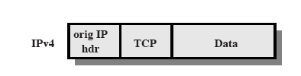
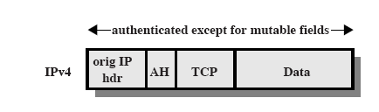
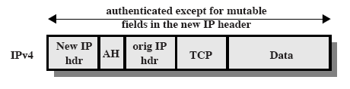
AH: Tunnel and Transport Mode
Original
Transport Mode
  Cover most of the original packet
Tunnel Mode
  Cover entire original packet

Slide 41
Encapsulating Security Payload (ESP)
Provide message content confidentiality
Provide limited traffic flow confidentiality
Can optionally provide the same authentication services as AH
Supports range of ciphers, modes, padding
  Incl. DES, Triple-DES, RC5, IDEA, CAST etc
  Pad to meet blocksize, for traffic flow

Slide 42
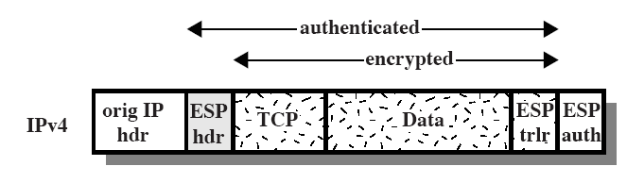
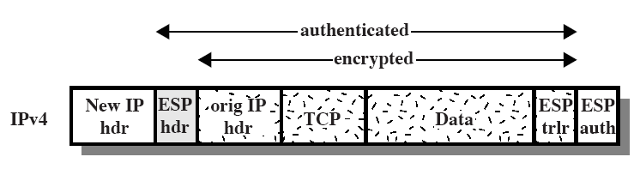
ESP: Tunnel and Transport Mode
Original
Transport Mode
  Good for host to host traffic
Tunnel Mode
  Good for VPNs, gateway to gateway security

Slide 43
Outbound Packet Processing
Form ESP header
  Security parameter index (SPI)
  Sequence number
Pad as necessary
Encrypt result [payload, padding, pad length, next header]
Apply authentication (optional)
  Allow rapid detection of replayed/bogus packets
  Integrity Check Value (ICV) includes whole ESP packet minus authentication data field

Slide 44
ESP Transport Example
Original IP Header
SPI
Sequence Number
Authentication coverage
Payload (TCP Header and Data)
Variable Length
Encrypted
Padding (0-255 bytes)
Pad
Length
Next
Header
Integrity Check Value

Slide 45
Inbound Packet Processing...
Sequence number checking
  Duplicates are rejected!
Packet decryption
  Decrypt quantity [ESP payload,padding,pad length,next header] per SA specification
  Processing (stripping) padding per encryption algorithm
  Reconstruct the original IP datagram
Authentication verification (optional)
  Allow potential parallel processing - decryption & verifying authentication code

Slide 46
Architecture & Concepts
Tunnel vs. Transport mode
Security association (SA)
  Security parameter index (SPI)
  Security policy database (SPD)
  SA database (SAD)
Authentication header (AH)
Encapsulating security payload (ESP)
Practical Issues w/ NAT

Slide 47
IPSec Pros
Hides the identity of your network
Provides secure channel: confidentiality, authenticity, and integrity
Connects sites (e.g., branch offices) with a cost-effective secure network compared with leased lines
Allows user to work from home and mobile hosts

Slide 48
IPSec Cons
A single failure in the path disconnect the entire network. Also cause performance bottlenecks.
Incompatible with NAT/PAT depending on the architecture
Tunneled traffic is undetected by IDS
VPN gateways might be compromised which leads to uncovering protected data

Slide 49
NATs
Network address translation = local, LAN-specific address space translated to small number of globally routable IP addresses
Motivation:
  Scarce address space
  Security: prevent unsolicited inbound requests
Prevalence of NATs
  Claim: 50% of broadband users are behind NATs
  All Linksys/D-Link/Netgear home routers are NATs

Slide 50
NAT types
All use net-10/8 (10.*.*.*) or 192.168/16
Address translation
Address-and-port translation (NAPT)
  most common form today, still called NAT
  one external (global) IP address
Change IP header and TCP/UDP headers
Notes:
No, no matter transport mode, tunnel mode, AH or ESP.

Slide 51

NAT Example
Messages sent between host B
to another host on the Internet
Host B original source socket:
192.168.0.101 port 1341
Host B translated socket:
68.40.162.3 port 5280
IAP’s Point of Presence
A
B
C
Router with NAT
External IP: 68.40.162.3
Internal IP: 192.168.0.0
Router assigns internal
IPs to hosts on LAN :
A: 192.168.0.100
B: 192.168.0.101
C: 192.168.0.102

Slide 52
Will IPSec Work with NAT ?
Consider both AH and ESP protocols.
Consider both transport and tunnel modes. For tunnel mode, consider the following two cases
  Sender – NAT – IPSec Gateway 1 – IPSec Gateway 2 – Receiver
  Sender – IPSec Gateway 1 – NAT – IPSec Gateway 2 – Receiver
What about no port # translation?
Practical solutions for NAT to work w/ IPSec
  IPSec – NAC Compatibility Requirements: RFC 3715
  UDP Encapsulation of IPsec ESP Packets: RFC 3948

Slide 53
Backup Slides
Notes:
Transport mode,
AH, no
ESP, no (b/c port # and checksum need to be changed)
IPsec ESP transport mode is imcompatible with NAT. In the case of TCP/UDP packets,
NAT would need to update the checksum in TCP/UDP headers, when an address in IP header is changed. However, as the TCP/UDP header is encrypted by the ESP, NAT would not be able to make this checksum update. As a result, TCP/UDP packets encrypted in transport mode ESP, traversing a NAT device will fail the TCP/UDP checksum validation on the receiving end and will simply not reach the target application.
For tunnel modes.
For config a: yes for both AH and ESP
For config b: No for both AH and ESP (b/c port # cannot be changed), unless specific reasons are given for ESP tunnel modes, e.g., UDP encapsulation.
But for NAT w/o port #, config b can work w/ ESP.

Slide 54
Combining Security Associations
SA’s can implement either AH or ESP
to implement both need to combine SA’s
  form a security association bundle
  may terminate at different or same endpoints
  combined by
    transport adjacency
    iterated tunneling
issue of authentication & encryption order
Notes:
An individual SA can implement either the AH or ESP protocol but not both. Sometimes a particular traffic flow will call for the services provided by both AH and ESP. Further, a particular traffic flow may require IPSec services between hosts and ,for that same flow, separate services between security gateways, such as firewalls. In all of these cases, multiple SAs must be employed for the same traffic flow to achieve the desired IPSec services. The term security association bundle refers to a sequence of SAs through which traffic must be processed to provide a desired set of IPSec services. The SAs in a bundle may terminate at different endpoints or at the same endpoints.
Security associations may be combined into bundles in two ways:
• Transport adjacency: more than one security protocol on same IP packet, without invoking tunneling
• Iterated tunneling: application of multiple layers of security protocols effected through IP tunneling
One interesting issue is the order in which authentication and encryption may be applied between a given pair of endpoints.

Slide 55
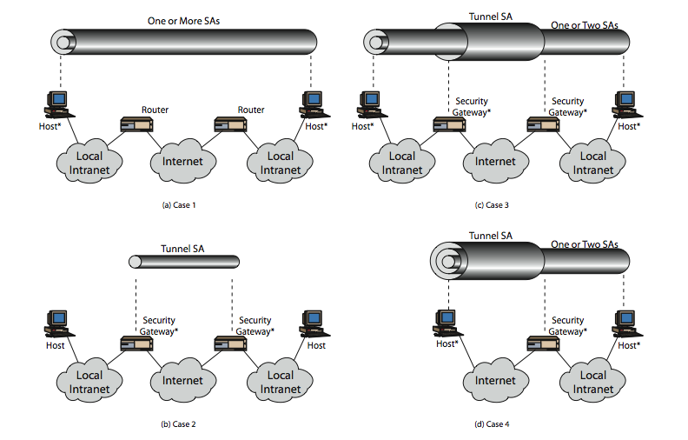
Combining Security Associations
Notes:
The IPSec Architecture document lists four examples of combinations of SAs that must be supported by compliant IPSec hosts or security gateways. These are illustrated in Stallings Figure 16.10. Note the *’d devices implement IPSec. The cases are:
Case 1 security is provided between end systems that implement IPSec.
Case 2 security is provided only between gateways (routers,firewalls,etc.) and no hosts implement IPSec.
Case 3 builds on Case 2 by adding end-to-end security .The same combinations discussed for cases 1 and 2 are allowed here.
Case 4 provides support for a remote host that uses the Internet to reach an organization’s firewall and then to gain access to some server or workstation behind the firewall. Only tunnel mode is required between the remote host and the firewall.

Slide 56
SA Bundle
More than 1 SA can apply to a packet
Example: ESP does not authenticate new IP header. How to authenticate?
  Use SA to apply ESP w/o authentication to original packet
  Use 2nd SA to apply AH

Slide 57
Outbound Packet Processing...
Integrity Check Value (ICV) calculation
  ICV includes whole ESP packet minus authentication data field
  Implicit padding of ‘0’s between next header and authentication data is used to satisfy block size requirement for ICV algorithm

Slide 58
Inbound Packet Processing
Sequence number checking
  Anti-replay is used only if authentication is selected
  Sequence number should be the first ESP check on a packet upon looking up an SA
  Duplicates are rejected!
Check bitmap, verify if new
reject
verify
Sliding Window
size >= 32
0

Slide 59
Anti-replay Feature
Optional
Information to enforce held in SA entry
Sequence number counter - 32 bit for outgoing IPSec packets
Anti-replay window
  32-bit
  Bit-map for detecting replayed packets

Slide 60
Anti-replay Sliding Window
Window should not be advanced until the packet has been authenticated
Without authentication, malicious packets with large sequence numbers can advance window unnecessarily
  Valid packets would be dropped!
Notes:
D & H, p 47

Slide 61
ESP Processing - Header Location...
IPv4
New
IP hdr
ESP
hdr
Orig
IP hdr
TCP
Data
ESP
trailer
ESP
Auth
IPv6
New
IP hdr
New
ext hdr
ESP
hdr
Orig
IP hdr
Orig
ext hdr
TCP
Data
ESP
trailer
ESP
Auth
Tunnel mode IPv4 and IPv6

Slide 62
Key Management
Handles key generation & distribution
Typically need 2 pairs of keys
  2 per direction for AH & ESP
Manual key management
  Sysadmin manually configures every system
Automated key management
  Automated system for on demand creation of keys for SA’s in large systems

