Slide 1
Java Petri Network Simulator (JPeNS)
Team 5
Jonathan Babbitt
&
Chris Hobbs

Slide 2
What is JPeNS?
Designed to aid in comprehension of Petri Networks
Displays the network along with buttons allowing the user to fire each transition one by one so they can step through and understand the network at their own pace
Supports the importing of premade networks from XML files so instructors can send XML files to students to load up and view
Color coded interface for more intuitive controls

Slide 3
Why We Chose Petri Networks?
They are an interesting topic
Sometimes a difficult topic to learn for people without a computing or engineering background
Could be taught at various levels of the education system given the right tools
Useful for mapping a broad range of trigger based systems
Software design Workflow management Process Modeling | Data analysis Diagnosis Simulation

Slide 4
JPeNS System Description
Loads up XML file and parses the nodes into lists
Goes through the various lists and creates buttons and labels for the transitions and places
Creates mxGraph objects for the various items of the network
Displays the graph in the main window
Gives you the ability to fire transitions in any order you like
Automatically updates the color coding each firing

Slide 5
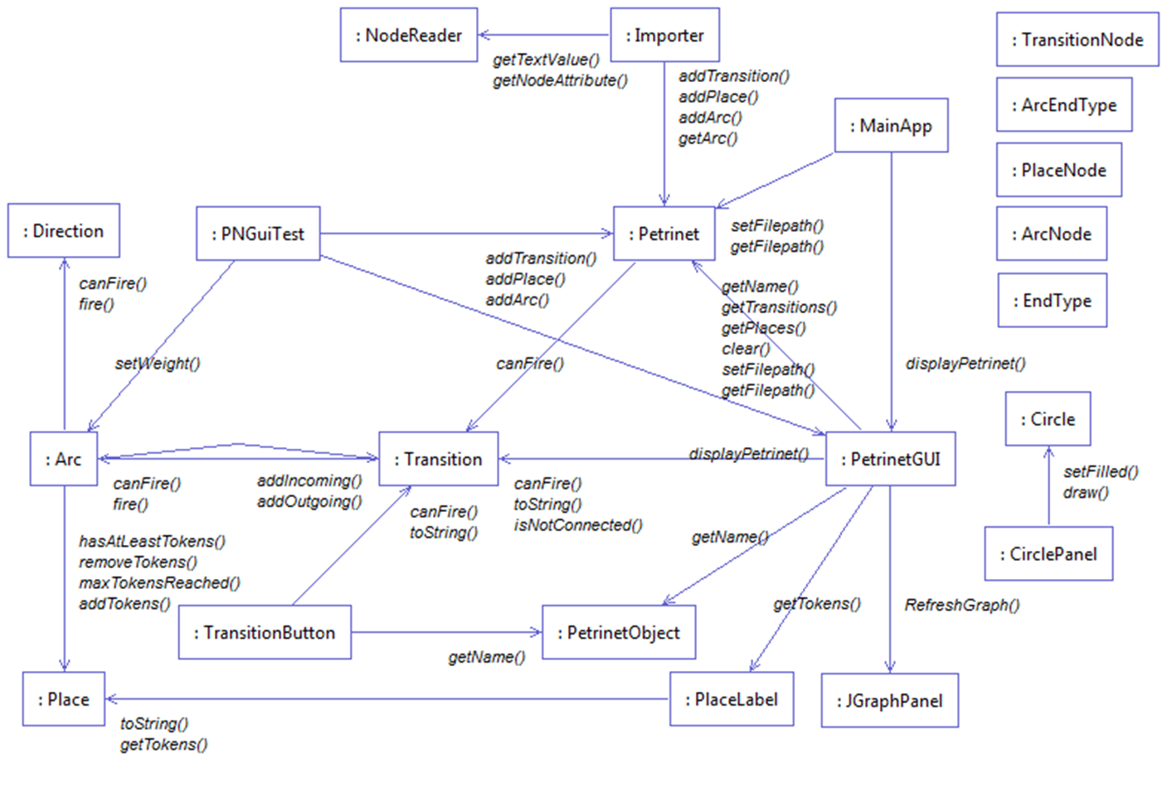

Slide 6
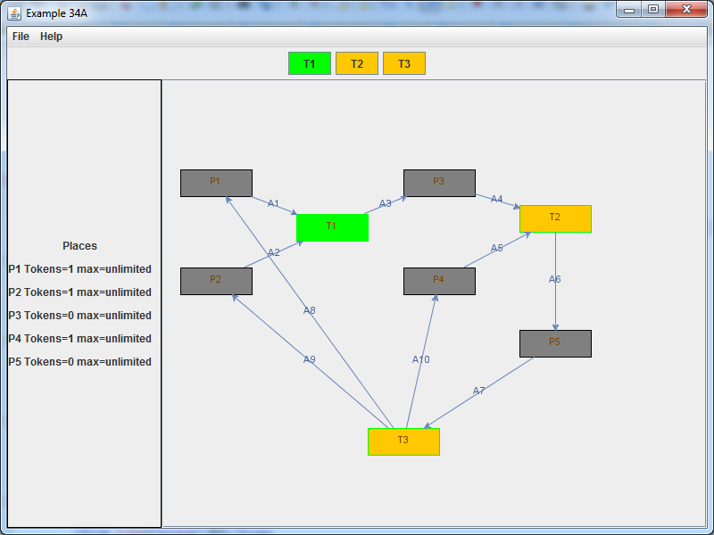
Results
Our final project came out very satisfying. It has a great intuitive feel and looks exactly how we imagined it. It is super easy to use and very easy to understand how the given networks function.

Slide 7
Conclusion

