Slide 1
Java Petri Network Simulator (JPeNS)
Team 5
Jonathan Babbitt
&
Chris Hobbs

Slide 2
What is JPeNS?
Designed to aid in comprehension of Petri Networks
Displays the network along with buttons allowing the user to fire each transition one by one so they can step through and understand the network at their own pace
Supports the importing of premade networks from XML files so instructors can send XML files to students to load up and view
Color coded interface for more intuitive controls

Slide 3
Why We Chose Petri Networks?
They are an interesting topic
Sometimes a difficult topic to learn for people without a computing or engineering background
Could be taught at various levels of the education system given the right tools
Useful for mapping a broad range of trigger based systems
Software design Workflow management Process Modeling | Data analysis Diagnosis Simulation

Slide 4
JPeNS System Description

Slide 5
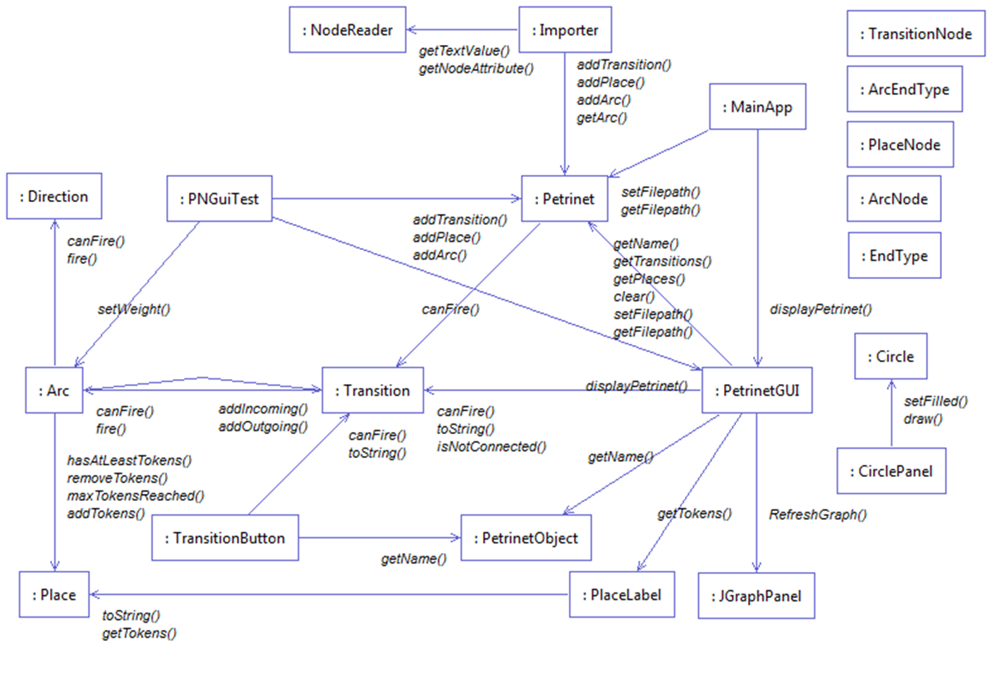

Slide 6

Results
Tested positive for usefulness?

Slide 7
Conclusion

