Slide 1
Java Petri Network Simulator (JPeNS)
Team 5
Chris Hobbs & Jonathan Babbitt
https://github.com/Hobbit/JPeNS

Slide 2
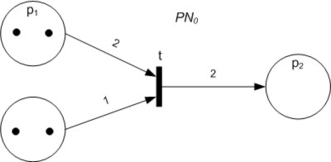
Petri Networks
A directed graph
Consists of Places, Transitions, Arcs
http://en.wikipedia.org/wiki/File:Petri_Net_A.jpg

Slide 3



Turning off the lights
3 doors open
2 doors open
1 doors open
Lights Off
Close Door
Close Door
Close Door

Slide 4
What is JPeNS?
Aid in comprehension of Petri Networks
Visual representation of networks
XML based file I/O
Color coded interface

Slide 5
Why We Chose Petri Networks?
Interesting topic
Difficult topic to learn
Taught at various levels of the education
Useful for mapping a broad range of trigger based systems
Software design Workflow management Process Modeling | Data analysis Diagnosis Simulation

Slide 6
JPeNS System Description
Utilizes XML files
Generates lists for transitions, places, etc
Generates GUI objects and mxGraph
Displays the main window
Fire transitions in any order you like
Updates the color coding each firing

Slide 7
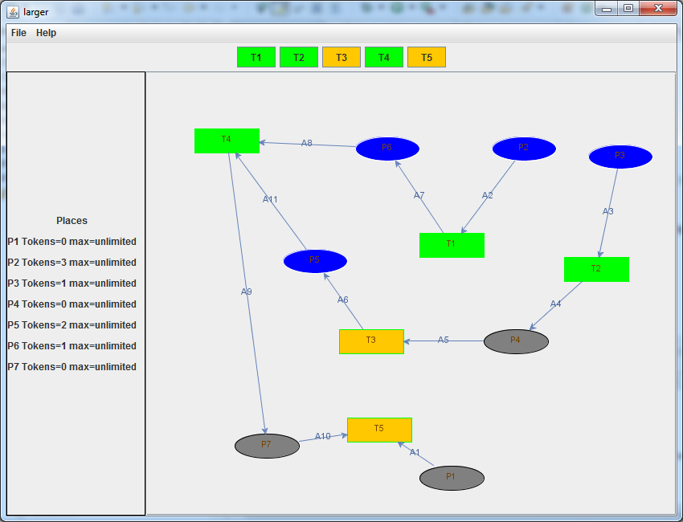
Results

Slide 8
Demo

Slide 9
