Slide 1
Java Petri Network Simulator (JPeNS)
Team 5
Jonathan Babbitt & Chris Hobbs

Slide 2
What is JPeNS?
Aid in comprehension of Petri Networks
Visual representation of networks
XML based file I/O
Color coded interface

Slide 3
Why We Chose Petri Networks?
Interesting topic
Difficult topic to learn
Taught at various levels of the education
Useful for mapping a broad range of trigger based systems
Software design Workflow management Process Modeling | Data analysis Diagnosis Simulation

Slide 4
JPeNS System Description
Utilizes XML files
Generates lists for transitions, places, etc
Generates GUI objects and mxGraph
Displays the main window
Fire transitions in any order you like
Updates the color coding each firing

Slide 5
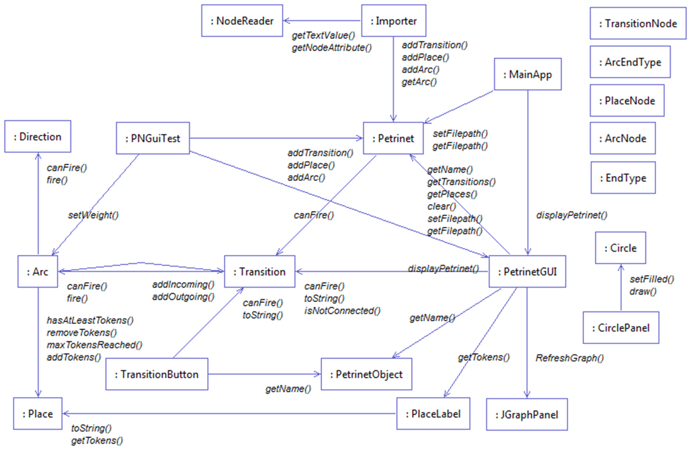

Slide 6
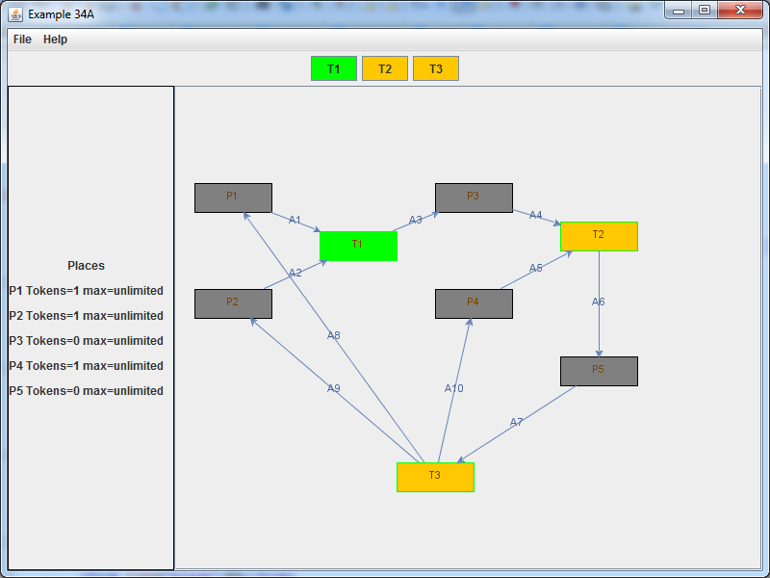
Results
Postive?

Slide 7
Conclusion

