Slide 1
Introduction to Distributed Consistency
Jingqi Chen
Notes:
最近读了两篇论文，Chubby和ZooKeeper；所以稍微写了一点关于这个的。
我觉得Shuo的distributed system learning早晚也会讲这两篇paper中的任意一篇，所以我这里不会涉及过多的技术细节，而更关注较为上层的设计和理念。

Slide 2
What
Consistency is contract between programmer and system.
For instance, we can use locks to get consistency of variables in concurrent programming.
It is much more complex and difficult to get consistency in a distributed system.
C in CAP theorem.
Notes:
Any by the way,

Slide 3
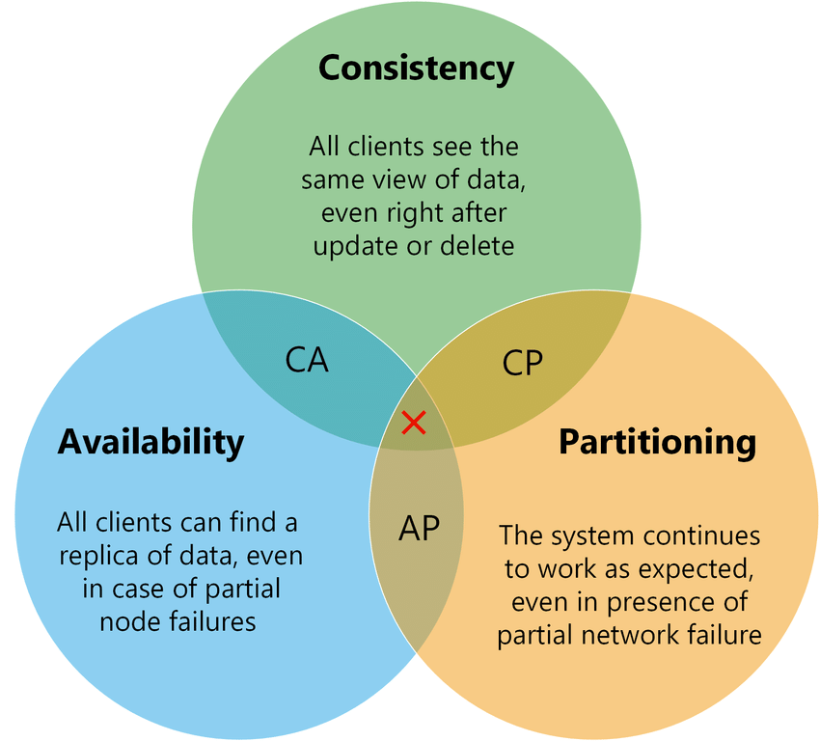

CAP
CA:
Chubby, ZooKeeper
CP:
BigTable, HBase
AP:
Dynamo, Cassandra

Slide 4
Why
All CA, CP systems need a C component.
The only difference is whether the C component is the system itself (CA system) or part of the it (CP system).
Without C, the only choice is the tradeoff between more computing effort and human intervention.

Slide 5
How
Distributed consensus algorithm is needed.
Basically it is something that the data will be there only if majority of servers are alive.
So we can define a state machine and put the command of it into distributed consensus store.
Then we can have some logic above the state machine.

Slide 6
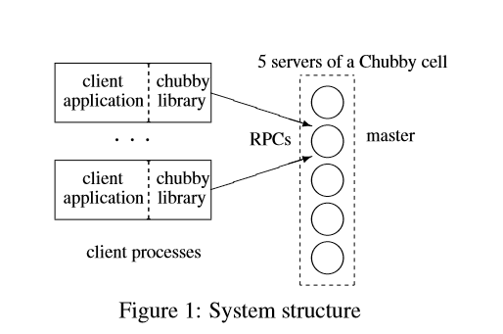
Case Study - Chubby
Chubby, a lock service, is intended for use within a loosely coupled distributed system consisting of moderately large numbers of small machines connected by a low latency network.

Slide 7
Chubby - Rationale
Why not consensus library or consensus service?
For consensus library:
It is quite hard to know how to use consensus library exactly.
Consensus library must run separately with the distributed service layer (BE in Exchange), which is almost the same for services and not light.
For consensus service:
Not better in common scenarios.
Notes:
And if there is consensus library, then the minimum of a service is 5 machines.
But there do exist consensus service

Slide 8
Chubby - Usage
GFS uses a Chubby lock to appoint a GFS master server, and Bigtable uses Chubby in several ways, to elect a master, to allow the master to discover the servers it controls and to permit clients to find the server.
Name service.
Repo of configuration information. (etcd)

Slide 9
Chubby – Discovery and Auto Failover
Clients find the master by sending master location requests to the replicas listed in the DNS.
If a replica fails and does not recover for a few hours, a simple replacement system selects a fresh machine from a free pool and starts the lock server binary on it.
It then updates the DNS tables, replacing the IP address of the failed replica with that of the new one.

Slide 10
Chubby – Nodes
Chubby exports a file system interface similar to, but simpler than that of UNIX; it is a tree.
The name space contains only files and directories, collectively called nodes. Every such node has only one name within one Chubby cluster.
Notes:
The per-node meta-data includes four monotonically increasing 64-bit numbers that allow clients to detect changes easily:
1. an instance number; greater than the instance number of any previous node with the same name
2. a content generation number (files only); this increases when the file’s contents are written
3. a lock generation number; this increases when the node’s lock transitions from *free* to *held*
4. an ACL generation number; this increases when the node’s ACL names are written

Slide 11
Chubby – API
Open()
Close()
GetContentAndStat()
SetContents()
SetACL()
Delete()
Acquire(), TryAcquire(), Release()
GetSequencer()
SetSequencer()
CheckSequencer()
Notes:
Clients can use this API to perform primary election as follows: All potential primaries open the lock file and attempt to acquire the lock.
One succeeds and becomes the primary, while the others act as replicas.
The primary writes its identity into the lock file with SetContents() so that it can be found by clients and replicas, which read the file with GetContentsAndStat(), perhaps in response to a file-modification event.

Slide 12
Chubby - Caching
To reduce read traffic, Chubby clients cache file data and node meta-data (including file absence) in a consistent, write-through cache held in memory.
When file data or meta data is to be changed, the modification is blocked while the master sends invalidations for the data to every client that may have cached it; this mechanism sits on top of KeepAlive RPCs.

Slide 13
Chubby - Performance
Failover duration - ~10s
RPC rate 1-2k/s; KeepAlive >90%
Stored Files; 90% <1k; 10% 1-10k; 0.2% > 10k
1 chubby cluster can serve ~10k machines
Interesting thing: use consistent hashing to choose chubby cluster

Slide 14
Consistency on Cloud
DynamoDB Lock Client
Single row operations in DynamoDB are atomic, which is powered by the underlying lock service using by DynamoDB and distributed file system (I assume DynamoDB is shared-storage).

Slide 15
Reference and QA
Burrows, Mike. "The Chubby lock service for loosely-coupled distributed systems." Proceedings of the 7th symposium on Operating systems design and implementation. USENIX Association, 2006.

