Slide 1

Family Health Tracker
A Private, On-Device Wellness Benefit for Your Workforce
Lower healthcare costs. Fewer sick days. Sharper, more present teams.
Prepared for HR & Total Rewards leadership · August 2026

Slide 2
Health care costs are outrunning the budget
Three numbers every HR leader is already watching
$18,500+
9.5%
$575B
Average total employer health cost per employee, 2026
Projected rise in U.S. employer health care costs for 2026
Annual U.S. employer cost of poor employee health — 1.5 billion lost workdays
Source: Mercer, 2026 Employer Health Benefits Outlook
Source: Aon, 2026 U.S. Health Care Cost Projection
Source: Integrated Benefits Institute, analysis of BLS data
The cost problem
Family Health Tracker

Slide 3



Chronic, everyday conditions drive the spend
Obesity and overweight alone — one slice of the chronic-disease picture — cost U.S. employers $425.5B in 2023
Reduced productivity (presenteeism)
$160.3B
Excess medical costs
$146.5B
Absenteeism — missed workdays
$82.3B
Source: GlobalData / Nature Nutrition & Diabetes, “Assessing the Economic Impact of Obesity and Overweight on Employers,” Dec 2024
What's driving it
Family Health Tracker

Slide 4
However you measure it, the number is enormous
Three independent estimates of the annual U.S. employer cost, in billions of dollars
Sources: Gallup (2013 absenteeism study) · GlobalData/Nature Nutrition & Diabetes (Dec 2024) · Integrated Benefits Institute (BLS analysis)
The productivity drain
Family Health Tracker

Slide 5


Everyday engagement has a proven return
The most-cited benchmark in the field — a meta-analysis of 36 peer-reviewed workplace wellness studies
$3.27
$2.73
saved in medical costs
for every $1 invested in workplace wellness engagement
saved in absentee-day costs
for every $1 invested in workplace wellness engagement
Source: Baicker, Cutler & Song, “Workplace Wellness Programs Can Generate Savings,” Health Affairs, 2010 (Harvard)
It's the field's oldest large benchmark and still its most-cited — later research refines it, but nothing since has replaced it.
What works
Family Health Tracker

Slide 6
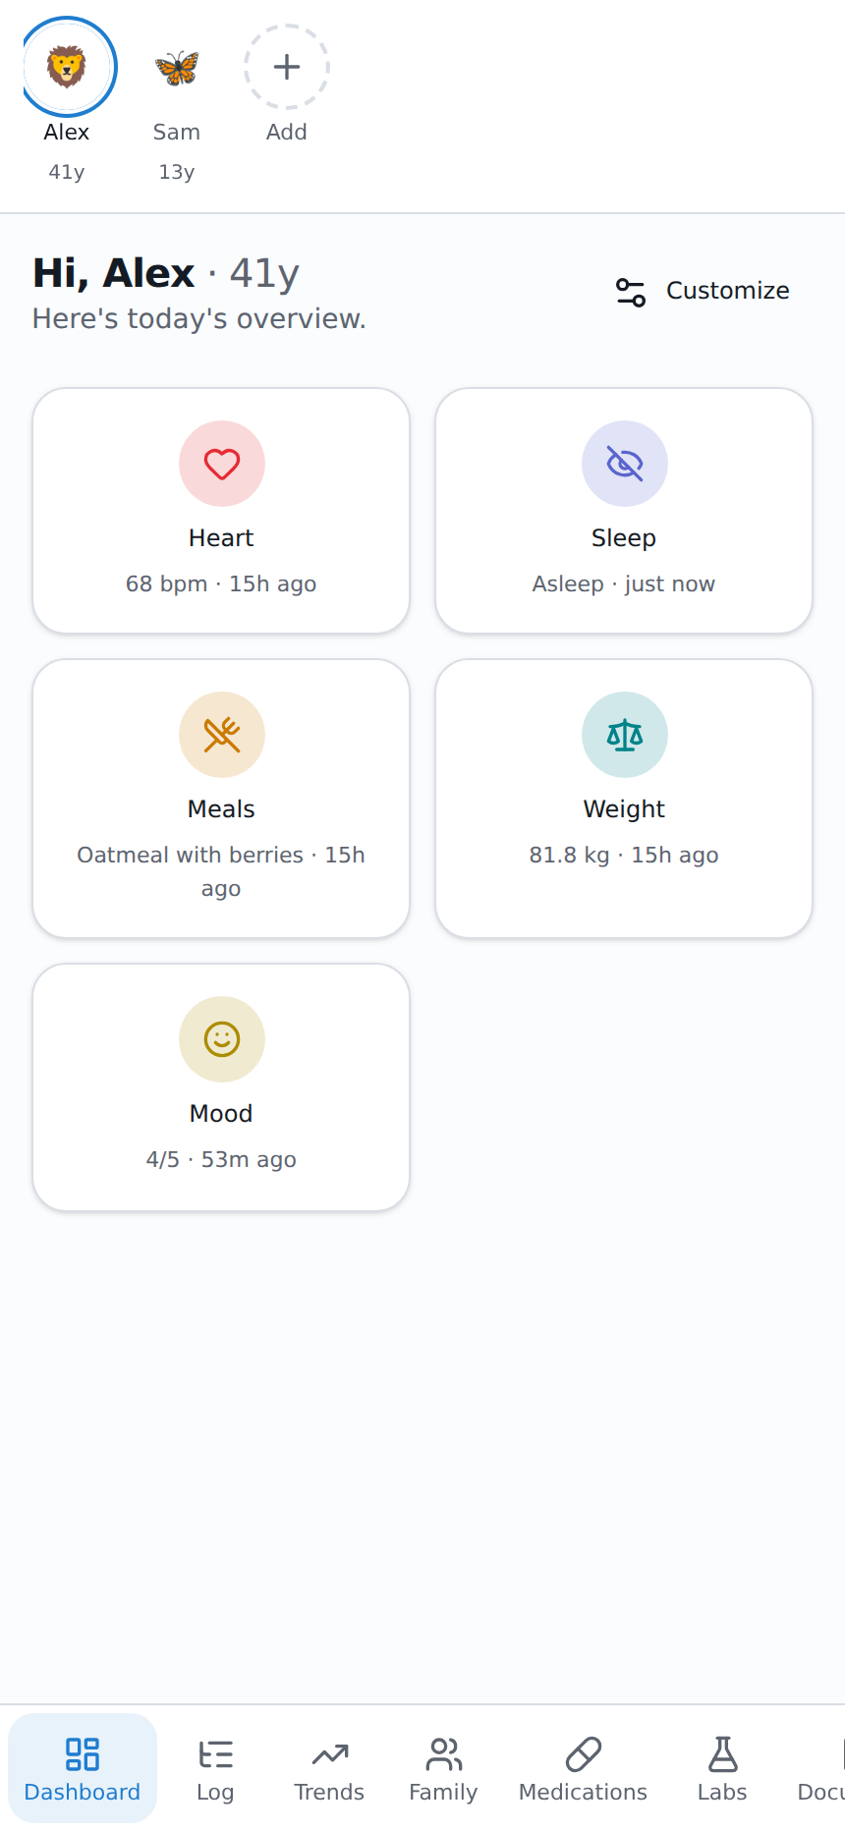
Meet the daily-use layer
Family Health Tracker is a free, multi-profile household health app. Every family member logs heart rate, sleep, meals, medications, and more in seconds — and everyday use is exactly what a wellness incentive program needs to actually work.
Works for one person or the whole household
Zero setup for HR or IT — it's a free download, nothing to administer
Every metric a wellness program cares about, in one place
Introducing Family Health Tracker
Family Health Tracker

Slide 7








Built for real households, not a corporate portal
Full symptom & vitals tracking
Trends over time
Family comparison
Lab results & flagging
Heart rate, sleep, weight, blood pressure, glucose, mood, and more
Day / week / month / custom-range charts for every metric
See how household members' data moves together, side by side
Thyroid, vitamin, lipid panels — auto-flagged against reference ranges
Medication tracking
Healthy tips & reminders
Nutrition label scanner
Import past health data
Per-profile med lists with taken/missed/skipped dose logging
Daily wellness tips plus optional on-device reminders
Photograph a label to auto-fill a meal's nutrition facts
Bring in an Apple Health export or CSV for long-term history
Feature overview
Family Health Tracker

Slide 8


Privacy isn't a feature here — it's the architecture
Why that matters for adoption: employees only try a wellness benefit they trust with their health data
Typical wellness apps
Family Health Tracker
Data uploaded to a vendor's cloud servers
All data stays on the employee's own device — zero network calls
Requires an account and vendor privacy policy review
No account, no login, nothing to breach
IT/Legal must vet a third-party data processor
No server exists for IT/Legal to review
Employees often hesitate to log sensitive details
Works identically in airplane mode — verifiable, not just promised
Why privacy wins adoption
Family Health Tracker

Slide 9



Where this fits your incentive program
The daily-engagement layer
Employees use it to actually build the habits your program rewards — logging vitals, meals, labs, and medication adherence day to day, not just once a quarter.
Pairs with what you already run
Works alongside points-based or self-attestation incentive structures you already administer — no new system for HR to stand up.
Honest about today's limits
There is no employer dashboard or aggregate reporting — by design, nothing leaves the device today. An optional, anonymized, opt-in reporting layer is a roadmap conversation we'd shape with a pilot partner, not a promise we're making now.
Fitting your program
Family Health Tracker

Slide 10

Let's pilot it
Propose a 6–8 week opt-in pilot with one team or department
Free to install — no procurement, no vendor contract to negotiate
Nothing for IT or Legal to review — there's no data processor relationship to establish
We'll check back in with participation trends you already track — not device data
Family Health Tracker · Private by design · github.com/HoboJellyphish/GitHubReposits

Slide 11

Sources
Mercer, “Employers and Workers Face Affordability Crunch as Health Insurance Cost Is Expected to Exceed $18,500 Per Employee in 2026,” 2025.
Aon, “U.S. Employer Health Care Costs Expected to Rise 9.5 Percent in 2026,” Sep 10, 2025.
Integrated Benefits Institute, “Poor Health Costs US Employers $575 Billion and 1.5 Billion Days of Lost Productivity,” analysis of U.S. Bureau of Labor Statistics data, 2015–2019.
GlobalData / Nature Nutrition & Diabetes, “Assessing the Economic Impact of Obesity and Overweight on Employers,” Dec 2024.
Gallup, “Unhealthy U.S. Workers’ Absenteeism Costs $153 Billion,” 2013.
Baicker, Cutler & Song, “Workplace Wellness Programs Can Generate Savings,” Health Affairs, 2010 (Harvard University; meta-analysis of 36 peer-reviewed studies).
Appendix
Family Health Tracker

