Slide 1
WHAT’S UP, HTML5?

Slide 2
New in HTML5
A new DOCTYPE
New elements and attributes
Obsolete 4.01 elements
APIs

Slide 3
A minimal DOCTYPE
The HTML5 declaration is short and sweet:
<! DOCTYPE html>
Compare that to a declaration for a Strict HTML 4.01 document:
<!DOCTYPE HTML PUBLIC "-//W3C//DTD HTML 4.01//EN" "http://www.w3.org/TR/HTML4.01/strict.dtd">
All the above syntax is case-insensitive
HTML5 does not have a DTD, which is why we have the simple DOCTYPE declaration.
Notes:
Discussion: What is DTD? The need for DTD?

Slide 4
Character Encoding
Character Encoding
<meta charset=“UTF-8”>
All the above syntax is case-insensitive

Slide 5
The <script> tag
Syntax
<script type="text/javascript" src="scriptfile.js"></script>
HTML 5 removes extra information required and you can use simply following syntax
<script src="scriptfile.js"></script>

Slide 6
The <link> tag
Syntax
<link rel="stylesheet" type="text/css" href="stylefile.css">
HTML 5 removes extra information required and you can use simply following syntax
<link rel="stylesheet" href="stylefile.css">

Slide 7
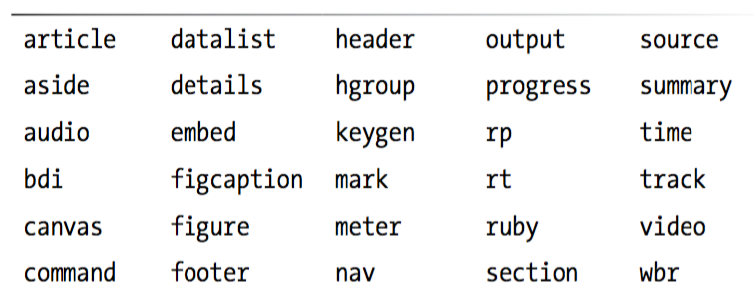
Elements and attributes
Besides the new input element which were introduced in the previous slide such as: color, date, datetime… HTML5 also introduce new elements and atributes
Notes:
Here we focus only on some elements: header, footer,aside,nav,section..

Slide 8
Organizing Page Content with HTML5 elements
Article
Section
Aside
Header
Footer
address
Notes:
Lecturer should provide a full example of combining all these elements in a web page

Slide 9
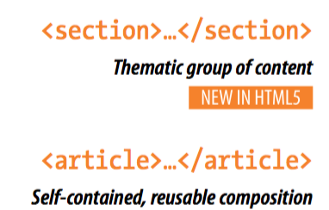
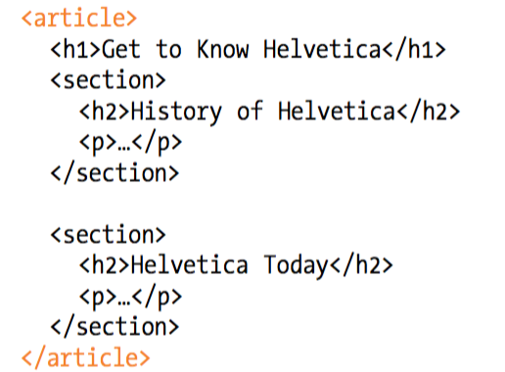
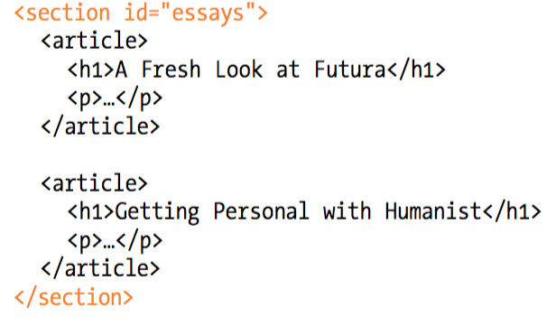
Article and Section
To divide long web documents into thematic sections
One section can contain many articles or one article can contain many section

Slide 10

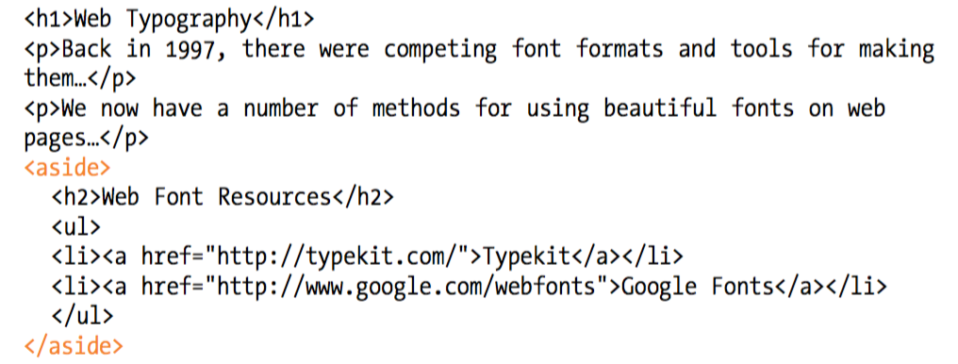
Aside (sidebars)
The aside element identifies content that is related but tangential to the surrounding content

Slide 11

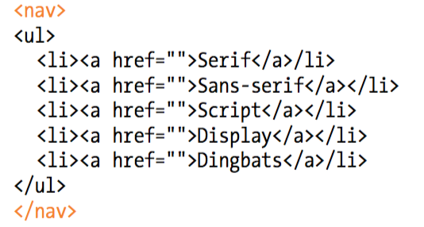
Navigation
The new nav element gives developers a semantic way to identify navigation for a site

Slide 12

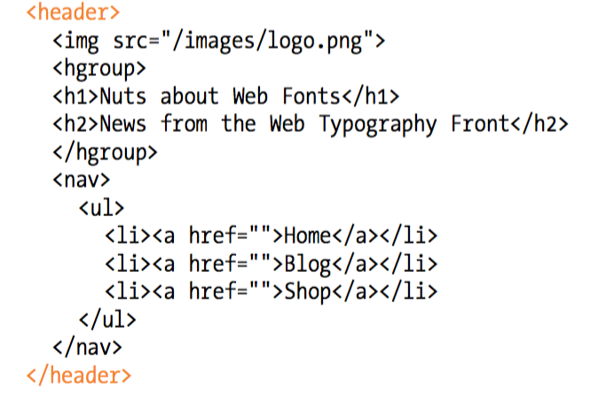
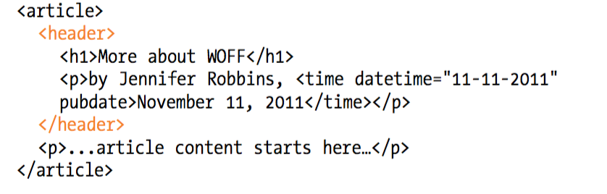
Headers
Header can appear at the beginning of the web page or in an individual article or section

Slide 13

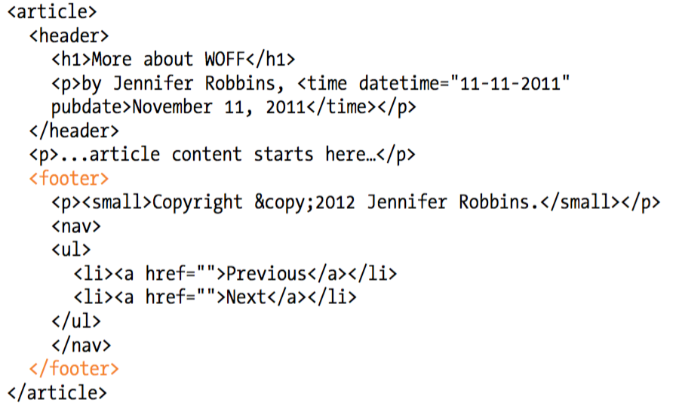
Footer

Slide 14
HTML5 Document - 1
The following tags have been introduced for better structure
section: This tag represents a generic document or application section. It can be used together with h1-h6 to indicate the document structure.
article: This tag represents an independent piece of content of a document, such as a blog entry or newspaper article.
aside: This tag represents a piece of content that is only slightly related to the rest of the page.
header: This tag represents the header of a section.

Slide 15
HTML5 Document - 2
footer: This tag represents a footer for a section and can contain information about the author, copyright information, etc.
nav: This tag represents a section of the document intended for navigation.
dialog: This tag can be used to mark up a conversation.
figure: This tag can be used to associate a caption together with some embedded content, such as a graphic or video.

Slide 16
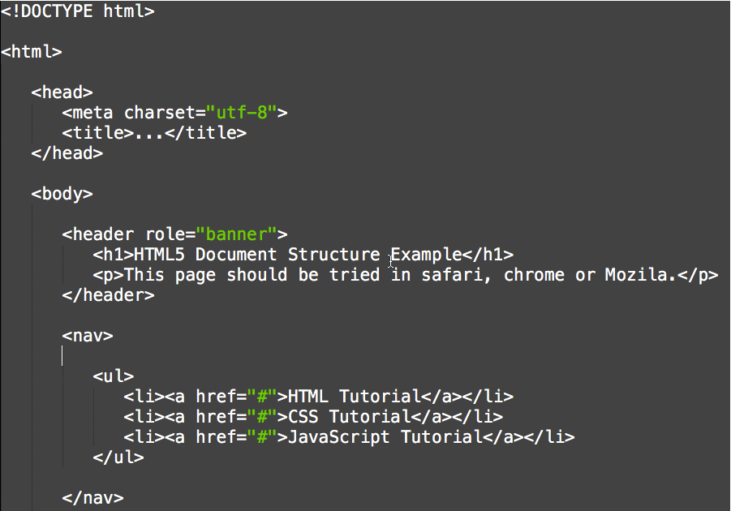

Slide 17
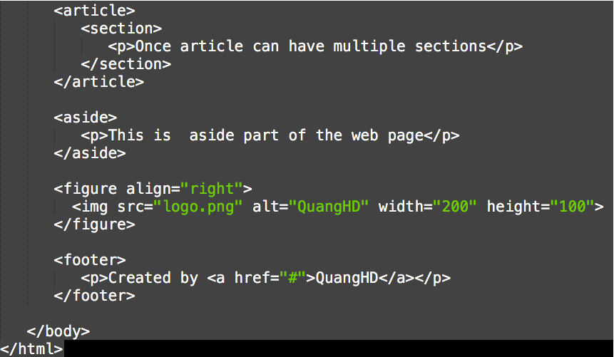
Result

Slide 18
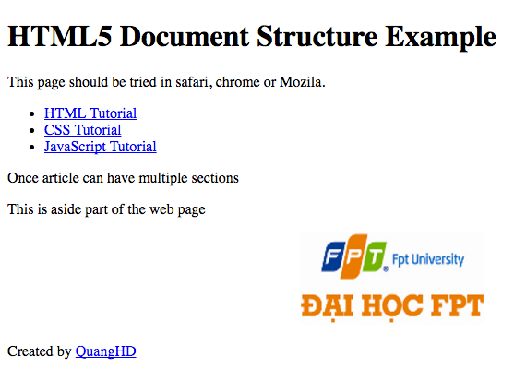
Result

Slide 19
Standard Attributes - 1
Attribute | Options | Function
accesskey | User Defined | Specifies a keyboard shortcut to access an element.
align | right, left, center | Horizontally aligns tags
background | URL | Places an background image behind an element
bgcolor | numeric, hexidecimal, RGB values | Places a background color behind an element
class | User Defined | Classifies an element for use with Cascading Style Sheets.
contenteditable | true, false | Specifies if the user can edit the element's content or not.
contextmenu | Menu id | Specifies the context menu for an element.

Slide 20
Standard Attributes - 2
Attribute | Options | Function
data-XXXX | User Defined | Custom attributes. Authors of a HTML document can define their own attributes. Must start with "data-".
draggable | true,false, auto | Specifies whether or not a user is allowed to drag an element.
height | Numeric Value | Specifies the height of tables, images, or table cells.
hidden | hidden | Specifies whether element should be visible or not.
id | User Defined | Names an element for use with Cascading Style Sheets.
item | List of elements | Used to group elements.
itemprop | List of items | Used to group items.

Slide 21
Standard Attributes - 3
Attribute | Options | Function
spellcheck | true, false | Specifies if the element must have it's spelling or grammar checked.
style | CSS Style sheet | Specifies an inline style for an element.
subject | User define id | Specifies the element's corresponding item.
tabindex | Tab number | Specifies the tab order of an element.
title | User Defined | "Pop-up" title for your elements.
valign | top, middle, bottom | Vertically aligns tags within an HTML element.
width | Numeric Value | Specifies the width of tables, images, or table cells.

Slide 22
Custom Attributes
A new feature being introduced in HTML 5 is the addition of custom data attributes.
A custom data attribute starts with data- and would be named based on your requirement. Following is the simple exampleof custom data attributes.
<div class="example" data-subject="physics" data-level="complex">
...
</div>
The above will be perfectly valid HTML5 with two custom attributes calleddata-subject and data-level.
You would be able to get the values of these attributes using JavaScript APIs or CSS in similar way as you get for standard attributes.

Slide 23
HTML5 – Web Forms 2.0 - 1
The <input> element in HTML4
text | password
checkbox | radio
submit | file
image | hidden
select | textarea
button

Slide 24
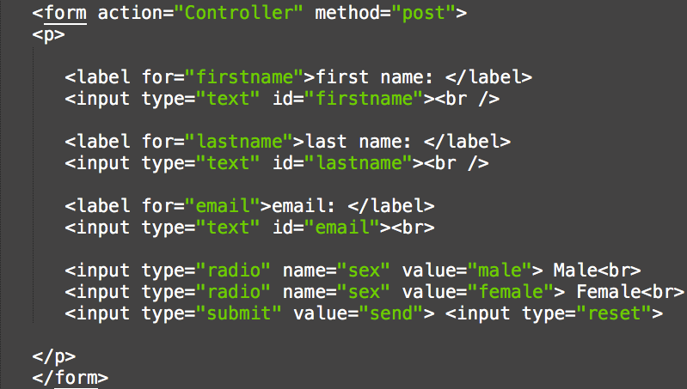
Example

Slide 25
HTML5 – Web Forms 2.0 - 2
New value for type attirbute of <input> element in HTML5
datetime | datetime-local
date | month
week | time
number | range
email | url

Slide 26
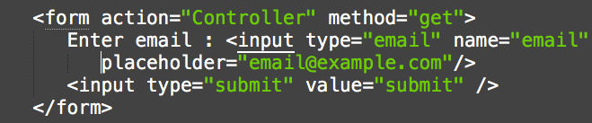
The placeholder attribute
HTML5 introduced a new attribute called placeholder.
Use on <input> and <textarea> elements provides a hint.
Examples:

Slide 27
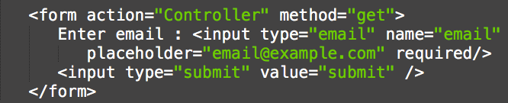
The required attribute
HTML5 introduced a new attribute called required replace javascript for client side validations empty text box
Example:

Slide 28
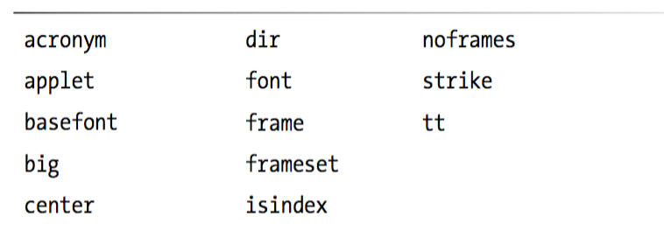
Obsolete HTML 4.01 Markup
Notes:
Obsolete: không dùng, cổ

Slide 29
APIs
Editing API
Drag and Drop API
Canvas AP
Web Storage API
Geolocation API
Web Workers API
Web Sockets API
Notes:
Just provide the overview of APIs not in details

Slide 30
Drag and Drop
Drag and Drop (DnD) is powerful User Interface concept
allows the user to click and hold the mouse button down over an element
drag it to another location
release the mouse button to drop the element there
DnD is supported by all the major browsers like Chrome, Firefox 3.5 and Safari 4 etc

Slide 31
DnD Events
dragstart: Fires when the user starts dragging of the object.
dragenter: Fired when the mouse is first moved over the target element while a drag is occuring.
dragover: This event is fired as the mouse is moved over an element when a drag is occuring.
dragleave: This event is fired when the mouse leaves an element while a drag is occuring.
drag: Fires every time the mouse is moved while the object is being dragged.
drop: The drop event is fired on the element where the drop was occured at the end of the drag operation.
dragend: Fires when the user releases the mouse button while dragging an object.

Slide 32
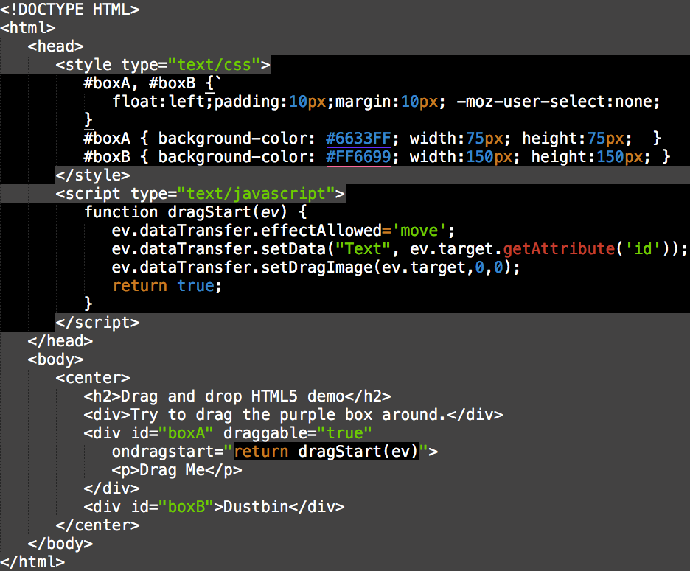
Example

Slide 33
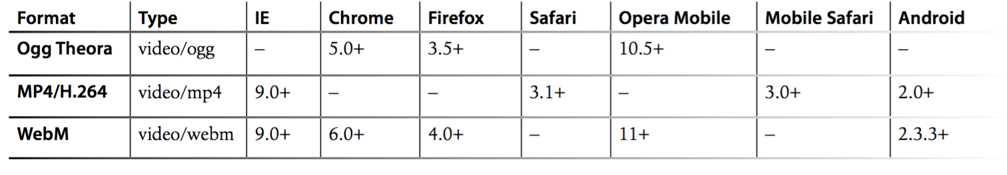
Videos supported

Slide 34


Adding a video to a page

Slide 35
Video Attributes - 1
autoplay: video will automatically begin to play back
autobuffer: video will automatically begin buffering
controls: allow to control video playback, including volume, seeking, and pause/resume playback
height: specifies the height of the video's display area, in CSS pixels.

Slide 36
Video Attributes - 2
loop: allow video automatically seek back to the start after reaching at the end
preload: video will be loaded at page load, and ready to run. Ignored if autoplay is present
poster: URL of an image to show until the user plays or seeks
src: The URL of the video to embed.
width: width of the video's display area, in CSS pixels.

Slide 37
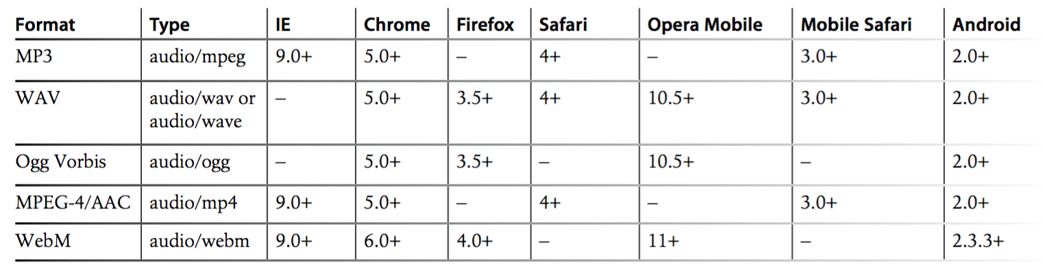
Audio supported

Slide 38

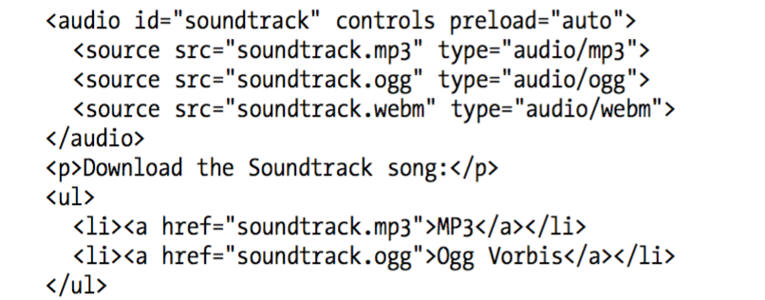
Adding audio to a page

Slide 39
Audio Attributes
autoplay: video will automatically begin to play back
autobuffer: video will automatically begin buffering
controls: allow to control video playback, including volume, seeking, and pause/resume playback
loop: allow video automatically seek back to the start after reaching at the end
preload: video will be loaded at page load, and ready to run. Ignored if autoplay is present
src: The URL of the audio to embed.

Slide 40
Canvas
Gives an easy and powerful way to draw graphics using JavaScript.
Can be used to draw graphs
Make photo compositions
Do simple (and not so simple) animations

Slide 41
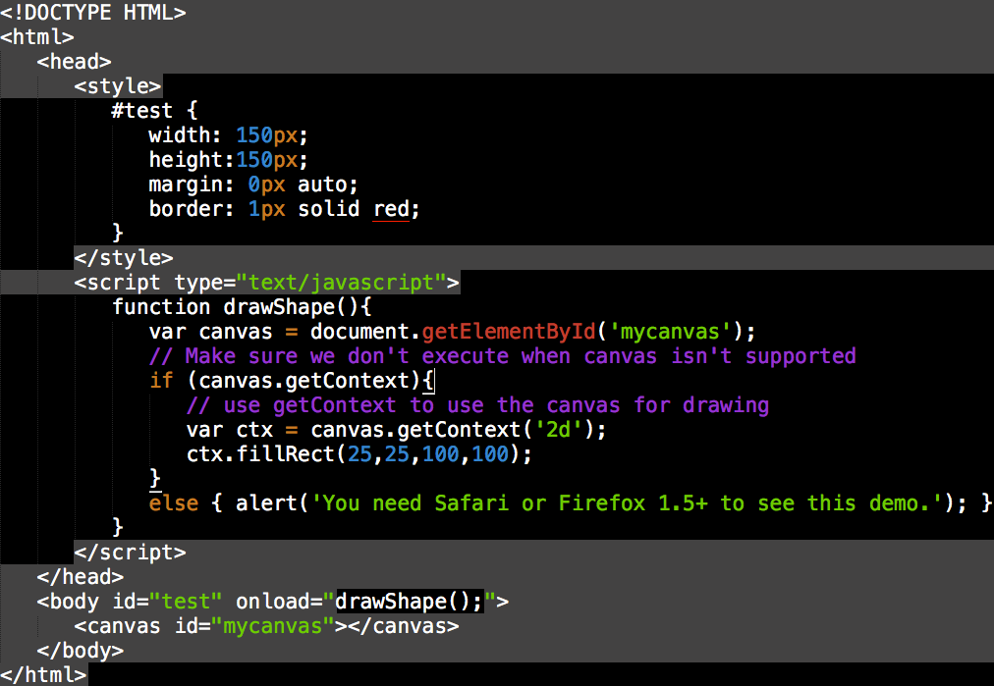
Example

Slide 42
Summary
Introduce new elements in HTML5: section, article, header…
Adding videos, audio to a web page

