Slide 1
Verilog设计概要
孟宪元
mengxy@mail.tsinghua.edu.cn

Slide 2
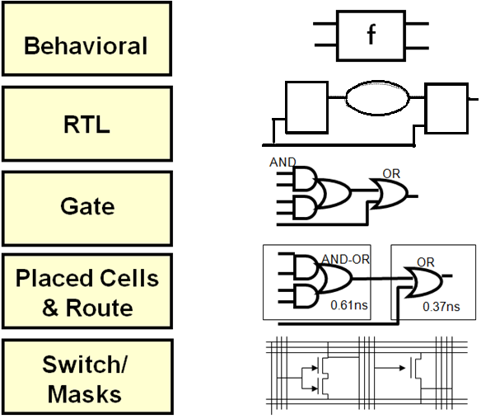

Slide 3
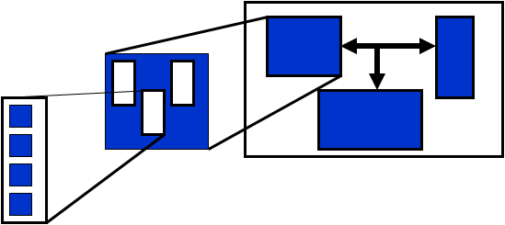
层次化设计

Slide 4
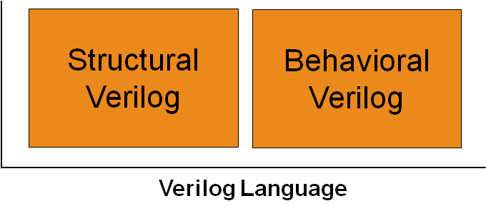
Inference and Instantiation

Slide 5
Key considerations when partitioning a design for Verilog design entry
Register outputs at module boundaries
Consistent with RTL-coding structure
Minimize the number of clocks per block
Important for timing constraints and optimization
Maintain critical signals within the block
In some cases it is preferable to not allow optimization across hierarchical boundaries
Choose the size of your blocks carefully
Should be small enough to allow easy understanding of the block’s functionality
Should not be too small, otherwise hierarchy gets too complex
Partition design along functional lines
Allows for easy testbench creation for sub-modules

Slide 6
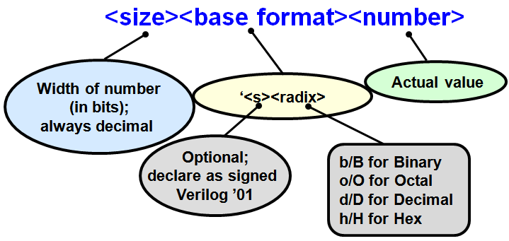
Numerical Representation

Slide 7
数据类型
In general, there are two data types used in Verilog for hardware modeling: net and variable
▪ The key difference is how they are updated in simulation
— net: Continually updated, evaluated, and executed whenever inputs change
— variable: Evaluated only when a procedural block executes
▪ Most combinatorial signals can be modeled as either net or variable

Slide 8
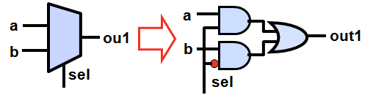
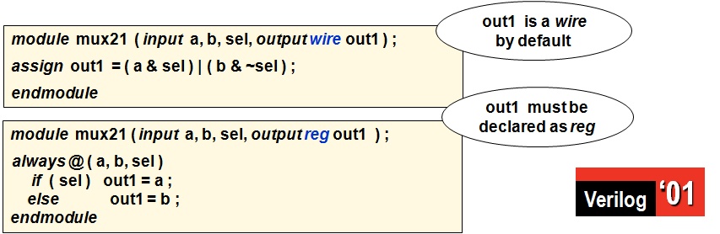
Comparing reg versus wire
Any object assigned within a Verilog procedural block (always and initial) must be declared as a reg data type
— Procedural blocks are discussed in detail in the “Verilog Procedural Statements” module

Slide 9
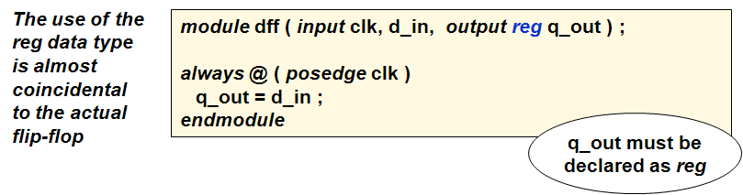
reg and Flip-Flop Confusion

Slide 10
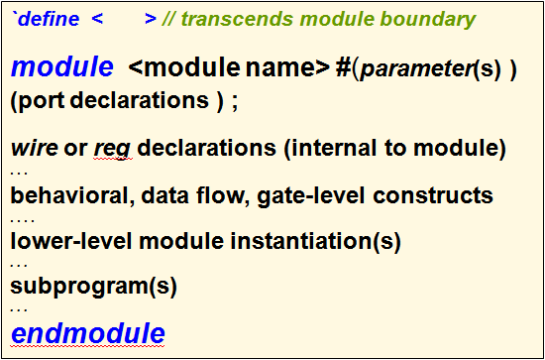
Module

Slide 11
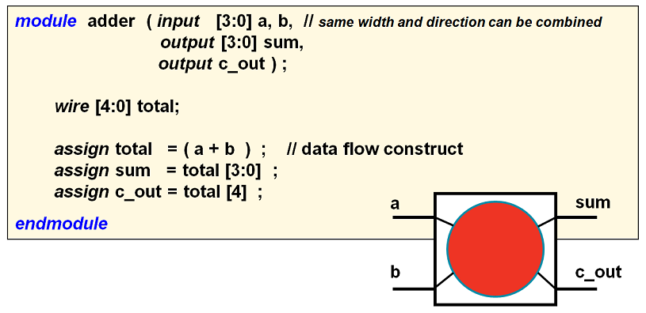
Module例子

Slide 12
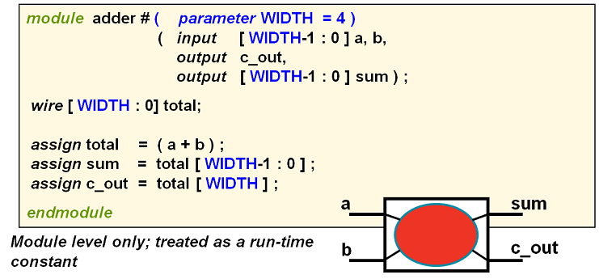
端口利用参数表示

Slide 13
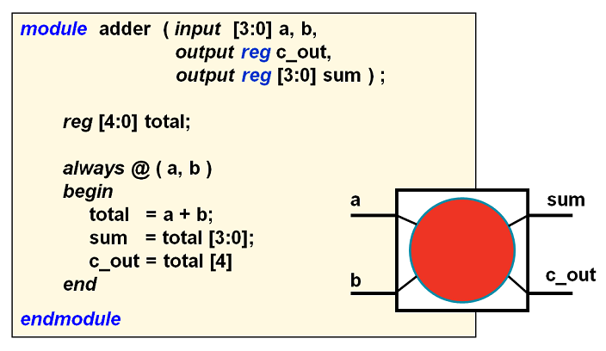
输出为reg 类型

Slide 14
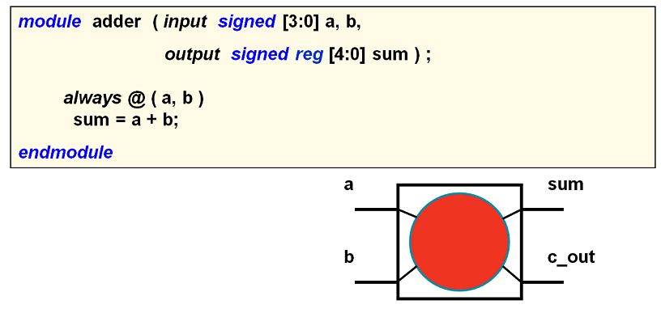
端口为signed类型

Slide 15
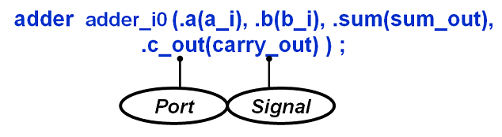

Slide 16
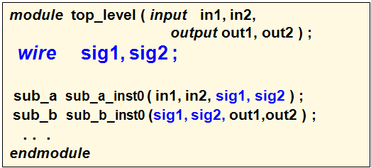
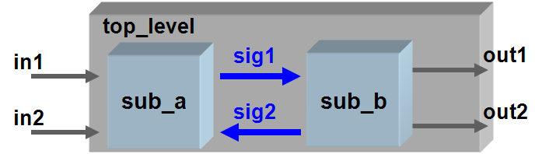
Module 内部连接

Slide 17
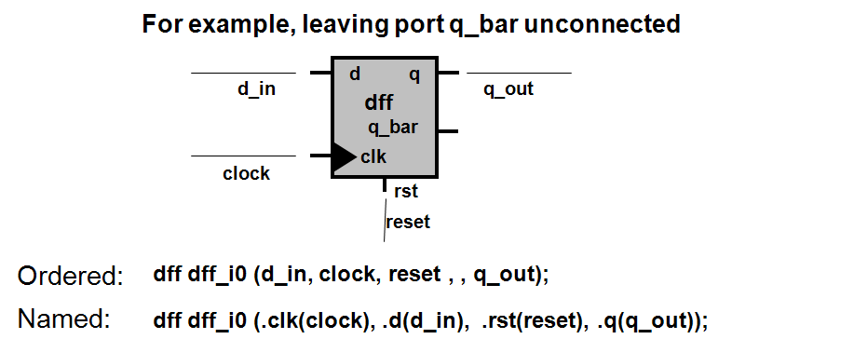
端口可以保留不连接

Slide 18
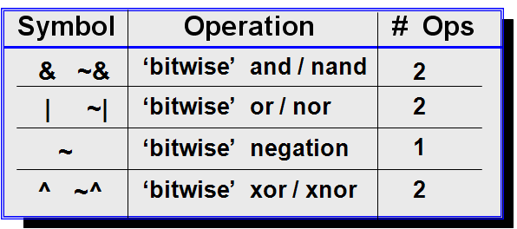
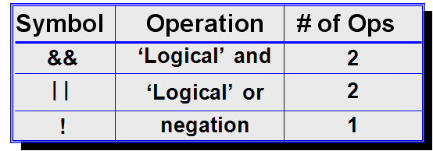
位运算符
逻辑运算符

Slide 19
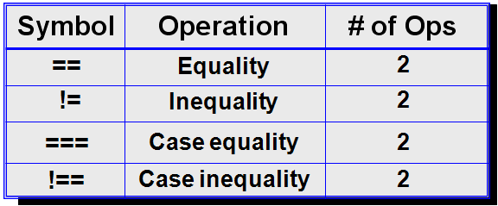
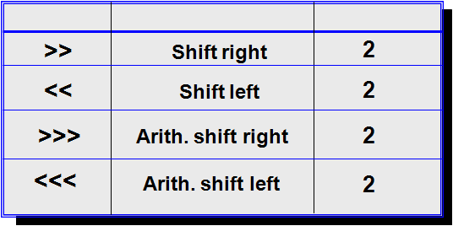
相等运算符
移位运算符

Slide 20
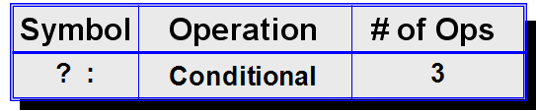
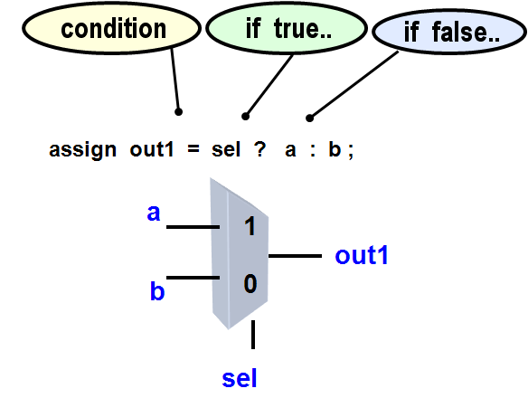
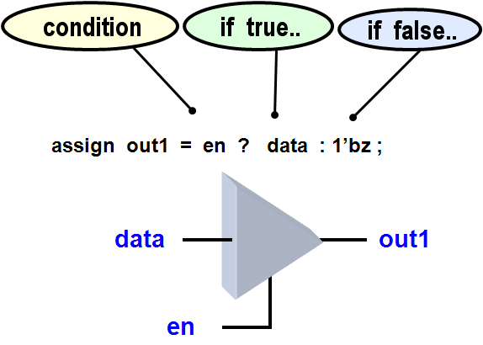
条件运算符

Slide 21
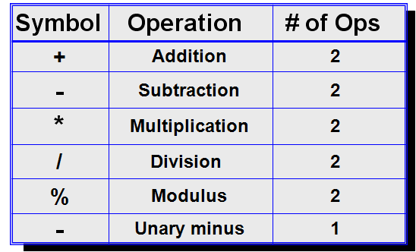
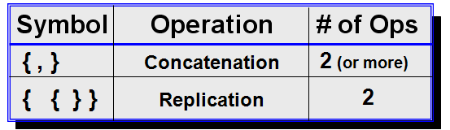
算术运算符
级联运算符

Slide 22
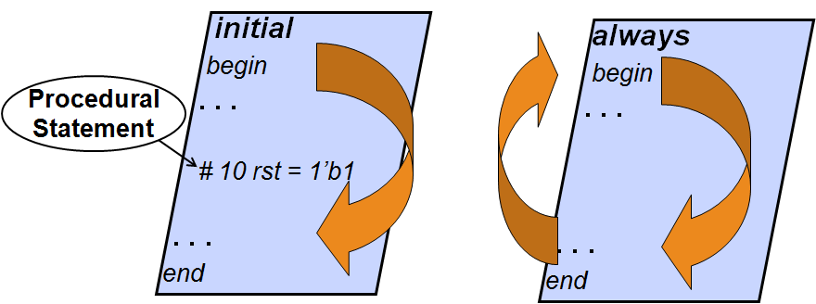
Procedural语句

Slide 23
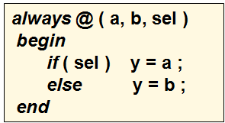
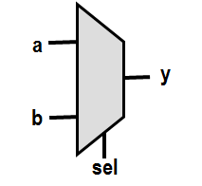
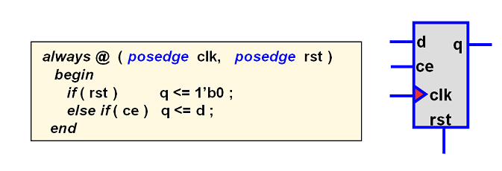

Slide 24
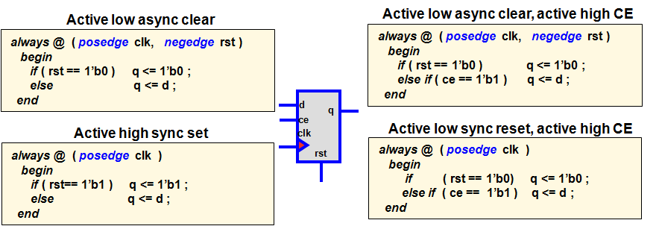

Slide 25
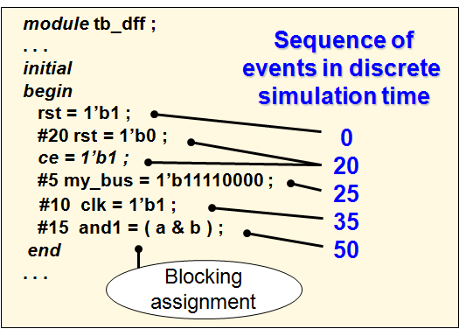
阻塞赋值

Slide 26
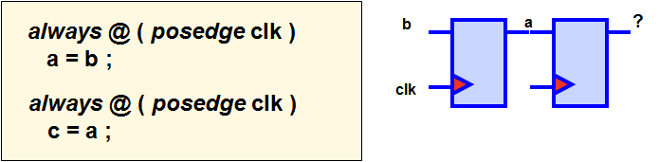

Slide 27
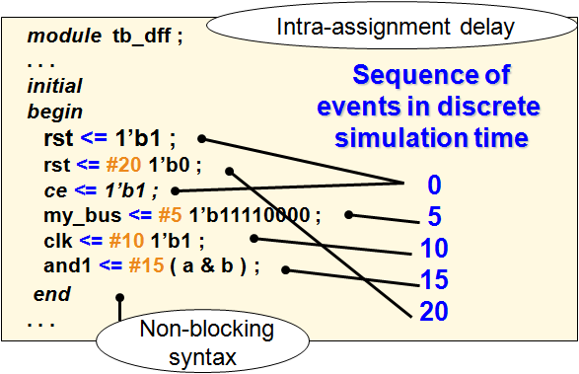
非阻塞赋值

Slide 28
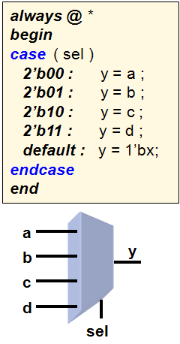
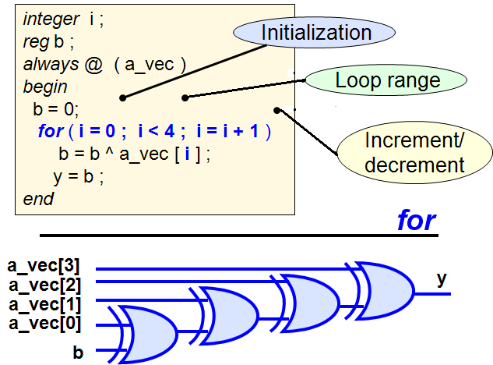

Slide 29
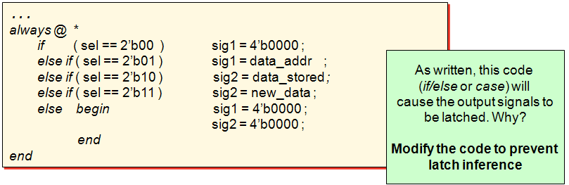
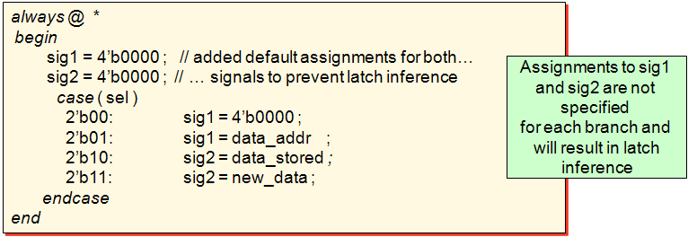

Slide 30
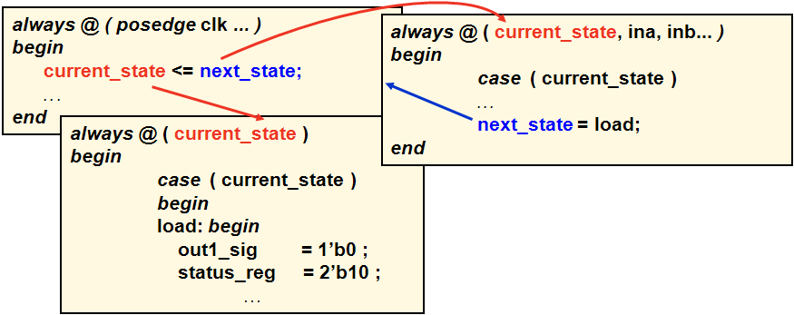

Slide 31
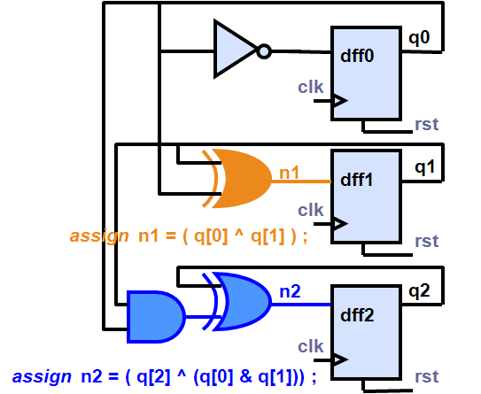
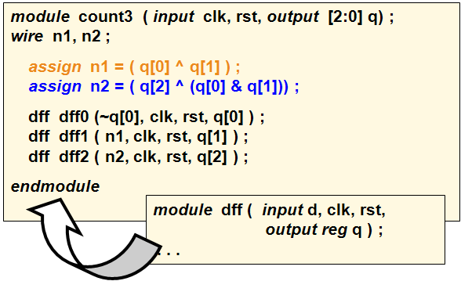

Slide 32
有限状态机设计
NS |  |  | PS
q2 | q1 | q0 | n2 | n1 | n0
0 | 0 | 0 | 0 | 0 | 1
0 | 0 | 1 | 0 | 1 | 0
0 | 1 | 0 | 0 | 1 | 1
0 | 1 | 1 | 1 | 0 | 0
1 | 0 | 0 | 1 | 0 | 1
1 | 0 | 1 | 1 | 1 | 0
1 | 1 | 0 | 1 | 1 | 1
1 | 1 | 1 | 0 | 0 | 0
n0 = ~ q0 n1 = q1 ^ q0 n2 = (q2 ^ ( q1 & q0))

Slide 33
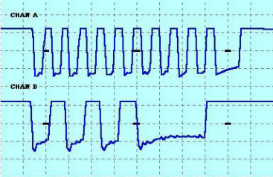

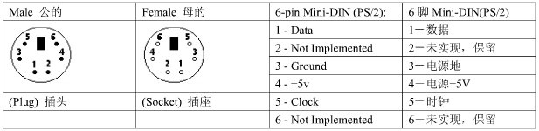

Slide 34
PS2
process(CLKIN,RST)
begin
if (reset='0' ) then
CLK<= '1';
elsif (CLKIN'event and CLKIN='1') then
if KBCLK='0' then
CLK <= KBCLK;
else
CLK <= '1';
end if;
end if;
end process;
process(CLK, KBDATA, S)
begin
if (CLK'event and CLK='0') then
M <= KBDATA & S(9 DOWNTO 1);
end if;
end process;
process(clk, M, N2, KBdata, S)
begin
if (CLK'EVENT AND CLK='1') THEN
S <= M;
end if;
DOUT <= (S(7 downto 0));
End process;
always @ (posedge clkin or posedge rst)
if (rst)
clk <= 1'b1;
else if (!kbclk )
clk <= kbclk;
else
clk <= 1'b1;
always @ (posedge clk)
M <= {kbdata, S[9:1]};
always @ (negedge clk)
begin
S <= M;
end
assign dout = S[8:1];

Slide 35
KEY | MAKE | KEY | MAKE
0 | 45 | 8 | 3E
1 | 16 | 9 | 46
2 | 1E | A | 1C
3 | 26 | B | 32
4 | 25 | C | 21
5 | 2E | D | 23
6 | 36 | E | 24
7 | 3D | F | 2B

Slide 36
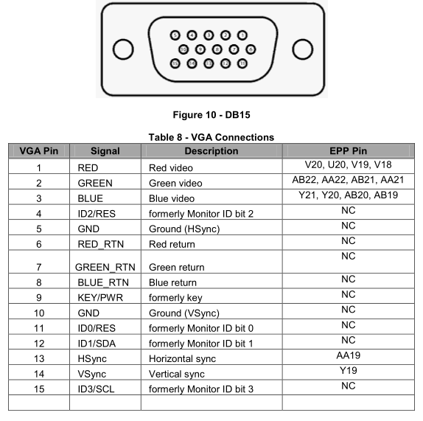
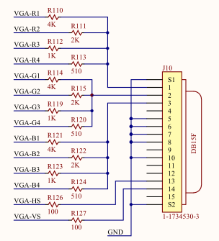
VGA

Slide 37
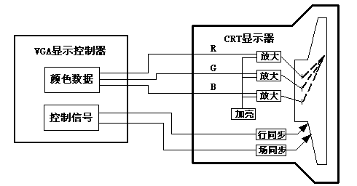

Slide 38
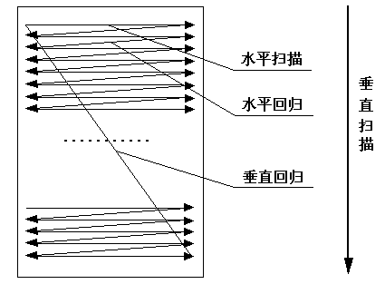
640x480x60
25MHz / 800
= 31.25KHz
31.25KHz / 520
= 60Hz

Slide 39
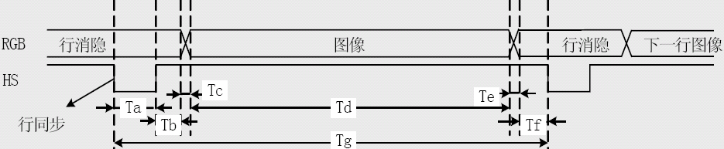
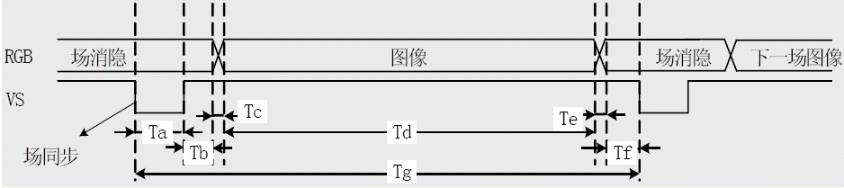

Slide 40
// 行同步信号H_Sync的产生
always @(posedge hClock or negedge Resetn) begin
if(!Resetn) begin
H_Cont <= 10'd0;
VGA_H_SYNC <= 1'b0;
end else begin
// 行同步计数器
if (H_Cont < 10’d800) H_Cont <= H_Cont + 10'd1;
else H_Cont <= 10'd0;
// 行同步信号产生，行同步期间该信号保持为低，否则为高
if (H_Cont < 10’d96) VGA_H_SYNC <= 1'b0;
else VGA_H_SYNC <= 1'b1;
end
end

Slide 41
// 场同步信号V_Sync的产生
always @(posedge vClock or negedge Resetn) begin
if(!Resetn) begin
V_Cont <= 10'd0;
VGA_V_SYNC <= 1'b0;
end else begin
// 当完成一行的扫描之后启动
if (H_Cont == 10'd0) begin
// 场同步计数器
if (V_Cont <10’d 520) V_Cont <= V_Cont + 10'd1;
else V_Cont <= 10'd0;
// 场同步信号产生，场同步期间该信号保持为低，否则为高
if (V_Cont < 10’d8) VGA_V_SYNC <= 1'b0;
else VGA_V_SYNC <= 1'b1;
end end end

Slide 42
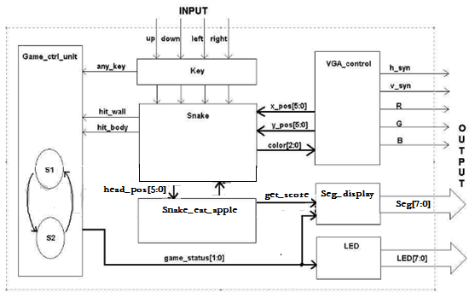

Slide 43
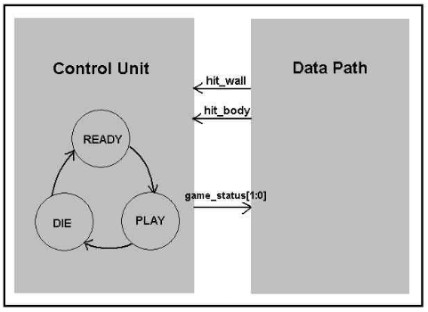
Game_contril_unit
此 unit接收来自其他模块的信号，决定游戏的状态，产生对其他模块的控制信号。在 Ready状态，等待任何键盘输入，一旦用户输入一键， 状态转入PLAY；
在 PLAY状态，此时模块等待蛇撞墙或蛇体，如果发生这些情况，模块转入DIE状态，
在 DIE状态 ， 它迫使屏幕闪烁几次，然后复位整个程序，转入Ready状态。

Slide 44
Snake: 项目最复杂的模块1 保持蛇的移动
2 按照键盘输入改变方向
3 作出蛇是否撞墙或
4 调vga程序确定屏幕显示
Snake eating apple :
按随机数产生位置随机的苹果和作出蛇是否吃了苹果的判决。
Key： 键盘输入要消除抖动。
VGA_control：
On-board_display：
7段译码和LED显示

Slide 45


Slide 46
Tetris
输入模块
  键盘检测模块、得分控制模块、
游戏控制模块
存储模块
  两块BRAM，分别存储图像颜色及字符编码
输出显示
  文本显示模块、游戏显示模块、以及VGA显示模块，最后对各个模块进行了接口建模，组成了该tetris设计。

Slide 47

整个控制系统状态机：

Slide 48

Electronic Piano

Slide 49


Slide 50
CPU设计
数据通道设计
任何CPU的数据通道的主要部件是一个寄存器堆和一个ALU，与某些暂存器（scratch rejister）和几个多路选择器相结合用来把数据路由到数据通道内正确的位置。
对于特定的指令集结构，数据通道通常不是唯一的。数据通道是为指令集共享的资源，它的功能是指令集中的每个指令操作要求的设施，使得每个指令可以有效地完成。这些操作集中围绕几个寄存器和一个ALU。在任何CPU的数据通道中寄存器堆和ALU起着最重要的作用。

Slide 51
寄存器堆（register file）
一个寄存器堆是一组带多个存取端口和随机存取能力的寄存器，这意味着在寄存器堆中任何寄存器的存取时间是相同的，通常由以下的参数表征：寄存器的数目、寄存器的宽度和端口数目。取决于实际的要求，最广泛利用的寄存器堆有16或32个寄存器，每个包含16或32位，端口最通常是两个读口和一个写口。寄存器堆通常由寄存器构造，但是也可以利用同步RAM来构造。
由双操作数指令集可以看出，寄存器堆需要两个读口和一个写口，以便需支持在一个周期执行寄存器到寄存器的操作。

Slide 52
ALU
算术逻辑单元ALU由两个主要的功能组成：算术和逻辑。为了适合逻辑和算术的移位操作，有时候也把移位器并入ALU中。考虑由标志寄存器、ALU和移位器组成的简单ALU。
在数据通道利用的ALU的功能可以从指令集所要求的操作来获得，如下表所示。

Slide 53
指令 | ALU 功能 | m3 | m2 | m1 | m0 | B/W
MOV（.B） MOV（.B） ADD（.B） ADDC（.B） SUB（.B），CMP（.B） SUBC（.B） DADD（.B） AND（.B），BIT（.B） BIC（.B） BIS（.B） XOR（.B） RRA（.B） RRC（.B） SWAP | F <—A F <—B A + B A + B + C A + notB + 1 A + notB + notC A + 6H, A + 60H A and B notA and B A or B A xor B Arith. Shift right into C Rotate right through C Swap byte | 0 0 0 0 0 0 0 0 1 1 1 1 1 1 | 0 0 0 0 1 1 1 1 0 0 0 0 1 1 | 0 0 1 1 0 0 1 1 0 0 1 1 0 0 | 0 1 0 1 0 1 0 1 0 1 0 1 0 1 | — — 0/1 0/1 0/1 0/1 0/1 0/1 0/1 0/1 0/1 0/1 0/1 0- | passA passB add(b/w) addc(b/w) sub(b/w) subc(b/w) dadd(b/w) and(b/w) bic(b/w) or(b/w) xor(b/w) asrc(b/w) rotatec(b/w) swap

Slide 54
控制单元设计
控制单元的目标是产生为数据通道执行指令要求的控制信号，控制单元接收来自指令寄存器（IR）和ALU标志（N、Z、V和C）的数据，产生要求 的控制信号。

Slide 55

Netlist
A netlist is a description of your design
Consists of cells, pins, port and nets
Cells are design objects
Instances of user modules/entities
Instances of library elements (BELs)
LUTs, FF, RAMs, DSP cells, etc…
Generic technology representations of hardware functions
Black boxes
Pins are connection points on cells
Ports are the top level ports of your design
Nets make connections between pins and from pins to ports
What is a Netlist?
55364**slide

Slide 56

Netlist Objects

Slide 57

Elaborated Design
Accessed through the Flow Navigator by selecting Open Elaborated Design
Representation of the design before synthesis
  Interconnected netlist of hierarchical and generic technology cells
    Instances of modules / entities
    Generic technology representations of hardware components
      AND, OR, buffer, multiplexers, adders, comparators, etc…

Slide 58

Object Names in Elaborated Design
Object names are extracted from RTL
  Instance and pin names of hierarchical objects
  Inferred flip-flops from underlying reg/signal/logic
    Suffix _reg is added
  Nets from underlying reg/signal/logic when it makes sense

Slide 59

Synthesized Design
Accessed through the Flow Navigator by selecting Open Synthesized Design
Representation of the design after synthesis Interconnected netlist of hierarchical and basic elements (BELs) Instances of modules / entities Basic elements LUTs, flip-flops, carry chain elements, wide MUXs Block RAMs, DSP cells Clocking elements (BUFG, BUFR, MMCM, …) I/O elements (IBUF, OBUF, I/O flip-flops)
Object names are the same as names in the elaborated netlist when possible

Slide 60

Implemented Design
Accessed through the Flow Navigator by selecting Open Implemented Design
Representation of the design during and after the implementation process
  Structurally similar to the Synthesized Design
  Cells have locations, and nets are mapped to specific routing channels

Slide 61


