Slide 1

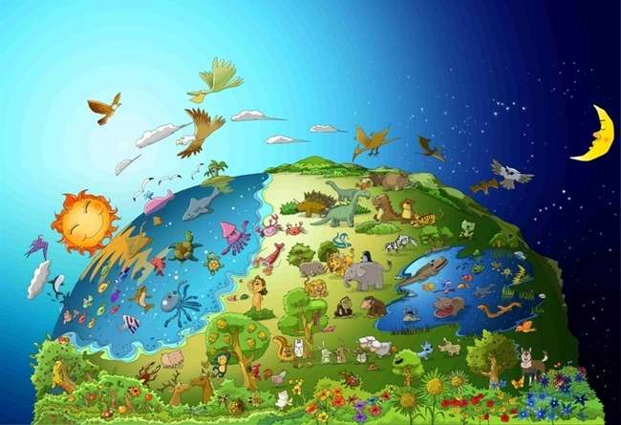

No.1 I Ilizwi ye uThixo
uThixo
Yenziwe
Umhlaba

Slide 2


Yanamhlanje Ilizwi
Ekuqaleni uThixo wadala
izulu nomhlaba.
Genesis 1:1

Slide 3
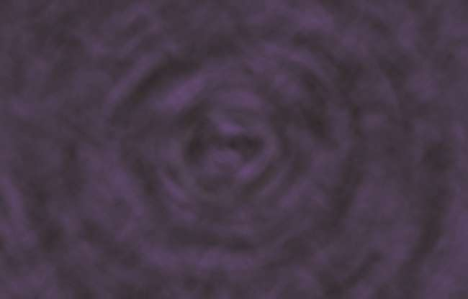
Ekuqaleni, kwakumnyama phezu komhlaba.
Kwakungekho mntu, kungekho kukhanya. Kwakungekho nto.

Slide 4
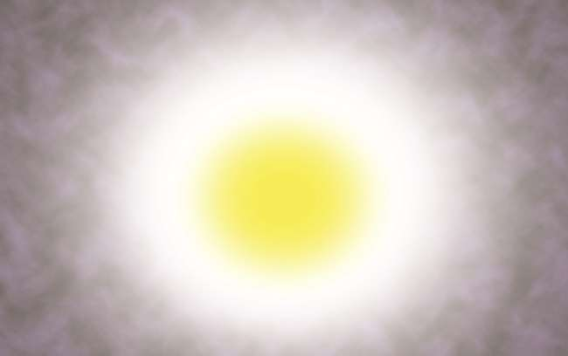
Wathi uThixo, Makubekho ukukhanya,
kwabakho ke ukukhanya.

Slide 5
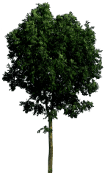



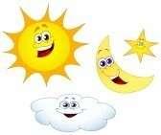
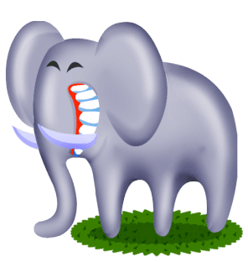
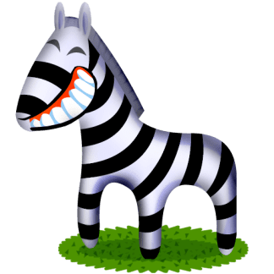
1
3
5
2
4
6
Ngosuku lokuqala, uThixo wahlukanisa ukukhanya nobumnyama. Wenza ihlabathi lonke iintsuku ezintandathu.

Slide 6
Zonke iintlobo zezilwanyana nezityalo, iintaka neentlanzi zizele emhlabeni, elwandle nasesibhakabhakeni. UThixo wajonga kuyo yonke into awayeyidalile, wathi: “Kulungile!

Slide 7


Isifundo sanamhlanje
Ngubani owenza ihlabathi?
UThixo wenza ihlabathi.
Ngubani ogcina ihlabathi lilungelelene?
UThixo uligcina lilungelelene ihlabathi.
Ihlabathi alizange lenziwe ngokwalo.
Ihlabathi alinakushukunyiswa lodwa.
Sifanele sikhumbule ukuba uThixo wenza ihlabathi liphela yaye usenegunya phezu kwalo lonke.

Slide 8
Ngubani uThixo?
Ngu...
umdali owenza ihlabathi lonke kuquka nam.

Slide 9
Imibuzo yanamhlanje
UThixo walenza ngantoni ihlabathi?
① ilitye
② amanzi
③ uthuli
④ igama
④ igama

Slide 10
Yanamhlanje Ilizwi
Ekuqaleni uThixo wadala
izulu nomhlaba.
Genesis 1:1

Slide 11

Abantwana BeBhayibhile No.2 ILizwi LikaThixo
Batya isiqhamo esalelweyo

Slide 12
ILizwi lanamhlanje
Wamdala ke uThixo umntu ngokomfanekiselo wakhe; wamdala ngokomfanekiselo kaThixo;
wadala indoda nenkazana.
IGenesis 1:27

Slide 13

UAdam noEva babezezona zidalwa zibalaseleyo phakathi kwezidalwa zikaThixo.
Kuba zadalwa ngokomfanekiselo kaThixo.

Slide 14

Wathi uThixo kwindoda, “Kuwo nawuphi na umthi osemyezweni ungatya; kodwa uze ungawudli kuwo umthi wokwazi okulungileyo nokubi, kuba xa uthe wadla kuwo uya kufa ngokuqinisekileyo .

Slide 15

Noko ke, uSathana wazenza inyoka wahenda uEva.
Ekugqibeleni, uEva wasidla eso siqhamo.

Slide 16

Kwaye uEva wanika uAdam enye.
UAdam wayidla, naye.

Slide 17

UThixo wabakhupha e-Eden ngenxa yokuba bengazange bamphulaphule uThixo.
Ukususela ngelo xesha, isono seza ehlabathini.

Slide 18
Isifundo sanamhlanje
Isono seza ehlabathini ngenxa yokuba uAdam noEva abazange bawuthobele umyalelo kaThixo.
Ngaba ndiyalithobela ilizwi likaThixo?
Ukuba ndiyakholwa kuThixo, kufuneka ndithobele ilizwi likaThixo.

Slide 19
uThixo?
Thixo..
Akakuthandi ukungathobeli.
Unoyolo umntu oligcinayo ilizwi lakhe.

Slide 20
Imibuzo yanamhlanje
Yintoni awathi uThixo mayingatyiwa eluntwini?
① iziqhamo
② inyama
③ imifuno
④ isiqhamo sokwazi okulungileyo nokubi
④ isiqhamo sokwazi okulungileyo nokubi

Slide 21
ILizwi lanamhlanje
Wamdala ke uThixo umntu ngokomfanekiselo wakhe; wamdala ngokomfanekiselo kaThixo;
wadala indoda nenkazana.
IGenesis 1:27

Slide 22

No.3 ILizwi likaThixo
UNowa wenza inqanawa enkulu (inqanawa) kwiNtaba Ephakamileyo

Slide 23
Yanamhlanje Ilizwi
Wathi uYehova kuNowa, Ngena, wena nendlu yakho yonke, emkhombeni, ngokuba ndikufumene ulilungisa kwesi sizukulwana.
( Genesis 7:1 )

Slide 24

Wabona uThixo ukuba bonke abantu bonakele emhlabeni iindlela zabo. UThixo wathi kuNowa: “Ndiza kutshabalalisa abantu nehlabathi . Yenza inqanawa enkulu entabeni!“

Slide 25

UNowa wenza inqanawa entabeni kanye njengoko uThixo wayemyalele. Abantu babecinga ukuba uphambene.

Slide 26

UNowa wangenisa lonke uhlobo lwezidalwa enqanaweni kunye namalungu kaNowa asibhozo njengoko uThixo wayemyalele.

Slide 27

Imvula yana emhlabeni kangangeentsuku eziyi-40 njengoko wayetshilo uThixo.

Slide 28

Ekugqibeleni, umhlaba wagutyungelwa ngamanzi. Yafa yonke into ephilileyo enyakazelayo emhlabeni. Kwasala uNowa yedwa, nabo babenaye emkhombeni.

Slide 29
Isifundo sanamhlanje
Abantu abazange bamphulaphule uNowa owabanika ithuba lokusindiswa kumkhukula omkhulu.
Kuphela bathi uNowa uphambene
Xa uhambisa ivangeli kubahlobo, banokungakumameli kakuhle.
Kodwa, ekugqibeleni, baya kwazi ukuba ilizwi likaThixo liyinyaniso.

Slide 30
UThixo ?
Thixo..
UThixo uthiyile isono kwaye uyasigweba isono.

Slide 31
Imibuzo yanamhlanje
Wathini uThixo kuNowa?
① Inqanawa (Inqanawa)
① Inqanawa (Inqanawa)
② Imoto
③ Indlu
④ Ibhayisekile

Slide 32
ILizwi lanamhlanje
Wathi uYehova kuNowa, Ngena, wena nendlu yakho yonke, emkhombeni, ngokuba ndikufumene ulilungisa kwesi sizukulwana.
Genesis 7:1

Slide 33

No.4 ILizwi likaThixo
Umnyama wawunguMnqophiso kaThixo

Slide 34
Yanamhlanje Ilizwi
Nanini na ubonakala umnyama emafini, ndowubona, ndiwukhumbule umnqophiso ongunaphakade phakathi koThixo nayo yonke imiphefumlo ephilileyo kulo lonke elimiweyo.
IGenesis 9:16

Slide 35

Zatshatyalaliswa zonke izinto eziphilileyo, kwasala uNowa yedwa, kwanabo babenaye emkhombeni.

Slide 36

Imvula yana emhlabeni kangangeentsuku ezingama-40.

Slide 37

Emva kokuba imvula iphelile, uNowa wathumela ihobe.
Labuyela kuye ihobe linegqabi lomnquma elisemtsha emlonyeni walo; Wazi uNowa, ukuba ehlile amanzi ehlabathini.

Slide 38

UNowa waphuma nentsapho yakhe, waza wanqula uThixo. “Enkosi Thixo ngokusinika ihlabathi elitsha.”

Slide 39

UThixo wambonisa umnyama njengomqondiso womnqophiso nentsikelelo. “Phila ngolonwabo kwihlabathi elitsha!”

Slide 40
Isifundo sanamhlanje
UThixo wamsindisa uNowa nentsapho yakhe.
UThixo wathembisa ukuba uya kubasikelela aze abenzele ihlabathi elitsha.
Kwakhona uThixo usisindise ngoYesu.
Kufuneka sikholelwe ukuba uThixo uya kwenza ihlabathi laKhe elitsha ngathi.

Slide 41
UYehova uThixo?
Yehova Thixo..
UYehova uThixo nguBawo wethu osindisa kwaye abasikelele kakhulu abantwana bakhe abathandayo xa sikholelwa kuye.

Slide 42
Imibuzo yanamhlanje
Yintoni awayithumela uNowa ukuze abone umhlaba womile?
① Ukhozi
② Ungqatyana
③ Ihobe
③ Ihobe
④ Idada

Slide 43
ILizwi lanamhlanje
Nanini na ubonakala umnyama emafini, ndowubona, ndiwukhumbule umnqophiso ongunaphakade phakathi koThixo nayo yonke imiphefumlo ephilileyo kulo lonke elimiweyo.
IGenesis 9:16

Slide 44

No.5 I Ilizwi ye uThixo
Abantu abakhayo
INqaba yaseBhabheli

Slide 45
ILizwi lanamhlanje
Yiyo loo nto kuthiwa yiBhabheli,* kuba uYehova wadubaduba khona apho
ulwimi lwehlabathi lonke. Wabachithachitha apho ke uYehova
phezu kobuso bomhlaba wonke.
IGenesis 11:9

Slide 46
Abantu babefuna ukuba mkhulu nodumo kunoThixo. Ke, Baqala ukwakha inqaba ephakamileyo.

Slide 47

Ngaloo ndlela, bayakha inqaba ngokupheleleyo.
“Masizibonakalise ehlabathini. Sibahle kakhulu!”

Slide 48


?
?
Noko ke, uThixo wakubona ukukhukhumala kwabo, waludubaduba ulwimi lwabo ukuze bangavani.

Slide 49

Ngenxa yokuba babengavani, babengakwazi ukusebenzisana. Ekugqibeleni, basasazeka phezu komhlaba. Kude kube ngoku, iilwimi zehlabathi zahlukile kwenye.

Slide 50
Isifundo sanamhlanje
Abantu bafuna ukuba mkhulu kwaye baphakame kunoThixo.
Le ngqondo ibizwa ngokuba "yikratshi".
UThixo ulithiyile ‘ikratshi’.
Isichasi sokuzigwagwisa 'kukuthobeka'.
Sifanele ‘sithobeke’ phambi kukaThixo ukuze simkholise.

Slide 51
UYehova uThixo?
Yehova Thixo..
UYehova uThixo mkhulu kwaye unobulumko kunathi.
Asinakuba nobulumko ngaphezu koThixo nangona sidibanisa bonke ubulumko bethu kunye.

Slide 52
Imibuzo yanamhlanje
Kwakutheni ukuze bangakwazi ukuyigqiba inqaba?
① UThixo wabangela umkhukula xa bawenza
② UThixo wenza ukuba kuqhambuke umlilo xa bawenza.
③ UThixo wenza inyikima xa bayenza.
④ UThixo wabenza ukuba bangaqondani xa besenza.
④ UThixo wabenza ukuba bangaqondani xa besenza.

Slide 53
Yanamhlanje Ilizwi
Yiyo loo nto kuthiwa yiBhabheli,* kuba uYehova wadubaduba khona apho
ulwimi lwehlabathi lonke. Wabachithachitha apho ke uYehova
phezu kobuso bomhlaba wonke.
IGenesis 11:9

Slide 54
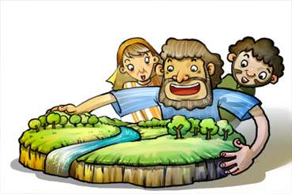
No.6 ILizwi likaThixo
UThixo wabiza uAbraham

Slide 55
ILizwi lanamhlanje
Wathi uYehova kuAbram, Lishiye ilizwe lakowenu, ebantwini bakowenu, nasezizweni zakowenu
ngena endlwini kayise, uye ezweni endiya kukubonisa lona.
Genesis 12:1

Slide 56

IUre yamaKaledi yayisisixeko esinqula izithixo.
UAbraham wazalelwa waza wahlala apho.

Slide 57

Kwathi ngamhla uthile, iNkosi uYehova yathi kuye, Hamba umke ezweni lakowenu, ndikusikelele.

Slide 58

Nangona uAbraham wayengazi apho makaye khona, walithobela ilizwi likaThixo waza wemka njengoko wayeyalelwe nguYehova.

Slide 59



Wafumana izinto ezinzima ezininzi ekuhambeni kwakhe kodwa uThixo wamkhusela ngokukhuselekileyo.

Slide 60

Ekugqibeleni, uAbraham wafika kwilizwe lakwaKanan. Wayehlala apho. “Enkosi, Thixo.”

Slide 61
Yanamhlanje Isifundo
UAbraham wayishiya idolophu yakowabo ngokuthobela ilizwi likaThixo.
Ngokunjalo, thina kufuneka bakholwe kuThixo kwaye balithobele ilizwi lakhe.
Sifanele sibe nomnqweno wokuthobela ilizwi likaThixo ngalo naliphi na ixesha.

Slide 62
Ngaba uYehova uThixo?
Yehova UThixo….
UnguBawo wethu osigcinayo isithembiso sakhe nangayiphi na indlela.

Slide 63
Imibuzo yanamhlanje
Wazalelwa phi uAbraham?
① eKanan
② IHaran
③ uSirayeli
④ IUre yamaKaledi
④ IUre yamaKaledi

Slide 64
Yanamhlanje Ilizwi
Wathi uYehova uThixo kuAbram, Lishiye ilizwe lakowenu, ebantwini bakowenu, nakwindlu kayihlo, uye ezweni endiya kukubonisa lona.
Genesis 12:1

Slide 65

No. 7 ILizwi LikaThixo
UIsake, uNyana Othenjisiweyo

Slide 66
Yanamhlanje Ilizwi
UAbraham ubeminyaka ilikhulu ezelwe, ukuzalelwa kwakhe uIsake unyana wakhe.
IGenesis 21:5

Slide 67

UThixo wathembisa uAbraham ukuba uThixo uya kumnika abantwana abangangeenkwenkwezi esibhakabhakeni ebusuku.
Kodwa, wayengenamntwana de waba neminyaka eyi-100 ubudala.

Slide 68

Ngenye imini, uThixo wamkhuphela phandle uAbraham ebusuku.
“Khangela phezulu ezulwini. Ngaba ungazibala iinkwenkwezi?”

Slide 69
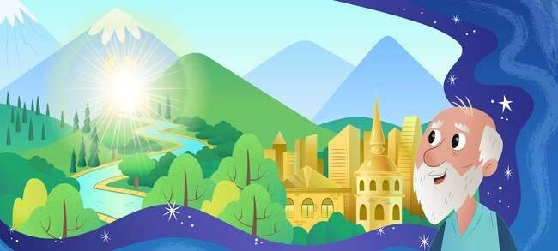
UThixo wamthembisa ukuba uza kumnika ilizwe elihle.

Slide 70
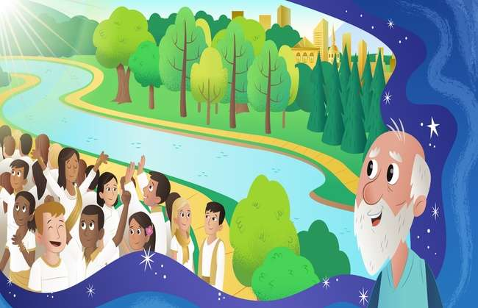
“Abantwana bakho baya kuba ngangeenkwenkwezi ezisesibhakabhakeni nentlabathi eselunxwemeni lolwandle.” UAbraham walikholwa idinga leNkosi.

Slide 71

UThixo wasigcina isithembiso sakhe. USara wamzalela uAbraham unyana. UAbraham wamthiya igama elinguIsake elithetha Uvuyo .

Slide 72
Yanamhlanje Isifundo
UAbraham wayekholelwa ngokwenene kwidinga likaThixo nangona lalibonakala lingenakwenzeka kuye.
UThixo wavuya kakhulu akubona ukholo luka-Abraham. UThixo wamnika uIsake, unyana wedinga.
Ngokuqinisekileyo uThixo uyasizalisekisa isithembiso sakhe, nangona kwakubonakala kungenakwenzeka kuthi.

Slide 73
UThixo u...
UThixo u...
USomandla (uyakwazi ukwenza yonke into)

Slide 74
Imibuzo yanamhlanje
Wayeneminyaka emingaphi uAbraham xa wayezala uIsake?
① 90
② 80
③ 70
④ 100
④ 100

Slide 75
ILizwi lanamhlanje
UAbraham ubeminyaka ilikhulu ezelwe, ukuzalelwa kwakhe uIsake unyana wakhe.
( Genesis 21:5 )

Slide 76

No. 8 ILizwi LikaThixo
UAbraham wamnikela uIsake kuThixo

Slide 77
ILizwi lanamhlanje
Wathi uThixo, Thabatha unyana wakho, emnye kuwe, omthandayo, uIsake;
nihambe niye kummandla waseMoriya. umenzele khona idini elinyukayo
kwenye yeentaba ndiya kukuxelela.
Genesis 22:2

Slide 78

Ngenye imini, uThixo wathi kuAbraham,
“Mnike unyana wakho okuphela kwamzeleyo njengedini elinyukayo.”

Slide 79

UAbraham wayemthanda uIsake kangangokuba waba lukhuni xa esiva kuThixo. Kodwa wagqiba kwelokuba athobele uThixo.

Slide 80

UAbraham wambopha uIsake, wamlalisa phezu kwesibingelelo, wazama ukumbulala. Kanye ngelo xesha,

Slide 81

“Abraham, Abraham, musa ukumbulala. Musani ukwenza nto kuye. Ngoku ndiyazi ukuba uyamoyika yaye uyamthanda uThixo.” Olu yayiluvavanyo uThixo awalwenzayo kuAbraham.

Slide 82

“Enkosi, Thixo!” UThixo walwamkela ukholo luka-Abraham ngovuyo. UThixo wamenza ukhokho wawo onke amakholwa.

Slide 83
Isifundo sanamhlanje
UAbraham wayemthanda kakhulu uIsake, kodwa kwakubalulekile kuye ukuthobela iLizwi likaThixo.
Ndifanele ndithande uThixo ngaphezu kwayo nayiphi na enye into, kwaye ngaphezu kwakhe nawuphi na omnye umntu emhlabeni.

Slide 84
uThixo?
uThixo ukhona..
Ubawo wethu owomeleza ukholo lwethu ngovavanyo.

Slide 85
Yanamhlanje Imibuzo
Wathini uThixo kuAbraham ukuba enze idini elinyukayo?
① Unyana
① Unyana
② Umfazi
③ Inja
④ Iigusha

Slide 86
ILizwi lanamhlanje
Wathi uThixo, Thabatha unyana wakho, emnye kuwe, omthandayo, uIsake;
nihambe niye kummandla waseMoriya. umenzele khona idini elinyukayo
kwenye yeentaba ndiya kukuxelela.
Genesis 22:2

Slide 87

No.9 I Ilizwi ye uThixo
UIsake akazange axabane

Slide 88
ILizwi lanamhlanje
Wemka apho, wemba elinye iqula, akwabambana mntu ngalo.
Wathi igama layo yiRehobhoti,* esithi, Kukalokunje uYehova usinike indawo
siya kuhluma elizweni.
IGenesis 26: 22

Slide 89
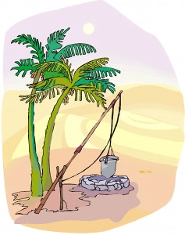
I amaqula babe ngoko kubalulekile, ngokuba bona unako fumana entsha amanzi entlango. UIsake wazuza ilifa kuyise.

Slide 90

Noko ke, amaFilisti ammonela. Ngoko ke, bawazalisa amaqula ngomhlaba.

Slide 91
Kodwa, uIsake akazange axabane nabo. Washukuma wemba iqula. Wafumana iqula lamanzi acocekileyo.

Slide 92

Ngeli xesha, abanye abantu balithabatha iqula kuIsake. Kodwa, akazange axabane nabo, kananjalo.

Slide 93

UThixo wamsikelela uIsake. Waphinda wemba elinye iqula. UThixo wamnika amanzi amnandi alapho. UIsake wenza isibingelelo, wabingelela umbulelo;

Slide 94
Isifundo sanamhlanje
UIsake akaxabananga nabo bathabatha amaqula akhe;
UThixo wamsikelela uIsake.
Kananjalo akufuneki sixabane nabanye.
Simele sibathande size sibaxolele abanye.

Slide 95
NguThixo??
UThixo….
Ubathiyile abo baxabana nabanye.
Uyabathanda abo bathandanayo.

Slide 96
Imibuzo yanamhlanje
Kwakutheni ukuze uIsake abandezeleke kwixesha elinzima?
① indlu
② imvana
③ kakuhle
③ kakuhle
④ usapho

Slide 97
Ilizwi lanamhlanje
Wemka apho, wemba elinye iqula, akwabambana mntu ngalo.
Wathi igama layo yiRehobhoti,* esithi, Kukalokunje uYehova usinike indawo
siya kuhluma elizweni.
IGenesis 26: 22

Slide 98

No.10 I Ilizwi ye uThixo
UEsawu wathengisa ngobuzibulo
ngesitya esinye esibomvu

Slide 99
ILizwi lanamhlanje
UYakobi wamnika uEsawu isonka nesityu seentlumayo.
Watya wasela, waphakama wahamba.
Ngoko uEsawu wabudela ubuzibulo bakhe.
Genesis 25:34

Slide 100

Umfazi kaIsake, uRebheka wazala amawele. Igama lonyana wokuqala lalinguEsawu yaye igama lowesibini yayinguYakobi.

Slide 101

UEsawu wayethanda ukuzingela. Ngoko, wayeyithanda imisebenzi yangaphandle. Kodwa, uYakobi wayeyindoda ezolileyo, ehlala ekhaya.

Slide 102

Ngenye imini, xa uYakobi wayepheka isityu, uEsawu wabuyela ekhaya elambile emva kokuzingela.

Slide 103
“Ndinike isityu!”, “Qala undithengisele ubuzibulo bakho. Emva koko ndiza kukunika. UEsawu walamba kangangokuba wathengisa ngobuzibulo bakhe ngesitya esinye sesityu esibomvu.

Slide 104

Ekugqibeleni, uYakobi wamqhatha uyise ukuze afumane intsikelelo. Ekugqibeleni, wayifumana intsikelelo. Zonke ezi zinto zabakho ngolungiselelo lukaThixo.

Slide 105
Isifundo sanamhlanje
UEsawu wacinga ukuba ukucombulula ingxaki yokulamba kubaluleke ngakumbi kunokufumana iintsikelelo zokomoya.
Ekugqibeleni, uYakobi waba i ukhokho wamaSirayeli.
Yintoni ocinga ukuba ibaluleke ngakumbi?
Intsikelelo yokuba ngabantwana bakaThixo ayinakuthathelwa indawo nantoni na.

Slide 106
uThixo?
uThixo yi
UThixo uzalisekisa intando yakhe phezu kwazo nje iimpazamo zabantu nobuxoki.

Slide 107
Namhlanje' Imibuzo
Wabuthengisa ngantoni uEsawu ubuzibulo bakhe?
① i-noodle
② isonka
③ inyama
④ isityu esibomvu
④ isityu esibomvu

Slide 108
Yanamhlanje Ilizwi
UYakobi wamnika uEsawu isonka nesityu seentlumayo.
Watya wasela, waphakama wahamba.
Ngoko uEsawu wabudela ubuzibulo bakhe.
Genesis 25:34

Slide 109

No. 11 ILizwi LikaThixo
Iphupha likaYakobi

Slide 110
ILizwi lanamhlanje
Waphupha ephupheni, ebona izinyuko zihleli emhlabeni, incopho yaso ifika ezulwini, nezithunywa zikaThixo zinyuka zisihla kuwo.
IGenesis 28: 12

Slide 111

UYakobi wamlukuhla ngobuxoki umkhuluwa wakhe. Wayesoyika ukubulawa. Ngoko, wabaleka wemka ekhaya waya kumalume wakhe kwaHaran.

Slide 112

Ebusuku, wathabatha ilitye khona, walala, walibeka phantsi kwentloko yakhe. Wayeyedwa apho ngaphandle kosapho. Ngoko wayesoyika waza waziva elilolo.

Slide 113

UYakobi wabona iingelosi zikaThixo zinyuka zisihla ngezinyuko emhlabeni zisiya ezulwini.

Slide 114

Weva ilizwi likaThixo, "ndinawe kwaye ndiya kukugcina naphi na apho uya khona."

Slide 115

Ekuvukeni kwakhe ekuseni, wanqula uThixo owathembisa ukuba uya kuba naye, waza wamzukisa uThixo.

Slide 116
Isifundo sanamhlanje
Njengokuba uThixo wayenoYakobi owayesoyika ukuba yedwa,
UBawo wethu uThixo naye uyasinyamekela xa sisodwa.
NjengoYakobi, sifanele simzukise kwaye simzukise uThixo ohlala enathi ngamaxesha onke.

Slide 117
uThixo?
uThixo
UThixo unathi naphi na nangaliphi na ixesha.
UThixo uhlala esikhathalele.

Slide 118
Yanamhlanje Imibuzo
Xa uYakobi walalayo, yintoni awayithabatha njengomqamelo?
① iinkuni
② ilitye
② ilitye
③ ingxowa
④ ulusu lwesilwanyana

Slide 119
ILizwi lanamhlanje
Waphupha ephupheni, ebona izinyuko zihleli emhlabeni, incopho yaso ifika ezulwini, nezithunywa zikaThixo zinyuka zisihla kuwo.
IGenesis 28: 12

Slide 120

No.12 I Ilizwi ye uThixo
UYosefu Wathengiswa Ngabazalwana Bakhe

Slide 121
ILizwi lanamhlanje
Yizani ke, simbulale, simphose kwelinye lala maqula
bathi uqwengwe lirhamncwa elikhohlakeleyo.
Emva koko siza kubona ukuba kuza ntoni na ngamaphupha akhe.
( Genesis 37:20 )

Slide 122

UYakobi ubenoonyana abalishumi elinababini; Wayemthanda uYosefu ngaphezu kwabo bonke oonyana bakhe. Ngoko, wenzela uYosefu ilaphu elihle

Slide 123

Abantakwabo bamthiya kakhulu kuba uyise wayemthanda ngokukhethekileyo. “Masimthengise ngoYosefu. Masimxelele utata ukuba ubhubhile.

Slide 124

Bamthengisa uYosefu waba likhoboka kubarhwebi.
Akukuva oku, uYakobi waba buhlungu kakhulu.

Slide 125

UYosefu wayephila ubomi obunzima njengekhoboka. Noko ke, wakholwa waza wathembela kuThixo ngaphandle kokwenza isono.

Slide 126

UYosefu wavalelwa entolongweni ngesityholo sobuxoki. Noko ke, wazama ukuba lilungisa phambi koThixo kwanasentolongweni. UThixo akazange amlibale uYosefu kwaye uThixo wayenamacebo amangalisayo ngaye.

Slide 127


Isifundo sanamhlanje
UYosefu wayethiyiwe waza wathengiswa njengekhoboka ngabantakwabo. Kwakhona wavalelwa entolongweni ngesityholo sobuxoki.
Noko ke, wathembela kuThixo waza wazama ukungenzi nasiphi na isono ngokungakumbi.
Sisenokujamelana nobunzima obuthile.
Masingoni sicele uncedo kubawo uThixo osiphulaphula ngokuzithandela.

Slide 128
uThixo?
Thixo wethu..
UBawo wethu uThixo unezicwangciso ezimangalisayo ngathi nangamaxesha anzima.

Slide 129


Imibuzo yanamhlanje
UYakobi wamnika ntoni uYosefu kuphela koonyana bakhe abalishumi elinababini?
① izinto zokudlala
② IBhayibhile
③ ilaphu elihle kakhulu
③ ilaphu elihle kakhulu
④ imali

Slide 130
ILizwi lanamhlanje
Yizani ke, simbulale, simphose kwelinye lala maqula
bathi uqwengwe lirhamncwa elikhohlakeleyo.
Emva koko siza kubona ukuba kuza ntoni na ngamaphupha akhe.
( Genesis 37:20 )

Slide 131

No. 13 ILizwi LikaThixo
UYosefu waba yiNkulumbuso eYiputa

Slide 132
ILizwi lanamhlanje
Wathi uFaro kuYosefu, Ndikubeke phezu kwalo lonke ilizwe laseYiputa.
IGenesis 41: 41

Slide 133

UFaro, ukumkani waseYiputa, waba nephupha. Iinkomo ezityebileyo ezisi-7 emva koko kwaphuma iinkomo ezi-7 ezimbi. iinkomo ezi-7 ezimbi zadla iinkomo ezityebileyo ezisi-7. Yayiliphupha elingaqhelekanga kakhulu.

Slide 134

Akukho bani wakwaziyo ukutolika iphupha lakhe ebhotwe. Umphathi wabangcamli owancedwa nguYosefu wamazisa kukumkani.

Slide 135

UThixo wanika uYosefu ubulumko. Ngoko, wakwazi ukutolika intsingiselo yephupha waza waxelela ukumkani.

Slide 136

UFaro wachukumiseka kangangokuba wamisela uYosefu owayelibanjwa kwisikhundla sesibini esiphezulu elizweni.

Slide 137

UYosefu waba yinkulumbuso yaseYiputa waza walilawula ilizwe ngobulumko awayebunikwe nguThixo.

Slide 138
Isifundo sanamhlanje
UThixo wayenamacebo amangalisayo ngoYosefu.
Xa sijongene nobunzima obuthile, asifanele siphoxeke;
kodwa kufuneka silindele izicwangciso ezimangalisayo zikaThixo ngathi kwaye sikholelwe kuThixo.

Slide 139
uThixo?
UThixo wenza ngokwentando yakhe.
Othobekileyo uya kuphakanyiswa yaye ophakamileyo uya kuthotywa.

Slide 140
Imibuzo yanamhlanje
Ziziphi izilwanyana ezabonakala kwiphupha likaFaro?
① intaka
② inja
③ ihashe
④ inkomo
④ inkomo

Slide 141
ILizwi lanamhlanje
Wathi uFaro kuYosefu,
“Ngoko ke ndikwenza umveleli welizwe lonke laseYiputa.”
IGenesis 41: 41

Slide 142

Hayi. 14 ILizwi likaThixo
UYosefu Wadibana Nabazalwana Bakhe Kwakhona

Slide 143
ILizwi lanamhlanje
Nangona uYosefu wayebazi abantakwabo, bona abazange bamqonde.
IGenesis 42: 8

Slide 144

UFaro wamisela uYosefu njengenkulumbuso yaseYiputa. UYosefu wayilawula ngobulumko iminyaka esi-7 yendlala eqatha.

Slide 145

Noko ke, kwakungekho ngqolowa kwaKanan ngenxa yendlala. Kwakufuneka behle baye eYiputa ukuya kufuna ukutya okuziinkozo. Nabakhuluwa bakaYosefu baya kuthenga ukudla eYiputa.

Slide 146

Nangona uYosefu wayebazi abantakwabo, bona abazange bamqonde.

Slide 147

UYosefu wabaxelela ukuba ungubani na. Bothuka ke bamjonga, baziva bemoyika

Slide 148

UYosefu wasiqonda isizathu sokuba uThixo amthumele eYiputa. Wabaxolela abazalwana bakhe waza wathabatha yonke intsapho yakhe wayisa eYiputa waza wayinyamekela ngokukhuselekileyo.

Slide 149
Isifundo sanamhlanje
UYosefu wabaxolela abantakwabo ababemphethe kakubi yaye ebathanda ngokokuthanda kukaThixo.
Kufuneka sizixolele iintsapho nabahlobo bethu kwaye sibathande.

Slide 150
uThixo?
Thixo..
Uyasixolela kwaye uyasithanda.

Slide 151
Imibuzo yanamhlanje
UYosefu waba yinkulumbuso yeliphi ilizwe?
① iYiphutha
① iYiphutha
② kwaSirayeli
③ iPersi
④ eBhabhiloni

Slide 152
ILizwi lanamhlanje
Nangona uYosefu wayebazi abantakwabo, bona abazange bamqonde.
IGenesis 42: 8

Slide 153

No.15 ILizwi likaThixo
Umntwana Owasindiswayo Emanzini

Slide 154
ILizwi lanamhlanje
Wakhula umntwana, wamsa ke kwintombi kaFaro, waba ngunyana wayo. Wamthiya igama elinguMoses, esithi, Ndamrhola emanzini.
iEksodus 2:10

Slide 155

UKumkani waseYiputa, uFaro, wayalela ukuba amakhwenkwe asandul’ ukuzalwa akwaSirayeli alahlwe kumlambo umNayile aze abulawe.

Slide 156

UYokebhede, unina kaMoses, wayengenakuyenza enye into ngaphandle kokuba avumele unyana wakhe athwalelwe kumlambo umNayile.

Slide 157

Ngelo xesha, inkosazana yaseYiputa yalubona usana ngoxa yayihlamba emlanjeni. Wayenenjongo yokukhulisa inkwenkwe.

Slide 158

Udade wabo wabona inkosazana ikhupha umntwana oyinkwenkwe engobozini. Wazisa unina wokwenene, uYokebhede, ukuba amncancisele usana oluyinkwenkwe.

Slide 159

Xa umntwana ekhula, wabuyiselwa kwinkosazana ukuba abe ngunyana wayo. Wamthiya igama elinguMoses, esithi, Ndamrhola emanzini; UMoses wakhulela eYiputa Ibhotwe.

Slide 160
Isifundo sanamhlanje
UThixo wamhlangula uMoses.
UThixo wasisindisa ngobulumko bakhe obumangalisayo namandla (ubonelelo).
Masikholelwe ukuba izicwangciso zikaThixo zikhulu kwaye zigqibelele kunam rhoqo.

Slide 161
Ngubani uThixo?
Thixo..
UnguThixo usomandla owenza ukuthanda Kwakhe phezu kwayo nje imiqobo.

Slide 162
Imibuzo yanamhlanje
Kwenzeka ntoni kumntwana othwelwe ngamanzi?
① Warhaxwa waza wadliwa yintlanzi.
② Iintaka zahlangula umntwana.
③ UThixo wamhlangula umntwana esibhakabhakeni.
④ INkosazana yaseYiputa yambona yamhlangula.
④ INkosazana yaseYiputa yambona yamhlangula.

Slide 163
ILizwi lanamhlanje
Wakhula umntwana, wamsa ke kwintombi kaFaro, waba ngunyana wayo. Wamthiya igama elinguMoses, esithi, Ndamrhola emanzini.
iEksodus 2:10

