Slide 1

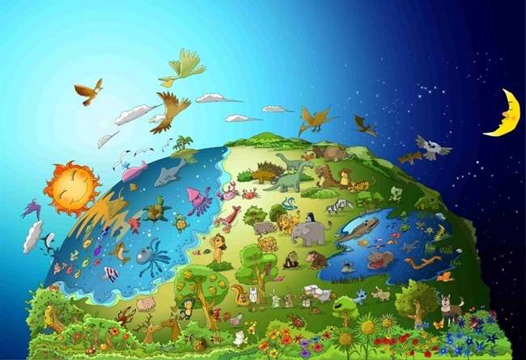

No.1 I Izwi kwe UNkulunkulu
UNkulunkulu
Kwenziwe
Umhlaba

Slide 2


Okwanamuhla Izwi
Ekuqaleni uNkulunkulu wadala
amazulu nomhlaba.
Genesise 1:1

Slide 3
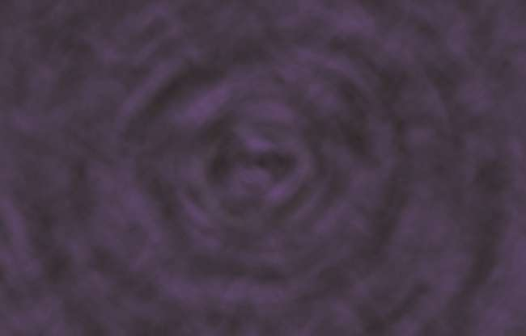
Ekuqaleni, ubumnyama babuphezu komhlaba.
Kwakungekho muntu, kungekho ukukhanya. Kwakungekho lutho.

Slide 4
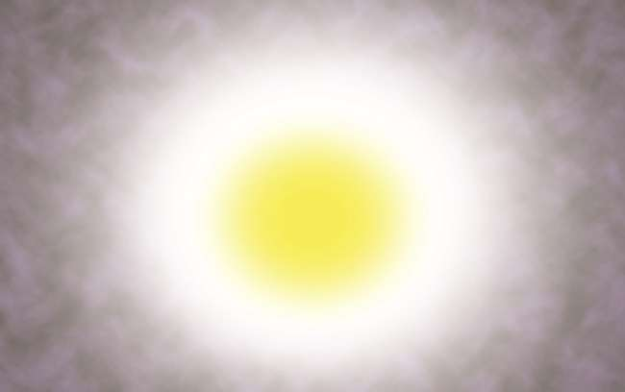
UNkulunkulu wathi, "Makube khona ukukhanya,"
kwaba khona ukukhanya.

Slide 5
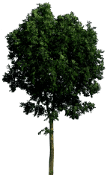



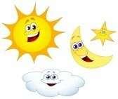
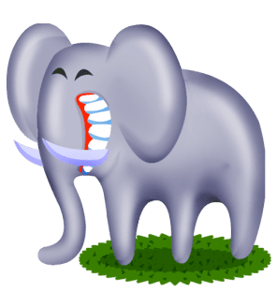
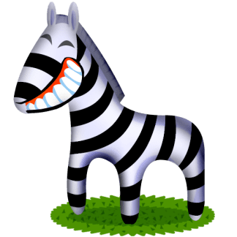
1
3
5
2
4
6
Ngosuku lokuqala, uNkulunkulu wehlukanisa ukukhanya nobumnyama. Wenza umhlaba wonke izinsuku eziyisithupha.

Slide 6
Zonke izinhlobo zezilwane nezitshalo, izinyoni nezinhlanzi zigcwele emhlabeni, olwandle nasesibhakabhakeni. UNkulunkulu wabuka konke ayekwenzile wayesethi, “Kuhle Kakhulu!

Slide 7


Isifundo Sanamuhla
Ubani owadala umhlaba?
UNkulunkulu wenza umhlaba.
Ubani ogcina umhlaba uhlelekile?
UNkulunkulu ugcina umhlaba uhlelekile.
Umhlaba awuzange wenziwa wona ngokwawo.
Umhlaba awukwazi ukunyakaziswa ngokwawo.
Kufanele sikhumbule ukuthi uNkulunkulu wenza umhlaba wonke futhi usabusa phezu kwawo wonke.

Slide 8
Ubani uNkulunkulu?
Ungu...
umdali owenza umhlaba wonke kuhlanganise nami.

Slide 9
Imibuzo Yanamuhla
UNkulunkulu wawenza ngani umhlaba?
① itshe
② amanzi
③ uthuli
④ igama
④ igama

Slide 10
Okwanamuhla Izwi
Ekuqaleni uNkulunkulu wadala
amazulu nomhlaba.
Genesise 1:1

Slide 11

Izingane ZeBhayibheli No.2 Izwi LikaNkulunkulu
Badla isithelo esinqatshelwe

Slide 12
Izwi Lanamuhla
UNkulunkulu wamdala umuntu ngomfanekiso wakhe, wamdala ngomfanekiso kaNkulunkulu;
wabadala owesilisa nowesifazane.
Genesis 1:27

Slide 13

U-Adamu no-Eva babeyizidalwa ezinhle kakhulu phakathi kwezidalwa zikaNkulunkulu.
Ngoba badalwa ngokomfanekiso kaNkulunkulu.

Slide 14

UNkulunkulu wathi kumuntu, “Kunoma yimuphi umuthi wensimu ungadla ngokukhululeka, kodwa ungadli kuwo umuthi wokwazi okuhle nokubi, ngoba lapho ususidla uyakufa nokufa .

Slide 15

Nokho, uSathane wazenza inyoka walinga u-Eva.
Ekugcineni, u-Eva wasidla isithelo.

Slide 16

Futhi u-Eva wanika u-Adamu enye.
U-Adamu wadla naye.

Slide 17

UNkulunkulu wabaxosha e-Edene ngoba abazange bamlalele uNkulunkulu.
Kusukela ngaleso sikhathi, Isono sangena emhlabeni.

Slide 18
Isifundo Sanamuhla
Isono sangena emhlabeni ngenxa yokuthi u-Adamu no-Eva abazange bawulalele umyalo kaNkulunkulu.
Ngiyalilalela izwi likaNkulunkulu?
Uma ngikholwa kuNkulunkulu, kufanele ngilalele izwi likaNkulunkulu.

Slide 19
UNkulunkulu ukhona?
Nkulunkulu..
Akathandi ukungalaleli.
Uyabusisa umuntu olalela izwi lakhe.

Slide 20
Imibuzo Yanamuhla
Yini uNkulunkulu ayisho ukuba ingadli esintwini?
① izithelo
② inyama
③ imifino
④ isithelo solwazi lokuhle nokubi
④ isithelo solwazi lokuhle nokubi

Slide 21
Izwi Lanamuhla
UNkulunkulu wamdala umuntu ngomfanekiso wakhe, wamdala ngomfanekiso kaNkulunkulu;
wabadala owesilisa nowesifazane.
Genesis 1:27

Slide 22

No.3 IZwi likaNkulunkulu
UNowa wenza umkhumbi omkhulu (umkhumbi) entabeni ende

Slide 23
Okwanamuhla Izwi
UJehova wayesethi kuNowa: “Ngena emkhunjini, wena nomndeni wakho wonke, ngoba ngikuthole ulungile kulesi sizukulwane.
( Genesise 7:1 )

Slide 24

UNkulunkulu wabona ukuthi bonke abantu emhlabeni babezonakalisile izindlela zabo. UNkulunkulu wathi kuNowa, “Ngizobhubhisa kokubili abantu nomhlaba . Yenza umkhumbi omkhulu entabeni!“

Slide 25

UNowa waqala ukwakha umkhumbi entabeni njengoba nje uNkulunkulu ayemyalile. Abantu babecabanga ukuthi uyahlanya.

Slide 26

UNowa wavumela zonke izinhlobo zezidalwa ukuba zingene emkhunjini namalungu omndeni kaNowa angu-8 njengoba uNkulunkulu ayemyalile.

Slide 27

Imvula yayilokhu ina emhlabeni izinsuku ezingu-40 njengoba nje uNkulunkulu ayeshilo.

Slide 28

Ekugcineni, umhlaba wagcwala amanzi. Yonke into ephilayo eyayihamba emhlabeni yafa. Kwasala uNowa kuphela, nalabo ababenaye emkhunjini.

Slide 29
Isifundo Sanamuhla
Abantu abamlalelanga uNowa owabanika ithuba lokusindiswa kuZamcolo omkhulu.
Bamane bathi uNowa uyahlanya
Uma uhambisa ivangeli kubangani, bangase bangakulaleli kahle.
Kodwa, ekugcineni, bayokwazi ukuthi izwi likaNkulunkulu liyiqiniso.

Slide 30
UNkulunkulu?
Nkulunkulu..
UNkulunkulu uyasizonda isono futhi uyasahlulela isono.

Slide 31
Imibuzo Yanamuhla
UNkulunkulu wathi enzeni kuNowa?
① Umkhumbi (Umkhumbi)
① Umkhumbi (Umkhumbi)
② Imoto
③ Indlu
④ Ibhayisikili

Slide 32
Izwi Lanamuhla
UJehova wayesethi kuNowa: “Ngena emkhunjini, wena nomndeni wakho wonke, ngoba ngikuthole ulungile kulesi sizukulwane.
Genesise 7:1

Slide 33

No.4 IZwi likaNkulunkulu
Uthingo lwaluyisivumelwano sikaNkulunkulu

Slide 34
Okwanamuhla Izwi
Njalo lapho uthingo luvela emafwini, ngizalubona, ngikhumbule isivumelwano esiphakade phakathi kukaNkulunkulu lezidalwa zonke eziphilayo emhlabeni wonke.
Genesis 9:16

Slide 35

Kwabhujiswa konke okuphilayo, kwasala uNowa kuphela nalabo ababenaye emkhunjini.

Slide 36

Imvula yayilokhu ina emhlabeni izinsuku ezingu-40.

Slide 37

Ngemva kokunqamuka kwemvula, uNowa wathumela ijuba.
Ijuba labuyela kuye lineqabunga lomnqumo elisha emlonyeni walo. UNowa wazi ukuthi, “Amanzi asebohlile emhlabeni.”

Slide 38

UNowa waphuma nomndeni wakhe, wakhuleka kuNkulunkulu. “Siyabonga Nkulunkulu ngokusinika izwe elisha.”

Slide 39

UNkulunkulu wamkhombisa uthingo njengophawu lwesivumelwano nesibusiso. “Phila ngenjabulo ezweni elisha!”

Slide 40
Isifundo Sanamuhla
UNkulunkulu wamsindisa uNowa nomndeni wakhe.
UNkulunkulu wathembisa ukuthi uyobabusisa futhi enze izwe elisha ngabo.
UNkulunkulu ubuye wasisindisa ngoJesu.
Kufanele sikholwe ukuthi uNkulunkulu uyokwenza izwe laKhe elisha ngathi.

Slide 41
UJehova uNkulunkulu?
Jehova Nkulunkulu..
UJehova uNkulunkulu unguBaba wethu osindisa futhi ebusisa abantwana bakhe abathandayo lapho sikholwa Kuye.

Slide 42
Imibuzo Yanamuhla
Yini uNowa ayithuma ukuba ayobona umhlaba womile?
① Ukhozi
② Undlunkulu
③ Ijuba
③ Ijuba
④ Idada

Slide 43
Izwi Lanamuhla
Njalo lapho uthingo luvela emafwini, ngizalubona, ngikhumbule isivumelwano esiphakade phakathi kukaNkulunkulu lezidalwa zonke eziphilayo emhlabeni wonke.
Genesis 9:16

Slide 44

No.5 I Izwi kwe UNkulunkulu
Abantu abakhile
UMbhoshongo waseBabele

Slide 45
Izwi Lanamuhla
Kungakho lathiwa iBabele, ngokuba uJehova waphithizela lapho
ulimi lomhlaba wonke. uJehova wabahlakaza lapho
ebusweni bomhlaba wonke.
Genesis 11:9

Slide 46
Abantu babefuna ukuba mkhulu nodumo kunoNkulunkulu. Ngakho, Baqala ukwakha umbhoshongo ophakeme.

Slide 47

Ngakho, bawakha ngokuphelele umbhoshongo.
“Asizibonakalise emhlabeni. Sibahle kakhulu!”

Slide 48


?
?
Nokho, lapho uNkulunkulu ebona ukuzikhukhumeza kwabo, wasanganisa ulimi lwabo ukuze bangezwani.

Slide 49

Ngenxa yokuthi babengazwani, babengakwazi ukusebenza ndawonye. Ekugcineni, bahlakazeka ebusweni bomhlaba. Kuze kube manje izilimi zomhlaba azifani.

Slide 50
Isifundo Sanamuhla
Abantu bafuna ukuba mkhulu futhi baphakame kunoNkulunkulu.
Lo mqondo ubizwa ngokuthi "ukuzikhukhumeza".
UNkulunkulu uyakuzonda ‘ukuzikhukhumeza’.
Okuphambene nokuqhosha 'ukuthobeka'.
Kufanele ‘sithobeke’ phambi kukaNkulunkulu ukuze simjabulise.

Slide 51
UJehova uNkulunkulu?
Jehova Nkulunkulu..
UJehova uNkulunkulu mkhulu futhi uhlakaniphile kunathi.
Asikwazi ukuhlakanipha kunoNkulunkulu nakuba sihlanganisa konke ukuhlakanipha kwethu ndawonye.

Slide 52
Imibuzo Yanamuhla
Kungani bengakwazanga ukuwuqeda lo mbhoshongo?
① UNkulunkulu wabangela uzamcolo lapho bewenza
② UNkulunkulu wenza ukuba kuqubuke umlilo lapho bewenza.
③ UNkulunkulu wenza ukuzamazama komhlaba lapho bekwenza.
④ UNkulunkulu wabenza ukuthi bangazwani lapho bekwenza.
④ UNkulunkulu wabenza ukuthi bangazwani lapho bekwenza.

Slide 53
Okwanamuhla Izwi
Kungakho lathiwa iBabele, ngokuba uJehova waphithizela lapho
ulimi lomhlaba wonke. uJehova wabahlakaza lapho
ebusweni bomhlaba wonke.
Genesis 11:9

Slide 54
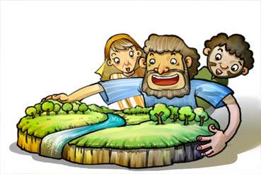
No.6 IZwi likaNkulunkulu
UNkulunkulu wabiza u-Abrahama

Slide 55
Izwi Lanamuhla
UJehova wayesethi ku-Abrama: “Phuma ezweni lakini, nasezizweni zakho, nasezizweni zakho;
hlala endlini kayise, uye ezweni engiyakukukhombisa lona.
Genesise 12:1

Slide 56

I-Uri lamaKaledi yayiwumuzi okhulekela izithombe.
U-Abrahama wazalelwa futhi wahlala khona.

Slide 57

Ngolunye usuku, iNkosi uJehova yathi kuye: “Phuma ezweni lakini, futhi ngizokubusisa.”

Slide 58

Nakuba u-Abrahama ayengazi ukuthi ayephi, walalela izwi likaNkulunkulu futhi wahamba njengoba nje uJehova ayemyalile.

Slide 59



Wabhekana nezinkinga eziningi ngesikhathi ehamba kodwa uNkulunkulu wamvikela ephephile.

Slide 60

Ekugcineni, u-Abrahama wafika ezweni laseKhanani. Wahlala lapho. “Ngiyabonga Nkulunkulu.”

Slide 61
Okwanamuhla Isifundo
U-Abrahama washiya umuzi wakubo ngokulalela izwi likaNkulunkulu.
Njengalokhu, thina kufanele bakholwe kuNkulunkulu futhi balalele izwi Lakhe.
Kufanele sibe nesifiso sokulalela izwi likaNkulunkulu nganoma yisiphi isikhathi.

Slide 62
UJehova uNkulunkulu?
Jehova UNkulunkulu….
UnguBaba wethu ogcina isithembiso saKhe kungakhathaliseki ukuthi kwenzekani.

Slide 63
Imibuzo Yanamuhla
Wazalelwaphi u-Abrahama?
① iKhanani
② IHarana
③ Israyeli
④ I-Uri yamaKaledi
④ I-Uri yamaKaledi

Slide 64
Okwanamuhla Izwi
UJehova uNkulunkulu wathi ku-Abrama: “Phuma ezweni lakini, nasezizweni zakho, nasendlini kayihlo, uye ezweni engiyakukukhombisa lona.”
Genesise 12:1

Slide 65

No. 7 IZwi LikaNkulunkulu
Isaka, iNdvodzana Yesetsembiso

Slide 66
Okwanamuhla Izwi
U-Abrahama wayeneminyaka eyikhulu mhla ezalelwa u-Isaka indodana yakhe.
Genesis 21:5

Slide 67

UNkulunkulu wathembisa u-Abrahama ukuthi uNkulunkulu uyomnika abantwana abangangezinkanyezi esibhakabhakeni ebusuku.
Kodwa, wayengenangane waze waba neminyaka eyi-100 ubudala.

Slide 68

Ngolunye usuku, uNkulunkulu wamkhiphela phandle u-Abrahama ebusuku.
“Bheka phezulu emazulwini. Ungakwazi yini ukubala izinkanyezi?”

Slide 69
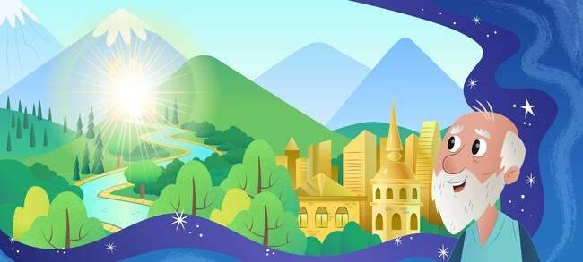
UNkulunkulu wamthembisa ukuthi uzomnika izwe elihle.

Slide 70
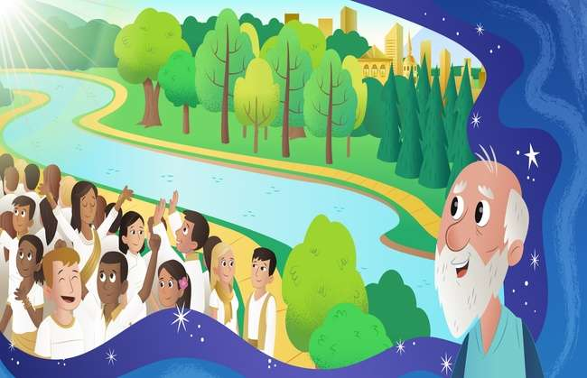
“Abantwana bakho bayakuba ngangezinkanyezi zezulu nesihlabathi sogwini lolwandle.” U-Abrahama wakholwa isithembiso seNkosi.

Slide 71

UNkulunkulu wasigcina isithembiso saKhe. USara wamzalela u-Abrahama indodana. U-Abhrahama wetha ibizo elithi Isaka elitsho intokozo .

Slide 72
Okwanamuhla Isifundo
U-Abrahama wayekholelwa ngempela esithembisweni sikaNkulunkulu nakuba sasibonakala singenakwenzeka kuye.
UNkulunkulu wajabula kakhulu lapho ebona ukholo luka-Abrahama. UNkulunkulu wamnika u-Isaka, indodana ethenjisiwe.
Ngokuqinisekile uNkulunkulu uyasifeza isithembiso Sakhe, nakuba kwakubonakala kungenakwenzeka kithi.

Slide 73
UNkulunkulu u...
UNkulunkulu u...
USomandla (ukwazi ukwenza konke)

Slide 74
Imibuzo Yanamuhla
Wayeneminyaka emingaki u-Abrahama lapho eba no-Isaka?
① 90
② 80
③ 70
④ 100
④ 100

Slide 75
Izwi Lanamuhla
U-Abrahama wayeneminyaka eyikhulu mhla ezalelwa u-Isaka indodana yakhe.
( Genesise 21:5 )

Slide 76

No. 8 IZwi LikaNkulunkulu
U-Abrahama wanikela ngo-Isaka kuNkulunkulu

Slide 77
Izwi Lanamuhla
Khona-ke uNkulunkulu wathi: “Thatha indodana yakho, indodana yakho eyodwa, u-Isaka, oyithandayo,
futhi uye esifundeni saseMoriya. umnikele khona njengomnikelo wokushiswa
kwenye yezintaba ngizokutshela ngayo.
Genesise 22:2

Slide 78

Ngolunye usuku, uNkulunkulu wathi ku-Abrahama,
“Nikela kimi indodana yakho okuwukuphela kwayo njengomnikelo wokushiswa.”

Slide 79

U-Abrahama wayemthanda u-Isaka kangangokuthi kwaba nzima lapho ezwa uNkulunkulu. Kodwa wanquma ukulalela uNkulunkulu.

Slide 80

U-Abrahama wabopha u-Isaka, wambeka e-altare, wazama ukumbulala. Ngaso leso sikhathi,

Slide 81

“Abrahama, Abrahama, ungambulali. Ungamenzi lutho. Manje ngiyazi ukuthi uyamesaba futhi uyamthanda uNkulunkulu.” Lokhu kwakuwuvivinyo uNkulunkulu alwenza ku-Abrahama.

Slide 82

“Ngiyabonga, Nkulunkulu!” UNkulunkulu walwamukela ngokuthokoza ukholo luka-Abrahama. UNkulunkulu wamenza ukhokho wawo wonke amakholwa.

Slide 83
Isifundo Sanamuhla
U-Abrahama wayemthanda kakhulu u-Isaka, kodwa kwakubaluleke kakhulu ukuba alalele iZwi likaNkulunkulu.
Kufanele ngithande uNkulunkulu ngaphezu kwanoma iyiphi enye into, futhi ngaphezu kwanoma yimuphi omunye umuntu emhlabeni.

Slide 84
UNkulunkulu ukhona?
UNkulunkulu ukhona..
Ubaba wethu owenza ukholo lwethu luqine ngovivinyo.

Slide 85
Okwanamuhla Imibuzo
UNkulunkulu wathini ku-Abrahama ukuba anikele njengomnikelo wokushiswa?
① Indodana
① Indodana
② Umfazi
③ Inja
④ Izimvu

Slide 86
Izwi Lanamuhla
Khona-ke uNkulunkulu wathi: “Thatha indodana yakho, indodana yakho eyodwa, u-Isaka, oyithandayo,
futhi uye esifundeni saseMoriya. umnikele khona njengomnikelo wokushiswa
kwenye yezintaba ngizokutshela ngayo.
Genesise 22:2

Slide 87

No.9 I Izwi kwe UNkulunkulu
U-Isaka akazange axabane

Slide 88
Izwi Lanamuhla
Wasuka lapho, wemba omunye umthombo, akwabakho ukuxabana ngawo.
Wayiqamba ngokuthi iRehobhoti, ethi: “Manje uJehova usinike indawo
futhi siyakuchuma ezweni.
Genesis 26: 22

Slide 89
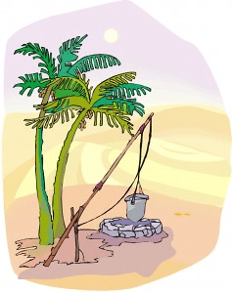
I imithombo babe ngakho kubalulekile, ngoba bona angakwazi thola kusha amanzi ogwadule. U-Isaka wadla ifa likayise.

Slide 90

Nokho, amaFilisti aba nomona ngaye. Ngakho, bagcwalisa imithombo ngomhlaba.

Slide 91
Kodwa, u-Isaka akazange axabane nabo. Wasuka lapho wagebha umthombo. Wathola umthombo wamanzi ahlanzekile.

Slide 92

Ngalesi sikhathi, abanye abantu bawuthatha umthombo ku-Isaka. Kodwa, akazange axabane nabo, futhi.

Slide 93

UNkulunkulu wambusisa u-Isaka. Waphinda wemba omunye umthombo. UNkulunkulu wamnika amanzi amasha avela lapho. u-Isaka wakha i-altare, wanikela ngomnikelo wokubonga.

Slide 94
Isifundo Sanamuhla
U-Isaka akaxabananga nabathatha imithombo yakhe;
UNkulunkulu wambusisa u-Isaka.
Akufanele futhi sixabane nabanye.
Kufanele sithande futhi sithethelele abanye.

Slide 95
UNkulunkulu ukhona??
UNkulunkulu….
Uyabazonda abaxabene nabanye.
Uyabathanda labo abathandanayo.

Slide 96
Imibuzo yanamuhla
Kungani u-Isaka abhekana nesikhathi esinzima?
① indlu
② iwundlu
③ kahle
③ kahle
④ umndeni

Slide 97
Izwi lanamuhla
Wasuka lapho, wemba omunye umthombo, akwabakho ukuxabana ngawo.
Wayiqamba ngokuthi iRehobhoti, ethi: “Manje uJehova usinike indawo
futhi siyakuchuma ezweni.
Genesis 26: 22

Slide 98

No.10 I Izwi kwe UNkulunkulu
U-Esawu wathengisa ngobuzibulo
ngesitsha esisodwa sesitshulu esibomvu

Slide 99
Izwi Lanamuhla
UJakobe wamnika u-Esawu isinkwa nesitshulu sikadali.
Wadla waphuza, wasukuma wahamba.
Ngakho, u-Esawu wadelela ubuzibulo bakhe.
Genesise 25:34

Slide 100

Umka-Isaka, uRebheka, wazala amawele. Igama lendodana yokuqala kwakungu-Esawu kanti eyesibili kwakunguJakobe.

Slide 101

U-Esawu wayethanda ukuzingela. Ngakho, wayethanda imisebenzi yangaphandle. Kodwa, uJakobe wayeyindoda ethule, ehlala ekhaya.

Slide 102

Ngolunye usuku, lapho uJakobe epheka isitshulu, u-Esawu wabuya elambile ngemva kokuzingela.

Slide 103
“Ngiphe isitshulu!”, “Qala ungithengisele ubuzibulo bakho. Bese ngikunika." U-Esawu wayelambile kangangokuthi wathengisa ubuzibulo bakhe ngesitsha esisodwa sesitshulu esibomvu.

Slide 104

Ekugcineni, uJakobe wamkhohlisa uyise ukuze athole isibusiso. Ekugcineni, wasithola isibusiso. Zonke lezi zinto zenzeka ngokuphatha kukaNkulunkulu.

Slide 105
Isifundo Sanamuhla
U-Esawu wacabanga ukuthi ukuxazulula inkinga yendlala kwakubaluleke kakhulu kunokuthola isibusiso esingokomoya.
Ekugcineni, uJakobe waba i ukhokho wama-Israyeli.
Yini ocabanga ukuthi ibaluleke kakhulu?
Isibusiso sokuba ngabantwana bakaNkulunkulu asinakuthathelwa indawo yalutho.

Slide 106
UNkulunkulu ukhona?
UNkulunkulu kuyinto
UNkulunkulu ufeza intando Yakhe naphezu kwamaphutha namanga abantu.

Slide 107
Namuhla' Imibuzo
U-Esawu wathengisa ngani ubuzibulo bakhe?
① i-noodle
② isinkwa
③ inyama
④ isitshulu esibomvu
④ isitshulu esibomvu

Slide 108
Okwanamuhla Izwi
UJakobe wamnika u-Esawu isinkwa nesitshulu sikadali.
Wadla waphuza, wasukuma wahamba.
Ngakho, u-Esawu wadelela ubuzibulo bakhe.
Genesise 25:34

Slide 109

No. 11 IZwi LikaNkulunkulu
Iphupho likaJakobe

Slide 110
Izwi Lanamuhla
Waphupha iphupho, ebona izitebhisi ziphezu komhlaba, isihloko saso sifinyelela ezulwini, nezingelosi zikaNkulunkulu zenyuka, zehla kuso.
Genesis 28: 12

Slide 111

UJakobe wakhohlisa umfowabo ngamanga. Wayesaba ukubulawa. Ngakho, wabaleka ekhaya waya kumalume wakhe eHarana.

Slide 112

Ebusuku, ethatha itshe khona, walala ebeka ngaphansi kwekhanda lakhe njengomcamelo. Wayeyedwa lapho engenamndeni. Ngakho wesaba futhi wazizwa enesizungu.

Slide 113

UJakobe wabona izingelosi zikaNkulunkulu zenyuka futhi zehla ngezitebhisi emhlabeni ziya ezulwini.

Slide 114

Wezwa izwi likaNkulunkulu, "Nginawe futhi ngizokuqapha nomaphi lapho uya khona."

Slide 115

Lapho evuka ekuseni, wakhonza uNkulunkulu owathembisa ukuthi uzoba naye, futhi wanikeza udumo kuNkulunkulu.

Slide 116
Isifundo Sanamuhla
Njengoba uNkulunkulu wayenoJakobe owayesaba ukuba yedwa,
UBaba wethu uNkulunkulu naye uyasinakekela lapho sisodwa.
NjengoJakobe, kufanele sidumise futhi sidumise uNkulunkulu onathi njalo.

Slide 117
UNkulunkulu ukhona?
UNkulunkulu
UNkulunkulu unathi noma kuphi nanoma nini.
UNkulunkulu usinakekela njalo.

Slide 118
Okwanamuhla Imibuzo
Lapho uJakobe elele, yini ayithatha njengomcamelo?
① ukhuni
② itshe
② itshe
③ isikhwama
④ isikhumba sesilwane

Slide 119
Izwi Lanamuhla
Waphupha iphupho, ebona izitebhisi ziphezu komhlaba, isihloko saso sifinyelela ezulwini, nezingelosi zikaNkulunkulu zenyuka, zehla kuso.
Genesis 28: 12

Slide 120

No.12 I Izwi kwe UNkulunkulu
UJosefa Wathengiswa Ngabafowabo

Slide 121
Izwi Lanamuhla
“Wozani manje, simbulale, simphonsa komunye wale migodi
bathi udliwe yisilwane esibi.
Sizobona-ke ukuthi amaphupho akhe athini."
( Genesise 37:20 )

Slide 122

UJakobe wayenamadodana ayishumi nambili. Wayemthanda uJosefa ukwedlula wonke amanye amadodana akhe. Ngakho, wenzela uJosefa indwangu enhle kakhulu

Slide 123

Abafowabo babemzonda kakhulu ngoba uyise wayemthanda ngokukhethekile. “Asimthengise uJosefa. Asitshele ubaba ukuthi ushonile.

Slide 124

Bathengisa uJosefa njengesigqila kubathengisi ababedlula.
Lapho ezwa lokhu, uJakobe wadabuka kakhulu.

Slide 125

UJosefa wayephila impilo enzima njengesigqila. Nokho, wakholwa futhi wancika kuNkulunkulu ngaphandle kokwenza isono.

Slide 126

UJosefa wavalelwa ejele ngecala elingamanga. Nokho, wazama ukuba olungile phambi kukaNkulunkulu ngisho nasetilongweni. UNkulunkulu akazange amkhohlwe uJosefa futhi uNkulunkulu wayenamacebo amangalisayo ngaye.

Slide 127


Isifundo Sanamuhla
UJosefa wazondwa futhi wathengiswa abafowabo njengesigqila. Waphinde wavalelwa ejele ngecala elingamanga.
Nokho, wancika kuNkulunkulu futhi wazama ukungenzi isono nakakhulu.
Singase sibhekane nobunzima obuthile.
Masingoni sicele usizo kuBaba wethu osilalela ngokuzithandela.

Slide 128
UNkulunkulu ukhona?
Baba wethu Nkosi..
UBaba wethu uNkulunkulu unezinhlelo ezimangalisayo ngathi ngisho nasezikhathini ezinzima.

Slide 129


Imibuzo Yanamuhla
Yini uJakobe ayinika uJosefa kuphela phakathi kwamadodana akhe ayishumi nambili?
① amathoyizi
② IBhayibheli
③ indwangu enhle ngokucebile
③ indwangu enhle ngokucebile
④ imali

Slide 130
Izwi Lanamuhla
“Wozani manje, simbulale, simphonsa komunye wale migodi
bathi udliwe yisilwane esibi.
Sizobona-ke ukuthi amaphupho akhe athini."
( Genesise 37:20 )

Slide 131

No. 13 IZwi LikaNkulunkulu
UJoseph waba nguNdunankulu eGibhithe

Slide 132
Izwi Lanamuhla
Wayesethi uFaro kuJosefa: “Ngalokho ngikubeka phezu kwezwe lonke laseGibithe.”
Genesis 41: 41

Slide 133

UFaro, inkosi yaseGibhithe, waba nephupho. Izinkomo ezikhuluphele eziyisi-7 emva kwalokho kwaphuma izinkomo eziyisi-7 ezimbi. 7 izinkomo ezimbi zadla 7 izinkomo ezikhuluphele. Kwakuyiphupho elixakile.

Slide 134

Akekho owayekwazi ukuchaza iphupho lakhe esigodlweni. Induna yabaphathizitsha eyasizwa uJosefa yamethula enkosini.

Slide 135

UNkulunkulu wanika uJosefa ukuhlakanipha. Ngakho, wakwazi ukuchaza incazelo yephupho futhi wayitshela inkosi.

Slide 136

UFaro wathinteka kangangokuthi wabeka uJosefa owayeyisiboshwa esikhundleni sesibili esiphakeme kunazo zonke ezweni.

Slide 137

UJosefa waba undunankulu waseGibhithe futhi walibusa kahle izwe ngokuhlakanipha uNkulunkulu amnika kona.

Slide 138
Isifundo Sanamuhla
UNkulunkulu wayenamacebo amangalisayo ngoJosefa.
Lapho sibhekene nobunzima obuthile, akufanele futhi siphoxeke,
kodwa kufanele silindele izinhlelo ezimangalisayo zikaNkulunkulu ngathi futhi sikholwe kuNkulunkulu..

Slide 139
UNkulunkulu ukhona?
UNkulunkulu wenza ngokwentando yaKhe.
Abaphansi bayophakanyiswa futhi abaphakeme bayokwehliswa.

Slide 140
Imibuzo Yanamuhla
Yiziphi izilwane ezavela ephusheni likaFaro?
① inyoni
② inja
③ ihhashi
④ inkomo
④ inkomo

Slide 141
Izwi Lanamuhla
Ngakho uFaro wathi kuJosefa:
“Ngalokho ngikubeka phezu kwezwe lonke laseGibithe.”
Genesis 41: 41

Slide 142

Cha. 14 IZwi likaNkulunkulu
UJosefa Waphinde Wahlangana Nabafowabo

Slide 143
Izwi Lanamuhla
Nakuba uJosefa ayebazi abafowabo, kodwa abazange bamazi.
Genesis 42: 8

Slide 144

UFaro wamisa uJosefa njengondunankulu waseGibhithe. UJosefa wayilawula ngokuhlakanipha iminyaka engu-7 yendlala enkulu.

Slide 145

Nokho, kwakungekho nhlamvu eKhanani ngenxa yendlala. Kwadingeka behlele eGibhithe ukuze bayolanda okusanhlamvu ukuze badle. Abafowabo bakaJosefa nabo baya eGibhithe bayothenga ukudla.

Slide 146

Nakuba uJosefa ayebazi abafowabo, kodwa abazange bamazi.

Slide 147

UJosefa wabatshela ukuthi ungubani. Bethuka bembuka bezwa bemesaba

Slide 148

UJosefa waqaphela ukuthi kungani uNkulunkulu amthuma eGibhithe. Wabathethelela abafowabo futhi wathatha wonke umndeni wakhe waya eGibhithe futhi wabanakekela ngokuphepha.

Slide 149
Isifundo Sanamuhla
UJosefa wabathethelela abafowabo ababemphatha kubi futhi ebathanda ngokwentando kaNkulunkulu.
Kufanele sithethelele imindeni yethu nabangane futhi sibathande.

Slide 150
UNkulunkulu ukhona?
Nkulunkulu..
Uyasithethelela futhi uyasithanda.

Slide 151
Imibuzo Yanamuhla
UJosefa waba undunankulu waliphi izwe?
① IGibhithe
① IGibhithe
② Israyeli
③ iPheresiya
④ IBhabhiloni

Slide 152
Izwi Lanamuhla
Nakuba uJosefa ayebazi abafowabo, kodwa abazange bamazi.
Genesis 42: 8

Slide 153

No.15 IZwi likaNkulunkulu
Ingane Eyasindiswa Emanzini

Slide 154
Izwi Lanamuhla
Umntwana esekhulile, wamyisa endodakazini kaFaro, waba yindodana yayo. Waqamba igama layo ngokuthi uMose, ethi: "Ngamkhipha emanzini."
Eksodusi 2:10

Slide 155

Inkosi yaseGibhithe, uFaro, yayala ukuba izingane zabafana ezisanda kuzalwa zakwa-Israyeli zilahlwe emfuleni iNayile ukuze zibulawe.

Slide 156

UJokebedi, unina kaMose, wayengenakukwenza ngaphandle kokuvumela indodana yakhe ithwalwe emfuleni iNayile.

Slide 157

Ngaleso sikhathi, inkosazana yaseGibhithe yabona umntwana ngesikhathi igeza emfuleni. Wayenenhloso yokukhulisa umfana.

Slide 158

Udadewabo wabona inkosazana ikhipha ingane yomfana kubhasikidi. Wethula unina wangempela, uJokebedi, ukuba amncelise umntwana womfana.

Slide 159

Lapho umntwana esekhulile, wabuyiselwa enkosazaneni ukuba abe yindodana yakhe. Waqamba igama layo ngokuthi uMose, ethi: “Ngamkhipha emanzini; UMose wakhulela eGibhithe Isigodlo.

Slide 160
Isifundo Sanamuhla
UNkulunkulu wamkhulula uMose.
UNkulunkulu wasisindisa ngobuhlakani bakhe obumangalisayo namandla (isipho).
Asikholwe ukuthi izinhlelo zikaNkulunkulu zikhulu futhi ziphelele kunezami njalo.

Slide 161
Ubani uNkulunkulu?
Nkulunkulu..
UnguNkulunkulu onamandla onke owenza intando yaKhe naphezu kwanoma yisiphi isithiyo.

Slide 162
Imibuzo Yanamuhla
Kwenzekani emntwaneni owathwalwa emanzini?
① Waminziswa futhi wadliwa izinhlanzi.
② Izinyoni zahlenga ingane.
③ UNkulunkulu wahlenga umntwana esibhakabhakeni.
④ INkosazana yaseGibhithe yambona futhi yamkhulula.
④ INkosazana yaseGibhithe yambona futhi yamkhulula.

Slide 163
Izwi Lanamuhla
Umntwana esekhulile, wamyisa endodakazini kaFaro, waba yindodana yayo. Waqamba igama layo ngokuthi uMose, ethi: "Ngamkhipha emanzini."
Eksodusi 2:10

