Slide 1

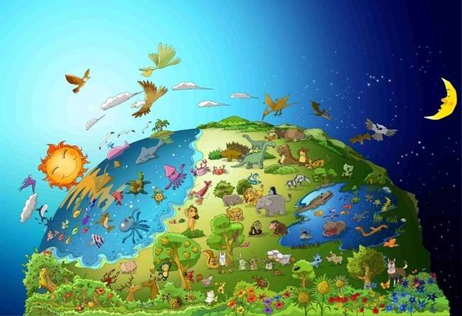

No.1 The Word of God
God
Made
The World

Slide 2


Today’s Word
In the beginning God created
the heavens and the earth.
Genesis 1:1

Slide 3

In the beginning, darkness was over the surface.
There was no man, no light. There was nothing.

Slide 4
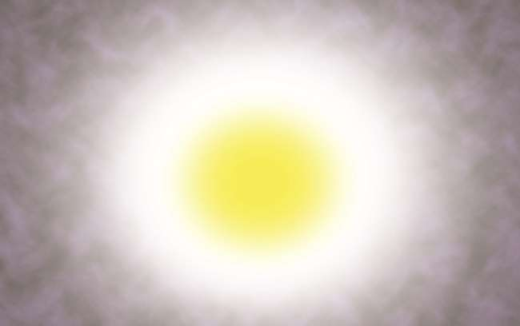
God said, “Let there be light,”
and there was light.

Slide 5
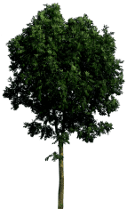



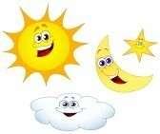
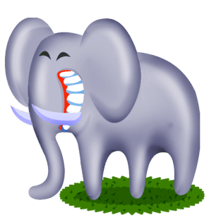
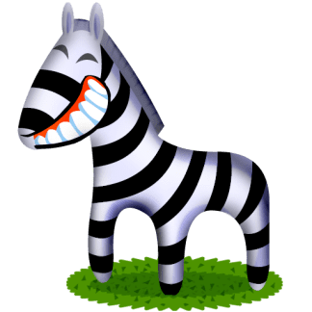
1
3
5
2
4
6
On the first day, God separated the light from the darkness. He made the whole world for six days.

Slide 6
All kinds of animals and plants, birds and fishes are full on the earth, in the sea and in the sky. God looked at all he had made and said, “Very Good!.”

Slide 7


Today’s Lesson
Who made the world?
God made the world.
Who keeps the world in order?
God keeps the world in order.
The world was not made by itself.
The world can not be moved by itself.
We should remember that God made the whole world and still control over them all.

Slide 8
Who is God?
He is...
the creator who made the whole world including me.

Slide 9
Today’s Quiz
With what did God make the world?
① stone
② water
③ dust
④ word
④ word

Slide 10
Today’s Word
In the beginning God created
the heavens and the earth.
Genesis 1:1

Slide 11

Bible Kids No.2 The Word of God
They ate the forbidden fruit

Slide 12
Today’s Word
God created man in his own image, in the image of God he created him;
male and female he created them.
Genesis 1:27

Slide 13

Adam and Eve was the best creatures among God’s creatures.
For they were created according to God’s image.

Slide 14

God said to the man, “"You are free to eat from any tree in the garden; but you must not eat from the tree of the knowledge of good and evil, for when you eat of it you will surely die."

Slide 15

But, Satan disguised as a snake tempted Eve.
Finally, Eve ate the fruit.

Slide 16

And Eve gave another to Adam.
Adam ate it, too.

Slide 17

God drove them out of Eden because they didn’t listen to God.
From that time, Sin came into the world.

Slide 18
Today’s Lesson
Sin came into the world because Adam and Eve did not obey God’s command.
Do I obey God’s word?
If I believe in God, I must obey God’s word.

Slide 19
God is?
God..
Dislikes disobedience.
Blesses the man who obeys His word.

Slide 20
Today’s Quiz
What did God say not to eat to the mankind?
① fruit
② meat
③ vegetable
④ the fruit of the knowledge of good and evil
④ the fruit of the knowledge of good and evil

Slide 21
Today’s Word
God created man in his own image, in the image of God he created him;
male and female he created them.
Genesis 1:27

Slide 22

No.3 The Word of God
Noah made a Big Ship (an Ark) on the High Mountain

Slide 23
Today’s Word
The LORD then said to Noah, "Go into the ark, you and your whole family, because I have found you righteous in this generation.
(Genesis 7:1)

Slide 24

God saw that all the people on earth corrupted their ways. God said to Noah, “I will destroy both people and the earth . Make a big ship on the mountain!“

Slide 25

Noah started making a ship on the mountain just as God commanded him. People thought he was mad.

Slide 26

Noah let every kind of creature come into the ship with Noah’s 8 family members as God commanded.

Slide 27

The rain kept coming on the earth for 40 days as God said.

Slide 28

In the end, the earth was covered with water. Every living thing that moved on the earth died. Only Noah was left, and those with him in the ark.

Slide 29
Today’s Lesson
People didn’t listen to Noah who gave them a chance to be saved from a big flood.
They only said that Noah was mad
When you deliver the gospel to friends, they may not listen to you well.
But, in the end, they are going to know that God’s word is true.

Slide 30
God ?
God..
God hates the sin and judges the sin.

Slide 31
Today’s Quiz
What did God say to Noah to make?
① A Ship (An Ark)
① A Ship (An Ark)
② A Car
③ A House
④ A Bike

Slide 32
Today’s Word
The LORD then said to Noah, "Go into the ark, you and your whole family, because I have found you righteous in this generation.
Genesis 7:1

Slide 33

No.4 The Word of God
The Rainbow was the God’s Covenant

Slide 34
Today’s Word
Whenever the rainbow appears in the clouds, I will see it and remember the everlasting covenant between God and all living creatures of every kind on the earth."
Genesis 9:16

Slide 35

Every living thing was wiped out, only Noah and those with him in the ark were left.

Slide 36

The rain kept coming on the earth for 40 days.

Slide 37

After the rain stopped, Noah sent out a dove.
The dove returned to him with fresh olive leaf in its beak. Noah knew, “The water receded from the earth!”

Slide 38

Noah came out with his family, and worshipped God. “Thank you God for giving us new world.”

Slide 39

God showed him a rainbow as the sign of the covenant and blessing. “Live happily in the new world!”

Slide 40
Today’s Lesson
God has saved Noah and his family.
God promised that He will bless them and make a new world through them.
God has also saved us through Jesus.
We have to believe that God will make His new world through us.

Slide 41
Yahweh God?
Yahweh God..
Yahweh God is our Father who saves and blesses His beloved children abundantly when we believe in Him.

Slide 42
Today’s Quiz
What did Noah send out to see the earth was dried?
① Eagle
② Sparrow
③ Dove
③ Dove
④ Duck

Slide 43
Today’s Word
Whenever the rainbow appears in the clouds, I will see it and remember the everlasting covenant between God and all living creatures of every kind on the earth."
Genesis 9:16

Slide 44

No.5 The Word of God
People who built
The Tower of Babel

Slide 45
Today’s Word
That is why it was called Babel --because there the LORD confused
the language of the whole world. From there the LORD scattered them
over the face of the whole earth.
Genesis 11:9

Slide 46
People wanted to be greater and more famous than God. So, They started to build a high tower.

Slide 47

Thus, they were building the tower altogether.
“Let’s show ourselves to the world. We are so great!”

Slide 48


?
?
However, when God saw their arrogance, he confused their language so they will not understand each other.

Slide 49

Because they could not understand each other, they could not work together. At last, they scattered over the face of the earth. Until now the world’s languages are different from each other.

Slide 50
Today’s Lesson
People want to be greater and higher than God.
This mind is called “arrogance”.
God hates ‘arrogance’.
The opposite of arrogance is ‘humility’.
We should be ‘humble’ before God to please Him.

Slide 51
Yahweh God ?
Yahweh God..
Yahweh God is greater and wiser than we are.
We can not be wiser than God even though we combine all our wisdom together.

Slide 52
Today’s Quiz
Why could they not finish the tower?
① God caused the flood when they made it
② God made a fire broken out when they made it.
③ God made an earthquake when they made it.
④ God made them not to understand each other when they made it.
④ God made them not to understand each other when they made it.

Slide 53
Today’s Word
That is why it was called Babel --because there the LORD confused
the language of the whole world. From there the LORD scattered them
over the face of the whole earth.
Genesis 11:9

Slide 54
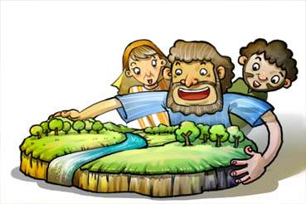
No.6 The Word of God
God called Abraham

Slide 55
Today’s Word
The LORD had said to Abram, "Leave your country, your people and your
father's household and go to the land I will show you.
Genesis 12:1

Slide 56

Ur of the Chaldeans was the idol worshipping city.
Abraham was born and lived there.

Slide 57

One day, The Lord God had said to him, “Leave your country, and I will bless you.”

Slide 58

Even though Abraham didn’t know where to go, he obeyed God’s word and left as the Lord had told him.

Slide 59



He suffered many difficult matters while he was travelling but God protected him safely.

Slide 60

Finally, Abraham arrived the land of Canaan. He lived there. “Thank you, God.”

Slide 61
Today’s Lesson
Abraham left his hometown with obeying God’s word.
Like this, we should believe in God and obey His word.
We should have the desire to obey God’s word in any time.

Slide 62
Yahweh God is?
Yahweh God….
He is our Father who keeps His promise at any cost.

Slide 63
Today’s Quiz
Where was Abraham was born?
① Canaan
② Haran
③ Israel
④ Ur of the Chaldeans
④ Ur of the Chaldeans

Slide 64
Today’s Word
The Lord God had said to Abram, “Leave your country, your people and your father’s household and go to the land I will show you.”
Genesis 12:1

Slide 65

No. 7 The Word of God
Isaac, the Promised Son

Slide 66
Today’s Word
Abraham was a hundred years old when his son Isaac was born to him.
Genesis 21:5

Slide 67

God promised to Abraham that God will give him children as many as stars in the night sky.
But, he had no child until he was 100 years old.

Slide 68

One day, God took Abraham outside at night.
“Look up at the heavens. Can you count the stars?”

Slide 69
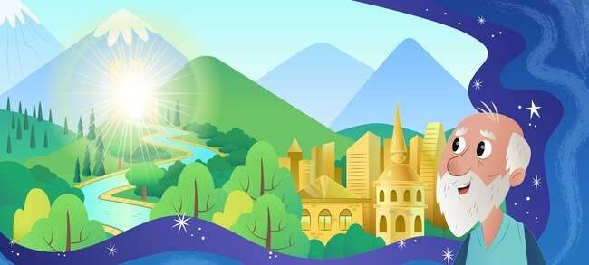
God promised him to give the beautiful land, too.

Slide 70
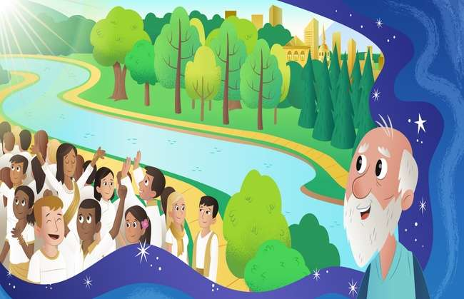
“Your children shall be as many as the stars in the sky, and the sands in the seashore.“ Abraham believed the Lord’s promise.

Slide 71

God kept His promise. Sarah bore a son to Abraham. Abraham gave the name Isaac which means Joy.

Slide 72
Today’s Lesson
Abraham really believed in God’s promise even though it looked impossible to him.
God was very happy when He saw Abraham’s belief. God gave him Isaac, the promised son.
God certainly fulfill His promise, even though it looked impossible for us.

Slide 73
God is…
God is...
Almighty (able to do everything)

Slide 74
Today’s Quiz
How old was Abraham when he had Isaac?
① 90
② 80
③ 70
④ 100
④ 100

Slide 75
Today’s Word
Abraham was a hundred years old when his son Isaac was born to him.
(Genesis 21: 5)

Slide 76

No. 8 The Word of God
Abraham offered Isaac to God

Slide 77
Today’s Word
Then God said, “Take your son, your only son, Isaac, whom you love,
and go to the region of Moriah. Sacrifice him there as a burnt offering
on one of the mountains I will tell you about.”
Genesis 22:2

Slide 78

One day, God said to Abraham,
“Offer Me your only son as a burnt offering.”

Slide 79

Abraham loved Isaac so much that he was hard when he heard from God. But he decided to obey to God.

Slide 80

Abraham bound Isaac and laid him on the alter, and he tried to kill him. At that very moment,

Slide 81

“Abraham, Abraham, do not kill him. Do not do anything to him. Now, I know that you fear and love God.” This was the test God did to Abraham.

Slide 82

“Thank you, God!” God accepted Abraham’s faith gladly. God made him an ancestor of all believers.

Slide 83
Todays’s Lesson
Abraham loved Isaac so much, but it was more important for him to obey God’s Word.
I should love God more than any other thing, and more that any other person in the world.

Slide 84
God is?
God is..
Our father who makes our faith stronger through test.

Slide 85
Today’s Quiz
What did God say to Abraham to offer as a burnt offering?
① Son
① Son
② Wife
③ Dog
④ Sheep

Slide 86
Today’s Word
Then God said, “Take your son, your only son, Isaac, whom you love,
and go to the region of Moriah. Sacrifice him there as a burnt offering
on one of the mountains I will tell you about.”
Genesis 22:2

Slide 87

No.9 The Word of God
Isaac didn’t quarrel

Slide 88
Today’s Word
He moved on from there and dug another well, and no one quarreled over it.
He named it Rehoboth, saying, "Now the LORD has given us room
and we will flourish in the land."
Genesis 26: 22

Slide 89
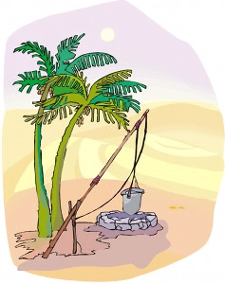
The wells were so important, because they could get fresh water in the desert. Isaac had the wells inherited by his father.

Slide 90

However, the Philistines envied him. So, they filled the wells with earth.

Slide 91
But, Isaac didn’t quarrel with them. He moved away and dug the well. He discovered a well of fresh water.

Slide 92

At this time, the other people took the well from Isaac. But, he didn’t quarrel with them, either.

Slide 93

God blessed Isaac. He dug another well again. God gave him fresh water from there. Isaac built an alter and gave thank offering.

Slide 94
Today’s Lesson
Isaac didn’t quarrel with those who took away his wells.
God blessed Isaac.
We also have not to quarrel with others.
We have to love and forgive others.

Slide 95
God is??
God ….
He hates those who quarrel with others.
He loves those who those who love each other.

Slide 96
Today’s quiz
Because of what did Isaac suffer a tough time?
① house
② lamb
③ well
③ well
④ family

Slide 97
Today’s word
He moved on from there and dug another well, and no one quarreled over it.
He named it Rehoboth, saying, "Now the LORD has given us room
and we will flourish in the land."
Genesis 26: 22

Slide 98

No.10 The Word of God
Esau sold the birthright
for the one bowl of red stew

Slide 99
Today’s Word
Then Jacob gave Esau some bread and some lentil stew.
He ate and drank, and then got up and left.
So, Esau despised his birthright.
Genesis 25:34

Slide 100

Isaac’s wife, Rebekah gave birth to twins. The first son’s name was Esau and the second was Jacob.

Slide 101

Esau liked hunting. So, he loved outdoor activities. But, Jacob was a quiet man, staying at home.

Slide 102

One day, when Jacob was cooking some stew, Esau came back home hungry after hunting.

Slide 103
“Give me some stew!”, “First sell me your birthright. Then I will give you some.” Esau was so hungry that he sold his birthright for one bowl of red stew.

Slide 104

Eventually, Jacob deceived his father to get the blessing. At last, he got the blessing. All these things were happened by the providence of God.

Slide 105
Today’s Lesson
Esau thought that solving hungry problem was more important than getting the spiritual blessing.
Finally, Jacob became the ancestor of the Israelites.
What do you think more important?
The blessing to be children of God can not be substituted for anything.

Slide 106
God is?
God is
God is fulfilling His own will in spite of men’s error and false.

Slide 107
Todays’ Quiz
For what did Esau sell his birthright?
① noodle
② bread
③ meat
④ red stew
④ red stew

Slide 108
Today’s Word
Then Jacob gave Esau some bread and some lentil stew.
He ate and drank, and then got up and left.
So, Esau despised his birthright.
Genesis 25:34

Slide 109

No. 11 The Word of God
Jacob’s Dream

Slide 110
Today’s Word
He had a dream in which he saw a stairway resting on the earth, with its top reaching to heaven, and the angels of God were ascending and descending on it
Genesis 28: 12

Slide 111

Jacob deceived his brother with a lie. He was afraid of being killed. So, he fled from home to his uncle in Haran.

Slide 112

At night, taking a stone there, he slept putting it under his head as a pillow. He was alone there without family. So he was afraid and felt lonely.

Slide 113

Jacob saw angels of God ascending and descending a stairway on the earth to heaven.

Slide 114

He heard the voice of God, ”I am with you and will watch over you wherever you go.”

Slide 115

When he awoke in the morning, he worshiped God who promised that he would be with him, and he gave glory to God.

Slide 116
Today’s Lesson
Like God was with Jacob who was afraid of being alone,
Our Father God also take care of us when we are alone.
Like Jacob, we should honor and give glory to God who be with us always.

Slide 117
God is?
God
God is with us anywhere and anytime.
God is taking care of us always.

Slide 118
Today’s Quiz
When Jacob slept, what did he take as a pillow?
① wood
② stone
② stone
③ bag
④ skin of animal

Slide 119
Today’s Word
He had a dream in which he saw a stairway resting on the earth, with its top reaching to heaven, and the angels of God were ascending and descending on it
Genesis 28: 12

Slide 120

No.12 The Word of God
Joseph Sold by His Brothers

Slide 121
Today’s Word
"Come now, let's kill him and throw him into one of these cisterns
and say that a ferocious animal devoured him.
Then we'll see what comes of his dreams."
(Genesis 37: 20)

Slide 122

Jacob had twelve sons. He loved Joseph more than any of his other sons. So, he made a richly beautiful cloth for Joseph

Slide 123

His brothers hated him a lot because their father loved him specially. “Let’s sell Joseph. Let’s tell to father he died.

Slide 124

They sold Joseph as a slave to merchants came by.
At hearing this, Jacob was deeply saddened.

Slide 125

Joseph lived a hard life as a slave. However, he believed and relied on God without committing any sin.

Slide 126

Joseph was sent into prison on a false charge. However, he tried to be righteous before God even in the prison. God didn’t forget Joseph and God had an amazing plans for him.

Slide 127


Today’s Lesson
Joseph was hated and sold as a slave by his own brothers. He was also put into prison on a false charge.
However, he relied on God and tried not to commit any sin all the more.
We may face some difficulties.
Let’s not commit any sin and to ask help to our father God who is willingly listening to our prayer.

Slide 128
God is?
Our Father God..
Our Father God has an amazing plans for us even in a difficult times.

Slide 129


Today’s Quiz
What did Jacob give only to Joseph among his twelve sons?
① toys
② Bible
③ richly beautiful cloth
③ richly beautiful cloth
④ money

Slide 130
Today’s Word
"Come now, let's kill him and throw him into one of these cisterns
and say that a ferocious animal devoured him.
Then we'll see what comes of his dreams."
(Genesis 37: 20)

Slide 131

No. 13 The Word of God
Joseph became Prime Minister in Egypt

Slide 132
Today’s Word
So Pharaoh said to Joseph, “I hereby put you in charge of the whole land of Egypt.”
Genesis 41: 41

Slide 133

Pharaoh, the king of Egypt, had a dream. 7 fat cows and after that 7 ugly cows came out. 7 ugly cows ate up 7 fat cows. It was very strange dream.

Slide 134

No one could interpret his dream in the palace. The chief cupbearer who was helped by Joseph introduced him to the king.

Slide 135

God gave Joseph wisdom. So, he could interpret the meaning of the dream and told it to the king.

Slide 136

Pharaoh was so moved that he appointed Joseph who was a prisoner to the second highest position of the land.

Slide 137

Joseph became the prime minister of Egypt and ruled over the land well with the wisdom God gave him.

Slide 138
Today’s Lesson
God had the amazing plans for Joseph.
When we face some difficulties, we should also not be disappointed,
but should expect God’s amazing plans for us and believe in God..

Slide 139
God is?
God does according to His will.
The lowly will be exalted and the exalted will be brought low.

Slide 140
Today’s Quiz
What animals appeared in Pharaoh’s dream?
① bird
② dog
③ horse
④ cow
④ cow

Slide 141
Today’s Word
So Pharaoh said to Joseph,
“I hereby put you in charge of the whole land of Egypt.”
Genesis 41: 41

Slide 142

No. 14 The Word of God
Joseph Met His Brothers Again

Slide 143
Today’s Word
Although Joseph recognized his brothers, they did not recognize him.
Genesis 42: 8

Slide 144

Pharaoh appointed Joseph as a prime minister of Egypt. Joseph controlled over the 7 years severe famine wisely.

Slide 145

However, there was no grain in Canaan because of famine. They had to go down to Egypt to get some grain to eat. Joseph’s brothers went to Egypt to buy food also.

Slide 146

Although Joseph recognized his brothers, they did not recognize him.

Slide 147

Joseph told them who he was. They were startled looking at him and felt afraid of him

Slide 148

Joseph recognized why God sent him to Egypt. He forgave his brothers and took all his family to Egypt and took care of them safely.

Slide 149
Today’s Lesson
Joseph forgave his brothers who treated him badly and loved them according to God’s will.
We have to forgive our family and friends and love them.

Slide 150
God is?
God..
Forgives us and loves us.

Slide 151
Today’s Quiz
What country’s prime minister did Joseph become?
① Egypt
① Egypt
② Israel
③ Persia
④ Babylon

Slide 152
Today’s Word
Although Joseph recognized his brothers, they did not recognize him.
Genesis 42: 8

Slide 153

No.15 The Word of God
A Child Who was saved from the Water

Slide 154
Today’s Word
When the child grew older, she took him to Pharaoh's daughter and he became her son. She named him Moses, saying, "I drew him out of the water."
Exodus 2:10

Slide 155

Egypt King, Pharaoh, ordered to throw away all Israelite newborn boys into the Nile river and let them to be killed.

Slide 156

Jochebed, Moses’ mother, had no choice but to let her son be carried away on the Nile river.

Slide 157

At that time, Egypt princess happened to see the baby while she was bathing in the river. She had in mind to grow the boy.

Slide 158

His sister saw princess take the baby boy out of the basket. She introduced his real mother, Jochebed, to nurse the baby boy for her.

Slide 159

When the child grew older, he was taken back to princess to become her son. She named him Moses, saying, “I drew him out of the water. Moses grew in the Egypt Palace.

Slide 160
Today’s Lesson
God rescued Moses.
God saved us with His amazing wisdom and power (providence).
Let’s believe that God’s plans are bigger and more perfect than mine always.

Slide 161
Who God is?
God..
He is the almighty God who accomplishes His will in spite of any hindrance.

Slide 162
Today’s Quiz
What happened to the child who was carried away in the water?
① He was drowned and eaten by fish.
② Birds rescued the child.
③ God rescued the child from the sky.
④ Princess of Egypt saw and rescued him.
④ Princess of Egypt saw and rescued him.

Slide 163
Today’s Word
When the child grew older, she took him to Pharaoh's daughter and he became her son. She named him Moses, saying, "I drew him out of the water."
Exodus 2:10

