Slide 1
ERP-Solution for Chocolate Inc.
Kevin Stadelmann, Technical ERP Consultant
05.07.2016
Notes:
Good afternoon Lady and Gentleman. My name is Kevin Stadelmann, I’m a technical ERP Consultant and I’m working for SAP.
Your CIO informed me, that you are struggling with your current IT-Infrastructur. It cannot meet your demand and so it is slowing down your growing process.
My objective is, to show you whithin the next few minutes, how you can be more successful by using the the right IT solution.

Slide 2

SAP is the leader in ERP Systems
Founded in 1976
Over 76’000 Employees
ERP-System market share > 20%
world's largest business software company
The Company – The Product – Integration – Monitoring
Notes:
Founded 1976, means 40 years of experience
76’000 employees and market share > 20% makes it to the largest business software company
Assume that SAP is to big/expensiv. Outdated reputation
SAP developed product for small-medium sized companies -> SAP Business All-in-One

Slide 3





The perfect solution for SME
Efficiency
Standardisation
Availability
Quality
Fundamentals
The Company – The Product – Integration – Monitoring
Notes:
- SAP Bsuiness All-in-One is based on our Fundamentals of our Success, Effiency, Standardisation, Availability and Quality
Effiency
Implemented Best-Practise Methods from over 10’000 implementation, simplify the business
Standardisation
Preconfigured ERP System, Don’t be afraid preconfigured. about 80% are the same, Clearly we can customize the system after your whishes.
Availability
higly scalable, when you grow, it is growing with you
That means you really can rely on SAP, because it will always meet your demand and not how your current IT-Infrastructure
Qualiity is everything
Main Goal is not only to implement a flawless solution, but also to educate your employees to use the solution in the best way possible
We offer intense training before the implementation and slight training after the implementation
By the way, we are certified by the Quality Standard ISO 9001

Slide 4
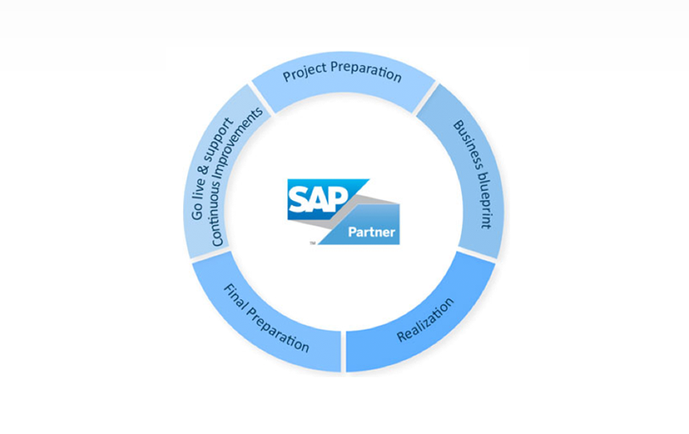
We provide a fast and high-quality integration
1. Solution Vision, Requierements
2. Installation, Training
3. Configurate, Customize
4. Stress Test, SLA Audit
5. Turn on the SAP system for the end-users
< 7 months
The Company – The Product – Integration – Monitoring
Notes:
Let’s talk about a schedule, our aim is to implement within 7 months
because of your needs, we implement in small steps beginning with Project Preparation
Define Solution Vision of the future-state of the SAP solution, define both business and technical requirements
Train the end-users to give all the required SAP knowledge and skills, install all SAP components
- Plan, script, execute and monitor SAP STRESS TESTS, to see if the expectations of the end users, defined in service level agreements, will be met.

Slide 5
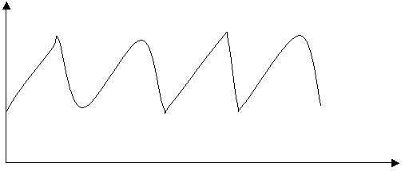
With monitoring to success
“what is not measurable is not manageable”
on time,
on budget,
on scope
Interval Monitoring
The Company – The Product – Integration – Monitoring
Notes:
we make sure that our solution will be successful implemented
We monitor and perform the progress of the project in intervals.
This will make sure that we complete on time, on budget and on scope.
Our KPI expertise will give you a reliable information about the project’s current state.
key performance indicator to measure
continous measure during the whole project
on time, on budget and on scope

Slide 6
Be more successful with our knowlegde, choose SAP Business All-in-One
High experience
Less than 7 months for Implementation
KPI to measure project progress
Notes:
So, coming to an end, I like to summarize my most important points during this brief presentation
High experience, 40 years and over 10’000 implementations
We are really fast in the implementation, less then 7 months
We have the necessary KPI to measure and manage the project
Thanks for your attention, now I’m open for any questions.

