Slide 1
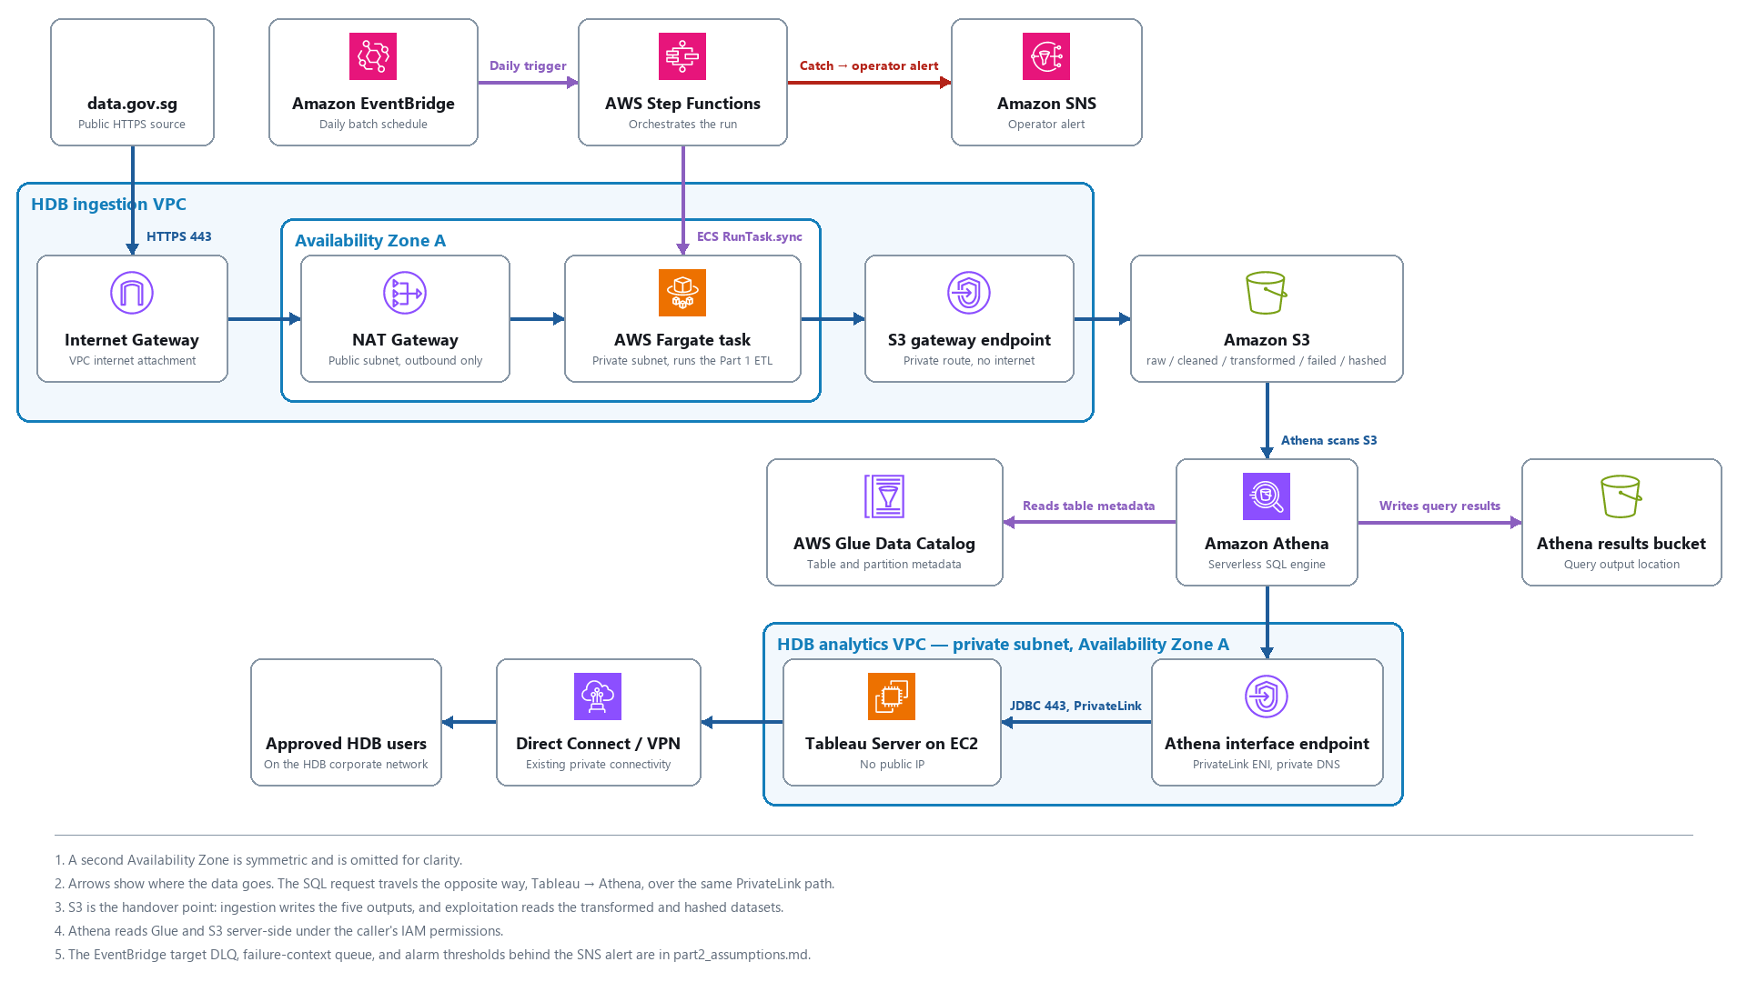
Part 2 — Architecture Overview
Public source to private analytics; S3 is the handover point between the two flows

Slide 2
Key Assumptions & Trade-offs
• Fargate over Lambda: no 15-minute limit or 10 GB storage ceiling for large-file download and ETL.
• S3 is the system of record; raw is versioned and never deleted, so every dataset is rebuildable.
• Analytics stays private: Tableau reaches Athena over an interface endpoint, never the internet.
• Lake Formation is excluded — IAM plus the Glue Data Catalog is sufficient for this scope.
• The remaining-lease reference date is pinned to a named constant, so reruns stay reproducible.
• One Availability Zone is shown for clarity; the second AZ is symmetric.

