Slide 1
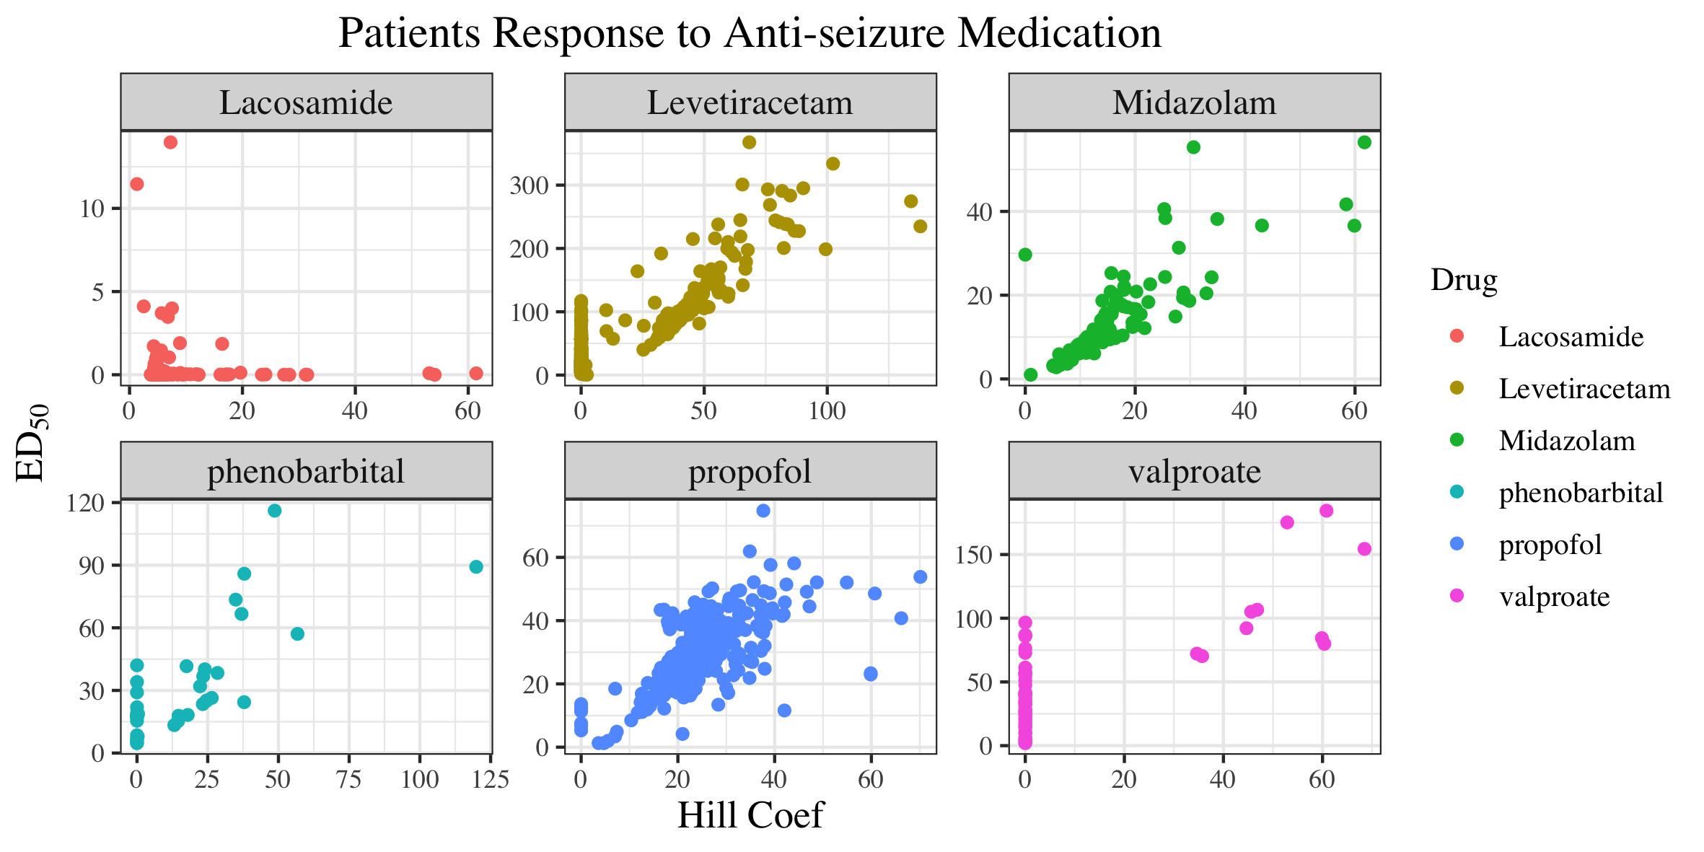

Slide 2
Nonresponsive Patients

