Slide 1
Average Effect
of EA: 16.7%
Hypoxic-Ischemic Encephalopathy Effect of EA: 17.3%
No Hypoxic-Ischemic Encephalopathy Effect of EA: 16.6%

Slide 2
Average Effect
of EA: 16.7%
Male Effect of EA: 17.7%
Female Effect of EA: 15.6%

Slide 3
ATE = 0.30
Female
CATE = 0.39
Native
CATE=0.35
Not Native
CATE=0.40
Male
CATE = 0.19
Native
CATE=0.18
Not Native
CATE=0.24
Native Neighbor>35%
CATE=0.186
Native Neighbor<35%
CATE=0.15
V-Pattern in ego-centric network
CATE = 0.39
V-Pattern not in ego-centric network
CATE = 0.44

Slide 4
Average Effect
of EA: 16.7%
Race: Black Effect of EA: 16.8%
Race: White Effect of EA: 16.5%
Race: Asian Effect of EA: 16.7%

Slide 5
Average Effect
of EA: 16.7%
CNS Infection
Effect of EA: 21.6%
Toxic Metabolic Encephalopathy
Effect of EA: 17.8%
No CNS Infection
Effect of EA: 16.4%
No Toxic Metabolic Encephalopathy
Effect of EA: 16.2%

Slide 6
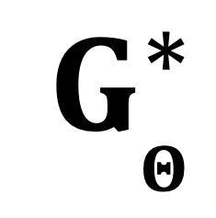

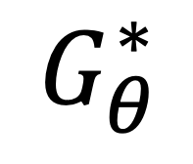
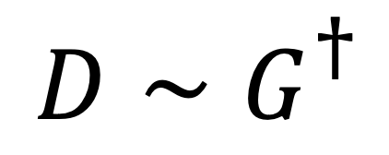
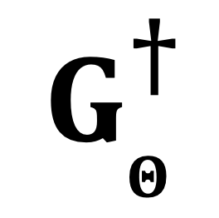
$$GΘ$$
$${D∼G}_{}^{†}$$
$$G_{Θ}^{†}$$
$$G_{Θ}^{∗}$$
$$G_{θ}^{∗}$$

Slide 7
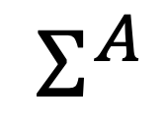
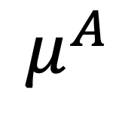
Learning P(A|B)
ENCODER
DECODER
A
$$μ^{A}$$
sample
R
A’
$$Σ^{A}$$
B

Slide 8
δ_{-t0}
λ _{-t0}
μ_{i}
δ _{+t0}
λ _{+t0}
α_{i, +t0}
X _{i,-t0}
Z_{i}
Y _{i,+t0}

Slide 9
0 | … | β_{j-1} | β_{j}
1 | 0 | -β_{j-1} | -β_{j}
1 | … | 0 | -β_{j}
 |  | -β_{j-1}
B =

Slide 10
X
Stage 1
Y
Y
X
ε_{Y}
GNN
regress
T
Stage 2
T
GNN
regress
X
ε_{T}
Stage 3
ε_{T}
ε_{Y}
TE
_{+ Spillover}
GNN
regress
X

