Slide 1
LAB 2 Verilog Review
FACULTY OF ENGINEERING
CAIRO UNIVERSITY
CMP3010: COMPUTER ARCHITECTURE COURSE

Slide 2
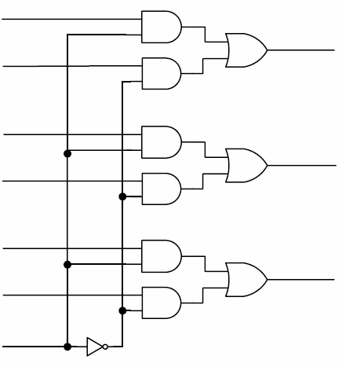
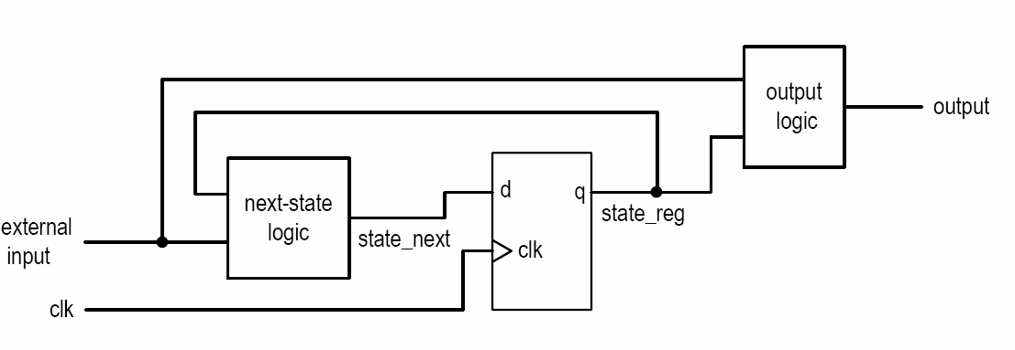
Combinational vs. sequential circuit
Combinational circuit:
No latches/FFs or closed feedback loop
Output is a function of inputs only
Sequential Circuit
With internal state (memory implemented by FF)
Output is a function of inputs and internal state

Slide 3
Procedural Blocks
There are two types of procedural blocks:
initial : initial blocks execute only once at time zero (start execution at time zero).
always : always blocks loop to execute over and over again; in other words, as the name suggests, it executes always.
1 module initial_example();
2 reg clk,reset,enable,data;
3
4 initial begin
5 clk = 0;
6 reset = 0;
7 enable = 0;
8 data = 0;
9 end
10
11 endmodule
1 module always_example();
2 reg clk,reset,enable,q_in,data;
3
4 always @ (posedge clk)
5 if (reset) begin
6 data <= 0;
7 end else if (enable) begin
8 data <= q_in;
9 end
10
11 endmodule
Doesn’t synthesize for testing only

Slide 4
Sensitivity List
The sensitivity list is used at the beginning of an always procedure to infer combinational logic or sequential logic behavior in simulation and synthesis.
always @(signal, signal, ... ) infers combinational logic if the list of signals contains all signals read within the procedure.
always @* infers combinational logic. Simulation and synthesis will automatically be sensitive to all signals read within the procedure. @* was added in Verilog-2001.
always @(posedge signal, negedge signal, ... ) infers sequential logic. Either the positive or negative edge can be specified for each signal in the list. A specific edge should be specified for each signal in the list.
Don’t recommend

Slide 5
Types of Procedural Statements
Procedural assignments
Conditional statements
If-else
case
Looping statements
for
while
repeat

Slide 6
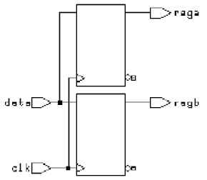
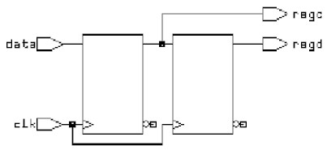
Procedural assignments
•
Blocking assignments
always @(posedge clk) begin
rega = data ;
regb = rega ;
end
Non-blocking assignments
always @(posedge clk) begin
regc <= data ;
regd <= regc ;
end
Don’t recommend

Slide 7
4x1 Multiplexer: using case statement
CASE Statement
module mux_4bits (y, a, b, c, d, sel);
input [3:0] a, b, c, d;
input [1:0] sel
output [3:0] y;
reg [3:0] y;
always @ (a or b or c or d or sel)
case (sel)
0: y = a;
1: y = b;
2: y = c;
3: y = d;
default: y = 4'bx;
endcase
endmodule
a[3:0]
b[3:0]
y[3:0]
c[3:0]
d[3:0]
sel[1:0]
To model combinational logic, all inputs must be listed in the sensitivity list of the procedural block.

Slide 8
4x1 Multiplexer: if else statement
if .. else Statement
module mux_4bits (y, a, b, c, d, sel);
input [3:0] a, b, c, d;
input [1:0] sel
output [3:0] y;
reg [3:0] y;
always @*
if (sel == 0) y = a; else
if (sel == 1) y = b; else
if (sel == 2) y = c; else
if (sel == 3) y = d;
else y = 4'bx;
endmodule
a[3:0]
b[3:0]
y[3:0]
c[3:0]
d[3:0]
sel[1:0]

Slide 9
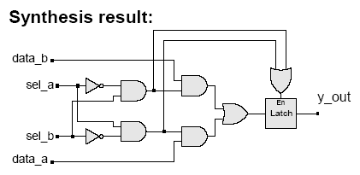
Unwanted Latches
Unintentional latches generally result from incomplete case statement or conditional branch
Example: case statement
always @ (sel_a or sel_b or data_a or data_b)
case ({sel_a, sel_b})
2'b10: y_out = data_a;
2'b01: y_out = data_b;
endcase
The latch is enabled by the "event or" of the cases under which assignment is explicitly made. e.g. ({sel_a, sel_b} == 2'b10) or ({sel_a, sel_b} == 2'b01)

Slide 10
Unwanted Latches (cont.)
Example: if .. else statement
always @ (sel_a or sel_b or data_a or data_b)
if ({sel_a, sel_b} == 2’b10)
y_out = data_a;
else if ({sel_a, sel_b} == 2’b01)
y_out = data_b;

Slide 11
Ways to avoid Latches
Cover all conditions
Set default value
1 module avoid_latch_else ();
2
3 reg q;
4 reg enable, d;
5
6 always @ (enable or d)
7 if (enable) begin
8 q = d;
9 end else begin
10 q = 0;
11 end
1 module avoid_latch_init ();
2
3 reg q;
4 reg enable, d;
5
6 always @ (enable or d)
7 begin
8 q = 0;
9 if (enable) begin
10 q = d;
11 end
12 end
There is one important rule that needs to be followed while modeling combinational logic.
If you use conditional checking using "if", then you need to mention the "else" part. Missing the else part results in a latch. If you don't like typing the else part, then you must initialize all the variables of that combo block as soon as it enters.

Slide 12
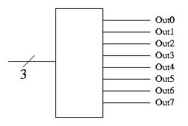
3 to 8 decoder using always
1 module decoder_always (in,out);
2 input [2:0] in;
3 output [7:0] out;
4 reg [7:0] out;
5
6 always @ (in)
7 begin
8 out = 0;
9 case (in)
10 3'b001 : out = 8'b0000_0001;
11 3'b010 : out = 8'b0000_0010;
12 3'b011 : out = 8'b0000_0100;
13 3'b100 : out = 8'b0000_1000;
14 3'b101 : out = 8'b0001_0000;
15 3'b110 : out = 8'b0100_0000;
16 3'b111 : out = 8'b1000_0000;
17 endcase
18 end
19
20 endmodule
Notes:
case (constant_expression) genvar_value : generate_item or generate_item_group genvar_value : generate_item or generate_item_group ... default: generate_item or generate_item_group
endcase

Slide 13
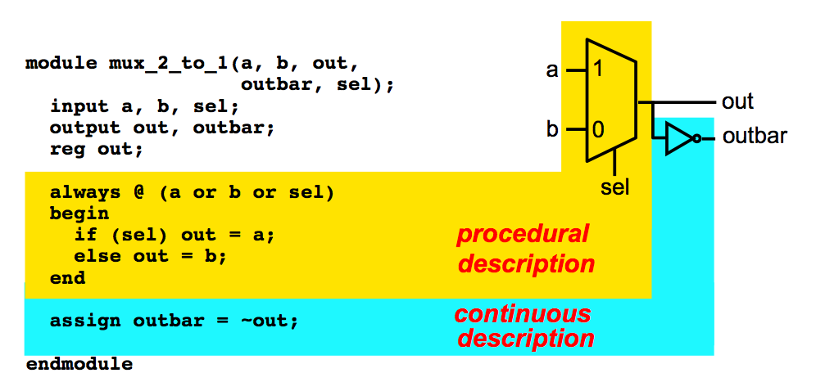
Mix assignments

Slide 14
Generics

Slide 15
N-BIT ADDER
A[N-1:0]
B[N-1:0]
How many bits do we need?
N=?
N-Bit Adder
Cin
Cout
S[N-1:0]

Slide 16
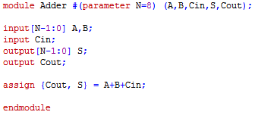
PARAMETERS
Module Definition
Module Instantiation

Slide 17
N-BIT ADDER
A[N-1]
B[N-1]
A[N-2]
B[N-2]
A[1]
B[1]
A[0]
B[0]
Full Adder
Full Adder
Full Adder
Full Adder
Cin
….
Cout
S[N-1]
S[N-2]
S[1]
S[0]

Slide 18
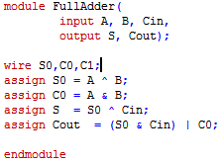
FULL ADDER
How to Instantiate this module “N” times in the Adder?

Slide 19
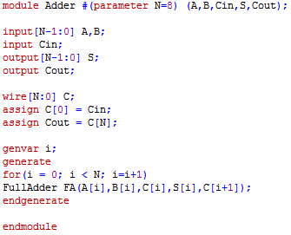
GENERATE

Slide 20
