Slide 1
New York vs. Toronto
By Seyedeh Hoda Mozaffari

Slide 2
Outline
Introduction
Data Description
Methodology
Results
Discussion
Conclusion

Slide 3
Introduction
Is Toronto really New York North?
How multicultural can be represented in Downtown New York and Toronto restaurants?
How is the quality of green spaces in downtown neighbourhoods of both cities?

Slide 4
Data Description
New York:
Online Source:https://cocl.us/new_york_dataset
Toronto:
Online Sources:
Wikipedia: https://en.wikipedia.org/wiki/List_of_postal_codes_of_Canada:_M
Link: http://cocl.us/Geospatial_data
Foursquare: A popular location data platform to explore venues around a geographical location.

Slide 5
Data Description Cont.
Pre-processing:
Scarping Wikipedia for its table
Keeping only useful columns and forming Pandas Dataframes
Dealing with missing values and not assigned values
Merging and combining dataframes

Slide 6
Methodology
Using different libraries including pandas, folium
Using Forsquare dataform
Using K-mean clustering algorithm to measure similarities between neighborhoods

Slide 7
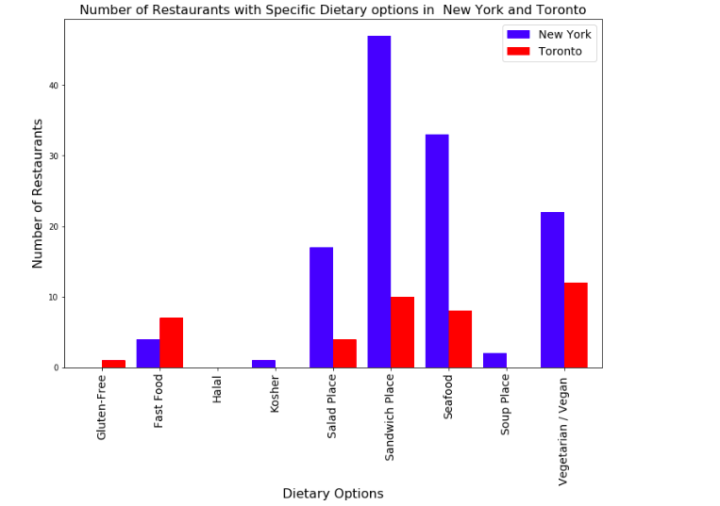
Results
Dietary Options:
a) Quantitatively:

Slide 8
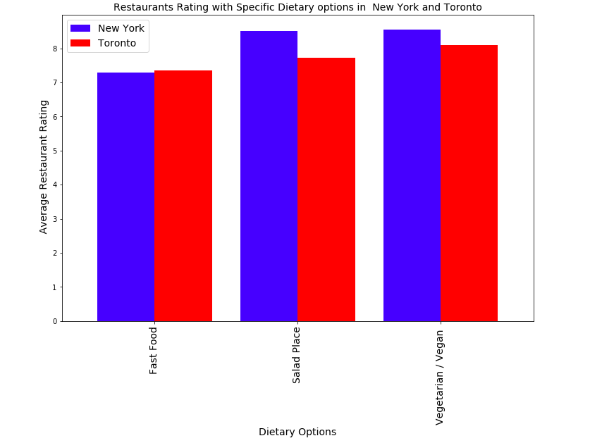
Results Cont.
Dietary Options:
b) Qualitatively:

Slide 9
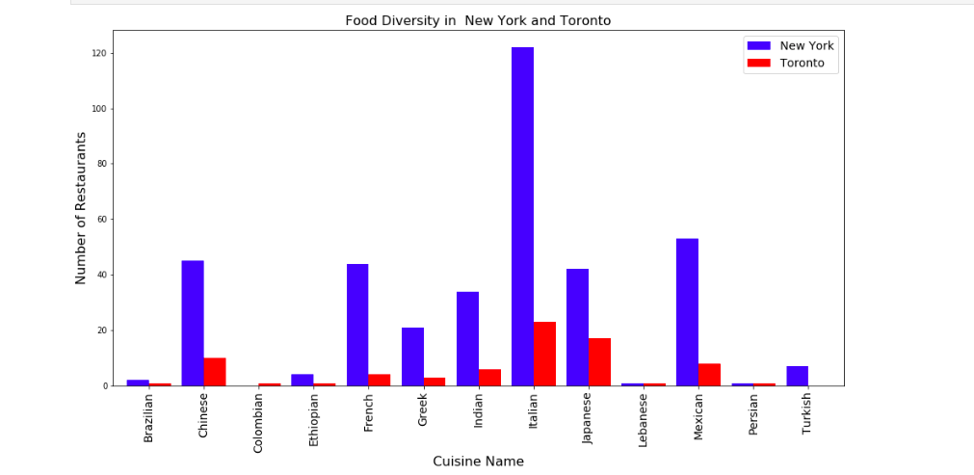
Results Cont.
Ethnic Cuisines:

Slide 10
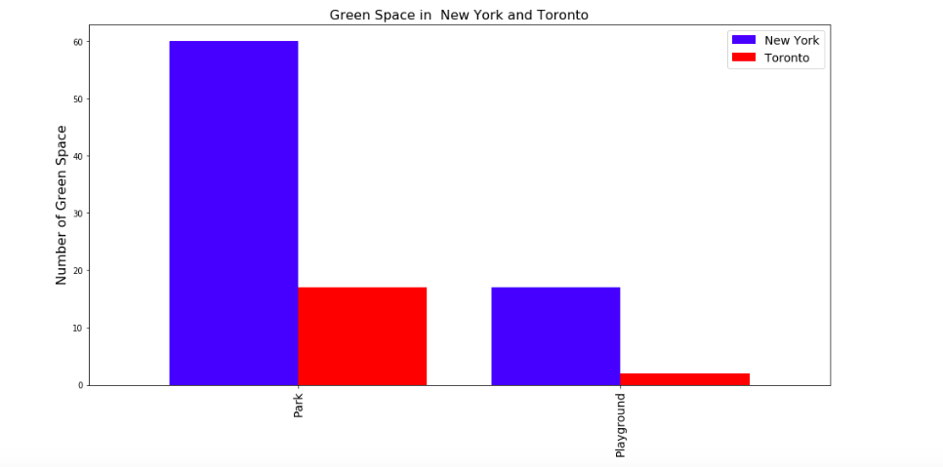
Results Cont.
Green Space:
a) Quantitatively:

Slide 11
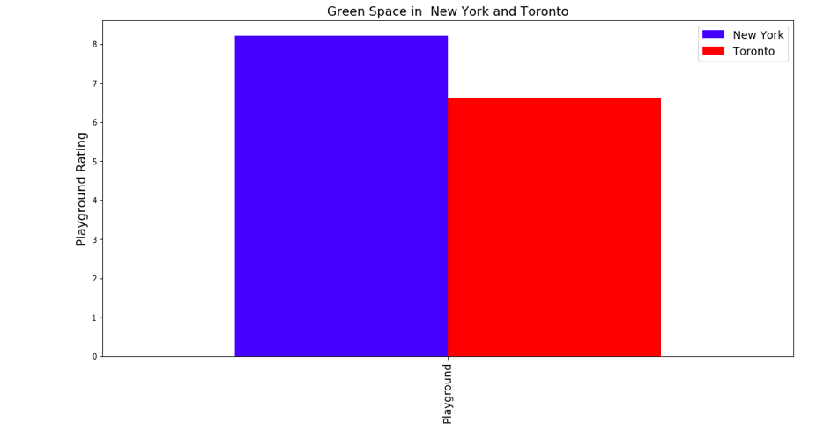
Results Cont.
Green Space:
b) Qualitatively:

Slide 12
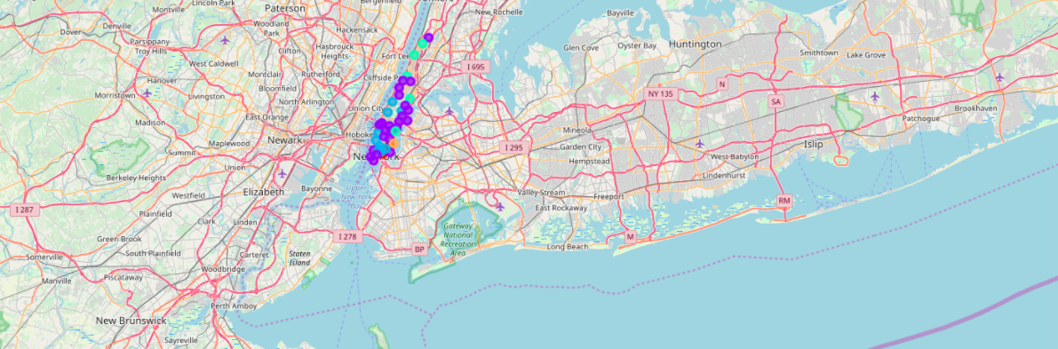
Results Cont.
Clustering
a) New York:

Slide 13
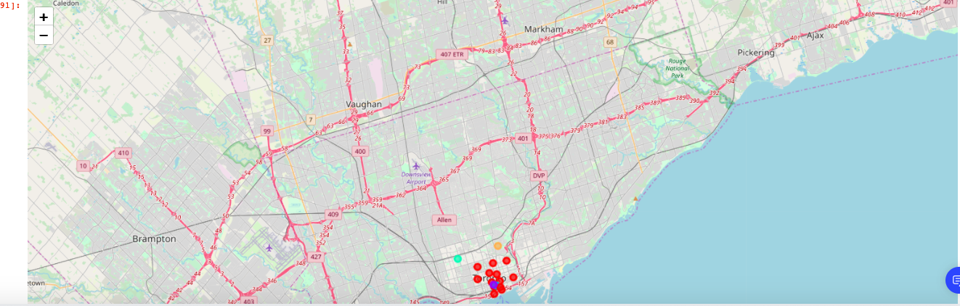
Results Cont.
Clustering
b) Toronto:

Slide 14
Discussions:
Italian cuisine is by the most popular food in New York and Toronto.
The least popular food in both cities was Middle Eastern cuisines.
In general, New York has 5 times more ethnic restaurants for categories offered in both cities.
The differences between service quality for three specific dietary options, i.e. fast food, salad and vegetarian/vegan diet were less than 10%.
A similar pattern can be observed for green spaces .
The most common venues in clustered neighbourhoods of New York are Italian and Mexican restaurants, and coffee shops, while coffee shops, gyms and bars are most common venues reported in Toronto.

Slide 15
Conclusion
New York beats Toronto in terms of food diversity and green space quantitatively with a large margin in nearly all categories. Nevertheless, the service quality in both cities is approximately equal for food sector.
It is recommended to use cities’ populations as well as their broadness to improve this report.

