Slide 1

Course Introduction
Winter 17 - GEOG 371
GeoVisualization: Web Mapping
Bo Zhao Ph.D.
College of Earth, Ocean and Atmospheric Sciences
zhao2@oregonstate.edu

Slide 2
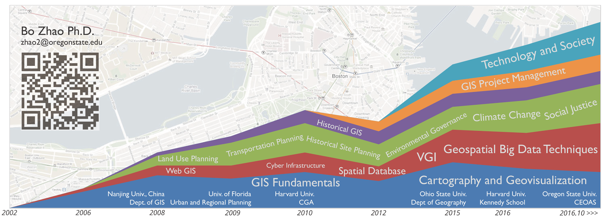
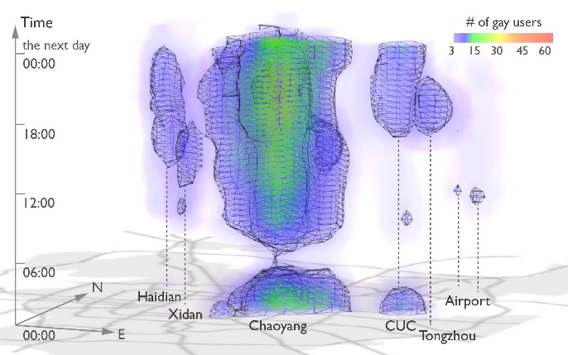
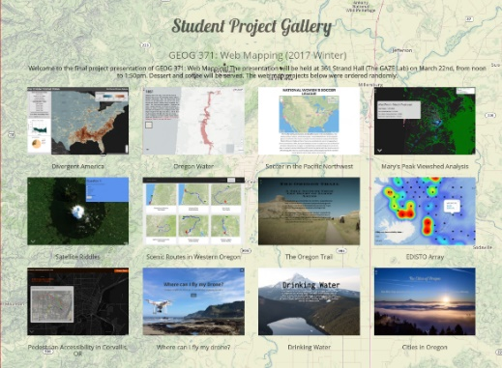
Teaching:
My goal is to help students efficiently and friendly communicate with the targeting audience using geovisualization.
Geog 370: Web Mapping
Geog 3/571: Web Mapping
Geog 4/572: Geovisual Analytics
Current Research:
Location-based Social Media; Location Spoofing
Storymap.js – a open source map storytelling library
Former Student Project Gallery
Visualization LGBT community in Beijing

Slide 3
Now, why are you here …?
So, why study Web Mapping?
Notes:
Now is your turn.

Slide 4
Instructor: | Bo Zhao, zhao2@oregonstate.edu
 | Office: 347 Strand Ag Hall
 | Office Hours: 2-3pm W or by appointment
Credits: | 4
Meetings: | Lecture: MWF 1200-1250 @Wilkinson 235; Lab: Th 1000-1150 @Wilkinson 210
Prerequisites: | GEOG 201 or GEO 301
Grades: | Letter grading (A to F)
Notes:
To be short,

Slide 5
Texts
No required textbook.
Required papers and online materials will be available on canvas.

Slide 6
Syllabus
Week | Lecture (M) | Lecture (W) | Lab (Th) | Lecture (F) | Reading
Wk * | N/A | Intro to the course | Lab 1: Project Management | Intro to Web Mapping | Markdown, GitHub, Typora, and Webstorm.
Wk 01 | Web Programming Basics I: HTML 5 and CSS | Web Mapping Architecture | Lab 2: Web Programming Basics | Lab 2: Web Programming Basics II: Javascript | HTML, CSS and Javascript
Wk 02 | Spatial Data for Web Mapping | Map Client I: Basics and Geographic Features | Lab 3: Web Map Design | Map Client II: Map Events and Mashup | Leaflet and JQuery
Wk 03 | Map Client III: Web Map Interaction | Map Server I: Intro to GeoServer | Lab 3: Cont'd | Map Server II: Styling | GeoServer docs
Wk 04 | Map Server III: Web Map Services | Base Map and Mapbox | Lab 4: Web Map Service | Map Server IV: Map Tiles | Bing Map Tile, and GeoWebCache
Wk 05 | Midterm Exam | Map Design I: Web Template and Framework | Lab 4: Cont'd | Map Design II: Bootstrap | Bootstrap docs, Kosara and Mackinlay (2013)
Wk 06 | Storytelling with Web Map I | Storytelling with Web Map II | Lab 5: Story Map | Map Design III: User Friendly Design Principles | storymap.js
Wk 07 | Time Series | Heat Map | Lab 5: Cont'd | Veterans Day
Wk 08 | Map Design IV: Map Critiques | 3D Web Mapping I: Basics | Lab 6: Thematic Map on the Virtual Globe | 3D Web Mapping II: Build a Virtual Environment
Wk 09 | 3D Web Mapping III: Thematic Map on a Virtual Globe | Final Project Discussion and Preparation | Lab 6: Cont'd | Thanksgiving Break
Wk 10 | Emerging Topics on Web Mapping | Final Project Discussion and Preparation | Final Project Discussion and Preparation | Final Project Presentation | Elwood et al. (2012), Sui and Zhao (2015)

Slide 7
Grading

Slide 8
Any questions?

