Slide 1
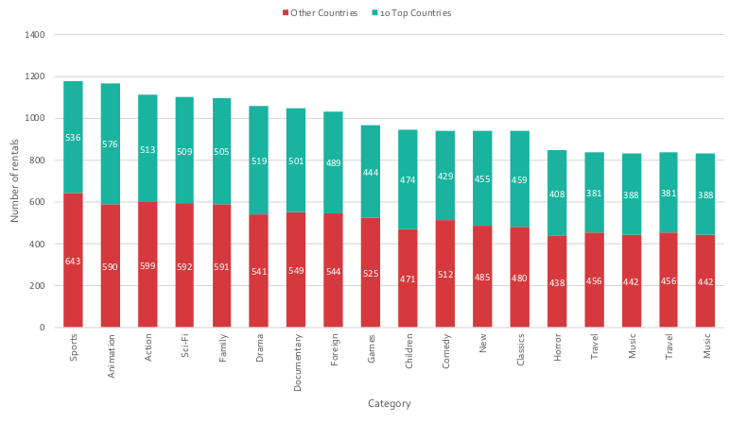
Query 1 - Rentals of the top 10 renting countries and the rest
How do the rentals for the 10 top renting countries compare to the other countries for each category?
Description: This bar chart shows the comparison between the number of rentals of the top 10 renting countries and the rest of the countries.
Staff ID
Notes:
SELECT DATE_TRUNC('month',rental_date) AS mon, staff_id,
COUNT(rental_id)
FROM rental
GROUP BY mon, staff_id
ORDER BY mon, staff_id
/* This query isn’t as complex as yours should be, as there isn’t a join - this is just an example template of what your ending slide should like */

Slide 2
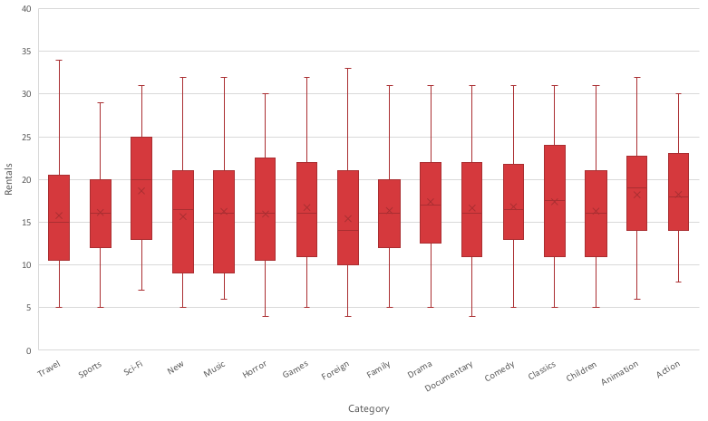
Query 2 - Film rentals distribution by category
How are the movies distributed by the amount of times they were rented inside of a category?
Description: This box and whisker chart shows the distribution of number of rentals of movies in each category.
Staff ID
Notes:
SELECT DATE_TRUNC('month',rental_date) AS mon, staff_id,
COUNT(rental_id)
FROM rental
GROUP BY mon, staff_id
ORDER BY mon, staff_id
/* This query isn’t as complex as yours should be, as there isn’t a join - this is just an example template of what your ending slide should like */

Slide 3
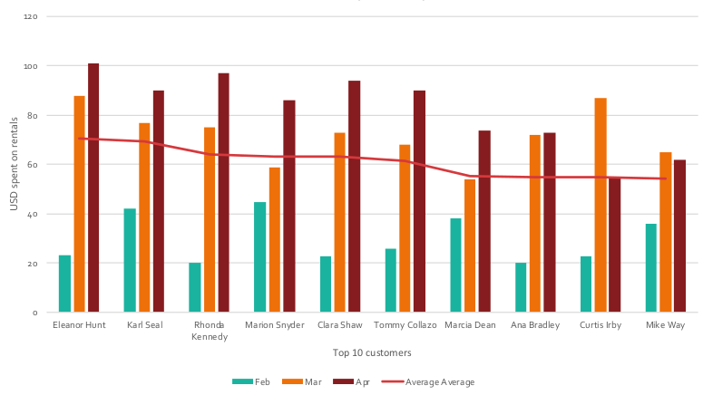
Query 3 - Amount spent by the top 10 paying customers between February and April 2007
How much did the top 10 paying customers spend on DVD rental over 2007?
Description: this chart shows the spending pattern of the all-time top 10 paying customers. The plotted line represents the average spent by each customer individually from February, 2007 to April, 2007, and it works as comparison between customers.
Staff ID
Notes:
SELECT DATE_TRUNC('month',rental_date) AS mon, staff_id,
COUNT(rental_id)
FROM rental
GROUP BY mon, staff_id
ORDER BY mon, staff_id
/* This query isn’t as complex as yours should be, as there isn’t a join - this is just an example template of what your ending slide should like */

Slide 4
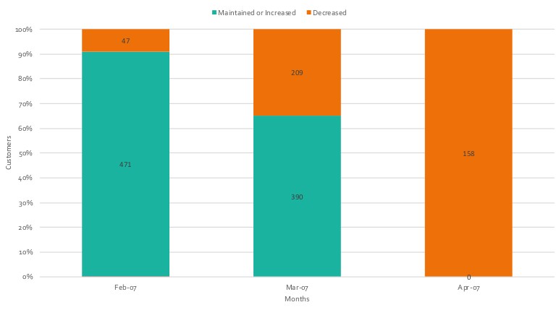
Query 4 - Amount spent in rentals compared to the previous month
How many customers have paid less in rentals compared to the previous month?
Description: this chart shows the amount and proportion of customers that have decreased the amount spent in rentals when compared to the previous month. The chart suggests the beginning of a downward trend in amount spent by customers, although the data is insufficient to show an actual trend in customers’ behavior.
Notes:
SELECT DATE_TRUNC('month',rental_date) AS mon, staff_id,
COUNT(rental_id)
FROM rental
GROUP BY mon, staff_id
ORDER BY mon, staff_id
/* This query isn’t as complex as yours should be, as there isn’t a join - this is just an example template of what your ending slide should like */

