Slide 1
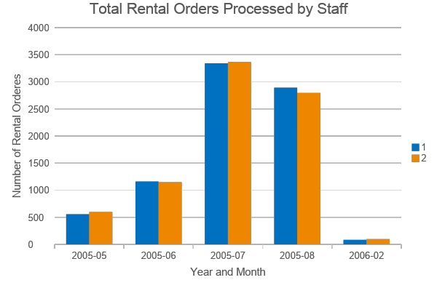
What were the total Rental Orders Per Staff?
We can see both store staff members filled in almost the same number of rental orders during each time unit.
Staff ID
Notes:
SELECT DATE_TRUNC('month',rental_date) AS mon, staff_id,
COUNT(rental_id)
FROM rental
GROUP BY mon, staff_id
ORDER BY mon, staff_id
/* This query isn’t as complex as yours should be, as there isn’t a join - this is just an example template of what your ending slide should like */

Slide 2
What were the total Rental Orders Per Staff?
We can see both store staff members filled in almost the same number of rental orders during each time unit.
Staff ID
Notes:
SELECT DATE_TRUNC('month',rental_date) AS mon, staff_id,
COUNT(rental_id)
FROM rental
GROUP BY mon, staff_id
ORDER BY mon, staff_id
/* This query isn’t as complex as yours should be, as there isn’t a join - this is just an example template of what your ending slide should like */

Slide 3
What were the total Rental Orders Per Staff?
We can see both store staff members filled in almost the same number of rental orders during each time unit.
Staff ID
Notes:
SELECT DATE_TRUNC('month',rental_date) AS mon, staff_id,
COUNT(rental_id)
FROM rental
GROUP BY mon, staff_id
ORDER BY mon, staff_id
/* This query isn’t as complex as yours should be, as there isn’t a join - this is just an example template of what your ending slide should like */

Slide 4
What were the total Rental Orders Per Staff?
We can see both store staff members filled in almost the same number of rental orders during each time unit.
Staff ID
Notes:
SELECT DATE_TRUNC('month',rental_date) AS mon, staff_id,
COUNT(rental_id)
FROM rental
GROUP BY mon, staff_id
ORDER BY mon, staff_id
/* This query isn’t as complex as yours should be, as there isn’t a join - this is just an example template of what your ending slide should like */

