Slide 1
Artificial Intelligence
Hodaya Moshayev, Moriane Perez, Ktzia Yitzhak

Slide 2
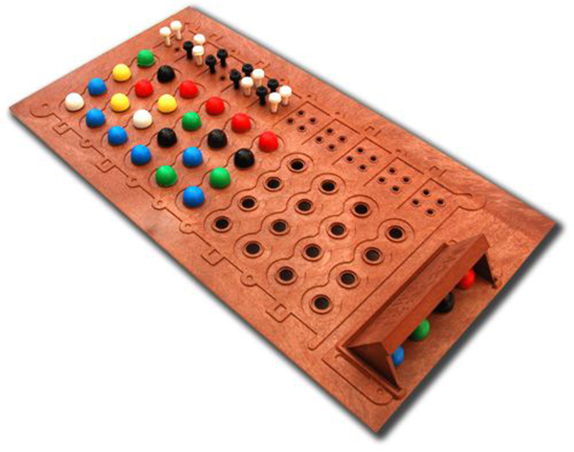
MasterMind

Slide 3
RULES OF THE GAME

Slide 4




STEP 1: Creating the Secret list.
Choosing 4 pegs from 6 colors

Slide 5


STEP 2: Test a Guess
Choosing another 4 pegs from 6 colors

Slide 6



STEP 3 : Evaluate similarity between Secret and Guess.
SECRET
GUESS

Slide 7


STEP 3 : Evaluate similarity between Secret and Guess.

Slide 8
STEP 4 : Try another Guess. until having:
SECRET
GUESS

Slide 9

STEP 4 : Try another Guess. until having:
OR MAXIMAL NUMBER OF TESTS REACHED

Slide 10
HOW TO START?
Creating function of random secret
nb_color: number of colors in the game, default = 6 [0,5]
niv: number of peg , default = 4
nb_tests: number of maximum attempts, default = 10

Slide 11
The Heuristic function

Slide 12
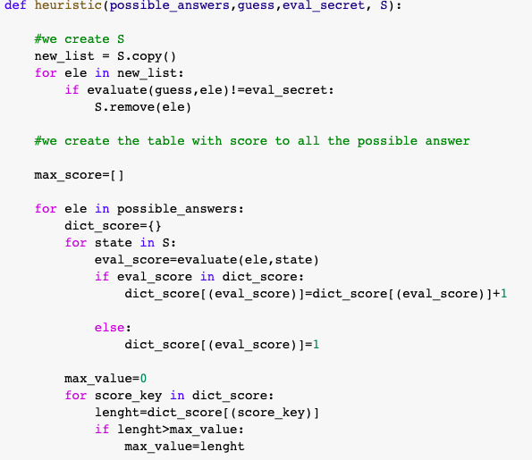
We use the function heuristic

Slide 13
NUMBER OF POSSIBLE STATE:
All the combinations: Nb_color^ nb_pleg
IN OUR EXAMPLE : 6^4= 1296 possible answers.
[0,0,0,0]
[0,0,0,1]
…
[5,5,5,5]

Slide 14
STEP 1:
Create the set S of 1296 possible codes -
S = [[0,0,0,0],[0,0,0,1]...
.
.
.
...[5,5,5,4],[5,5,5,5]]

Slide 15
STEP 2:
CHOOSE RANDOMLY A GUESS AND REMOVE IT FROM S
CANNOT USE IT AGAIN!

Slide 16
STEP 3:
Get the evaluation between the secret and the current guess
evaluate(4,1,5,4], [2,2,4,5]])= (0,2)
evaluate([4,1,5,4], [4,3,4,0]) = (1,1)

Slide 17

STEP 4:
=>If the evaluation is (4,0)
=>Else, find the new Guess

Slide 18
1st GUESS: Random choice
2nd GUESS: Random choice ? ?
3thrd GUESS: ?
…
Maximal nb_test GUESS: ?

Slide 19
1ST POSSIBILITY:
RANDOM CHOICE
NUMBER OF POSSIBLE GUESSES: Nb_color^ nb_peg
HERE : 6^4= 1296
PROBABILITY(Secret) =0.00077 =/(1296-1) LOSS THE GAME
Guess 1
Notes:
להפסיד במשחק

Slide 20
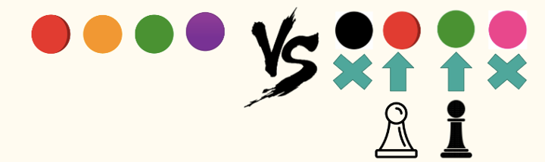
2ND POSSIBILITY:
USING INFORMATION FROM THE PREVIOUS GUESS
INFORMATION: 1 BLACK + 1 WHITE
TARGET: KEEP THESE GOOD PLEGS UNTIL THE END
QUESTION: HOW TO IDENTIFY THEM?

Slide 21
A BIT OF MATHEMATICS…
ALL POSSIBLE GUESSES: SIZE(S) = 1296
TARGET: REDUCE THE NUMBER OF POSSIBLE ANSWERS AND FIND NEXT GUESS
WHY?
SIZE(S_new)= n1 < 1296
n1< 1296 ⇔ 1/n1 > 1/1296 ⇔ P(Secret in S_new)>P(Secret in S)
HOW DOING THAT?

Slide 22
STEP 5:
-Remove from S any answer such that:
evaluate(answer,guess) evaluate(guess, secret)
-Secret is in S: Symetric function
evaluate(guess, secret) evaluate (secret, guess)
Notes:
כמובן

Slide 23
evaluate([1,1,2,2], secret) = (1,1)
evaluate([1,1,2,2], [1,1,1,2]) = (3,0)
evaluate([1,1,2,2], [1,1,1,3]) = (2,0)
evaluate([1,1,2,2], [1,1,1,4]) = (2,0)
evaluate([1,1,2,2], [1,3,1,4]) = (1,1)
SIZE(S) IS REDUCED but S(size) != 1,
THEN WHAT?

Slide 24
SAME IDEA:
Continue reducing number of possible answers until finding the best new guess
HOW? Dividing S

Slide 25
STEP 6:
Dividing S following the evaluation between all possible answers and answers in S.
[1,2,3,2] | 15 | 445 | 0 | 0 | 0 | 0 | 0 | 0 | 0 | 0 | 0 | 0 | 0 | 0
[1,1,2,3] | 226 | 4 | 0 | 0 | 0 | 113 | 0 | 0 | 0 | 0 | 0 | 0 | 125 | 0
(B,W) | (0,0) | (0,1) | (0,2) | (0,3) | (0,4) | (1,0) | (1,1) | (1,2) | (1,3) | (2,0) | (2,1) | (2,2) | (3,0) | (4,0)

Slide 26
STEP 7:
Apply MiniMax technique to find the next guess:
Select the group with maximal size for the 1296 answers: THE SCORE
[1,2,3,2] | 15 | 445 | 0 | 0 | 0 | 0 | 0 | 0 | 0 | 0 | 0 | 0 | 0 | 0
[1,1,2,3] | 226 | 4 | 0 | 0 | 0 | 113 | 0 | 0 | 0 | 0 | 0 | 0 | 125 | 0
(B,W) | (0,0) | (0,1) | (0,2) | (0,3) | (0,4) | (1,0) | (1,1) | (1,2) | (1,3) | (2,0) | (2,1) | (2,2) | (3,0) | (4,0)
WHY THE MAX? SECRET HAS MORE PROBABILITY TO BE IN THE PARTITION

Slide 27
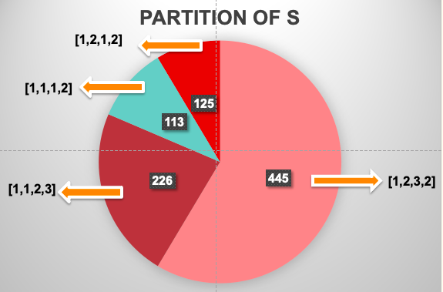
[1,1,2,3]

Slide 28
STEP 8:
Apply MiniMax technique to find the next guess:
Select the answer with minimal score for the 1296 answers
[1,2,3,2] | 15 | 445 | 0 | 0 | 0 | 0 | 0 | 0 | 0 | 0 | 0 | 0 | 0 | 1
[1,1,2,3] | 226 | 4 | 6 | 0 | 0 | 15 | 10 | 0 | 5 | 5 | 3 | 2 | 24 | 1
(B,W) | (0,0) | (0,1) | (0,2) | (0,3) | (0,4) | (1,0) | (1,1) | (1,2) | (1,3) | (2,0) | (2,1) | (2,2) | (3,0) | (4,0)
WHY THE MIN? AGAIN: DECREASE SIZE OF S FOR THE NEXT GUESS AND INCREASE THE PROBABILITY TO WIN

Slide 29
All the 1296 answers have now a score:
[1,1,2,3] SCORE 25
[1,2,3,2] SCORE 84
…
5,5,5,5] ] SCORE x
WHY THE MIN? AGAIN: DECREASE SIZE OF S FOR THE NEXT GUESS AND INCREASE THE PROBABILITY TO WIN

Slide 30
SECRET = [5,5,4,2]
GUESS | BLACK | WHITE
[3, 0, 2, 0] | 0 | 1
[1, 1, 4, 3] | 1 | 0
[2, 4, 4, 5] | 1 | 2
[0, 2, 5, 4] | 0 | 3
[5, 5, 4, 2] | 4 | 0
ATTEMPTS
5
TIME
0.809s

Slide 31
SECRET = [4,0,4,5]
GUESS | BLACK | WHITE
[3, 0, 4, 0] | 2 | 0
[0, 0, 1, 2] | 1 | 0
[2, 3, 3, 5] | 1 | 0
[4, 0, 4, 5] | 4 | 0
ATTEMPTS
4
TIME
0.304s

Slide 32
SECRET = [5,3,0,2]
GUESS | BLACK | WHITE
[0, 4, 0, 5] | 1 | 1
[0, 1, 0, 2] | 2 | 0
[0, 1, 4, 3] | 0 | 2
[3, 5, 0, 2] | 2 | 2
[5, 3, 0, 2] | 4 | 0
ATTEMPTS
5
TIME
0.645s

Slide 33
SECRET = [1,3,0,0]
GUESS | BLACK | WHITE
[5, 2, 4, 1] | 0 | 1
[0, 0, 3, 1] | 0 | 4
[1, 3, 0, 0] | 4 | 0
ATTEMPTS
3
TIME
0.408s

Slide 34
SECRET = [5,5,4,2]
GUESS | BLACK | WHITE | MEAN (Size of S) | MEAN (Running Time of Heuristic)
[3, 0, 2, 0] | 0 | 1 | 1296 | ≈ 0.2 second
[1, 1, 4, 3] | 1 | 0 | 767 | ≈0.15 seconds
[2, 4, 4, 5] | 1 | 2 | 342 | ≈0.05 seconds
[0, 2, 5, 4] | 0 | 3 | 101 | ≈0.035 seconds
[5, 5, 4, 2] | 4 | 0 | 3 | ≈0

Slide 35
CONCLUSIONS:
THE SIZE OF THE GAME | AVERAGE ATTEMPTS: | AVERAGE TIMES:
4^6 | 4.25 | 0.5415s
5^5 | 4 | 3.05s
5^7 | 5 | 1.5m
7^10
Notes:
אקספוננציאלית

Slide 36
DIFFICULTIES:
NP-complete
Nb_color=10 and Nb_peg=10
=> 10^10 exponential complexity.
Definition of NP-Complete:
Complexity Time is Exponential

Slide 37

Supervised Learning
MinMax
Reinforcement Learning
CSP
Search (Heuristic functions)
Notes:
היינו יכלוים לחשוב שמדובר בשתי שחקנים אבל לא מדובר בבעיית min-max כי מדובר בניחוש של שחקן אחד את הקוד של השחן השני
אנו מחפשים פתרון ולא קיים לנו
target value
למידה באמצעות חיזוקים על סמך הנסינות הקודמים מנחשים את החוקיות ומחליטים על הצעד הבא
בעיית סיפוק אילוצים - אך כמות האילוצים הנוצרת היא מאוד גדולה
באמצעות פונקציה יורסטית
לדבר על ההסטוריה של המשחק ולספר שהרבה מתמתקאים שניסו למצוא את הפתרו ואנחנו לקחנו את הפתרון שלו…

Slide 38
IMPROVEMENTS:
Using other heuristic functions
Local Search algorithms (Simulated Annealing)
Adding GUI - colors instead of numbers
Expanding to player vs agent
Notes:
genetibh

Slide 39
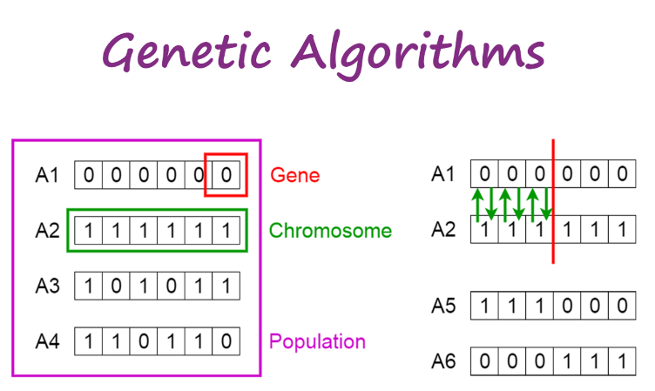
LOCAL SEARCH ALGORITHMS:
Genetic algorithms
Simulated Annealing
Notes:
במינימום מקומי מונע היתקעות - חישול מדומה
אלגוריתם גנטי - יצירת מידע חדש מבוסס על הקודם

Slide 40
EXPANDING TO PLAYER VS AGENT
Player vs Player
Computer vs Player
Computer
Notes:
genetic algorithm or simulated annealing

Slide 41
BIBLIOGRAPHY:
the computer as master mind - donald e. knuth
בול פגיעה – ויקיפדיה
Moodle

Slide 42
OUR WORK:
NOTEBOOK for the Code
Word Document for Explantion
PowerPoint for the Presentation

Slide 43
THANKS FOR LISTENING!

