Slide 1

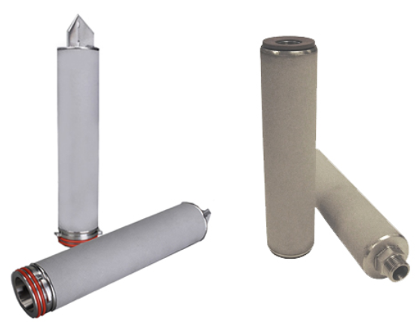
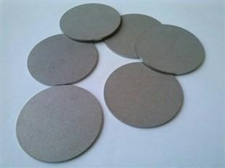
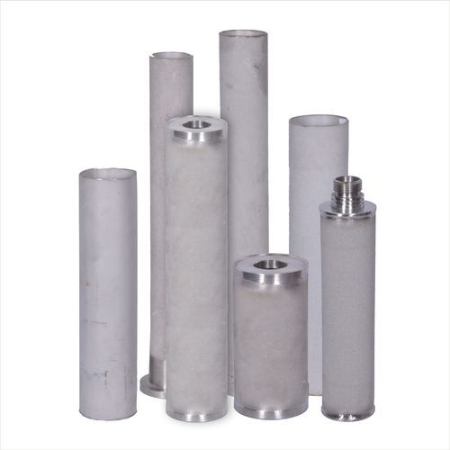
KGT SINTERED POWDER METAL FILTER
ABOUT
The KGT Powdered Sintered Stainless Steel Filter cartridge has a constant pore structure achieved with controlled sintering of SS metal powder imparting it mechanical strength and wide range of chemical compatibility with consistent efficiency.
Apart from the wide chemical compatibility, the filters are suitable for either gas or liquid having a high differential Pressure holding capacity.
The KGT Powdered Sintered Stainless Steel Metal Filter cartridge is available in SS304/SS316 and SS316L.
ADVANTAGES
Due to wide range to media selection, a variety of liquids from acids to alkalis; from seawater to process water; and in gases from air to fuel gas to hot exhaust gases.
Standard dimensions of 2.5” outer diameter and 1” internal diameter ensures fitment in most standard housings with varied length availability. (other dimensions are available on request)
Available in 10 / 20 / 30 / 40 / 60 inches length. (Other lengths available on request.)
A depth ranging between 2-3.5 mm of sintered stainless steel ensures optimal strength to withstand differential pressure.
DIFFERENCIAL PRESSURE DATA
For Normal Flow from Outside to Inside for liquids compatible with the filter media, the maximum differential pressure is 1.5 bard (22 psid) @ 75⁰C.
APPLICATIONS
Corrosive Fluids Steam
Amine, Glycol Thermic Fluids
High Temperature applications in liquids and gases

Slide 2

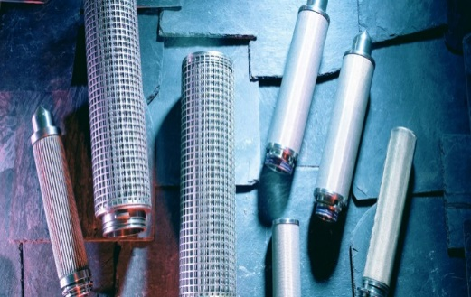
KGT SINTERED POWDER METAL FILTER
PART NUMBERING GUIDE
Filter Element Part Number : KGT - - - PSS - - -
Short Code Description Short Code Description
010 1 μm 020 2 μm
050 5 μm 100 10 μm
200 20 μm 300 30 μm
400 40 μm 500 50 μm
(Other Removal Ratings are available as per requirements. Efficiency of the filter will be 99.9%)
Short Code Description
Length (inches)
10 10
20 20
30 30
40 40
60 60
Filter
Short Code Fitment Style
7 Size 226 double O-rings, flat top
0 Double Open end with Gaskets
3 SOE with NPT Threads
Seal
Short Code Material Of Construction
N Nitrile
E EPDM
S Silicone
V Viton® A
(Viton® is a registered trademark of Chemours Company.)
Filter Media
Short Code Material Of Construction
SS SS304
SST SS316
SSL SS304L
SSTL SS316L
 6, Anurag, Rajaji Path, Ramnagar, Dombivli, Mumbai, 421201, Maharashtra, India
 +91 251 2420878  +91 9166 593 315  solutions@klengas.com

