Slide 1
NWEN304 Group 17 – Book Store
Members:
Zane Rawson
Mars (Huaiqu) Cai

Slide 2
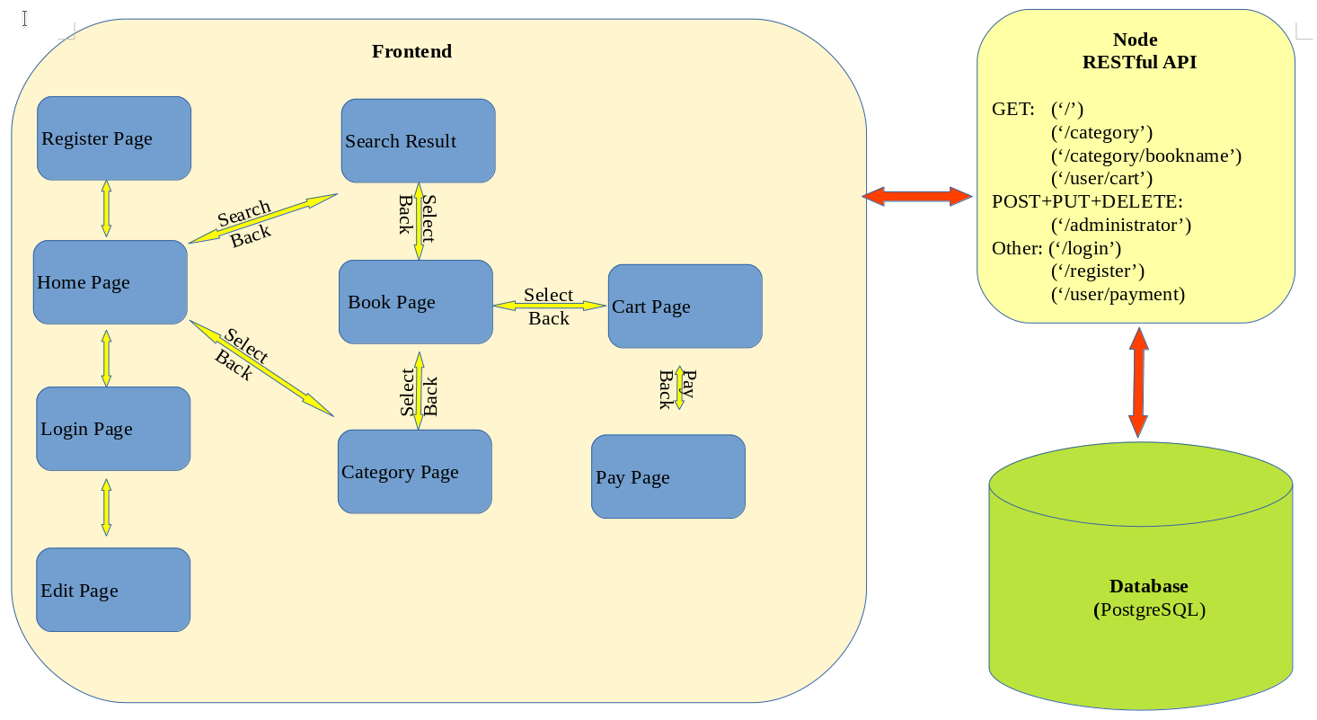
High Level System Architecture

Slide 3
Division of Work
Gitlab Boards

Slide 4
Division of Work
Mars | Zane | Shared
High level system architecture | Create database | Host on heroku
Error handling | Track users activities | Develop authentication protocols
Implement Caching | Recommendation system | Develop front end
Define RESTful interface | Initial home page design

Slide 5
Progress
Gitlab

Slide 6
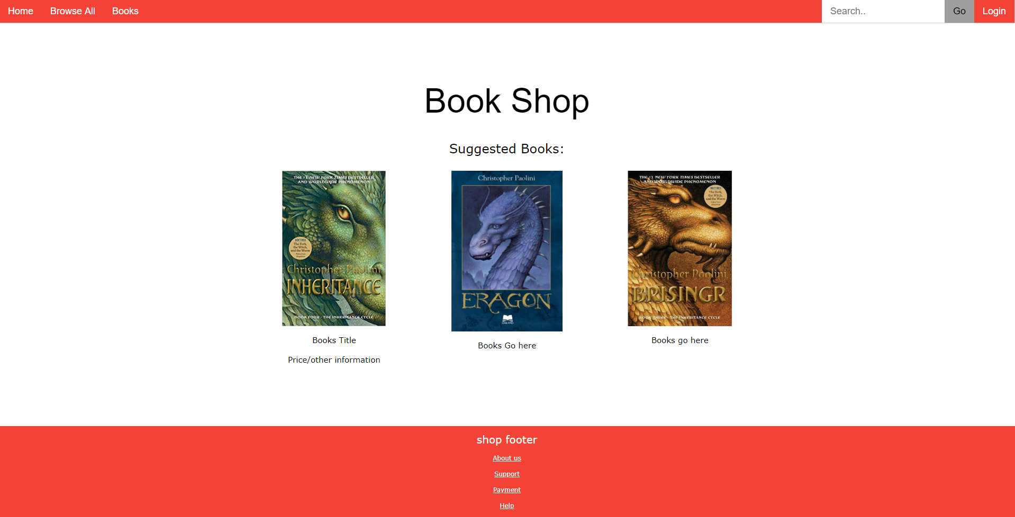
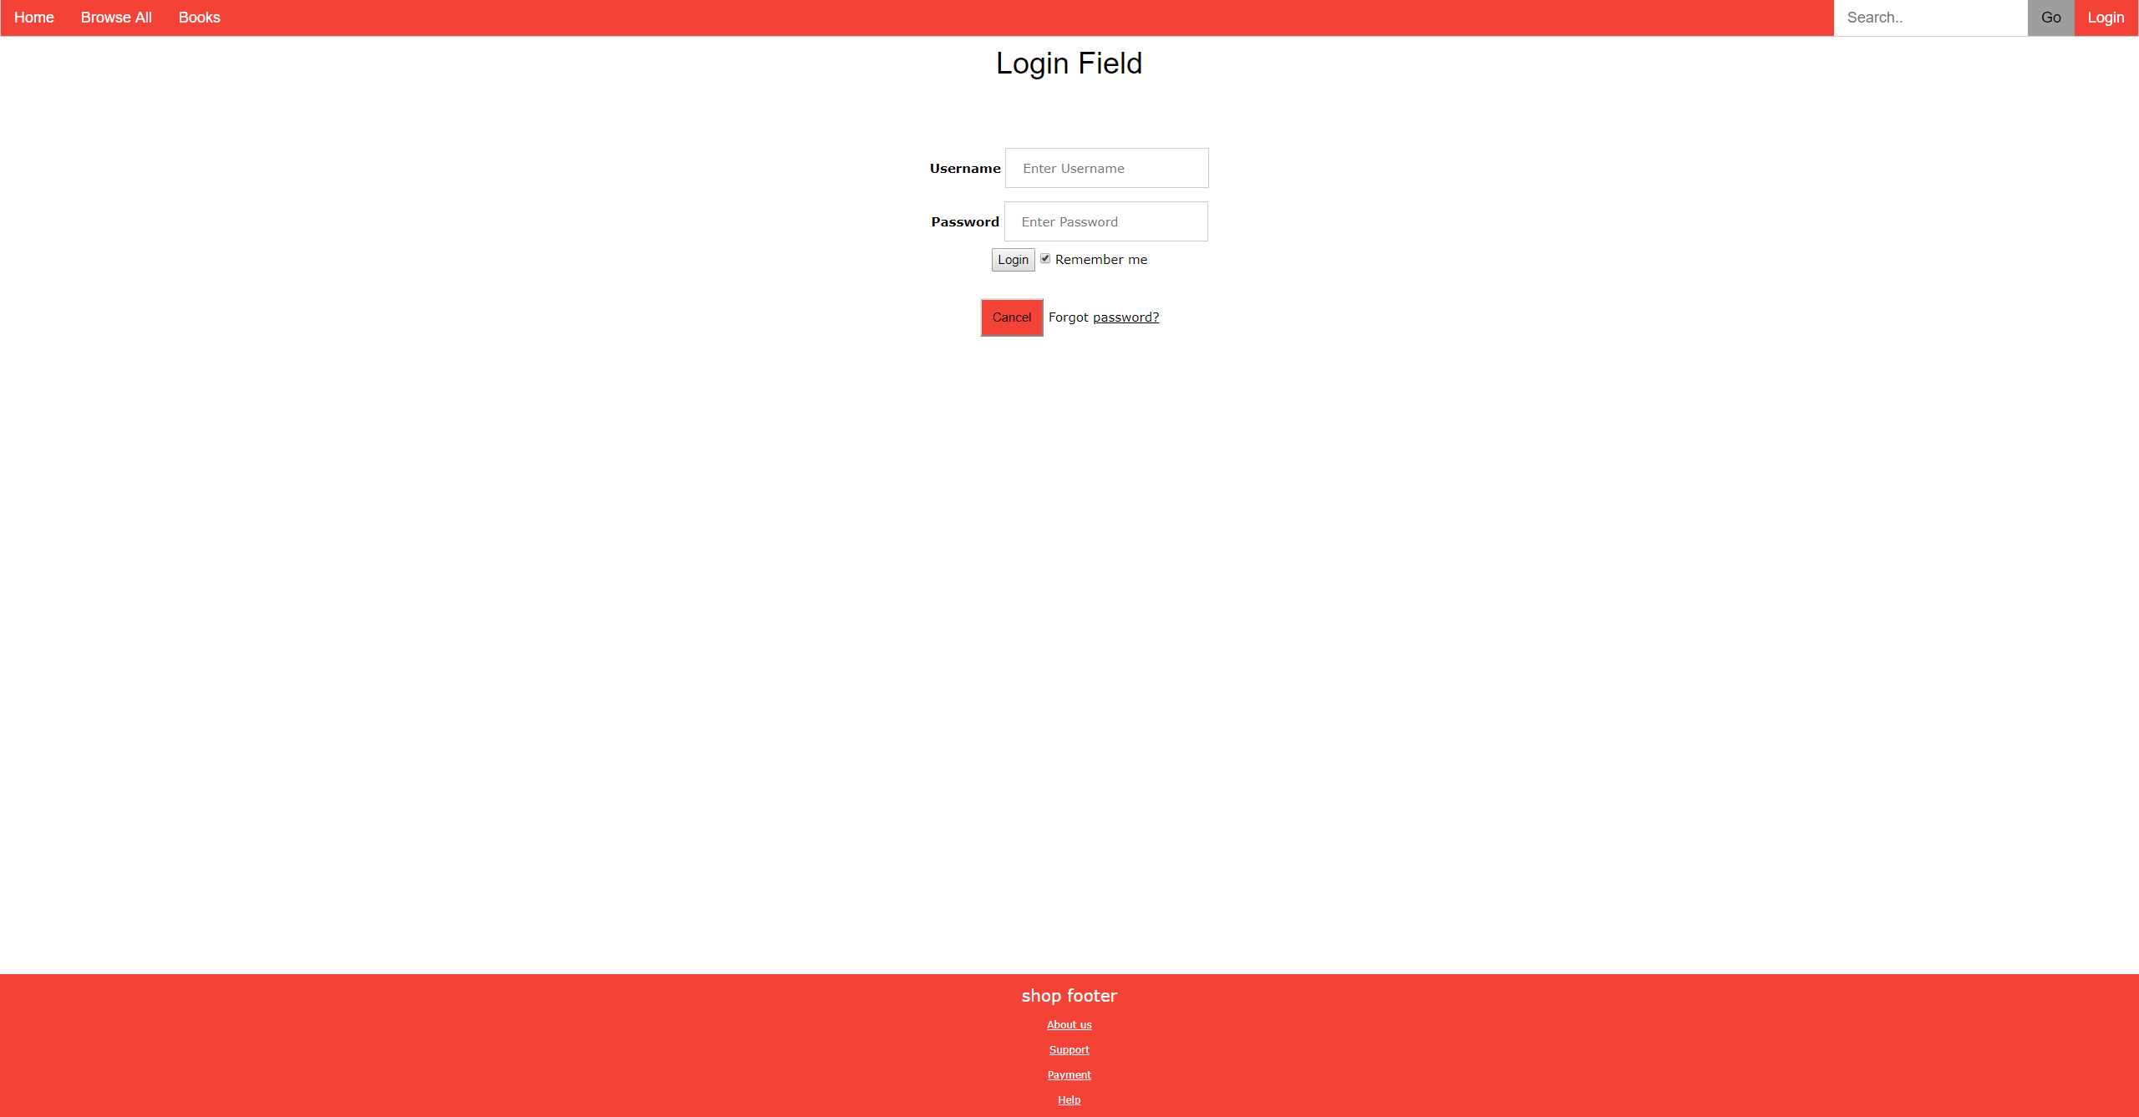
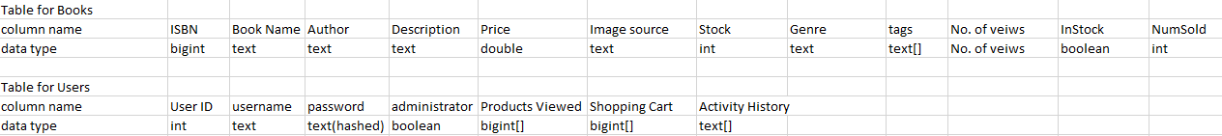
Progress

