Slide 1
NWEN304 Group 17 – Book Store
Members:
Zane Rawson
Mars (Huaiqu) Cai

Slide 2
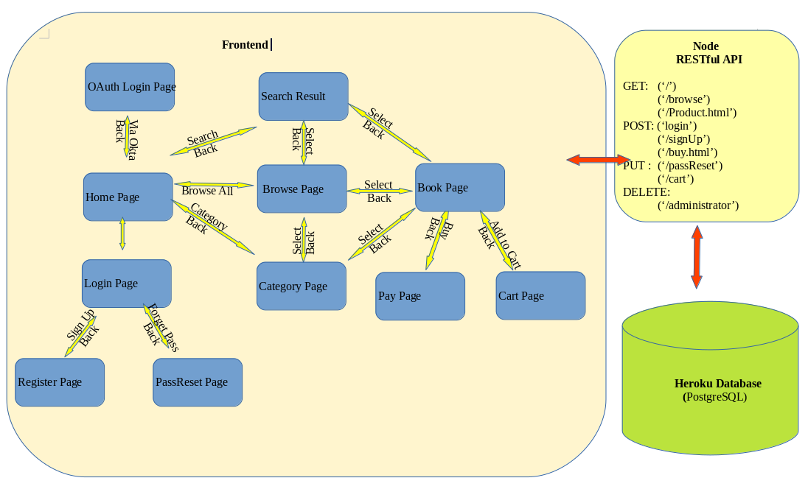
System Architecture

Slide 3
Database schema
Books table
Type | ISBN | Title | Author | Price | imgsrc | stock | genre | views | desciption | available | sold
Name | bigint | varchar | text | int | text | int | text | int | varchar | boolean | int

Slide 4
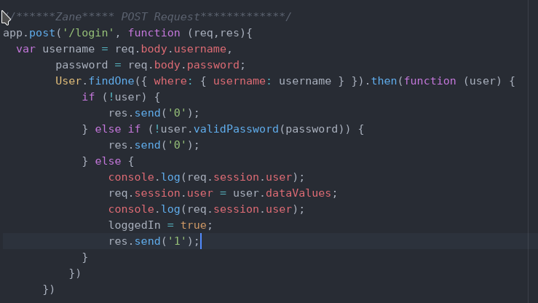
Key Functional Blocks
Login Function:
  Connects to the user.js fie and searches the database based on username
  Bcrypt is used compare
  passwords
  If matched then the user
  information is stored

Slide 5
Key Functional Blocks
Frontend: each pages(html file)
Corresponding js file
Middleware: “app.js” file
Query send to the postgresql database
Send message back to client

Slide 6
Division of Work
Mars | Zane | Shared
System architecture | Create database | Login Page
Error handling | Track users activities | Develop authentication protocols
Oauth | Recommendation system | Develop front end
Define RESTful interface | Initial home page design
Password reset function | Search function
Sign-up function | Browse Page
 | Purchase Page
 | Cart Page
 | Managing session data
 | Heroku setup

Slide 7
Oauth login and forget password

