Slide 1
NWEN304 Group 17 – Book Store
Members:
Zane Rawson
Mars (Huaiqu) Cai
Notes:
1

Slide 2
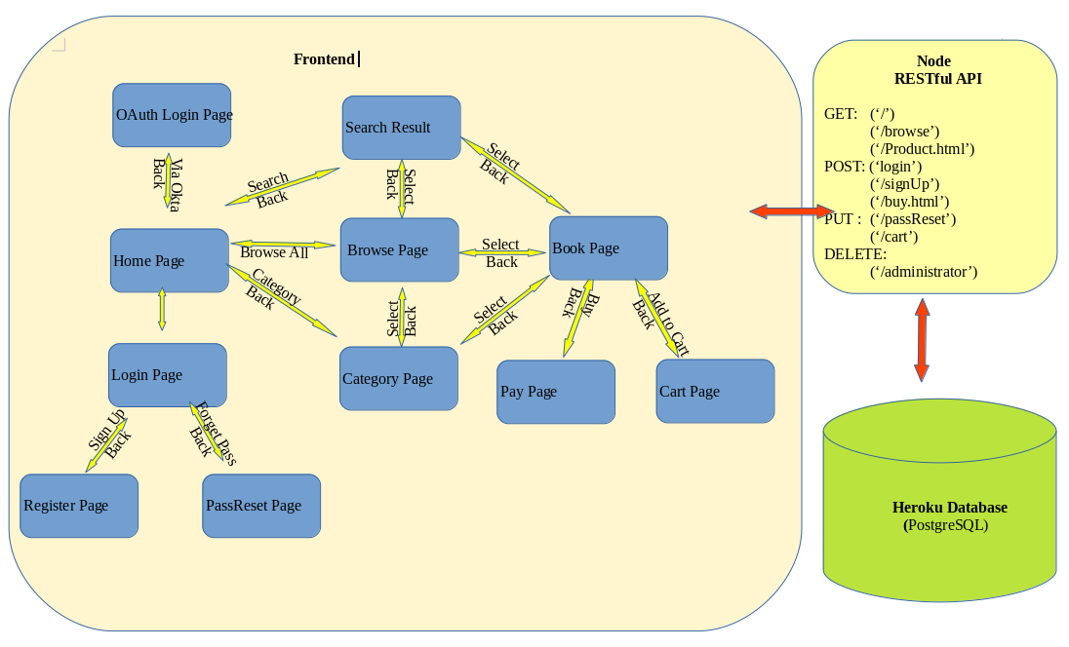
System Architecture
2
Notes:
2

Slide 3
Database Layout
Books Table
ISBN | Title | Author | Description | price | imgsrc | stock | genre | tags | views | Avialable | Sold
bigint | text | text | text | double | text | int | text | Text[] | int | boolean | int
Unique: ISBN
Primary key: ISBN
Not Null: ISBN, Title, Author, Description, Price, genre
Users Table
Id | Username | Email | Password | Products Viewed | Cart | Purchases | Admin | Created At | Updated At
int | Varcahr(255) | Varcahr(255) | Varcahr(255) | Bigint[] | Bigint[] | Bigint[] | boolean | Timestamp | Timestamp
Unique: Id, Email, Username
Primary key: Id (sequential)
Not Null: Id, Email, Username, Password, Admin, Created At, Updated At

Slide 4
Division of Work
Mars | Zane | Shared
System architecture | Create database | Login Page
Error handling | Track users activities | Develop authentication protocols
Oauth | Recommendation system | Develop front end
Define RESTful interface | Initial home page design
Password reset function | Search function
Sign-up function | Browse Function
 | Purchase Function
 | Cart Function
 | Managing session data
 | Heroku setup
4
Notes:
4

Slide 5
Key Functional Blocks
Frontend: each pages(html file)
Corresponding js file
Middleware: “app.js” file
Query send to the postgresql database
Send message back to client
5
Notes:
5

Slide 6
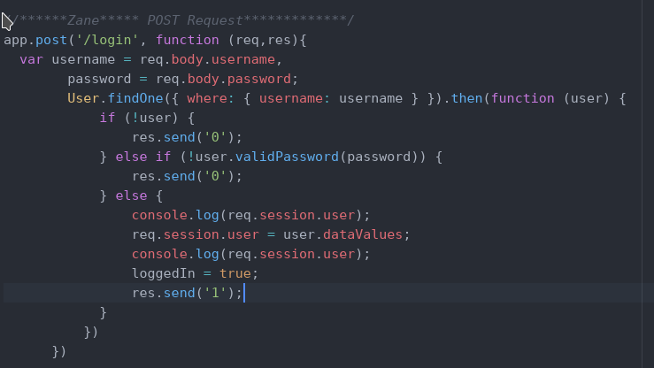
Key Functional Blocks
Login Function:
Connects to the user.js fie and searches the database based on username
Bcrypt is used to compare the passwords
If matched, then the user information is stored
6
Notes:
6

Slide 7
Key Functional Blocks
Browse/Search Function:
Selects the books from the database
Generates the html elements for each book
Search query is extracted from the url
7
Notes:
7

Slide 8
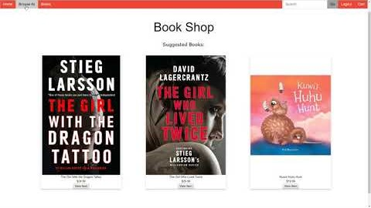
Project Video
8
Notes:
8

