Slide 1
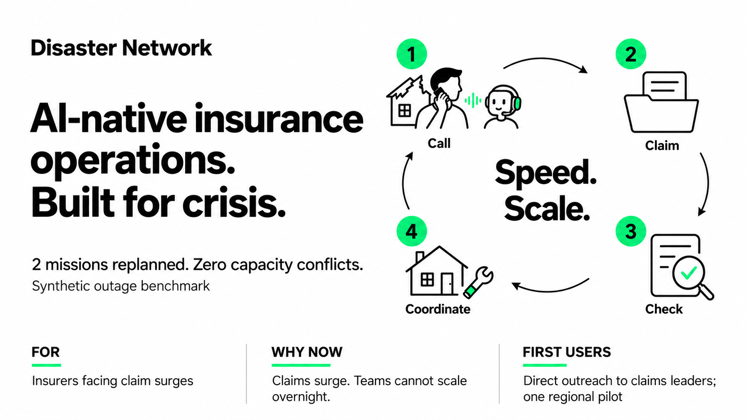
Notes:
The user explicitly requested a single ImageGen image for the entire slide. All visible text and artwork are therefore rasterized together; there are no editable text boxes. The accent specified by the user is #0af06d, used only on numbered discs, illustration details and footer heading underlines. All text is black. The center reads Speed. Scale. The visible evidence is a labelled synthetic outage benchmark.
The four stages are a conceptual workflow: hotline, claim file, policy checks, repair planning. The prototype does not make real coverage approvals, bookings, payments or physical interventions. The Allstorm and client data are invented.
Aiven PostgreSQL stores the three-customer fixture and Jules's confirmed intake. The 80-household / 170-person insurer operations portfolio and provider actions remain separate frontend fixtures. No real policy PDF was imported; tools read stored text sections.
Visible evidence: an offline execution of the actual application replan/applyPlan code on one synthetic provider outage. Same two affected missions for both planners; the baseline lacks remaining-capacity context. Baseline: zero feasible replacements, two capacity violations. Application: two feasible replacements, zero capacity violations. Three blocked missions and unrelated assignments remain unchanged. Not an LLM or production benchmark. Reproduce with bun run scripts/submission-benchmark.js; raw JSON and source hashes are in docs/submission/evidence.
Proposed customer acquisition: direct outreach to insurer claims/assistance leaders and one regional flood-response pilot. This is a proposed route to first users, not existing traction.
French pitch: Des opérations d’assurance natives IA pour absorber les pics de sinistres, accélérer l’assistance et optimiser les coûts. Le client appelle, le dossier est constitué, le contrat est vérifié, puis un plan d’intervention est préparé.

