Slide 1
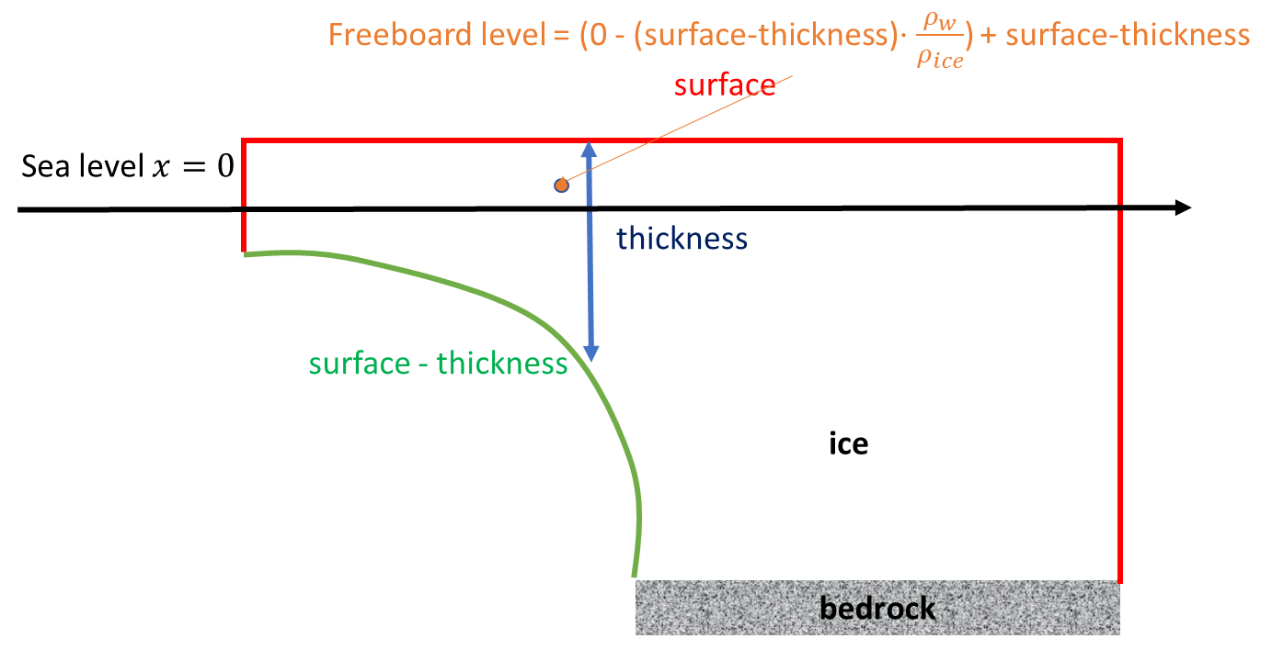
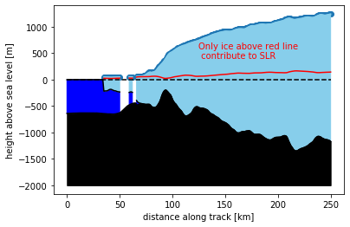

Slide 2
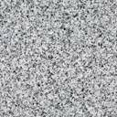

Freeboard level = (0 - (surface-thickness)$⋅\frac{ρ_{w}}{ρ_{ice}}$) + surface-thickness
surface
Sea level $x=0$
thickness
surface - thickness
ice
bedrock

