Slide 1
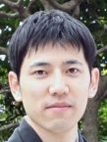

Random stuff I’ve been working on
11/26/18
Joint work with:

Slide 2
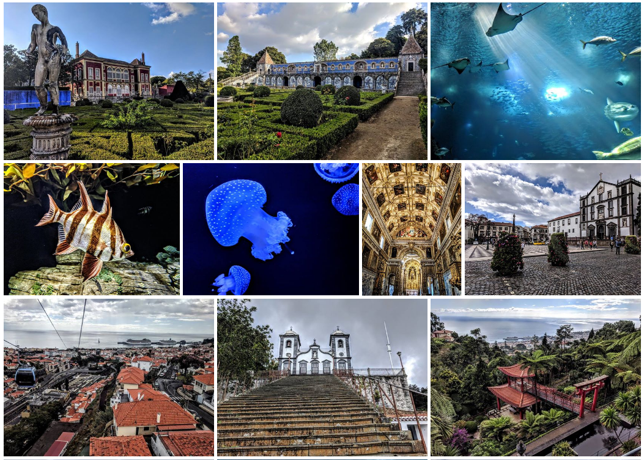
Random stuff I’ve been working on

Slide 3

Random stuff I’ve been working on

Slide 4
Random stuff I’ve been working on
Submitted K99
Publishing purgatory
Cell (review and reject + 1.5 months)
bioRxiv
Nature Biotech (no review + 1 month)
Genome Biology (no review + 2 weeks)
Genome Research (?)
Website for Xpresso (my first ever website!)
Built based on code from mouse ATAC-seq data website
MPRA analysis
HepG2 pilot library of ~9,400 enhancers
K562 library of ~7,500 enhancers
HepG2 library of ~80,000 enhancers & promoters, tested in both orientations
Testing some future plans proposed in K99

Slide 5
Xpresso website
Demonstration of functionality

Slide 6
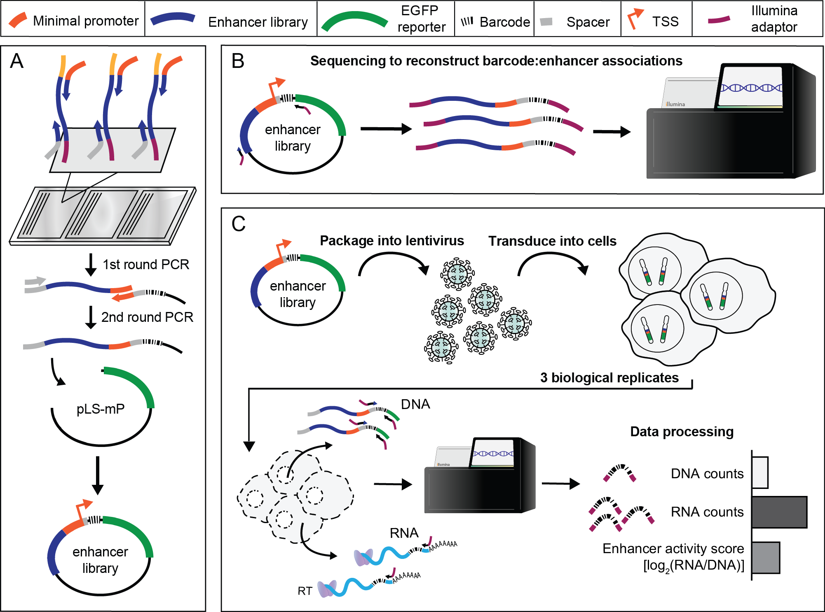
MPRA Schematic

Slide 7
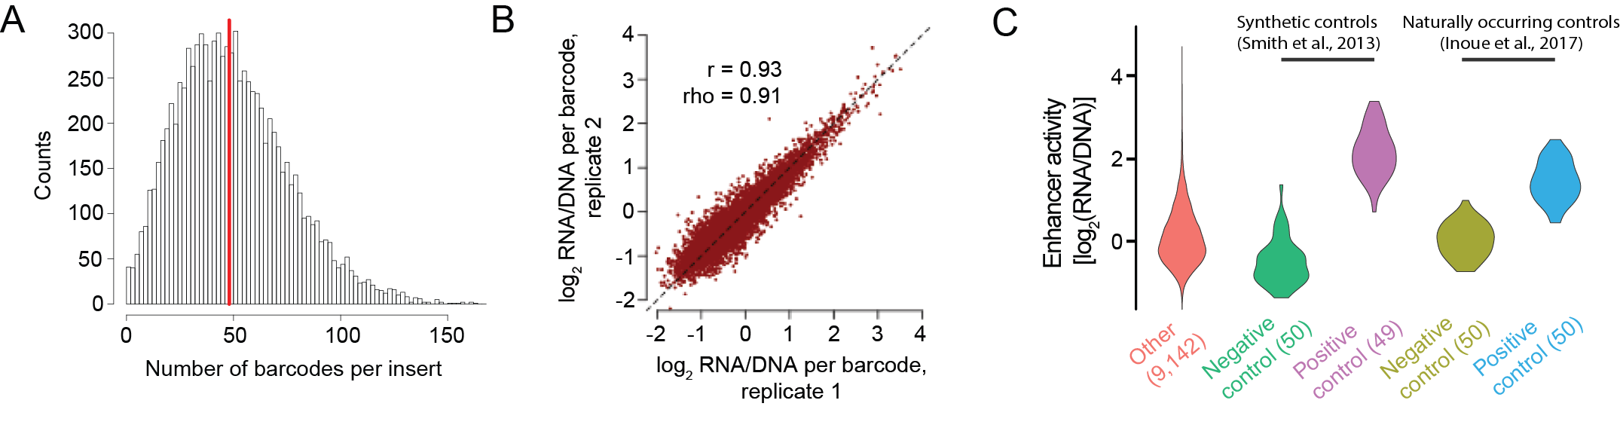
HepG2 pilot library of ~9,400 enhancers
HepG2 library of ~80,000 enhancers & promoters in progress…

Slide 8
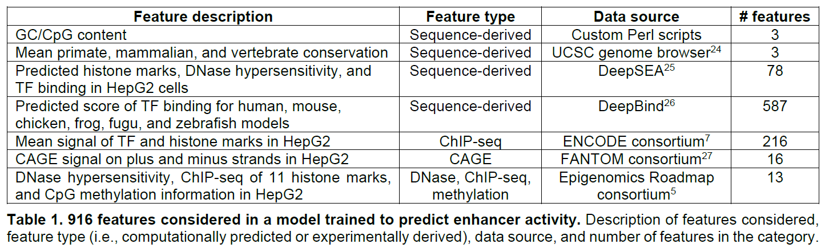
Explaining enhancer activity using a lasso regression model

Slide 9
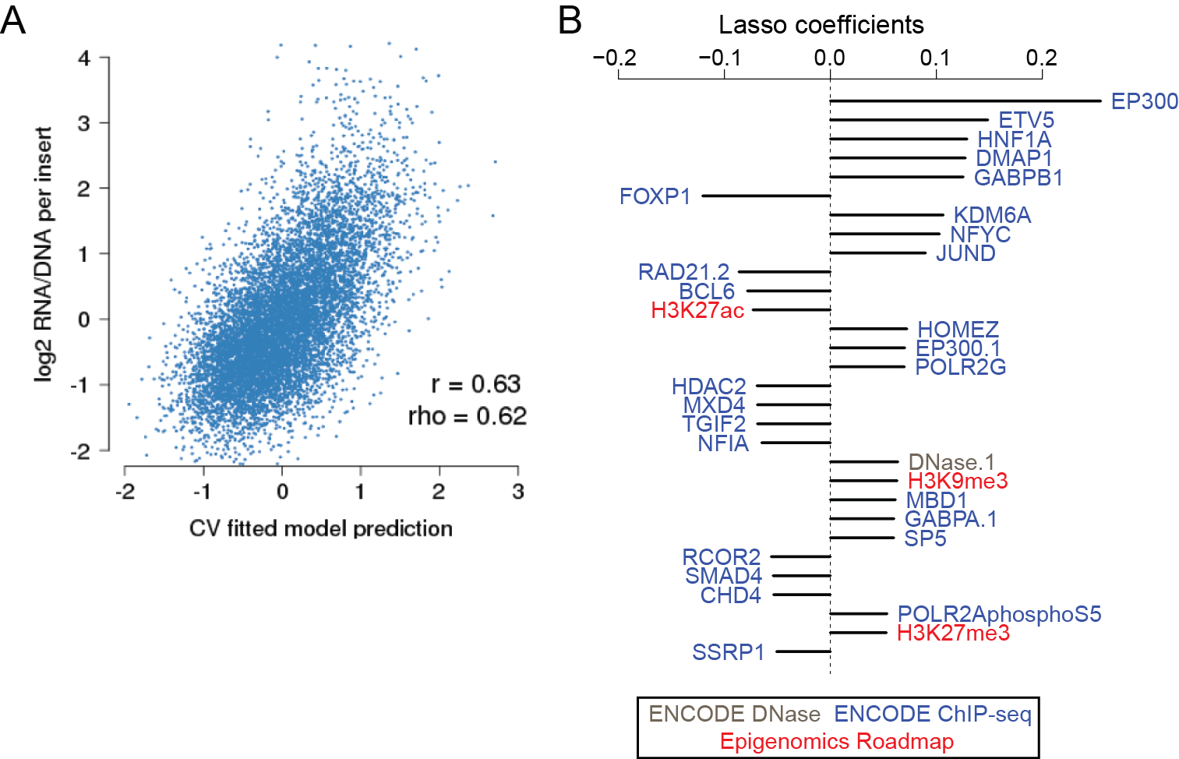
A model to predict enhancer efficacy
Notes:
Foxp1 repressor
Ep300 activating
BCL6 repressor
HDAC6 – deacetylase

Slide 10
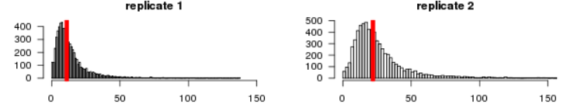
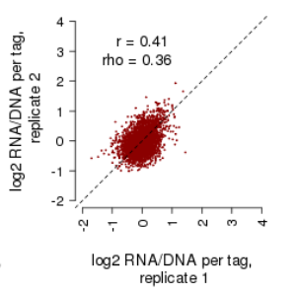
K562 library of ~7,500 enhancers: poor data reproducibility

Slide 11
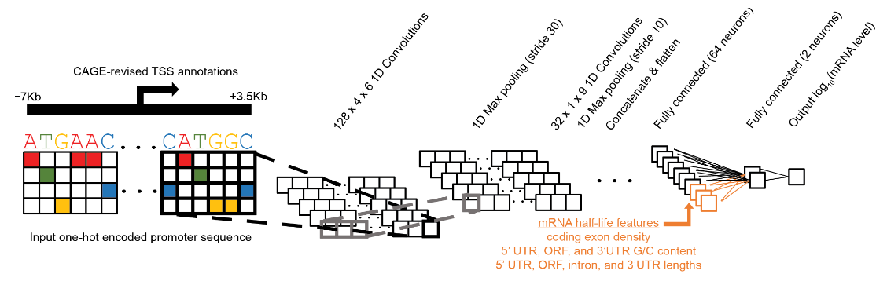
Predicting expression from sequence

Slide 12
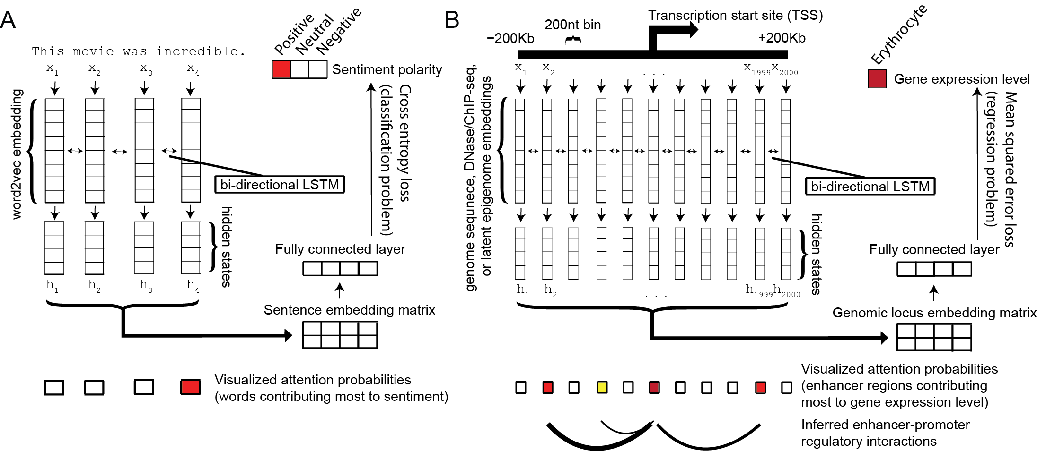
Self-attention based methods from computational linguistics

Slide 13
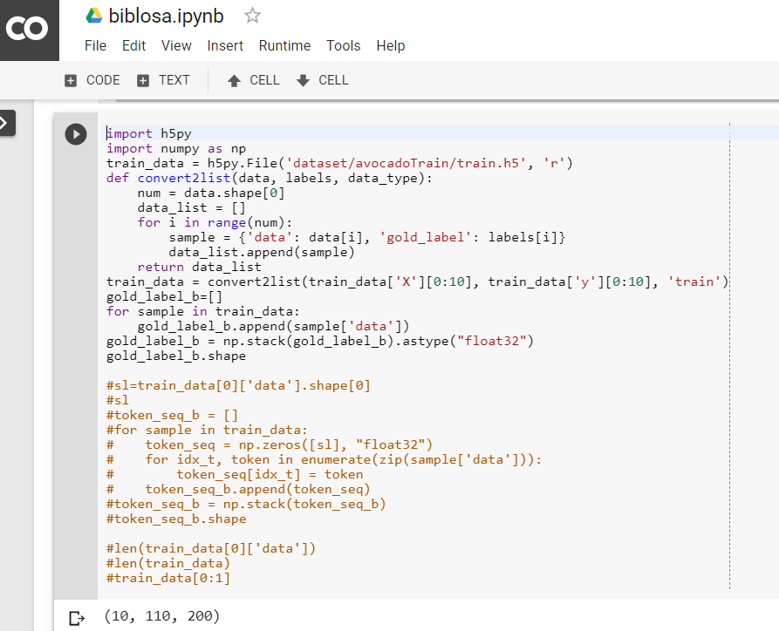
Testing code on Google Colab (free GPU access) w/ iPython notebooks

